Slide 1

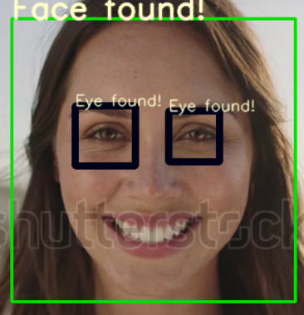
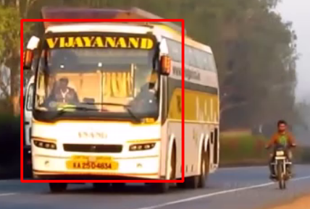
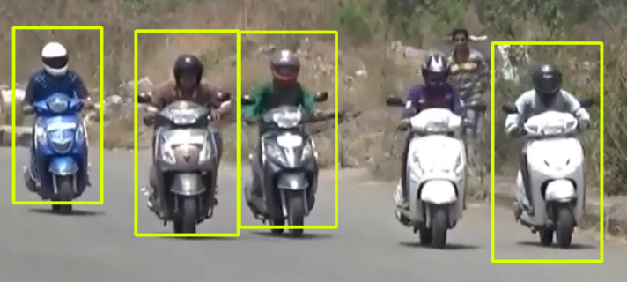
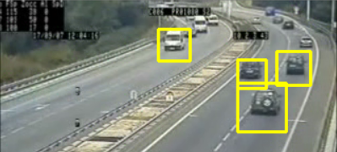
Object(s) in Video capturing
By:
Routh.Kiran babu.

Slide 2
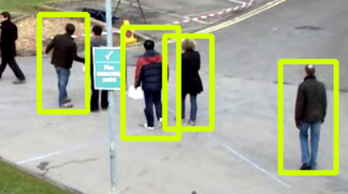
Requirements:
opencv-4.0.1-vc14_vc15.
Python (Above 3.7 Version).
Scientific XML files.

Slide 3
Behind works
Video is subdivided or sampled by photos and filtered out to get the required component with help of xml scientific files.
While click on keyboards it has some delay.
Some coordinates must be placed for text and rectangle rendering.

Slide 4
Application
Used in high security detection.
Object detection allows AI and robotics to pick and allow to machine learning(not absolutely).
And can be updated in next generations.

Slide 5
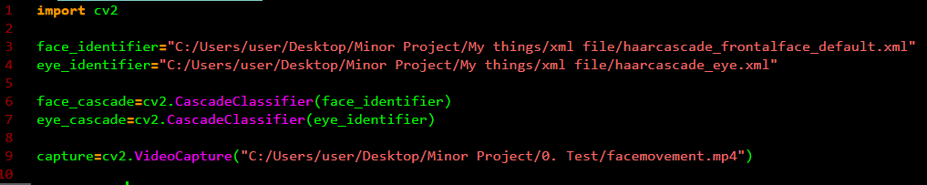
Coding part

Slide 6
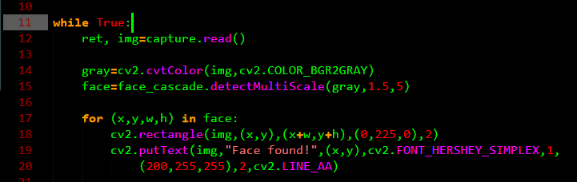
Coding part

Slide 7
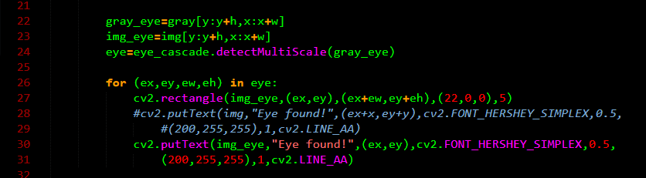
Coding part

Slide 8
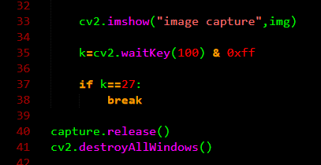
Coding part

Slide 9
outcome
Knows importance of harcascade XML files.
Open cv application helps the interaction between XML files and human demands for object.

Slide 10
