Slide 1
How to handle bugs
Master Class

Slide 2
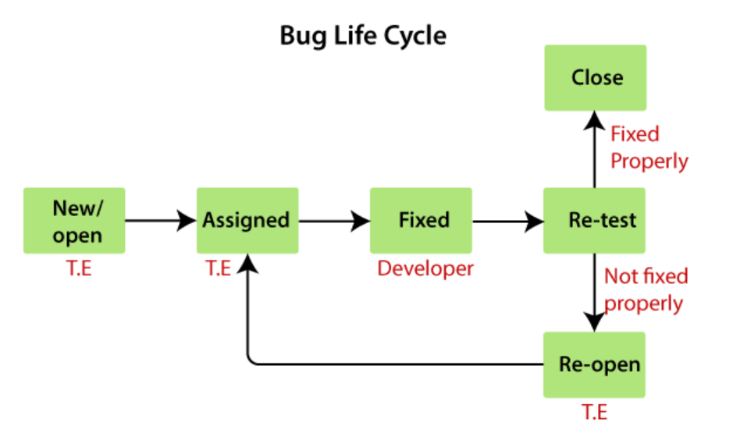

Slide 3
Developer can also mark status as-
Duplicate
Deferred/Postpone
Cannot reproduced
Cant be fixed
Invalid/Reject
RFE

Slide 4
Test Metrics
Test Metrics are numbers that show how well testing is going. They help measure things like how many tests passed, how many bugs were found, and how much testing is left to do.

Slide 5
Important
Passed Test Cases Percentage: Test Cases that Passed Coverage is a metric that indicates the percentage of test cases that pass.
Passed Test Cases Percentage = (Total number of passed test cases / Total number of test cases executed) x 100

Slide 6
-
Failed Test Cases Percentage: This metric measures the proportion of all failed test cases.
Failed Test Cases Percentage = (Total number of failed test cases / Total number of tests executed) x 100

Slide 7
-
Blocked Test Cases Percentage: During the software testing process, this parameter determines the percentage of test cases that are blocked.
Blocked Test Cases Percentage = (Total number of blocked tests / Total number of tests executed) x 100

Slide 8
-
Fixed Defects Percentage: Using this measure, the team may determine the percentage of defects that have been fixed.
Fixed Defects Percentage = (Total number of flaws fixed / Number of defects reported) x 100

Slide 9
-
Defects Deferred Percentage: This measures the percentage of the defects that are deferred for future release.
Defects Deferred Percentage = (Defects deferred for future releases / Total Defects Reported) x 100

Slide 10
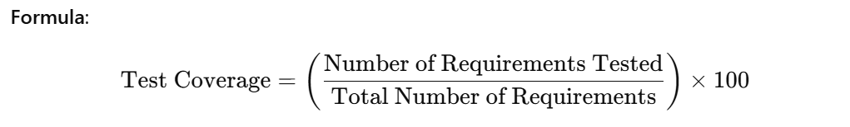
-
Test Coverage - Measures the percentage of the application that is covered by test cases.

Slide 11
-
Defect density- Number of defects identified per requirement
No of defects found/Number of requirements
Defect Leakage - (No of defects found in UAT/No of defects found in Testing)*100

