Slide 1
2.已完成的功能展示
Job presentation has been completed

Slide 2
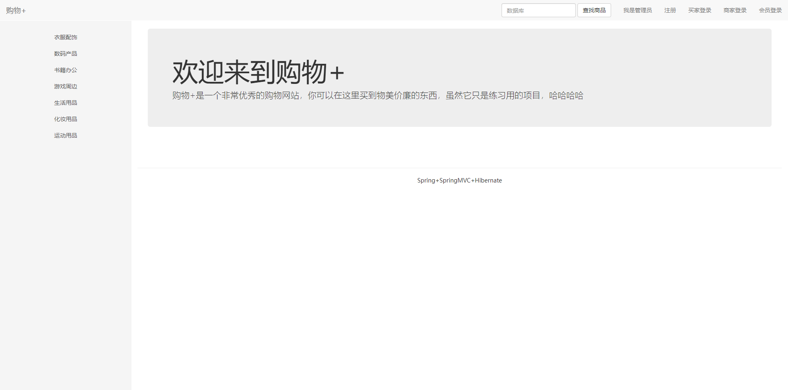
已完成的功能展示-主页
Job presentation has been completed

Slide 3
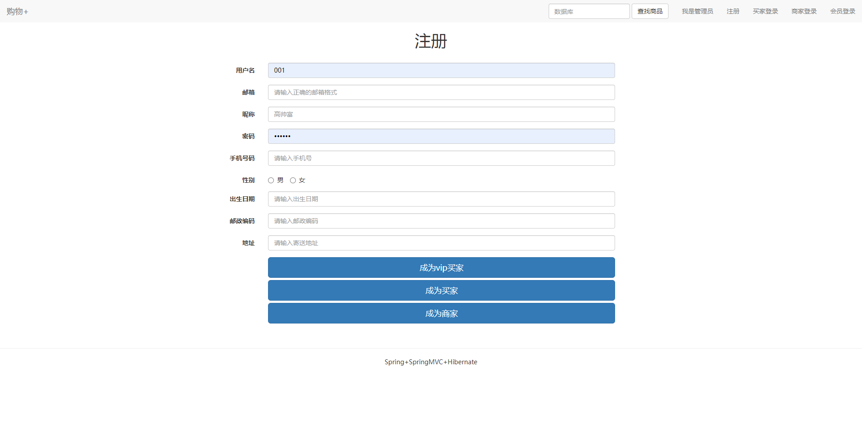
已完成的功能展示-用户注册
Job presentation has been completed

Slide 4
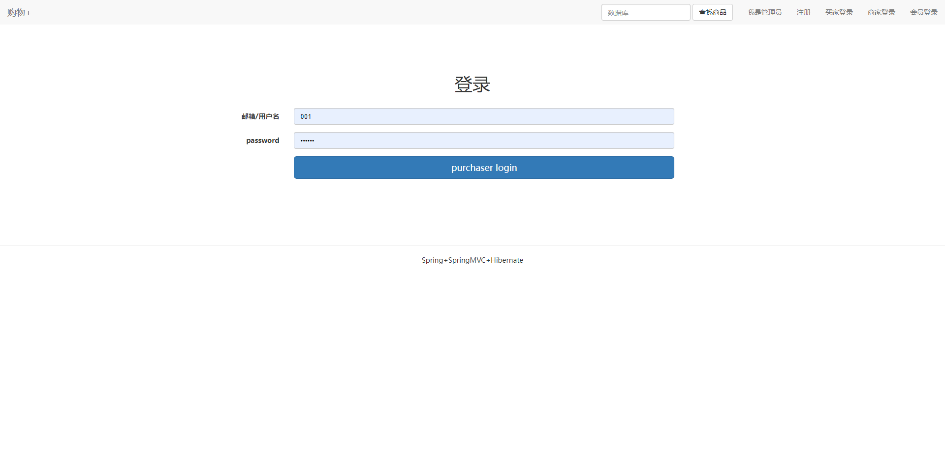
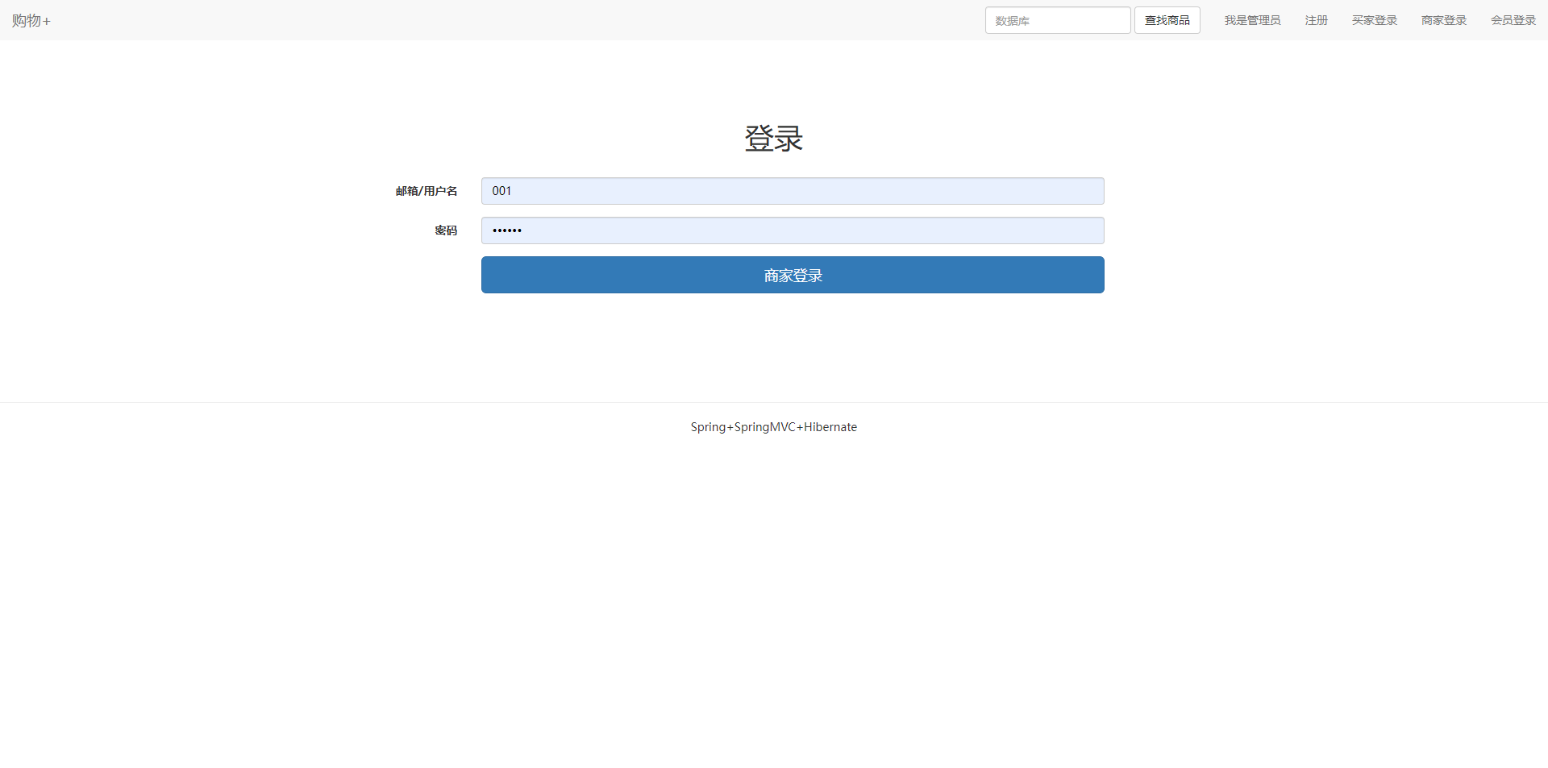

已完成的功能展示-各种用户登录
Job presentation has been completed

Slide 5
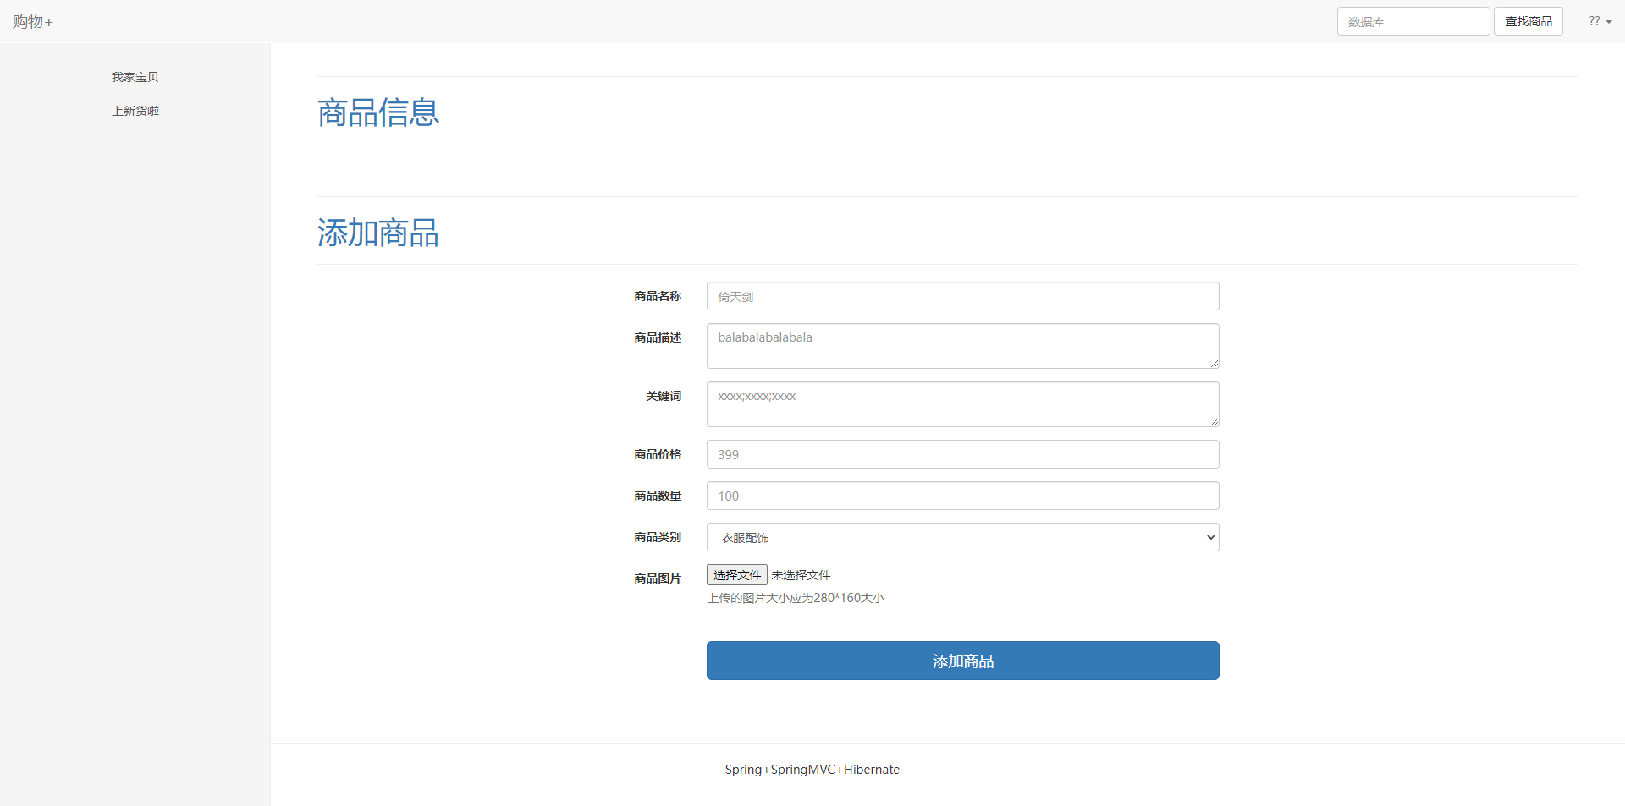
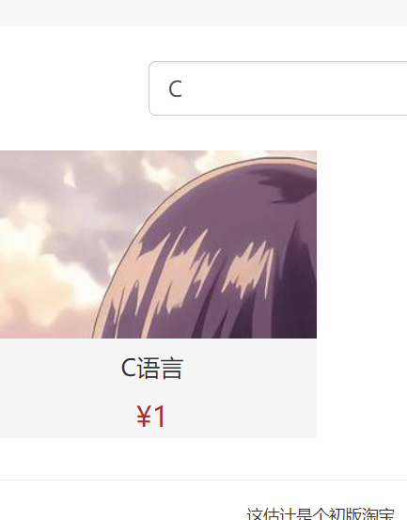
已完成的功能展示-商家页面&商品搜索
Job presentation has been completed

Slide 6
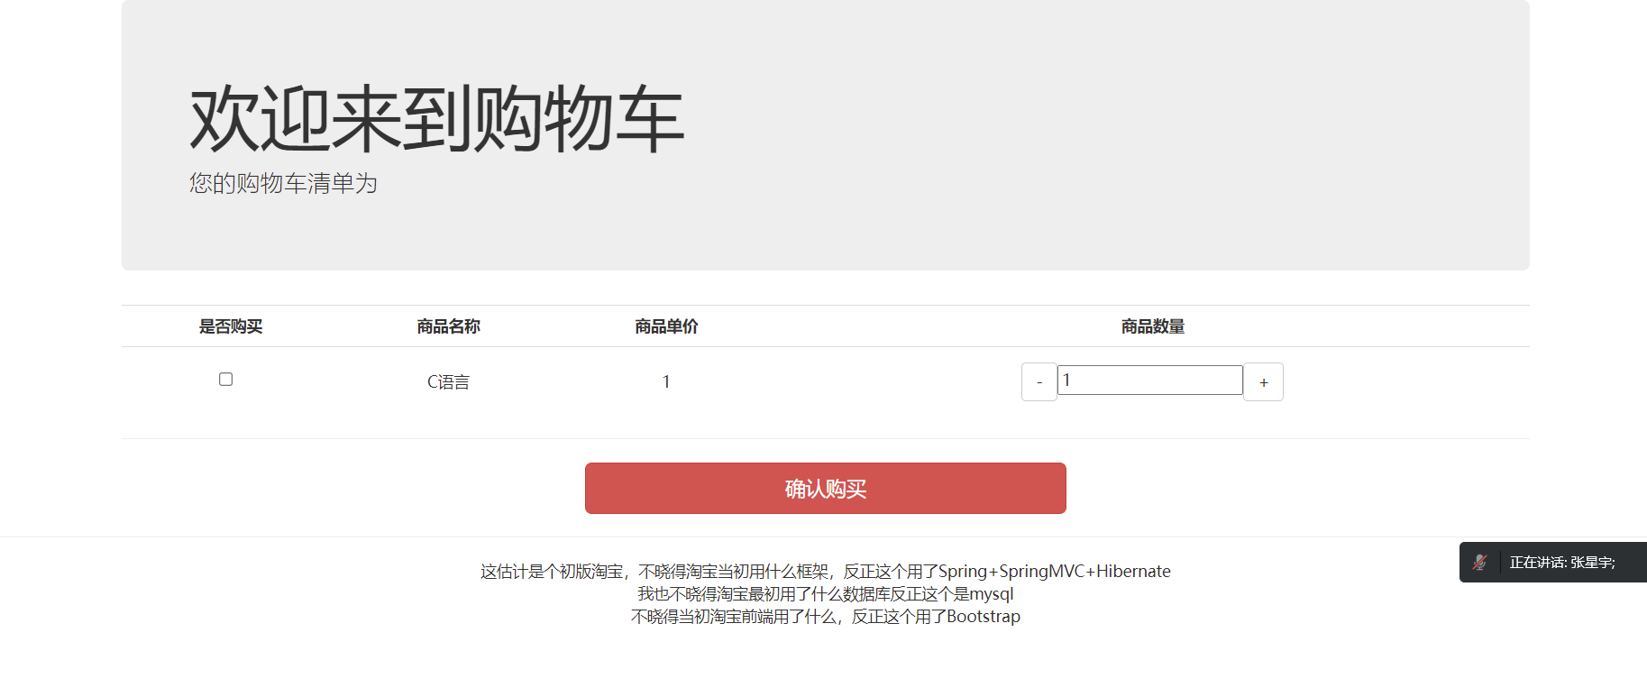
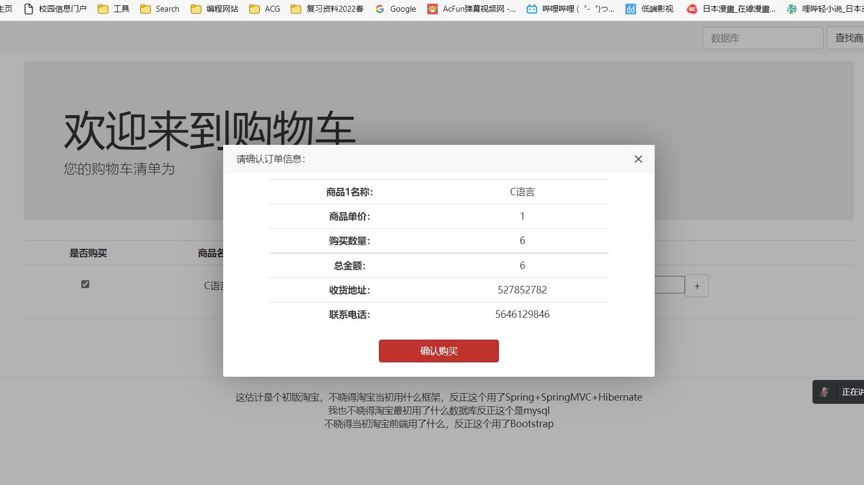
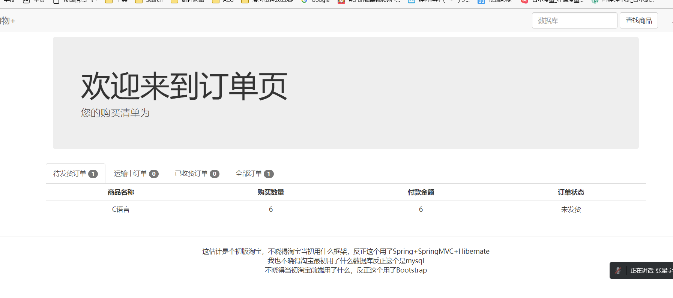
已完成的功能展示-购买页面
Job presentation has been completed

