Slide 1
Block-sparse
matrix matrix
multiplication

Slide 2
输入参数
第一部分
$$R_{A}^{m×k}×R_{B}^{k×n}=R_{C}^{m×n}$$
def blocksparse_matmat_multiply(
dense_a, ptr_b=None, indices_b=None, data_b=None, shape_b=None, dense_b=None, blockshape=(32, 32), device='cpu'):
# B使用blocksparse格式
A = bm.random.random((m, k)) bsr_indices, bsr_ptr = bp.conn.FixedProb(0.1, pre=k//32, post=n//32).require('csr') bsr_data = bm.random.random((32 * len(bsr_indices), 32)) B = get_dense(bsr_ptr, bsr_indices, bsr_data, (k, n), (32, 32)) C1 = blocksparse_matmat_multiply(dense_a=A, ptr_b=bsr_ptr, indices_b=bsr_indices, data_b=bsr_data,shape_b=(k,n), blockshape=(32, 32), device=bm.get_platform())
# B使用dense格式
A = bm.random.random((m, k)) B = bm.random.rand(k, n) * (bm.random.rand(k, n) < 0.1) C1 = blocksparse_matmat_multiply(dense_a=A, dense_b=B, blockshape=(32, 32), device=bm.get_platform())
dense_a: 矩阵A稠密矩阵
ptr_b, indices_b, data_b, shape_b: 矩阵B的稠密矩阵(blocksparse表示)
dense_b: 矩阵B稠密矩阵
blockshape: block的形状大小
device: ‘cpu’或 ‘gpu’

Slide 3
若B矩阵为dense格式的处理
第一部分
if dense_b is not None: # m, n, k m = dense_a.shape[0] n = dense_b.shape[1] k = dense_a.shape[1] # blockcount blockcount = (n // blockshape[0], k // blockshape[1]) # mask mask = get_mask(dense_b, blockshape, blockcount) # n_blocks n_blocks = mask.sum() # data_b data_b = get_data(dense_b, mask, blockshape, blockcount, n_blocks) # ptr_b, indices_b ptr_b, indices_b = get_ptr_indices(mask, blockcount, n_blocks)
通过dense_b来求mask, n_blocks, data_b, ptr_b, indices_b

Slide 4
若B矩阵为dense格式的处理-mask，n_blocks
第一部分
def get_mask(dense_b, blockshape, blockcount): mask = jnp.zeros(blockcount[0] * blockcount[1], dtype=jnp.bool_) for i in range(blockcount[1]): for j in range(blockcount[0]): if jnp.abs(dense_b[i * blockshape[1]: (i + 1) * blockshape[1], j * blockshape[0]: (j + 1) * blockshape[0]]).sum() != 0: mask = mask.at[i * blockcount[0] + j].set(True) mask = mask.reshape(blockcount[1], blockcount[0]) return mask
通过计算一个block中的所有值的绝对值的和是否=0来判断是否有值
# n_blocks n_blocks = mask.sum()
n_blocks为mask为True的数量

Slide 5
若B矩阵为dense格式的处理-data_b
第一部分
def get_data(dense_b, mask, blockshape, blockcount, n_blocks): data = jnp.zeros( shape=(n_blocks * blockshape[1], blockshape[0]), dtype=jnp.float32 ) assignment_count = 0 for i in range(blockcount[1]): for j in range(blockcount[0]): if mask[i, j]: data = data.at[assignment_count * blockshape[1]: (assignment_count + 1) * blockshape[1], :].set(dense_b[i * blockshape[1]: (i + 1) * blockshape[1], j * blockshape[0]: (j + 1) * blockshape[0]]) assignment_count += 1 return data
按列来将mask对应为True的block存在data_b中

Slide 6
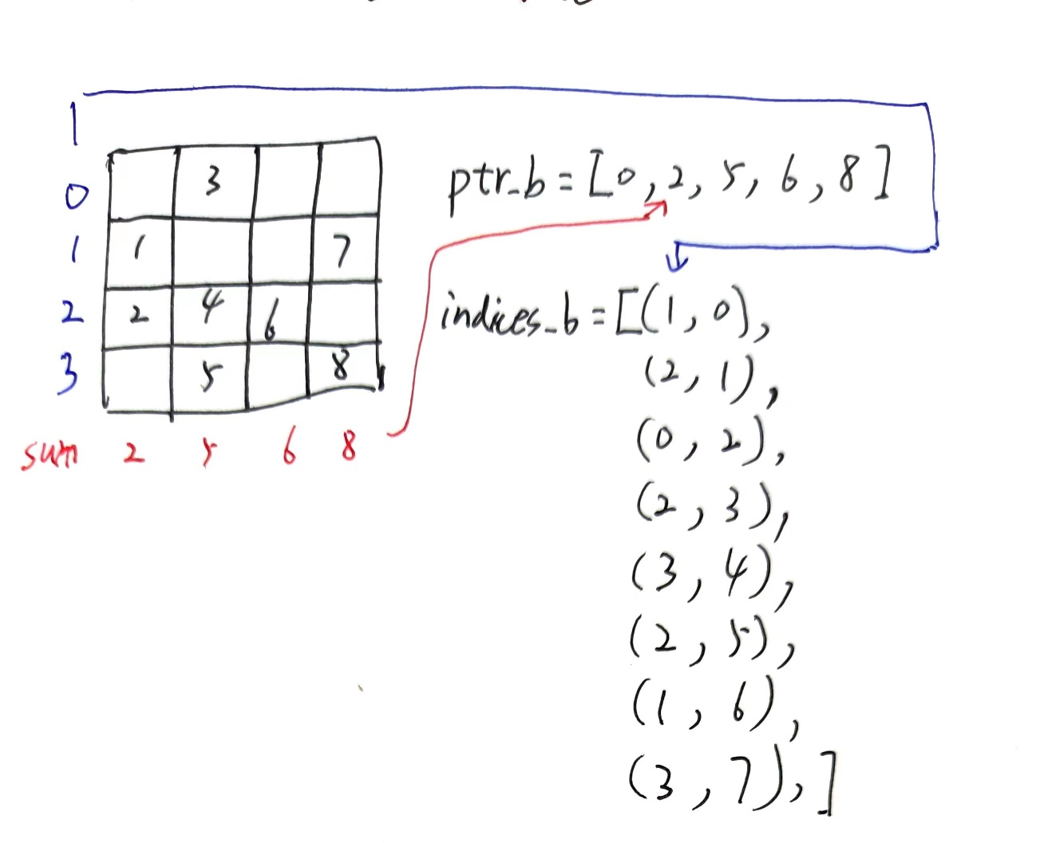
若B矩阵为dense格式的处理-ptr_b, indices_b
第一部分
def get_ptr_indices(mask, blockcount, n_blocks, block_ptr=None): nnz = jnp.nonzero(mask) if block_ptr is None: block_ptr = jnp.arange(0, len(nnz[0])) indices = jnp.argsort(block_ptr) _ = jnp.take(block_ptr, indices) blocks = nnz[0][jnp.array(indices)], nnz[1][jnp.array(indices)] blocks = jnp.stack([nnz[0][jnp.array(indices)], nnz[1][jnp.array(indices)]], axis=-1).astype( dtype=jnp.int32 ) blocks = jnp.flip(blocks, axis=-1).flatten() X = blockcount[1] Y = blockcount[0] rows = nnz[0][:] cols = nnz[1][:]
block_indices = jnp.zeros(X * Y, dtype=jnp.int32) positions = rows * Y + cols for position in positions: block_indices = block_indices.at[positions].set(block_ptr + 1) block_indices = block_indices.reshape(X, Y).transpose().reshape(X * Y) block_ptr = block_indices[jnp.nonzero(block_indices)[0]] - 1 X, Y = Y, X rows = cols nnztt = jnp.nonzero(mask.transpose()) cols = nnztt[:][1] rows.astype(jnp.int32) ptr_b = jnp.zeros((X + 1,), dtype=jnp.int32) for row in rows: ptr_b = ptr_b.at[row + 1].set(ptr_b[row + 1] + 1) ptr_b = ptr_b.cumsum(0).astype(dtype=jnp.int32) indices_b = jnp.stack([cols, block_ptr], axis=1).astype(dtype=jnp.int32) return ptr_b, indices_b
将mask存为CSC格式的ptr_b和indices_b

Slide 7
若B矩阵为blocksparse格式的处理
第一部分
else: # m, n, k m = dense_a.shape[0] n = shape_b[1] k = dense_a.shape[1] # blockcount blockcount = (n // blockshape[0], k // blockshape[1]) mask = get_mask_from_ptr_indices(ptr_b, indices_b, blockcount) n_blocks = mask.sum() ptr_b, indices_b = get_ptr_indices(mask, blockcount, n_blocks)
因为输入的indices与我们需要的indices不同，所以需要重新通过传进来的indices与ptr来构建真正我们需要的indices

Slide 8
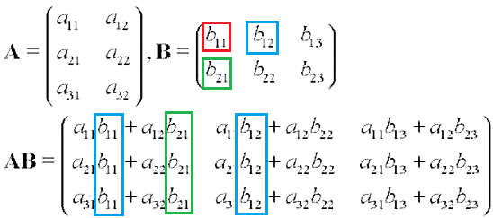
进行计算-CPU
第一部分
矩阵B中的元素仅会影响自己列的C矩阵的值，最终可以为遍历所有的b的元素，然后将得出的数值进行累加

Slide 9
进行计算-CPU
第一部分
@numba.njit(fastmath=True, parallel=True, nogil=True) def _blocksparse_matmat_numba_imp(outs, ins): res_val = outs[0] res_val.transpose() res_val.fill(0) A_data, B_ptr, B_indices, B_data, m, n, k, block_size_rows_b, block_size_cols_b = ins m = np.int32(m) n = np.int32(n) k = np.int32(k) block_size_rows_b = np.int32(block_size_rows_b) block_size_cols_b = np.int32(block_size_cols_b) # index[0]为index, index[1]为该index对应的block的index for idx, index in enumerate(B_indices): # find the column row_index = 0 for ptr in B_ptr[1:]: if ptr > idx: break row_index += 1 row_start = row_index * block_size_cols_b # find the row col_start = index[0] * block_size_rows_b # calculate the value and add to the res_val for i in range(block_size_rows_b): for j in range(block_size_cols_b): if B_data[index[1] * block_size_rows_b + i, j] == 0: continue row_now = row_start + j col_now = col_start + i res_val[:, row_now] += A_data[:, col_now] * B_data[index[1] * block_size_rows_b + i, j] return res_val

Slide 10

进行计算-GPU
第一部分
cutlass 是 NVIDIA 推出的一款线性代数模板库，它定义了一系列高度优化的算子组件，开发人员可以通过组合这些组件，开发出性能和 cudnn、cublas 相当的线性代数算子。

