Slide 1
The Talk on How to Do A Talk
Dan Bougere

Slide 2
Who Am I
15 years experience in multiple areas of IT
Been a participant (willing and unwilling) of many briefings, talks, presentations, etc.
Given presentations at Bsides Austin, Bsides Tulsa, SecureDelaware, ShowMeCon, and DerbyCon.
Given work presentations for clients after engagements and other requests

Slide 3
Intro
What Makes A Bad Talk
What Makes a Good Talk
Resources
Questions

Slide 4

So, What DOES Make A Bad Talk?

Slide 5
It’s Like Porn...
Presentation of Topic
Method of Speaking
Slide Deck
You Know It When You See It

Slide 6
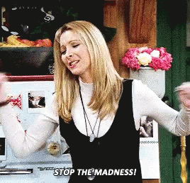
Presentation of Topic
You think this is awesome and interesting.
You assume everyone knows what you do.
You have a lot to get through, and let everyone know at the beginning to strap in.
Killing Us Softly

Slide 7
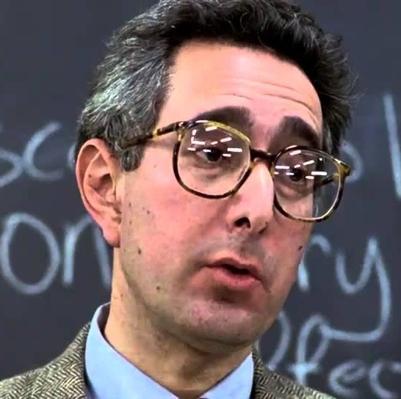
Method of Speaking
You have a mic, so enunciating or talking above your normal volume isn’t necessary
Monotone means I am a serious person talking about serious things.
I know! I’m going to act like a professor giving a lecture.
With Your Song

Slide 8
Slide Deck: The Conjuring
Templates exist for a reason, but not necessarily a good one
You may be required to use it. If so, sucks for you.
Welcome to hell, folks.

Slide 9

Slide Deck: The Swarm

Slide 10
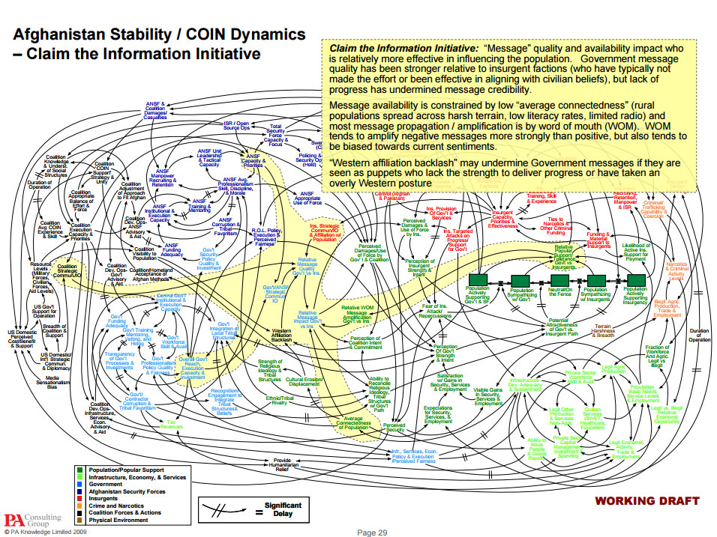
Slide Deck: Scream

Slide 11
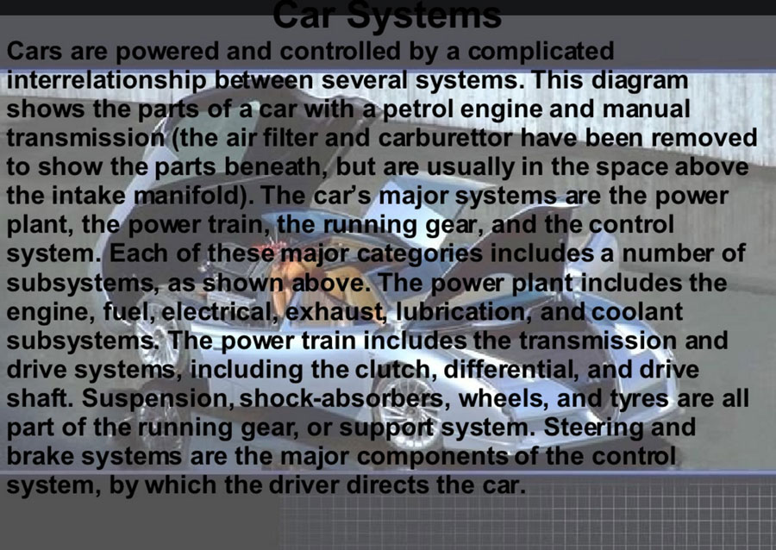
Slide Deck: The Shining

Slide 12
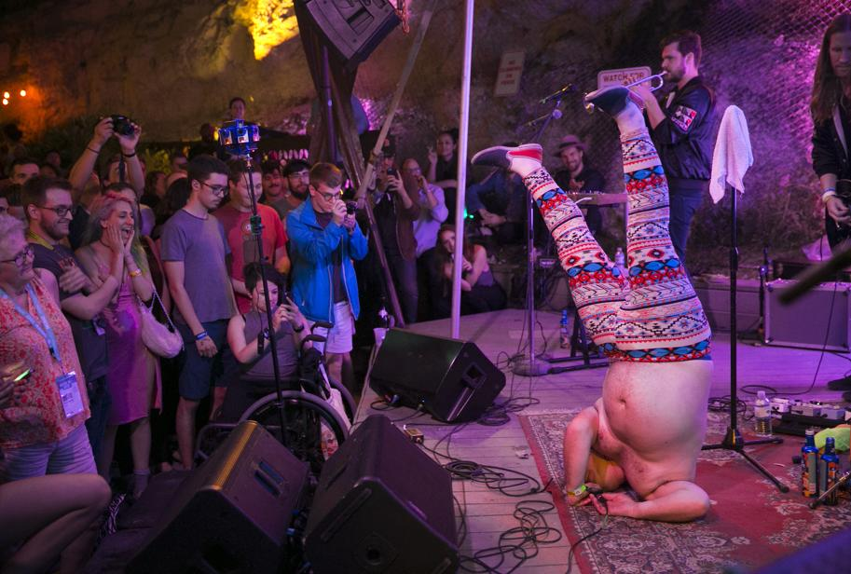
Ok, So What Is A Good Talk?

Slide 13
Presentation of Topic
You think this is awesome and interesting!
Your job is to convince others that it is.
Consider your audience.
Consider the time you’re given.
If you’re right, people will have questions and you should account for that.
Wake Me Up!

Slide 14
Presentation of Topic
You assume everyone knows what you do.
You started at the beginning once, too.
If you’re discussing an advanced topic, give a quick summary at the beginning of fundamental concepts.
Likewise, don’t make it all summary with five minutes at the end of your titled topic.
Wake Me Up Inside!

Slide 15
Presentation of Topic
You have a lot to get through, and let everyone know at the beginning to strap in.
Seriously? It’s called editing.
Remember your allotted time slot, and subtract five minutes.
Keep on topic, on track with questions, and most of all on time!
Bring Me To Life!

Slide 16
Method of Speaking
You have a mic, so enunciating or talking above your normal volume isn’t necessary
The mic picks up what you give it. It’s not magic.
You don’t have to be an announcer, just aware.
We all have accents, verbal ticks, or other mannerisms to someone.
Wake Up!

Slide 17
Method of Speaking
Monotone means I am a serious person talking about serious things.
Pretend you’re having an animated conversation with the audience.
Vary your tone, sentence structure, and delivery speed.
Monotone is used in hypnosis for a reason.
How Long? Not Long

Slide 18
Method of Speaking
I know! I’m going to act like a professor giving a lecture.
You’re trying to convey your enthusiasm, not prepare them for a quiz on Friday.
Move around within reason. Force the audience to follow you.
Remember, they don’t have to listen to you.
Cause What You Reap Is What You Sow!

Slide 19
Slide Deck
You saw the bad examples. Here’s some concepts to make Good Ones™
We Gonna Get Funky!

Slide 20
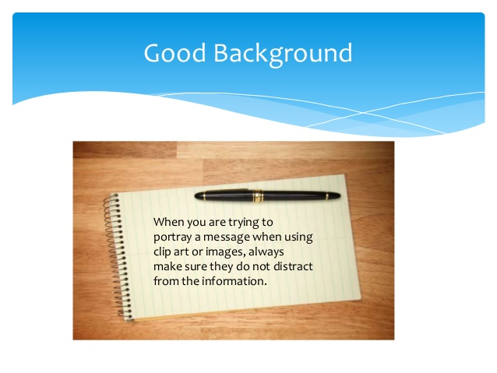
Slide Deck
Clap, Clap, Clap...Clap Your Hands!

Slide 21
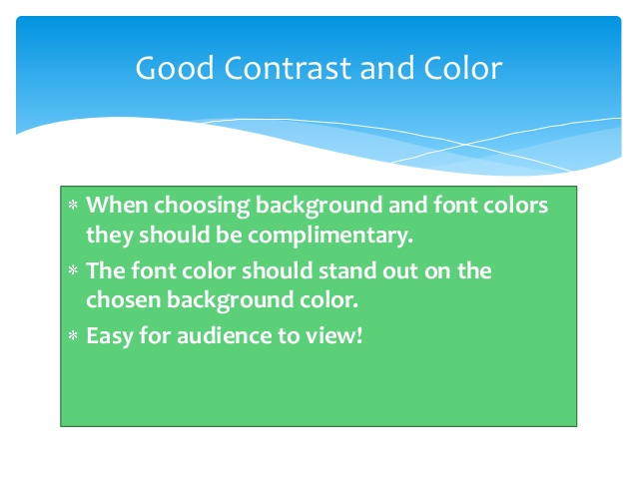
Slide Deck
To The Left

Slide 22

Slide Deck
Take It Back Now, Y’all

Slide 23
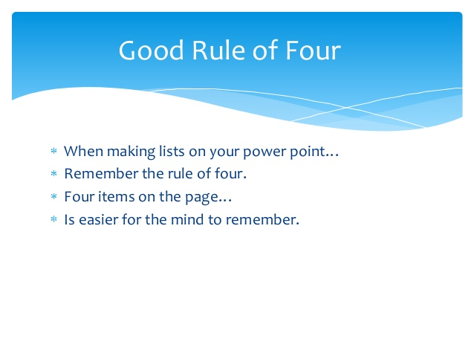
Slide Deck
One Hop This Time

Slide 24
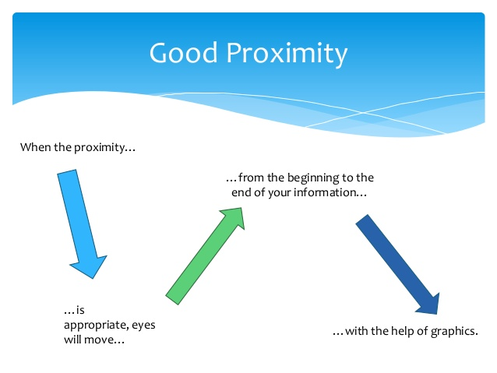
Slide Deck
Right Foot, Left Stomp

Slide 25
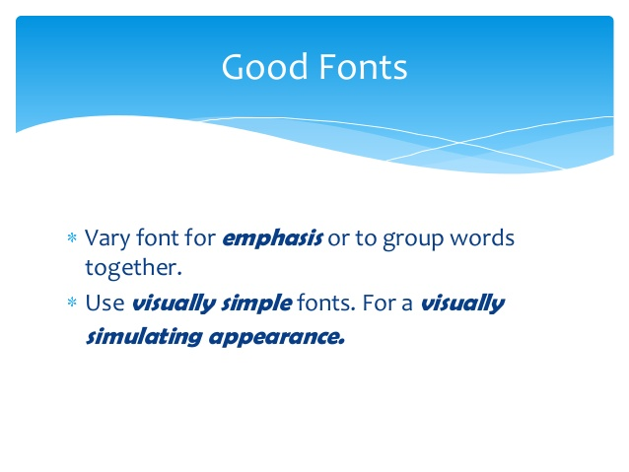
Slide Deck
Cha Cha Real Smooth

Slide 26
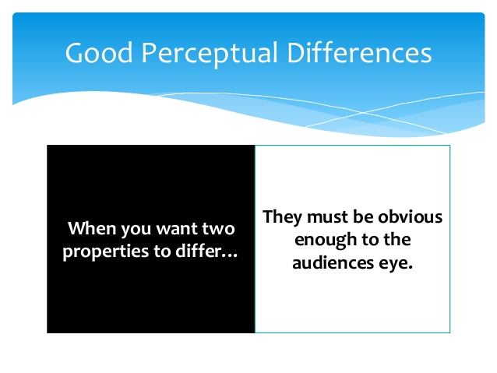
Slide Deck
Let’s Go To Work

Slide 27
Resources
https://speaking.io
LinkedIn has a bunch of examples and SlideShares as well.

Slide 28


Slide 29




Contact Info
dbougere@gmail.com
@Rouxgaru
https://www.linkedin.com/in/danbougere
Slides: https://github.com/Rouxgaru/slides

