Slide 1
Embrace the Click
Five effective Social Engineering protections
Dan bOUGERE

Slide 2
Traffic Light Protocol
This presentation falls under WHITE
“Subject to standard copyright rules, WHITE information may be distributed freely, without restriction”
https://en.wikipedia.org/wiki/Traffic_Light_Protocol

Slide 3
What We Will Cover
Intro
Pick Your Battles
Five Methods
Takeaway

Slide 4
Intro

Slide 5

Who Am I
Last name is pronounced BOO-zhair
13+ Years in IT
Last 10 spent in various security roles
Spent time in the Intelligence Community doing “fun” things that used many methods of social engineering
Senior Security Consultant at Securicon, LLC doing the same “fun” things for commercial and government clients.
http://securicon.com

Slide 6
What exactly is social engineering?
Essentially, convincing someone to do something they otherwise would (or should) not.
Relies on many ingrained psychological traits:
Rapport
Deference to authority
Reciprocation
Consistency of action/thought
Desire to help those in need
Desire to be considered a “good” or “helpful” person

Slide 7

Why is it effective?
Modern defense-in-depth strategies have made traditional methods of exploitation extremely difficult and time consuming.
There is very little risk associated with performing these activities.
Humans are, by far, the weakest link in any security chain.
“Every organization has that one person….”
©20th Century Fox
Notes:
No low-hanging fruit of exposed services on the internet
Keep calling till you find the “one person”
Hacking the human is so much easier than hacking the firewall

Slide 8
Pick Your Battles

Slide 9
Typical Social Engineering Threats
Data Loss
Intellectual Property
Proprietary Information
Ransomware
Financial/Wire Transfer
Internal/Customer Account Access
Notes:
IP/PI – can be used for financial gain (stock manipulation, pricing, etc)

Slide 10
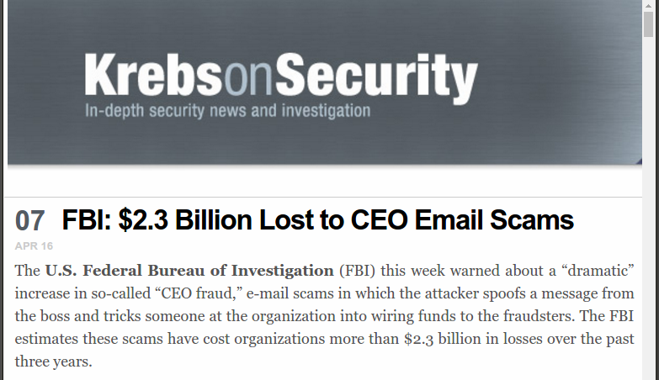
No, They Couldn’t Have!
Notes:
Small to midsize are usually the target.

Slide 11
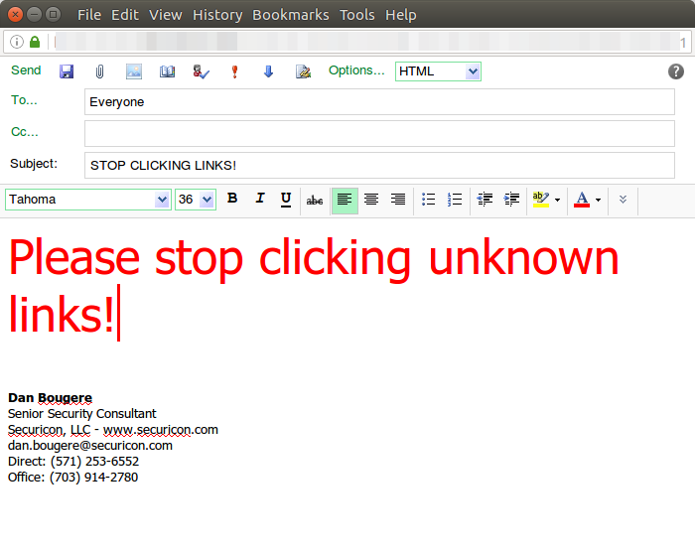
Why Keep Fighting?
Notes:
How many times has your IT folks sent this out?

Slide 12
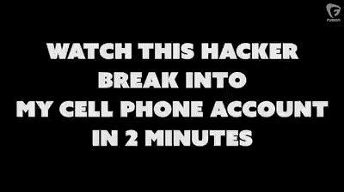
Seriously, Why Keep Fighting?

Slide 13
Mindful Acceptance
Your people are going to do this.
You are expecting them to change ingrained social behaviors from our earliest ancestors.
Everyone knows what the “definition of insanity” is, right?

Slide 14
Five Methods

Slide 15
1 Use Your Existing Technology

Slide 16
1 – Use Your Existing Technology
Turn OFF HTML email.
Email is used for business communication, yes? Do you really need backgrounds, icons, or cat pictures?
Multiple methods to hide malicious links are quickly exposed in text-only emails.
Web bugs are popular and can provide drips of information that are useful in later stages. These are not viable in non-HTML email.
There are many how-to guides available for almost all email servers:
Gmail - https://support.google.com/a/answer/2786758?hl=en
Exchange 2013 -
https://technet.microsoft.com/en-us/library/bb310794(v=exchg.150).aspx

Slide 17
1 – Use Your Existing Technology (2)
Blacklists
While not perfect, there are many blacklists maintained on the internet that you can subscribe and implement on your server(s).
Return Path Reputation Network Blacklist (RNBL)
SpamHaus
SpamCop
Many more: https://blog.returnpath.com/blacklist-basics-the-top-email-blacklists-you-need-to-know-v2/

Slide 18
1 – Use Your Existing Technology (3)
Antivirus and Gateway Scanners
Everyone is running an antivirus scanner on their email server, right?
It is much easier to stop infections and shenanigans at the source.
Most popular malware and ransomware comes in archives (zip, tar, msi, etc) or in malicious Office or PDF documents.
Or in BOTH!
ClamAV is a popular solution that is cross platform.
http://www.clamav.net/

Slide 19
1 – Use Your Existing Technology (4)
Filtering
Everyone has a firewall, even if it is Windows Firewall or iptables.
Most are familiar with blocking unwanted traffic coming IN to the network.
What if I told you that you can also do the same thing for traffic going OUT of your network?
Do client desktops need to send email via SMTP?
Do your fileservers (or any servers) need to communicate to servers in Asia or Eastern Europe?
Do your credit card systems need to communicate with ANYONE else besides your processor? Hint: This answer should probably be no.

Slide 20
2 Social Media/Internet Awareness

Slide 21
2 – Social Media/Internet Awareness
You would be amazed at the amount of information that is available on social media.
It’s not just Millennials!
It takes one friend/contact who isn’t careful to open up your entire profile.
Metadata is also important
Friends of friends
Interest groups
Alumni networks

Slide 22
2 – Social Media/Internet Awareness (2)
You would be appalled at the amount of information that is available on BUSINESSES via social media.
Photographs with tags of employees/positions
Philanthropic outreach
Advertising
Contract Awards
Open Positions
Notes:
Advertising: partners, contracts won, etc.
Open Positions: tech used, headhunting, skill sets needed

Slide 23
2 – Social Media/Internet Awareness (3)
You would be terrified at the amount of information that is available via Google and other search engines.
Google…Google Hacking: https://www.blackhat.com/presentations/bh-europe-05/BH_EU_05-Long.pdf
Documents
Directories
Firewall/Router Configurations
Waivers on Old Technology
Notes:
Advertising: partners, contracts won, etc.

Slide 24
2 – Social Media/Internet Awareness (4)
Recognize that this information is out there, and will be used by bad people.
Recognize that a blanket ban is unrealistic and ineffective.
Find a middle ground!
Mitigate the amount of information exposed on social media and the internet
Restrict profiles to Friends/Contacts only
Stress to everyone that this information can be used against not only them, but everyone ELSE that knows them.
Notes:
Advertising: partners, contracts won, etc.

Slide 25
3 Procedures and People

Slide 26
3 – Procedures and People
What happens when someone gets a call or an email from “IT” requesting their password be reset?
What happens when someone receives an “urgent request” from your CEO to transfer money to an account quickly?
What happens when your front desk person is asked to plug in a thumb drive when a client’s laptop mysteriously no longer works?
What happens when someone forgets or loses their badge?

Slide 27
3 – Procedures and People (2)
Remember those psychological traits we discussed earlier?
If an individual has no guidance, they will do what they feel is best. That is what social engineers depend on!
“IT you said? Sure, I’ll go change my password right now on the new site.”
“I’ll transfer the money right now. The reference ID is….”
“Sure! Here, I’ll print those up for you really quick. Technology huh?”
“I’ll badge you in this time, but next time you’ll need to get a temp one.”

Slide 28
3 – Procedures and People (3)
Give them the tools to be successful!
Procedures
Accounts and passwords
Financial transactions
Change management
Access controls
Other critical areas
Points of Contact
Who do I call when I get a request outside of procedure?
Who do I call second when the first person is sick, on vacation, or just not answering?

Slide 29
4 Training

Slide 30
4 – Training
Individuals have a variety of technology levels, cultural touchstones, trusting behavior, and willingness to help.
Social engineers will keep trying until they find “that one user.”
How do we get everyone on the same page?

Slide 31
4 – Training (2)
Send phishing emails
Many companies will provide this service with differing degrees of fine tuning.
May also provide off-the-shelf solutions and ongoing training
Make vishing calls
Again, many companies will provide this service and ongoing training.
NO ONE IS IMMUNE, so no one should be excluded.

Slide 32
4 – Training (3)
Take this seriously. Bad guys do!
“Annual Training” is basically useless. No one pays attention and wants to get through it as quickly as possible.
All negative reinforcement all the time is ineffective as well. You will terrify people into refusing to do anything for anyone.
Games and Positive Reinforcement
Competition is good!
Small rewards and prizes for “catching the phisherman” keeps it relevant, and if you ever ARE targeted…
Positive atmosphere of communication. When in doubt, ASK!

Slide 33
5 Vigilance

Slide 34
5 – Vigilance
It is vitally important that the same emphasis is placed on securing the human as well as the organization.
Remember that we are all susceptible, and that our attack surface is constantly changing as we live our lives.
Instill a healthy skepticism in all new hires, and make sure they are aware of policies and procedures. New hires are always a target!
Make sure to stress that anyone may question a request and have it verified at any time with NO repercussions.

Slide 35
Takeaway

Slide 36
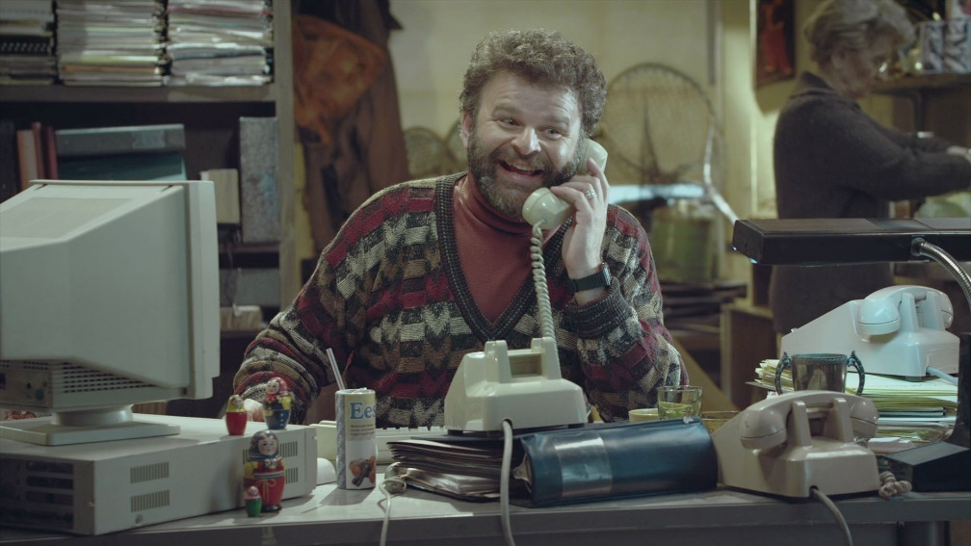
What Did We Learn?
Your people are going to do this. Accept that!
Give them the tools and awareness to fight back.
It’s better you do it rather than “Peggy” from Posnan, right?
©Discover

Slide 37




Dan.Bougere@Securicon.com
@Rouxgaru
https://www.linkedin.com/in/danbougere
Slides: https://github.com/Rouxgaru/slides

