Slide 1
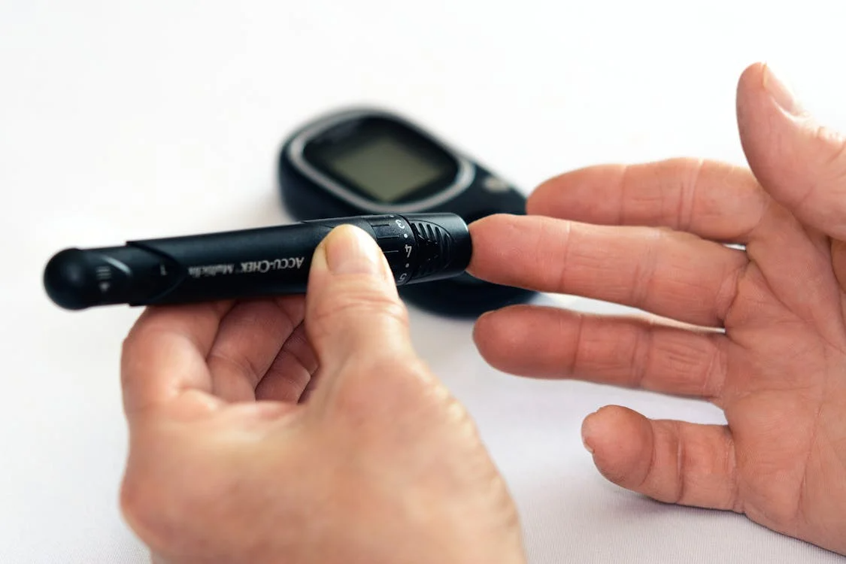

Application of Machine Learning Techniques for the Early Detection of Diabetes: A Comparative Study of Classification Models
Student: Sebastian Russo
Prof: Rand Kouatly
Prof: Souad El Hassanie
Software Engineering Bs.

Slide 2
Outline
line
Problem Statement
Research Question
Thesis objectives
Literature Review
Methodology
Plan
References
University of Applied Sciences Europe

Slide 3
Problem Statement
Diabetes is a chronic disease that continues to increase its global prevalence, posing serious health risks for patients as well as burdening healthcare infrastructures. The early detection of such diseases is critical for effective intervention and management. Traditional diagnostic methods, can be time consuming and may not fully address the potential of the available healthcare data. With the growing availability of health-related datasets and advancements in machine learning, it is feasible to explore Machine Learning approaches for early and accurate diabetes prediction. Nevertheless, many challenges remain, especially in determining which Machine Learning model performs best, which this proposed study aims to address.

Slide 4
Research Questions
Which Machine Learning algorithms provide the most accurate results in predicting diabetes based on health datasets?
How do different features (like cholesterol, BMI, age, sex etc.) influence the predictive power of ML models?
Can ensemble models outperform traditional single classifiers in diabetes prediction?
What challenges arise in implementing ML-based diagnostic tools in real-world healthcare systems?
How can the interpretability of ML models influence their adoption in clinical decision-making in diagnostics?

Slide 5
Thesis objectives
General Objective
To explore and compare the performance and effectiveness of various machine learning classification models in the early detection of diabetes using a real world health dataset.
Specific Objectives
To identify and preprocess the relevant diabetes related dataset.
To implement and evaluate multiple ML algorithms, specifically Logistic Regression, Decision Tree, Random Forest and SVM.
To assess the performance of each model using standard classification metrics.
To analyze the feature importance and model interpretability in the context of medical decision making.
To discuss the potential integration of ML models into healthcare systems for diagnostic support (not replacement).

Slide 6
Literature Review
Diabetes and the Need for Early Detection
Diabetes mellitus is a chronic metabolic disorder that presents an elevated blood glucose levels, result of defects in insulin secretion or action. The most common form of diabetes is Type 1, Type 2 and gestational diabetes. According to the World Health Organization (2021), diabetes is one of the leading causes of death globally and associated with long-term complications like heart diseases, kidney failure among others.
Type 2 constitutes for 90% of all diabetes cases, developing gradually and remains undiagnosed for long periods of time, primarily due to its asymptomatic nature in its early stages. A delayed diagnosis is concerning because an early intervention can reduce the risk of complications and improve patient outcomes, since an early stage management involves lifestyle modifications or preventive medication (American Diabetes Association, 2023).
Traditional diagnostics rely on periodic blood glucose testing, HbA1c measurements and patient reported symptoms. While still used, these methods are more reactive and fail to identify patients in early stages of the disease (or those with a high risk), especially in populations with limited access to healthcare services and underdeveloped healthcare infrastructure. Moreover, conventional diagnostic can be time consuming and often underuse all the available patient data, which could include behavioral demographic and lifestyle information that may improve the diagnosis.

Slide 7
Literature Review 2
Role of Machine Learning in Healthcare
Enhance diagnostic accuracy: Machine learning algorithms are highly effective in processing complex medical datasets, like imaging data and Electronic Health Records, to identify patterns typical of diseases. These models have shown promising results in detecting early signs of conditions like diabetic retinopathy, cardiovascular diseases and several types of cancer before obvious symptoms. Their diagnostic performance is comparable to that of traditional methods and sometimes better (Barth, S. and Flam, S., 2025).
Personalize treatment plans: Analyzing a patient's medical history, behavioral data and lifestyle factors, these models can support the development of personalized treatment plans. These plans can enhance the outcomes and minimize side effects (Sarkar et al., 2020).
Predictive analytics for disease prevention: Machine learning systems can process large scale datasets and estimate an individual’s risk of developing certain diseases. These predictive capabilities can allow healthcare professionals to conduct early interventions and apply preventative measures (Kelley, 2024).

Slide 8
Methodology
Research Design
The proposed methodology will employ a quantitative, experimental research design to evaluate and compare the effectiveness of multiple supervised machine learning models in predicting the presence of diabetes or not (classification problem).
The methodology will be structured around the standard data science lifecycle, with steps like data acquisition, preprocessing, model development, model testing, evaluation and interpretation of results.
A comparative approach will be adopted to determine the relative performance of the models, using the same dataset for all models training and testing as well as a unified evaluation framework based on predefined metrics such as Accuracy, F1-score, Precision etc.
The proposed study would span from the 1st of June of 2025 with a deadline of 27th of July of 2025.

Slide 9
Plan
Thesis Proposal
Obtained dataset
Chapter 2 Literature Review
Chapter 3 Theoretical Background
Chapter 4 Methodology
Experimentation 1: Dataset analysis (EDA)
Experimentation 2: Model train and test
Results and comparison
Chapter 5 Results
Chapter 6 Conclusion and Future work
Chapter 1 Introduction and Abstract

Slide 10
References
World Health Organization: WHO, (2024). Diabetes. Available at: https://www.who.int/news-room/fact-sheets/detail/diabetes (Accessed: 26th May 2025).
American Diabetes Association, (2022). American Diabetes Association Releases 2023 Standards of Care in Diabetes to Guide Prevention, Diagnosis, and Treatment for People Living with Diabetes, Press Release. Available at: https://diabetes.org/newsroom/american-diabetes-association-2023-standards-care-diabetes-guide-for-prevention-diagnosis-treatment-people-living-with-diabetes (Accessed: 26th May 2025).
Barth, S. and Flam, S, (2025). Machine Learning in Healthcare: Guide to Applications & benefits. Available at: https://www.foreseemed.com/blog/machine-learning-in-healthcare (Accessed: 28th May 2025).
Sarkar, K. et al, (2020). Machine Learning for Health (ML4H) 2020: Advancing Healthcare for All. ML4H. Available at: https://proceedings.mlr.press/v136/sarkar20a/sarkar20a.pdf (Accessed: 28th May 2025).
Kelley, K, (2024). Machine learning in healthcare: applications, use cases, and careers. Caltech. Available at: https://pg-p.ctme.caltech.edu/blog/ai-ml/machine-learning-in-healthcare-applications-use-cases-careers (Accessed: 28th May 2025).

Slide 11

Q&A

