Slide 1
Task List
Notes:
Andy is the goat
🐐

Slide 2
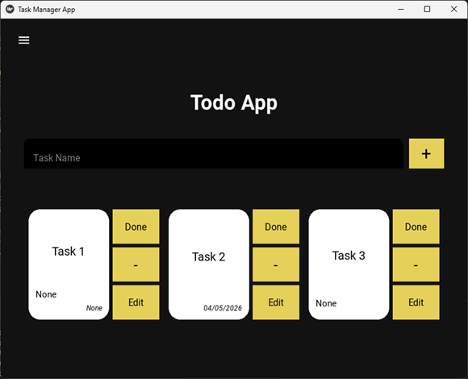
Project Overview
Purpose: to Track tasks
Audience: Anyone with a Busy schedule; Students, managers, employees, parents.
Main Problem Solved: Organize Schedule by Keeping track of to-do’s.

Slide 3
Outstanding Features
Categories: Color changing tasks based on categories
Task View: Card UI layout
Editing Task: Able to edit all parts of the task
Hamburger menu options: Create and remove category
Local Database: Stores tasks locally rather than on the Cloud

Slide 4
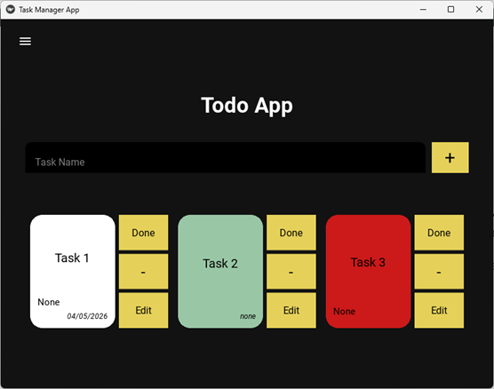
Card View UI
What it shows:
●Title, description, deadline, category
●Buttons for edit/delete/mark done
●Cards change color based on categories
Why it matters: Controller tests ensure the UI always displays accurate data.

Slide 5
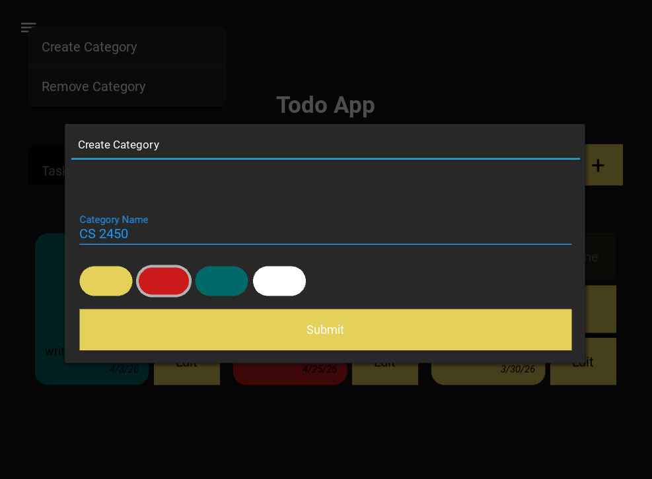
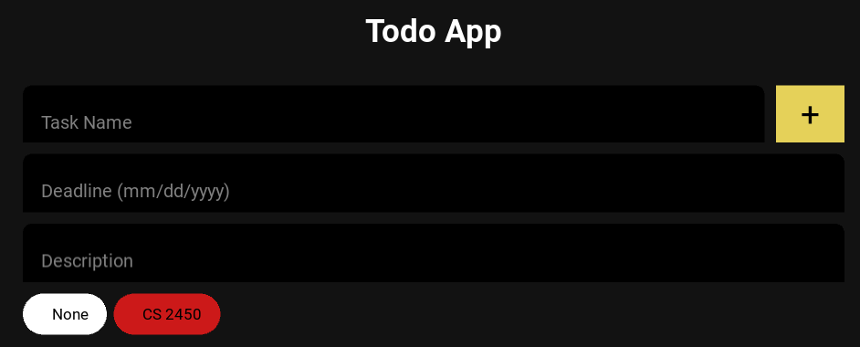
Creating
Categories
How to:
Write category name
Pick color
Select category for new task
Why It Matters: Allows user to create
groups for for their tasks. Great for
organizing tasks.

Slide 6
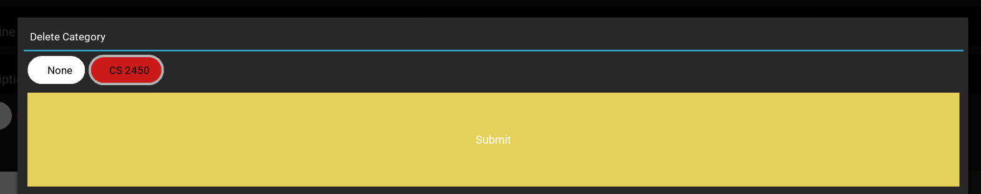
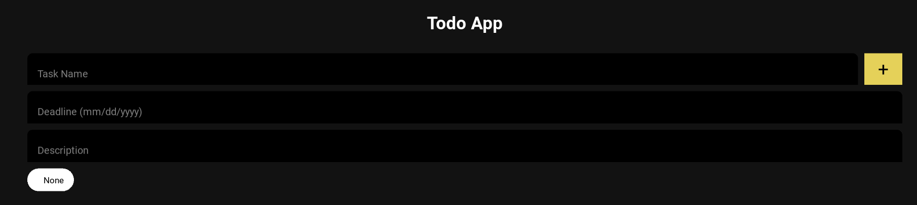
Deleting
Categories
How to:
Select category to delete
Press submit
Effects:
Category gone from selection
Tasks that were part of that category lose color
Why it Matters: Allows user to remove categories that aren’t relevant anymore.

Slide 7
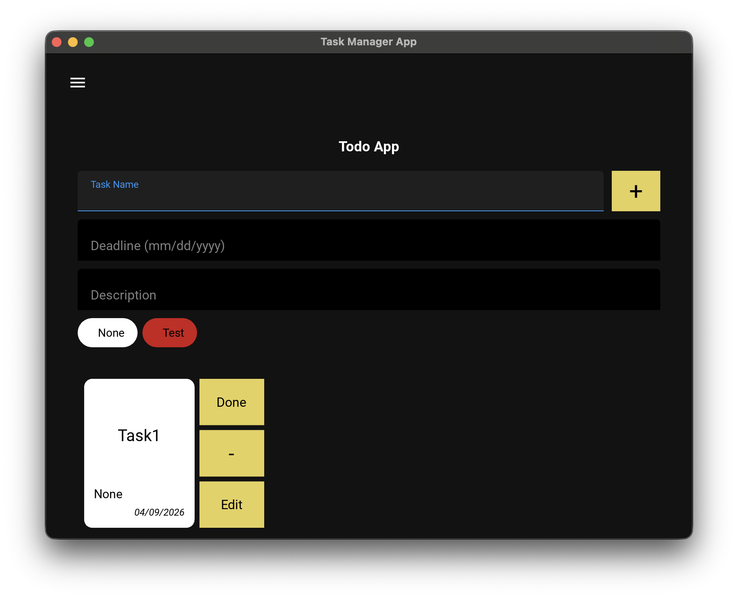
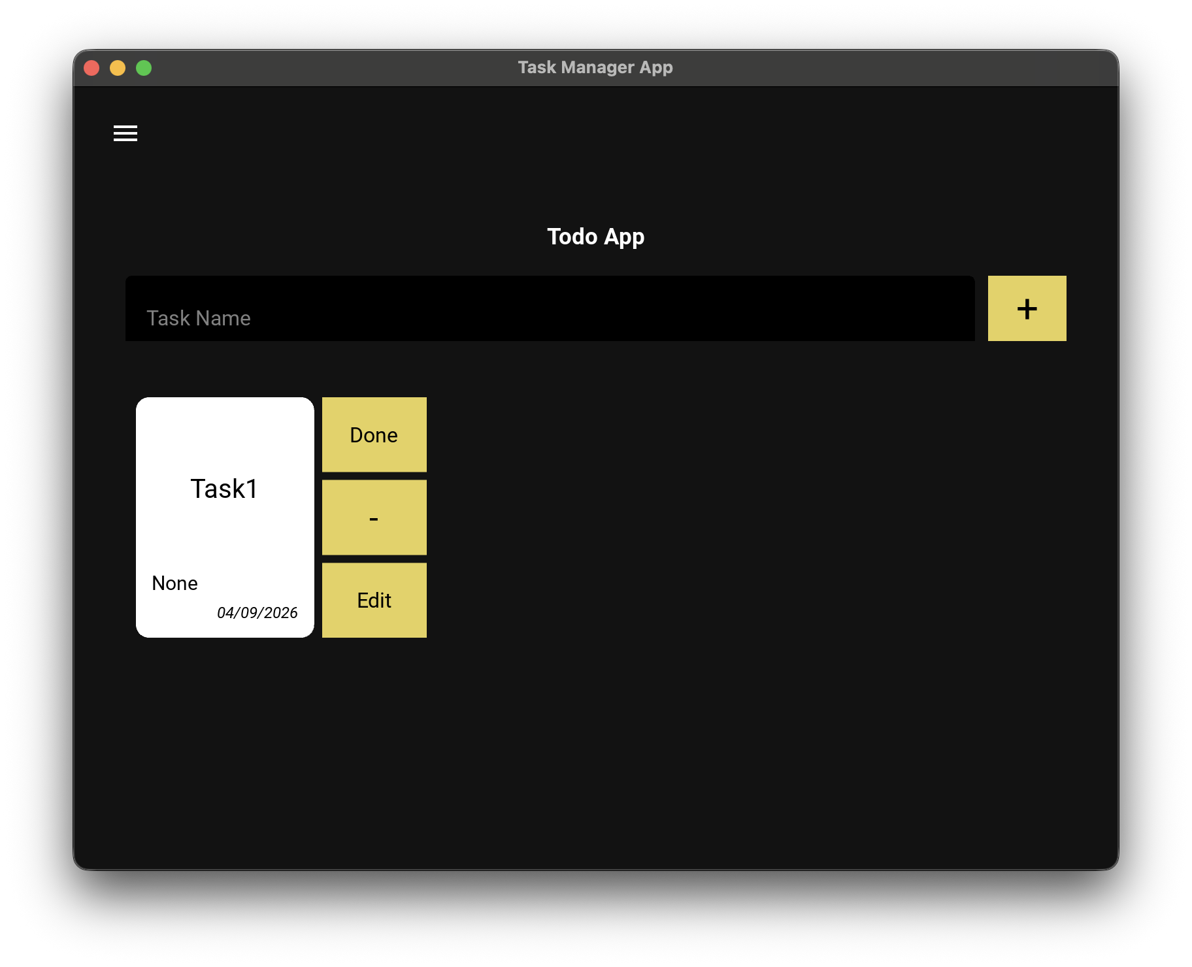
Pop-up Task
Features
How to:
Click on Task Name to add task
The pop-up features show up
Effects:
Let’s you describe your task the way you want
You can add deadline, description, categories

Slide 8
Development Processes
Planning:
Weekly meetings organized by the scrum master
Roles switched every other week
Tasks assigned and added to the backlog every meeting
Here are our UML diagrams and wireframe:

Slide 9
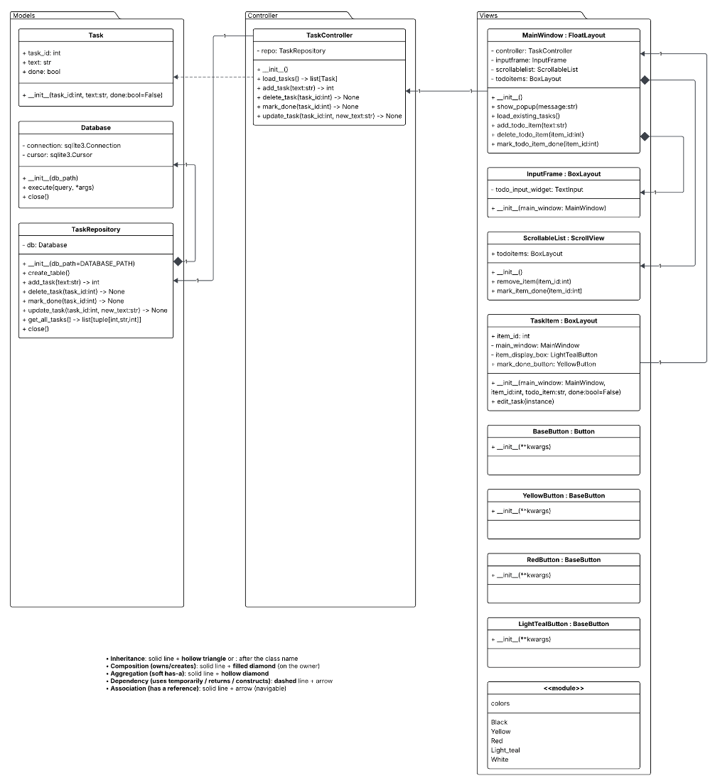
UML Diagram
Design Pattern: This is our diagram that explains how
our to do app works. We used an MVC design pattern
which shows the data, logic, and UI for our app.
How it works: If a user types in a task in view, it sends
It to the controller The Controller takes that text and
passes it to the TaskRepository in the Model, which
saves it to the database. By keeping these three lanes
separate, our code is much easier to test, fix, and
upgrade.

Slide 10
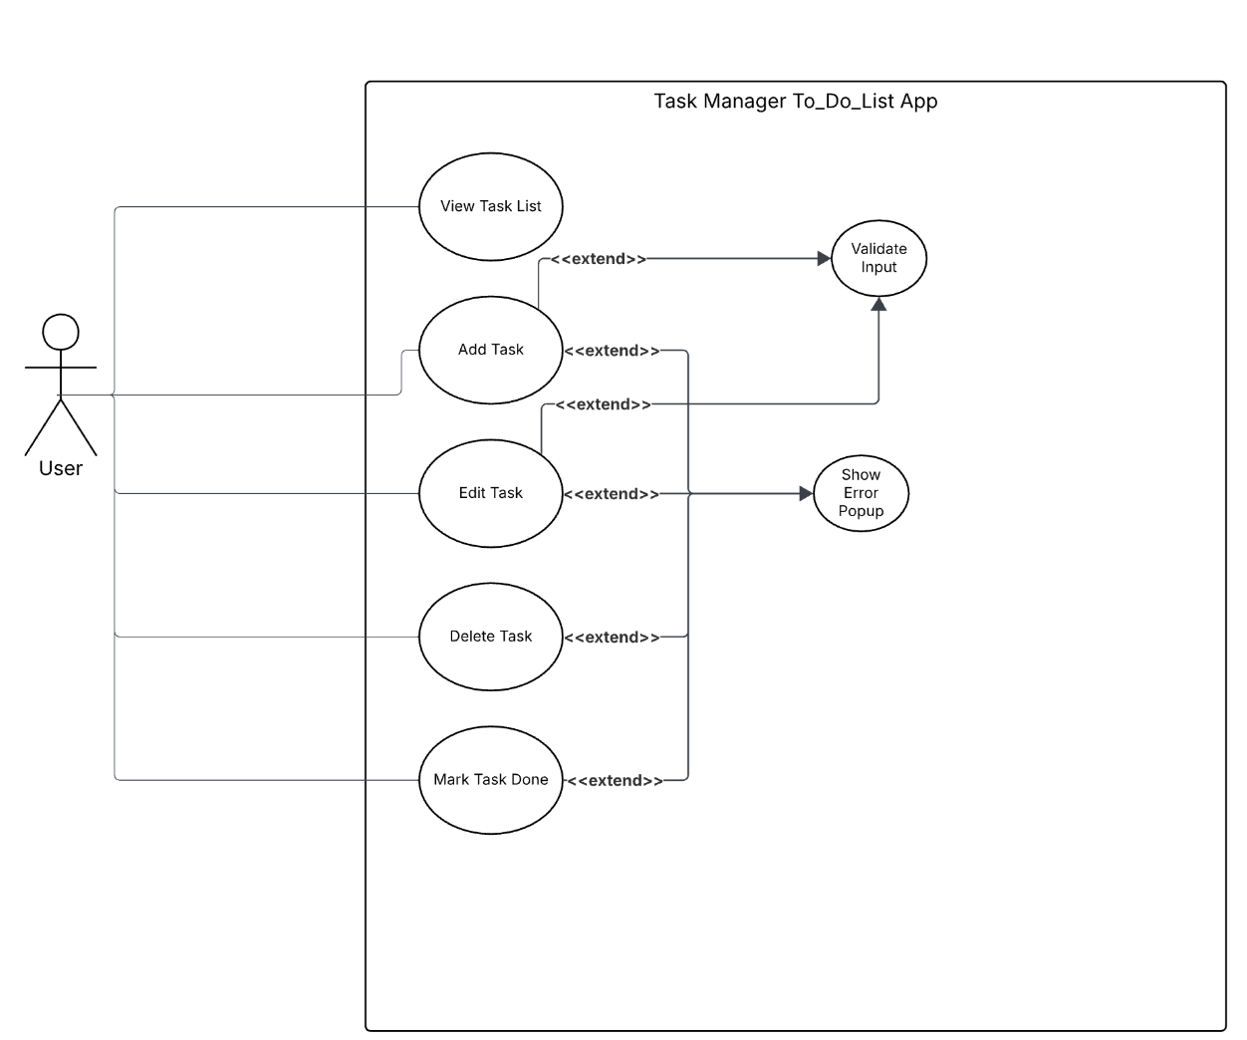
Use Case
UX: Here is our use case diagram which shows
Everything that user can do in our to-do list app.

Slide 11
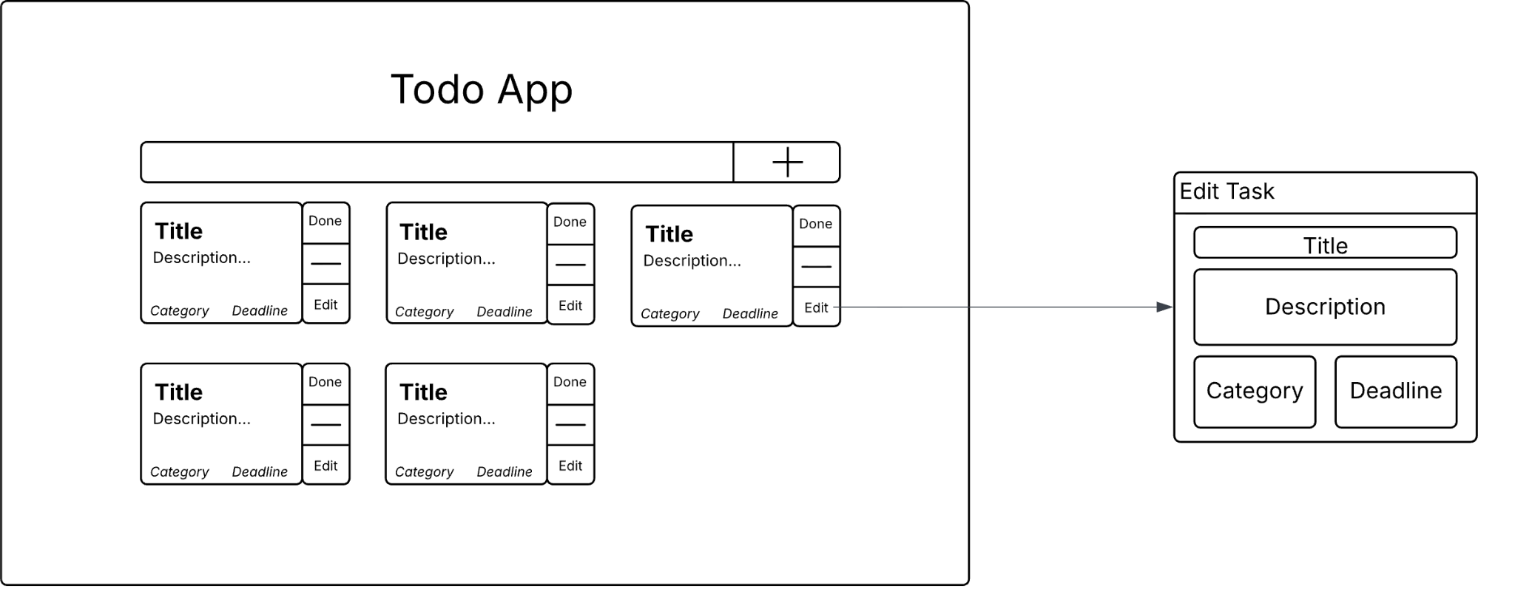
Wireframe

Slide 12
Requirement analysis
Requirements:
Project requirements in the SRS
Functional Requirements:
  Ability to add, delete, edit, categorize, and mark tasks done
  Task model will include task id, name, description, deadline, and done
  The system shall include an abstract repository interface for storing tasks
  Tasks will persist in local storage for the user to access at any time

Slide 13
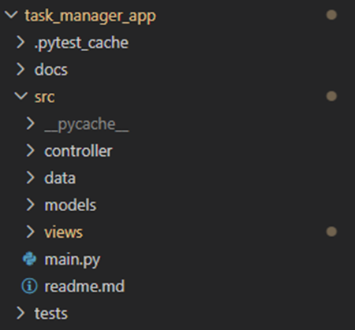
Engineering Practices
Design Principles
MVC architecture to separate UI, logic, and data
SOLID principles to keep classes focused, extendable, and maintainable
Design Patterns
Singleton used for shared configuration/state where only one instance should exist
Testing Practices
Wrote unit tests for core controller and repository functions
Used in‑memory SQLite for deterministic, isolated test runs
Added integration tests to validate controller ↔ repository behavior
Robustness Measures
Input validation to prevent invalid data
error handling for missing or incorrect task IDs
Defensive coding to avoid crashes and inconsistent state

Slide 14
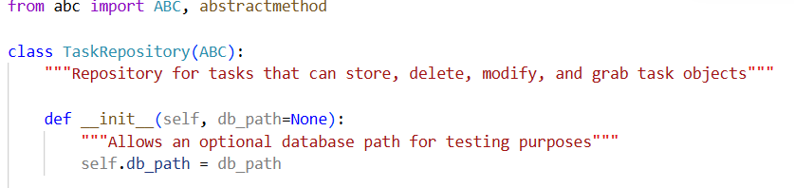

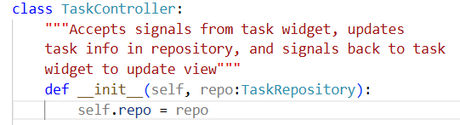
Dependency Inversion
(SOLID example)
Definition: High-level modules should not import anything from low-level modules. Both should depend on abstractions
How it’s Used:
Task Repo is an abstract class
Sqlite repo is an instance of Task Repo
Task controller uses abstract Task Repo instead of a detailed implementation
Sqlite repo is a version injected in
What it’s For: Dependency inversion gives a more flexible and scalable design. If new implementation was decided (e.g. PostgresRepo), then only a new repository class would have to be created.

Slide 15
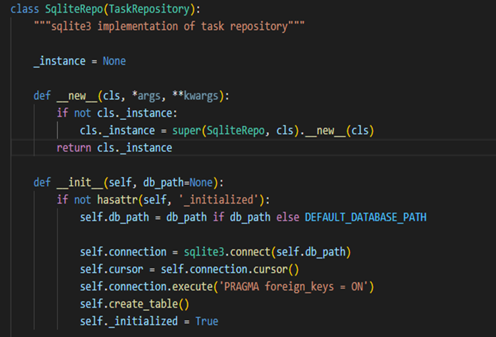
Singleton Pattern
What it is
Ensures only one instance of the database connection exists
Centralizes access to the SQLite database
Prevents multiple competing connections in the app
Why we used it
SQLite doesn’t handle many simultaneous connections well
The app needs a single shared repo for tasks and categories
Simplifies controller → repository communication
Benefits
Consistent database state
Lower resource usage
Easy access from anywhere in the app
Challenges
Shared global state made testing harder
Tests needed isolation fixtures to avoid leftover data
Schema changes required deleting the old DB file

Slide 16
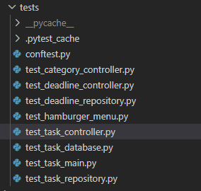
Testing Overview
What we tested
Controllers (task, category, deadline)
Repositories (SQL operations)
Integration flows (end‑to‑end behavior)
UI initialization (app loads correctly)
Validation & edge‑case handling
Why it matters
Ensures correctness across the entire system
Prevents regressions
Confirms controllers call the right repo methods
Guarantees consistent database behavior

Slide 17
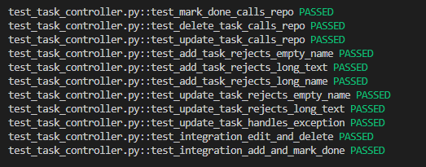
Controller Tests
What we tested
CategoryController
  create, rename, delete category
  assign category to task
  get all categories
TaskController
  add/update/delete task
  mark task done
  reject invalid input
DeadlineController
  set/update/remove deadlines
  get overdue tasks
Why it matters
Ensures UI actions trigger the correct logic
Prevents invalid data from reaching the database

Slide 18
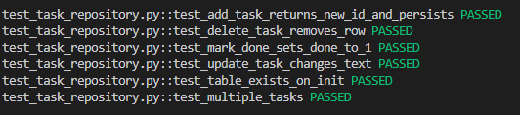
Repository Tests
What we tested
TaskRepository
  add task returns new ID
  update task text
  delete task removes row
  mark done sets done = 1
  multiple tasks behave correctly
DeadlineRepository
  set/update/remove deadlines
  overdue task queries
Why it matters
Ensures database consistency
Confirms schema and queries work as intended
Prevents data corruption

Slide 19
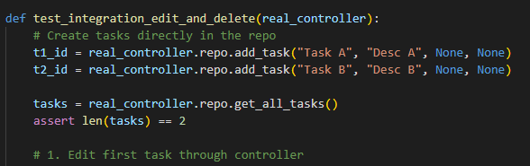
Integration and UI testing
Integration tests
Add → mark done
Add → edit → delete
Verifies controller + repository + DB work together
UI tests
App initializes correctly
Hamburger menu loads
Menu items trigger actions
Why these matter
Validate real user flows
Ensure the system works end‑to‑end
Catch issues unit tests can’t see

Slide 20
Future Enhancements
User Experience (UX) Enhancements
Dynamic Views: Ability to toggle between Card and List layouts.
Task Completion: Visually strike-through or move finished tasks to a completed list.
Notifications & Deadlines: Add date validation and push alerts for upcoming due dates.
Architecture & Scalability
Factory Pattern: Refactor task creation to easily support new task types.
Configuration File: Extract hard-coded values (like UI colors) into a central config file for easier maintenance

