Slide 1


Slide 2
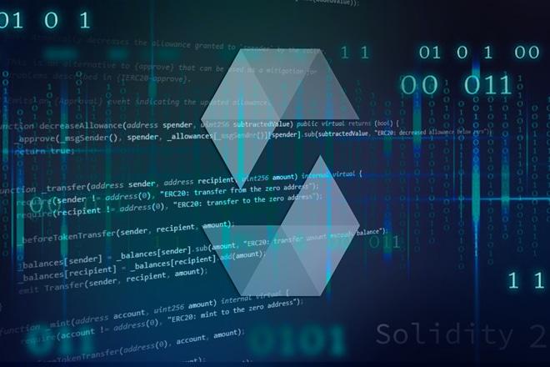

In this project, I have created an NFT marketplace decentralized application (dapp) for the auction of digital assets using smart contracts, solidity, and streamlit.

Slide 3
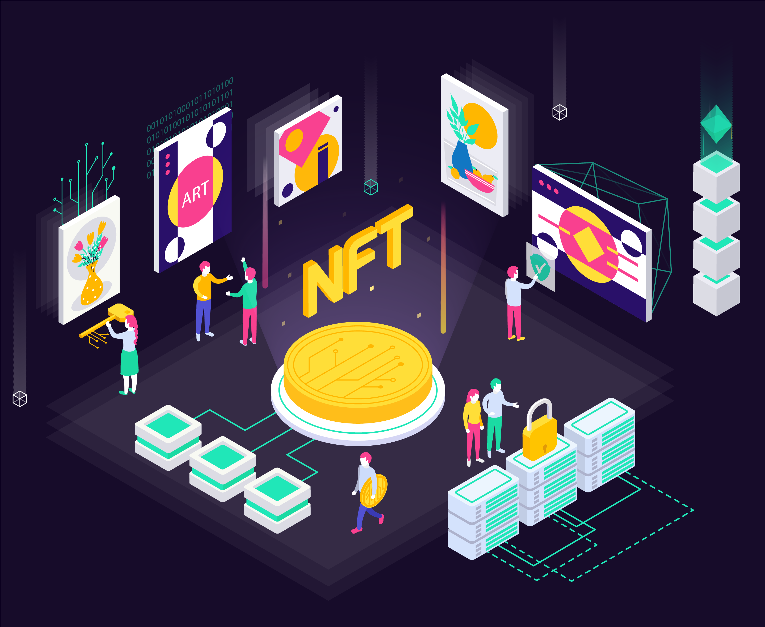
My NFT dApp's goal is to support local and emerging artists and provide them with a fast and efficient FinTech platform to register their work and sell them through an auction-based marketplace allowing them to connect with collectors all over the world through a decentralized network.

Slide 4
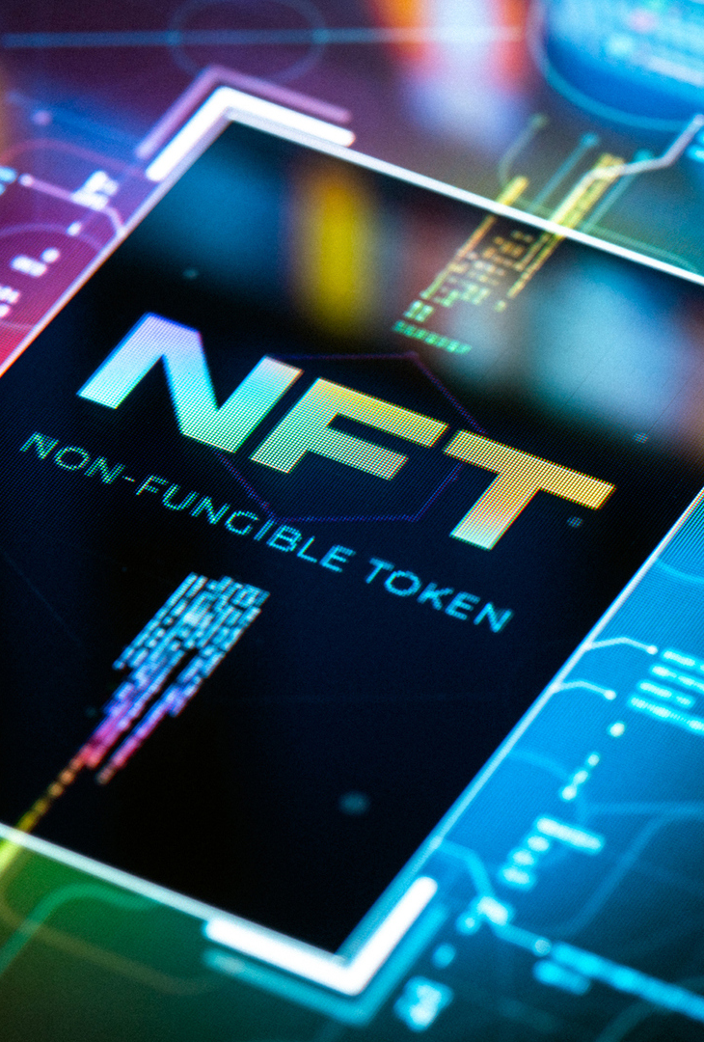
NFT dApp auction marketplace provides:
A platform that connects artists and collectors through blockchain technology with complete transparency. It holds an asset/token/deed that is to be auctioned using ERC721 standards.
2. Ability to place bids in auctions, over a decentralized network with the following functions and features: </br>
>
- the ability to participate in an English auction whereby bid prices keep increasing over the duration of the auction.
- the ability to monitor the auction process (start bid, bid price, the highest bidder, etc.)
- the ability to view the frequency of each bidder
- safe and secure transfer of NFT ownership upon auction completion
- safe and secure transfer of funds upon auction completion
- refund of funds to bidders that did not get not lucky

Slide 5
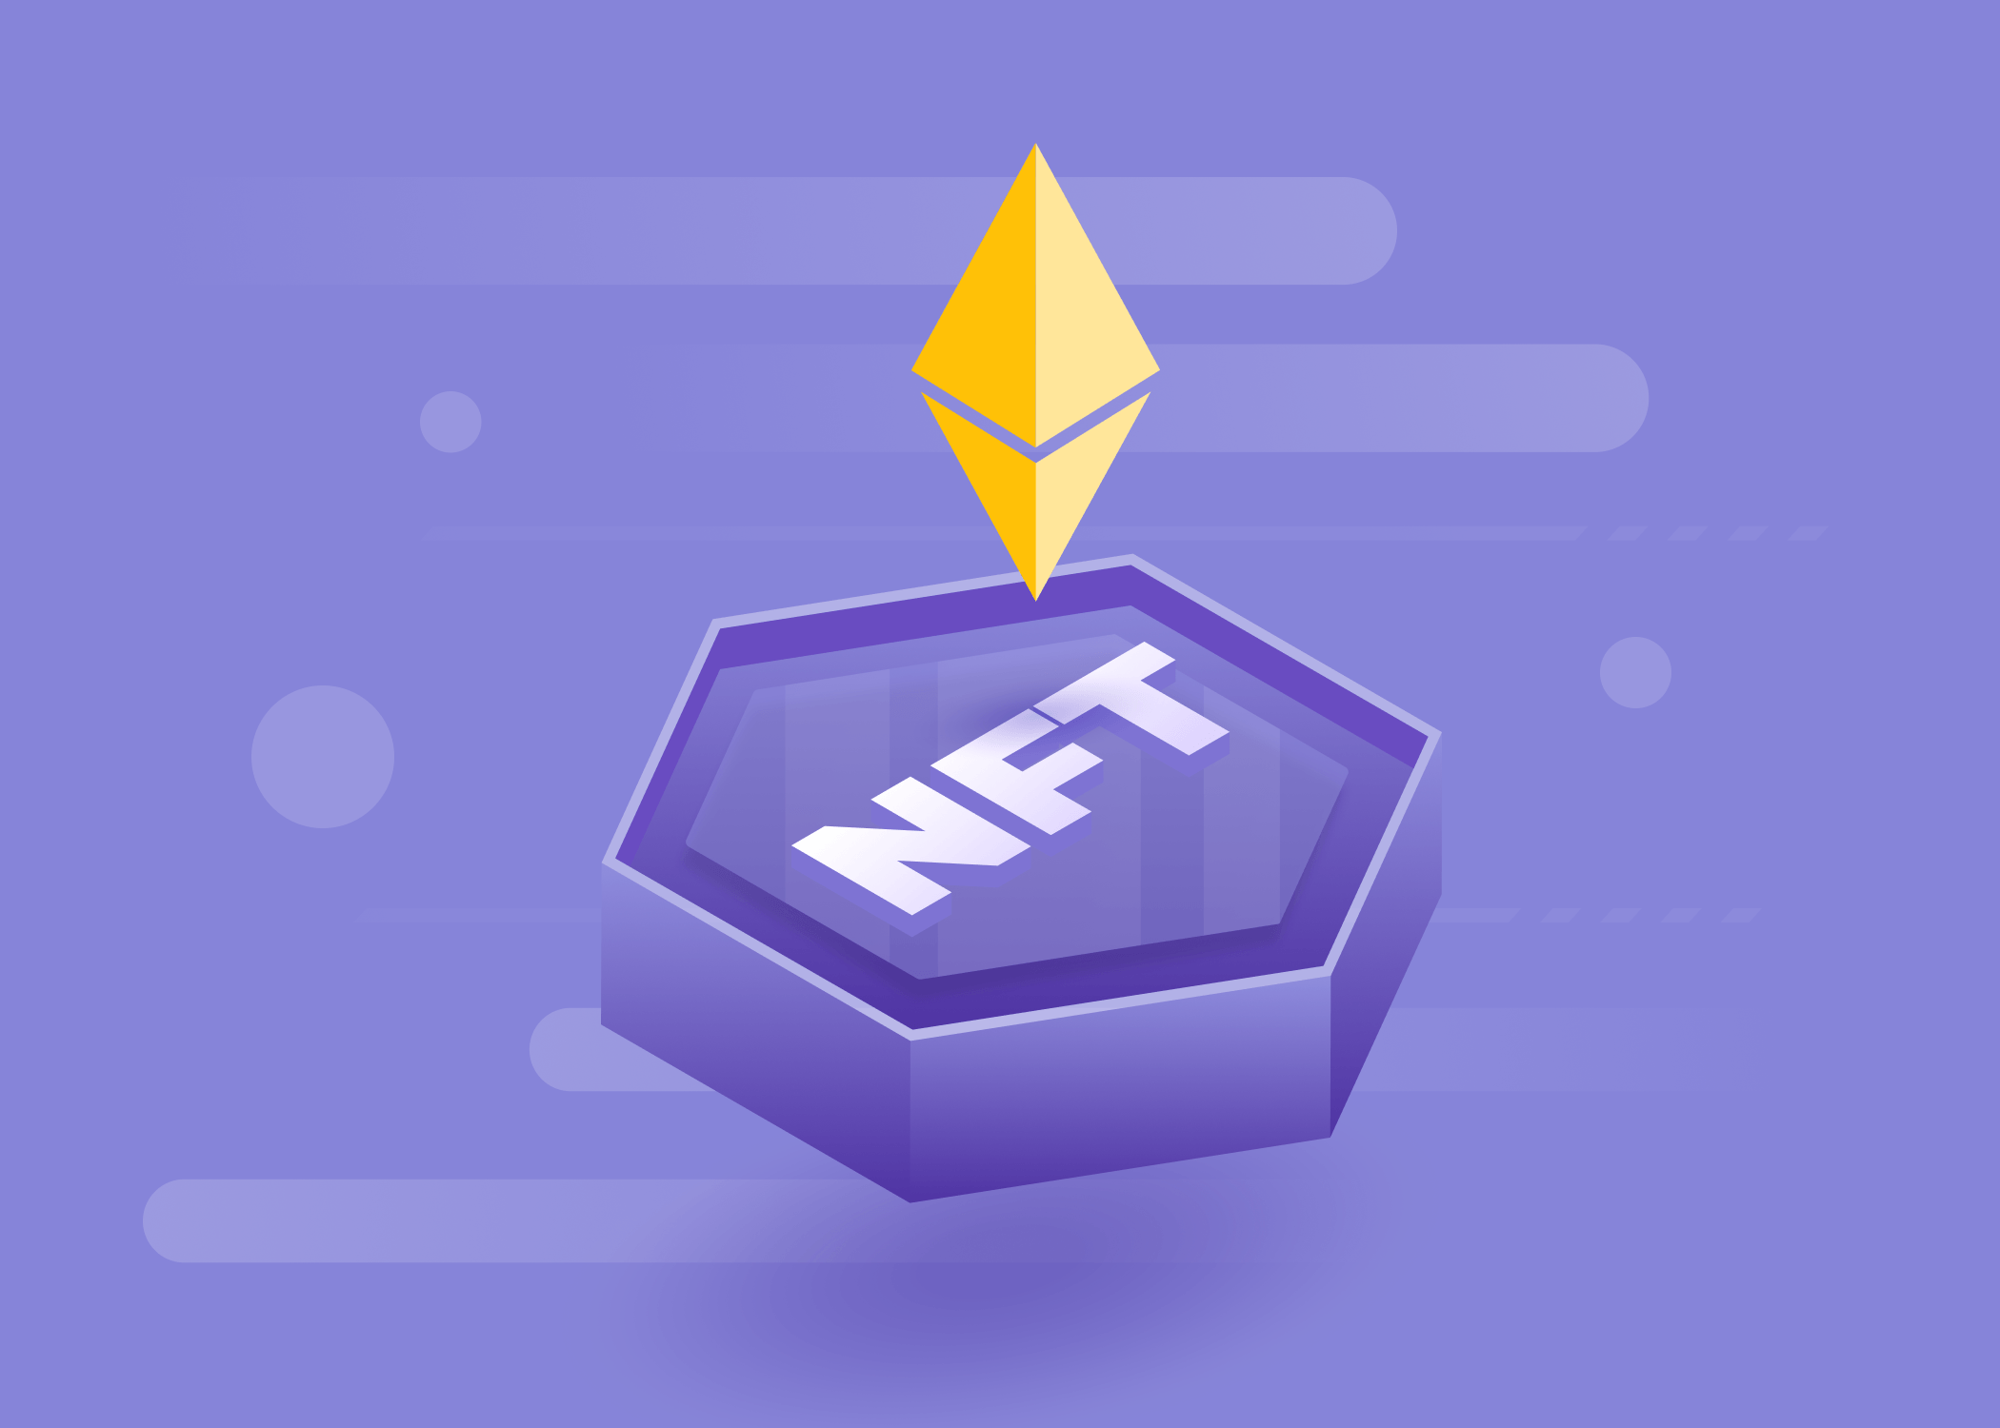
3. Use of Polygon Network provides the users with a method that is lower in cost and more efficient (faster) as compared to transacting directly over the Ethereum Network (Polygon is essentially a "scaling solution" that aims to address the inefficiencies of transacting with the high demand Ethereum network - it groups multiple transactions into a single block before committing to the main Ethereum network)
4. Works with digital assets stored over an established and secure file storage system (IPFS - Pinata)
5. Our NFT dApp does not charge any fees or retain any of the profits from the NFT sales hence providing a free-of-cost platform for the artists. As opposed to OpenSea, which charges a chunky one-time registration fee to list each NFT as well as recurring fees.

Slide 6


In order to test and demo my application I need to have an inventory of digital artwork. I created some custom ones using Photoshop. In order to generate the IPFS links for the custom artwork, I utilized Pinata.

