Slide 1



Using Environmental Data
to Predict Forest Fire Risk
SmartForest
Algerian Forest Fires Dataset • 3 ML Models • 95.92% Accuracy
Forest Fire Risk Prediction
DOMAIN
DATASET
Environmental Analytics
UCI – Algerian Fires
SDG 15: Life on Land
TEAM
BATCH
Anamika K T & Sibani B
AIML-B • SRM IST • 2026
github.com/Rover-sp24/MiniProject_DS_AIML-B_2026_SmartForest

Slide 2

Problem Statement
The Problem
Our Solution
Forest fires cause irreversible ecological damage to biodiversity and carbon sinks
Analyze environmental parameters to proactively predict fire risk zones
Traditional monitoring is reactive — damage happens before response
Build ML classification models on historical sensor data
Climate change is increasing fire frequency and severity globally
Identify key environmental triggers before fire occurrence
No proactive data-driven prediction tools for early intervention
Support forest management with data-driven early warning
Slide 2 / 10

Slide 3
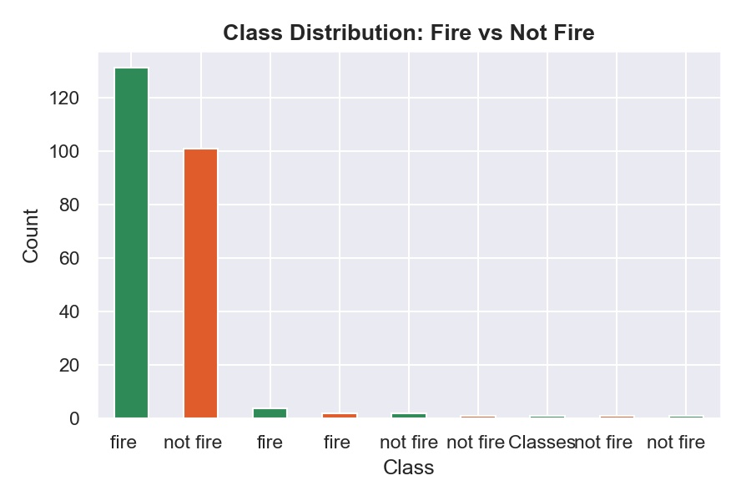
Dataset Overview
244
13
2
130
Total Records
Features
Regions
Fire Instances
Key Environmental Features
Class Distribution
Temperature
Noon temp in °C
RH
Relative Humidity %
Rain / Ws
Rainfall & Wind speed
FFMC / ISI
Fuel moisture & Spread index
FWI
Fire Weather Index (target predictor)
Classes
Fire (1) or Not Fire (0)
UCI Machine Learning Repository • Algerian Forest Fires Dataset • June–Sep 2012
Slide 3 / 10

Slide 4
Project Workflow
01
02
03
04
Problem Identification
Dataset Collection
Data Preprocessing
Exploratory Analysis
Predict fire risk zones from env. data
UCI Algerian Forest Fires – 244 records
Clean, encode, scale, train-test split
Correlations, distributions, patterns
05
06
07
Data Visualization
Model Development
Result Interpretation
Heatmaps, box plots, scatter plots
Logistic Regression, DT, Random Forest
Accuracy, Recall, Feature Importance
Slide 4 / 10

Slide 5
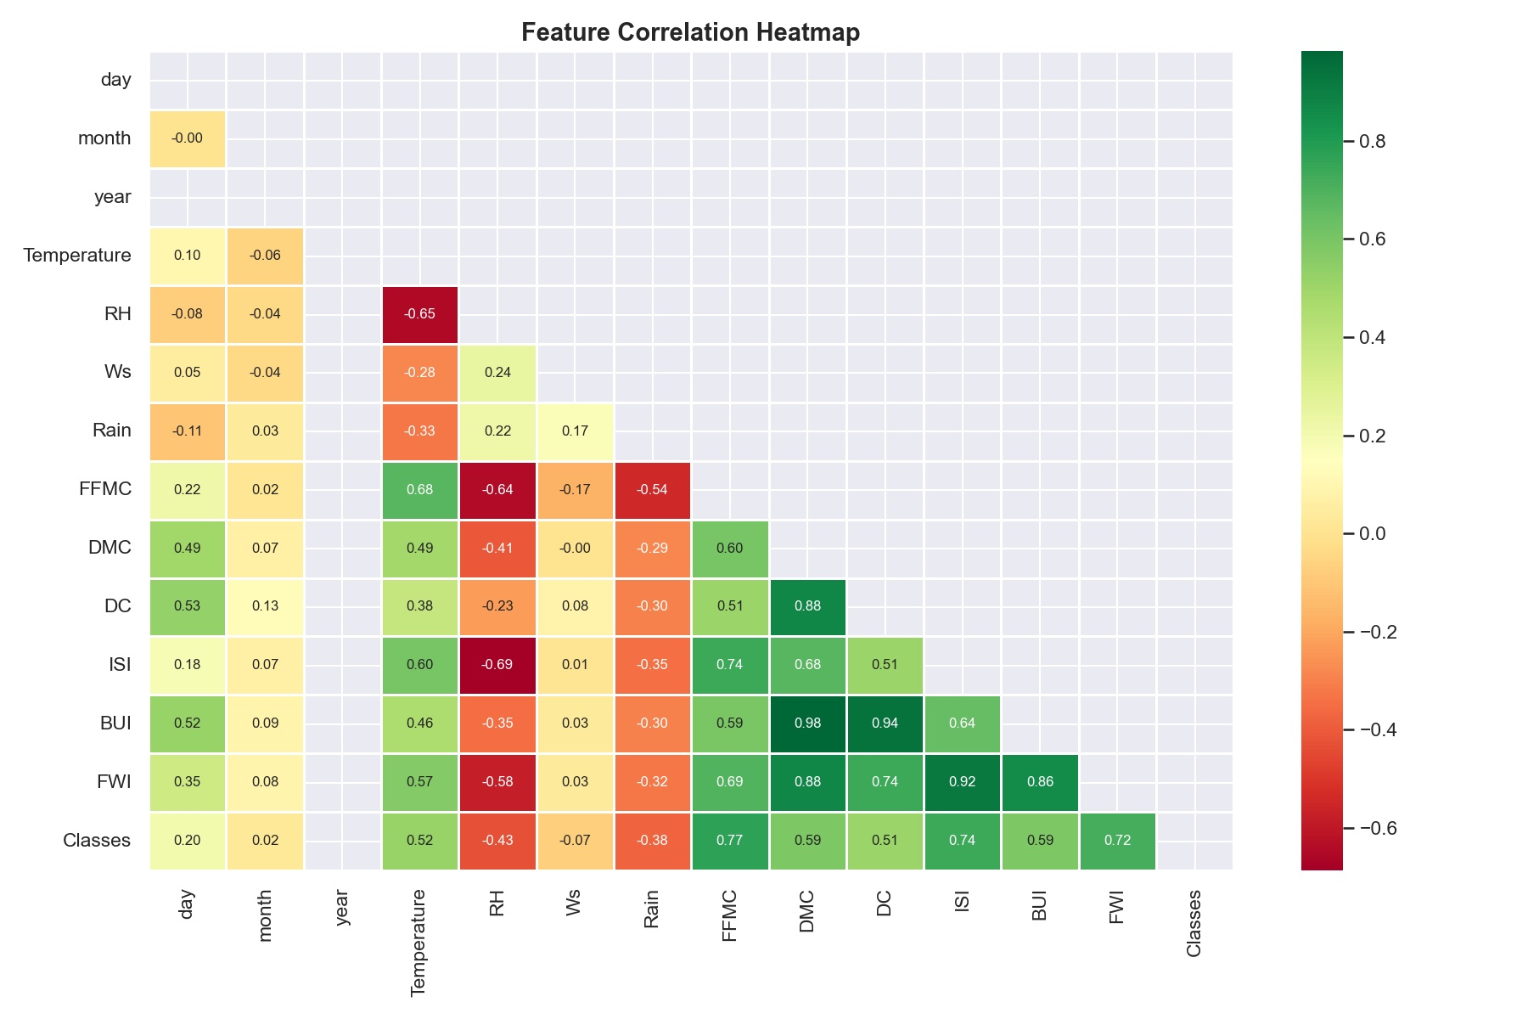
EDA: Feature Correlations
Key Insights
0.77
FFMC ↔ Fire (strongest)
0.74
ISI ↔ Fire
0.72
FWI ↔ Fire
-0.43
RH ↔ Fire (inverse)
0.98
BUI ↔ DC (redundant)
Slide 5 / 10

Slide 6
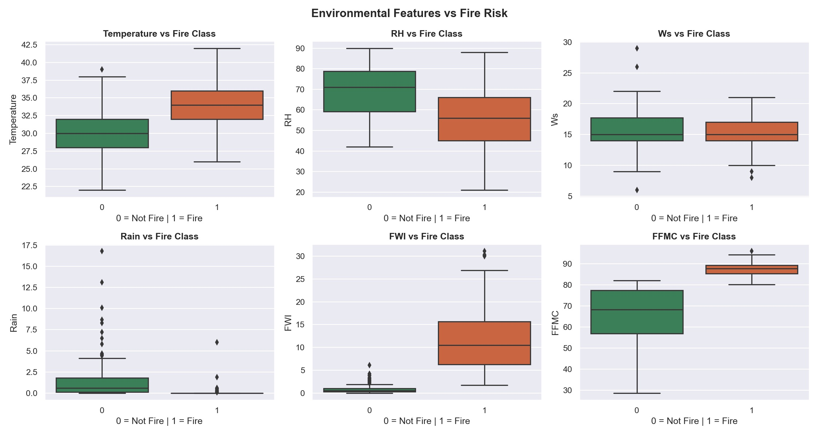
EDA: Environmental Features vs Fire Risk
Fire instances show higher Temperature, FWI, FFMC — and lower Rain & RH. Consistent with real-world fire conditions.
Slide 6 / 10

Slide 7

Model Development
Preprocessing Pipeline
Classifiers Trained
Remove embedded region header rows from CSV
Logistic Regression
Convert all feature columns to numeric types
max_iter=1000 • Baseline linear classifier
Encode target: fire = 1, not fire = 0
StandardScaler normalization on 10 features
Decision Tree
80/20 stratified split → 196 train, 49 test
max_depth=5 • Non-linear feature interactions
Random Forest
n_estimators=100 • Ensemble + feature importance
Slide 7 / 10

Slide 8
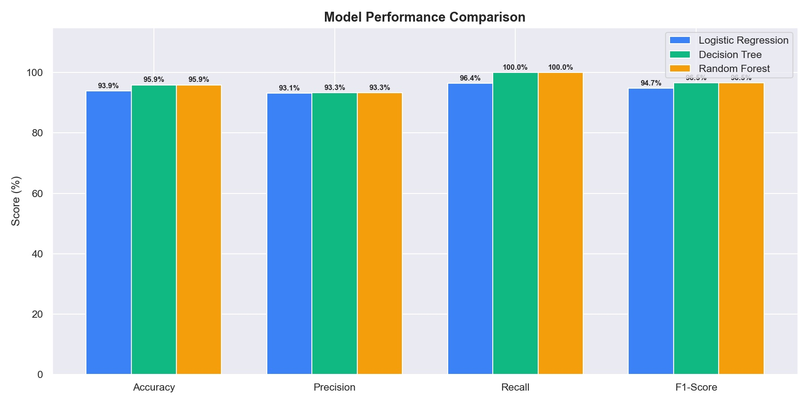
Model Results
Model
Accuracy
Precision
Recall
F1-Score
🏆 Best Models
Logistic Regression
93.88%
93.10%
Decision Tree & Random Forest
96.43%
94.74%
95.92% Accuracy • 100% Recall
Decision Tree
95.92%
93.33%
100%
96.55%
Random Forest ★
95.92%
93.33%
100%
96.55%
0 Fire Incidents Missed
Perfect Recall on Test Set
Slide 8 / 10

Slide 9
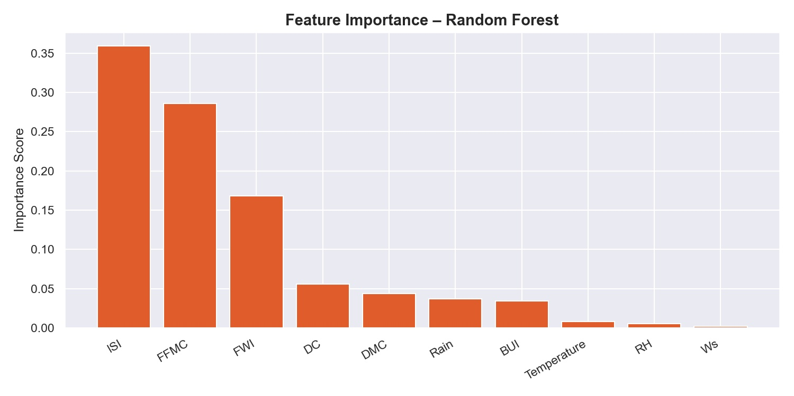
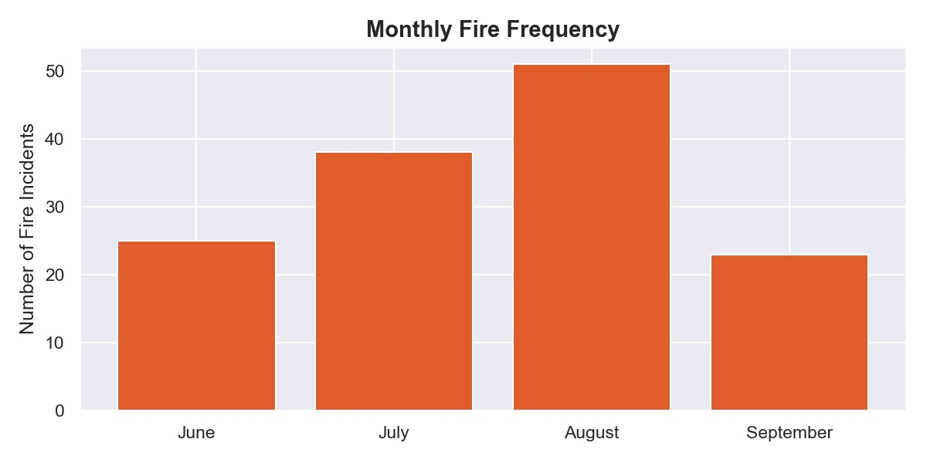
Feature Importance & Key Findings
Top Predictors
#1 ISI
0.36
Importance score
#2 FFMC
0.29
Importance score
#3 FWI
0.17
Importance score
ISI + FFMC + FWI = 82%
of total model importance
Slide 9 / 10

Slide 10

Conclusion & Team
Decision Tree & Random Forest: 95.92% accuracy with 100% recall — zero fires missed
Team
Anamika K T
ISI, FFMC & FWI account for 82% of predictive importance
RA2311026050012
Preprocessing & EDA
August peak fire season — model can trigger early seasonal alerts
Rover-sp24
Sibani B
Directly supports SDG 15: Life on Land through proactive forest protection
RA2311026050056
Modelling & Visualization
Sibani-Balaji
SDG 15: Life on Land • SRM IST • AIML-B • 2026
Slide 10 / 10

