Slide 1


Challenges in Modern Parenting
In today's fast-paced world, parents face a significant challenge in effectively monitoring and caring for their babies due to demanding work schedules and responsibilities.
Problem Statement:
Traditional baby monitoring systems lack the ability to provide comprehensive insights into a baby's needs and emotions, leaving parents anxious and disconnected.
Key Issues:
Limited Insights: Existing systems offer basic monitoring, missing emotional cues.
Parental Distress: Parents often feel detached due to incomplete information.
Expensive Systems: Existing systems offering basic functionalities are also expensive in market.

Slide 2
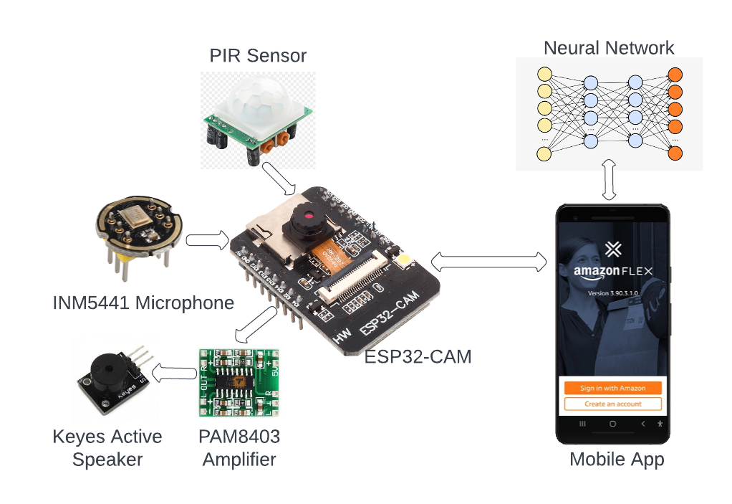
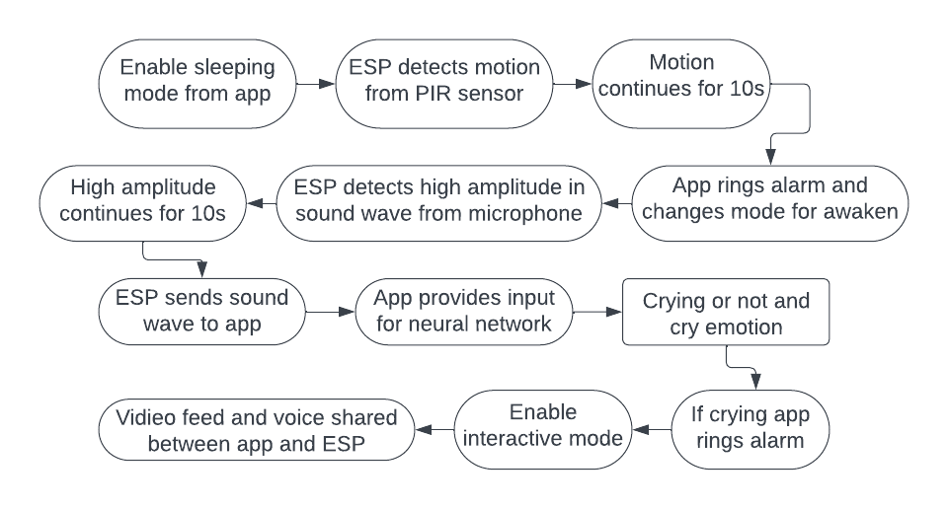
Revolutionizing Baby Monitoring
Our solution utilizes cutting-edge technology to bridge the gap between busy parents and their babies' emotional needs.

