Slide 1
End Semester Evaluation of Project
on
DETECTION OF MALICIOUS MOBILE WEBPAGES
BY
RIA JAIN (11710582)
HARSH MITTAL (11710580)
ROHAN (11710532)
Under the Supervision of
Dr. AK Singh, Professor

Slide 2
Introduction
The Internet has now become an important part of everyone's lives. Internet provides all the basic necessities to the users by just clicking a button. According to a report, count of users who have access to the internet has reached 3 billion.
According to Data Breach Investigations Report of Verizon’s 2019, almost 32% of the data breach attacks involved phishing activity.
Even in this pandemic situation of our country, amongst the fears of COVID-19 pandemic, the use of malicious websites has increased rapidly. Attackers have created a Coronavirus tracker map to spread malware that is basically focused on stealing the information from the user's phone. A phishing website was created, ‘coronavirus-map.com’ that seemed to be a benign live tracking map for COVID-19 virus but it aimed to contaminate visitors with the AZORult trojan.
So, Aim of this project is to build an android application which will detect phishing websites with good accuracy. We tried using the least number of features and also the most effective one’s which will help in predicting zero day websites. Various ML algorithms will be compared with each other in order to achieve the best accuracy. This approach has achieved a higher number of accuracy.

Slide 3
Problem Description
Phishing is basically a fraud practice that aims to get the information of users using the internet by stating that they are not a fraud entity. It has compromised millions of users' data. These attacks are increasing at a very fast pace. Due to smaller screen sizes, it is very difficult to differentiate between malicious and legitimate websites on mobiles. Many mechanisms exist to detect malicious webpages on desktop but mobile specific webpages differ significantly from desktop web pages.
Below are some more reasons of why mobile phones are more prone to these attacks:
Websites can easily be copied by duplicating the source code of legitimate websites
There are less security mechanisms in mobile phones.
As discussed above, size of mobile phones are usually much smaller than desktop,so it is nearly impossible to detect malicious websites on the basis of their UI.
Consequently, it has become a dire need to develop a solution which tells which URL is malicious. Therefore, this project aims at creating a mobile application which will differentiate between malicious and legitimate mobile websites.

Slide 4
Related Work
Whitelisting or blacklisting method is efficient for detecting phishing websites. In this method, either a list of malicious webpages or legitimate web pages is created. Whenever a user visits the website, it checks the URL in the existing database and responds accordingly.
DNS based approach, is the popular approach for detecting malicious websites. In this approach, the IP address of a phishing website will be validated. The URL will be sent to DNS which then verifies whether the IP address is present in the list of IPs of genuine sites.
Phishing attack detection using proactive prevention uses genuine existing URLs to generate all possible combinations of URLs. After this, it is checked if each and every combination exists on the web or not. Then the URLs are separated into two sets of phishing and non-phishing.
Visual similarity based method is basically to compare the visual appearance of the websites. Even though websites look similar in their appearance but there are significant differences between them.

Slide 5
Proposed Approach
Stage 1.
This stage checks if Domain name of the URL is an IP address or a website address. If it is an IP address, it warns the user that the URL might be malicious and skips the further steps. If not then it moves to the next step.
Stage 2.
This stage checks whether the input URL is already present in the database. If it is already present, then it just returns the existing label for the URL i.e., if the URL is malicious or not malicious and skips further steps avoiding unnecessary computation.
Stage 3.
The application sends the URL to a server. A set of features will be extracted and then feature analysis is performed on these extracted features to get important indicators for the model and then various classification algorithms has been applied and evaluated which will classify the URL into either a legitimate or a malicious site.
Stage 4.
In this stage, the detected website URL will be added to the database handled by the server for future use so that if the same URL is being requested by the user again, it can be detected at an earlier stage. Now, the result is sent to the application which displays it to the user.

Slide 6
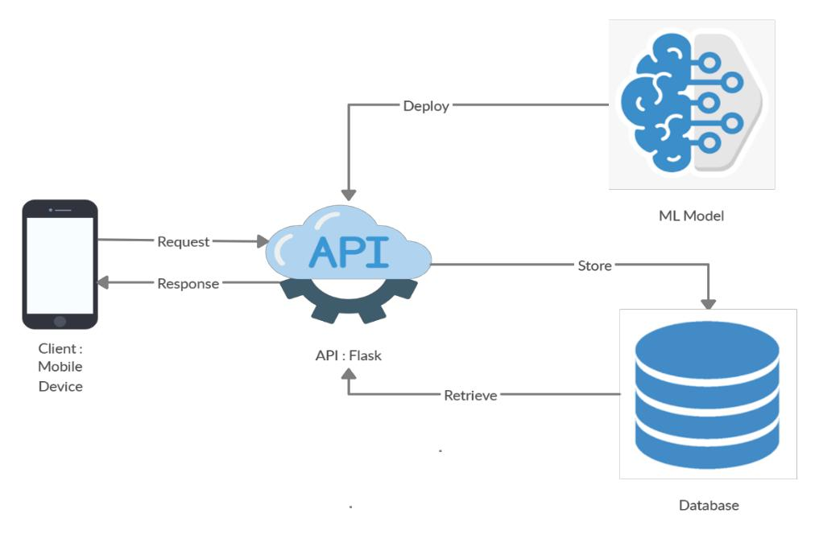
Proposed Approach
Fig.1 Architecture of the Malicious Mobile Webpage Detection Application

Slide 7
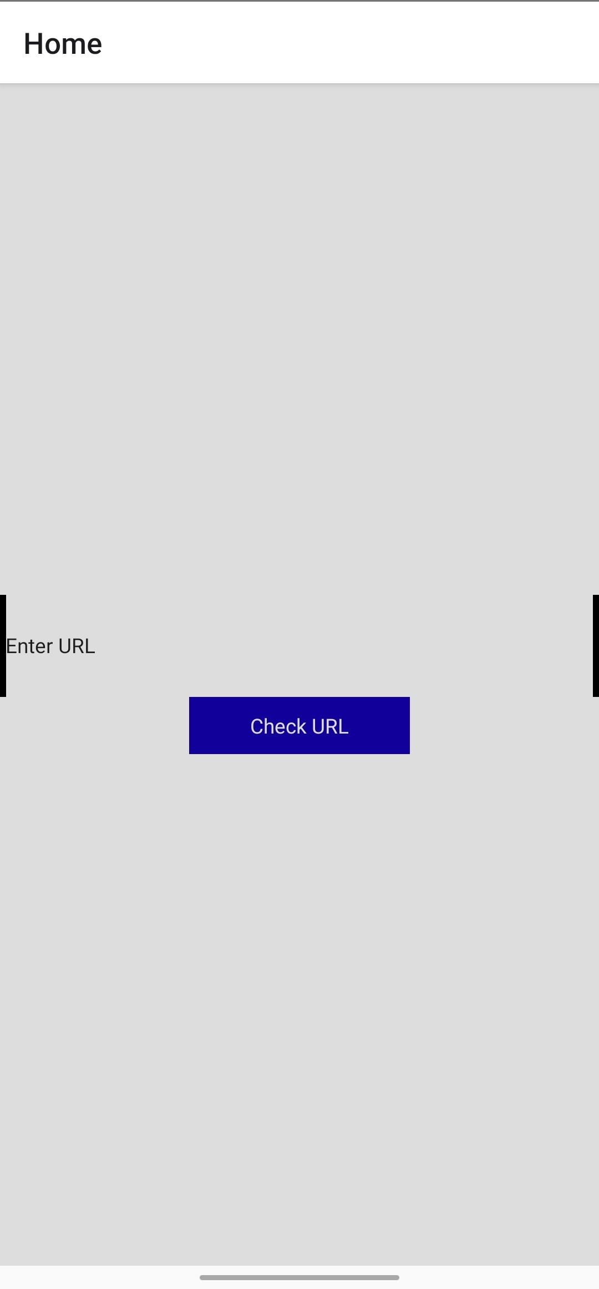


Result
1.
2.
3.

Slide 8
Conclusion
The Internet has now become an important part of everyone's lives. For every single thing, the internet is needed be it food order, video calling, browsing etc. And in the current scenario, mobile phone users are increasing day by day therefore it is an urgent need to have a system which classifies whether a website is malicious or not. But systems who detect mobile specific malicious web pages are less as compared to desktop sites. Mobile web pages and desktop sites have huge differences in their appearance, content, layout etc. Present systems for detection of mobile specific web pages have their own drawbacks as some are not cost effective others are not for the websites who appear for just one day or may be for one week. So our approach overcomes all of the above drawbacks with a very high accuracy rate. We look forward to enhancing our system so that it will be convenient for the users. We would like to aware the audience about the phishing attacks and hence using our phishing detection system for their own safety.

Slide 9
References
[1] Yousif, H., Al-saedi, K. H., & Al-Hassani, M. D. (2019). Mobile Phishing Websites Detection and Prevention Using Data Mining Techniques. International Journal of Interactive Mobile Technologies, 13(10).
[2] Jun, Ho., Huh, & Hyoungshick, Kim.: Phishing Detection with Popular Search Engines: Simple and Effective. Available at: https://link.springer. com/chapter/10.1007/978-3-642 -27901-0_15
[3] Yue, Zhang, Jason Hong & Lorrie Cranor.: CANTINA: A Content-Based Approach to Detecting Phishing Web Sites. Available at: https://www.cs.cmu.edu/~jasonh/publicat ions/www2007-cantina-final.pdf
[4] Shcherbakova, T., Vergelis, M., & Demidova, N. (2015). Spam and phishing in Q2 2015. Quarterly Spam Reports. Available at: https://securelist.com/spam-and-phishing-in-q2-of-2015/71759/ (Last accessed on 26 May 2020)
[5] Crane C. (2019). 20 Phishing Statistics to Keep You from Getting Hooked in 2019. Available at: https://www.thesslstore.com/blog/20-phishing-statistics-to-keep-you-from -getting -hooked-in-2019/ (Last accessed on 26 May 2020)
[6] Crane C. (2020). Coronavirus Scams: Phishing Websites & Emails Target Unsuspecting Users. Available at https://www.thesslstore.com /blog/coronavirus -scams-phishing- websites -emails-target-unsuspecting-users/ (Last accessed on 26 May 2020)

Slide 10
References
[7] Canalys. Google’s Android becomes the world’s leading smart phone platform. Canalys research release 2011/013, 2011.
[8] Adrienne Porter Felt & David Wagner.: Phishing on Mobile Devices. Available at: https://people.eecs. berkeley. edu/~daw/papers/mobphish-w2sp11.pdf
[9] Li, L., Berki, E., Helenius, M., & Ovaska, S. (2014). Towards a contingency approach with whitelist-and blacklist-based anti-phishing applications: what do usability tests indicate?. Behaviour & Information Technology, 33(11), 1136-1147.
[10] Gastellier-Prevost, S., Granadillo, G. G., & Laurent, M. (2011, February). A dual approach to detect pharming attacks at the client-side. In 2011 4th IFIP International Conference on New Technologies, Mobility and Security (pp. 1-5). IEEE.
[11] Ferolin, R. J., & Kang, C. U. (2012). Phishing attack detection, classification and proactive prevention using fuzzy logic and data mining algorithm.
[12] Rushikesh Josh. (2015). Interactive Phishing Filter. Available at https://scholarworks. sjsu.edu/cgi /viewco ntent.cgi?a rticle=1426&context=etd_projects

Slide 11
THANK YOU!!!!

