Slide 1
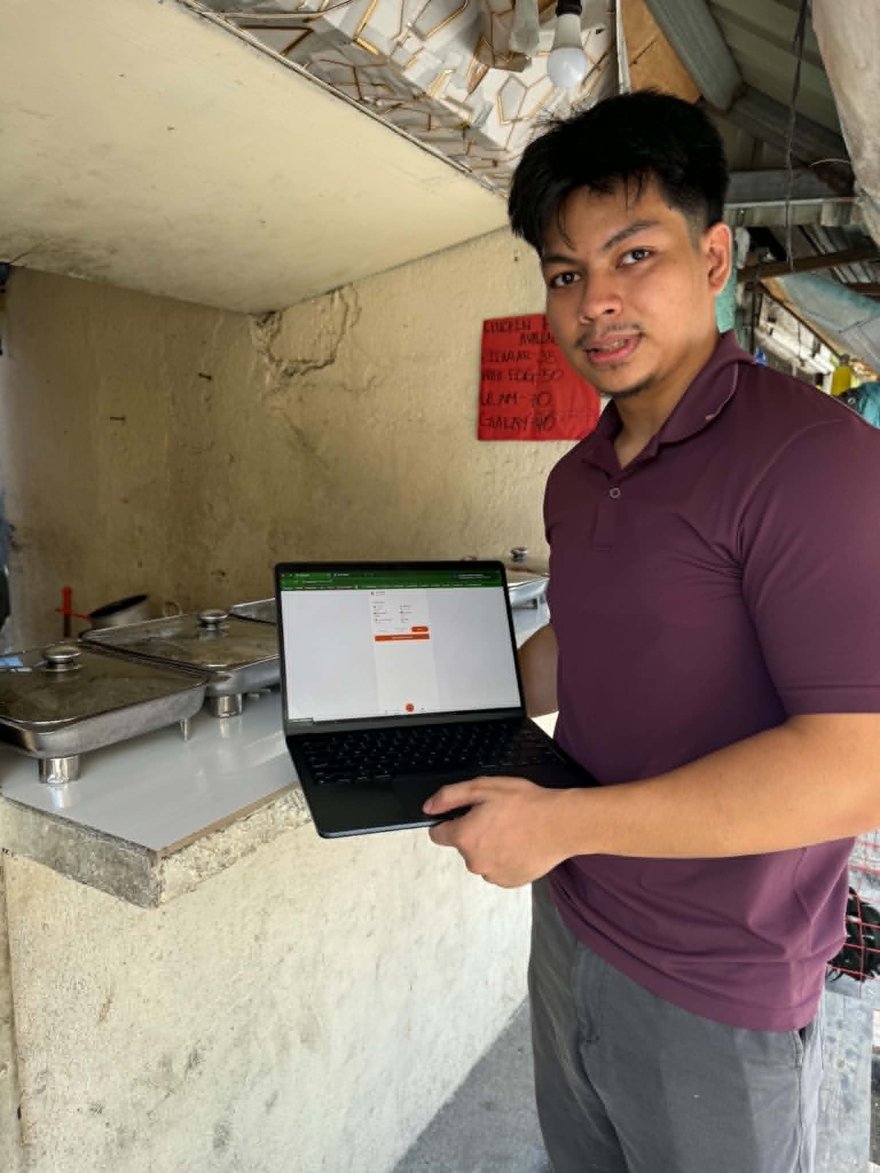
🍲
CarinderAI
Lutong bahay, smarter ops.
Built at a real
carinderia.
Paper lists → digital orders. Camera watches the counter.
Books that close themselves.
📍 Tested live at a real carinderia, NCR
Rovince Eduvane
Anthony Seumal

Slide 2
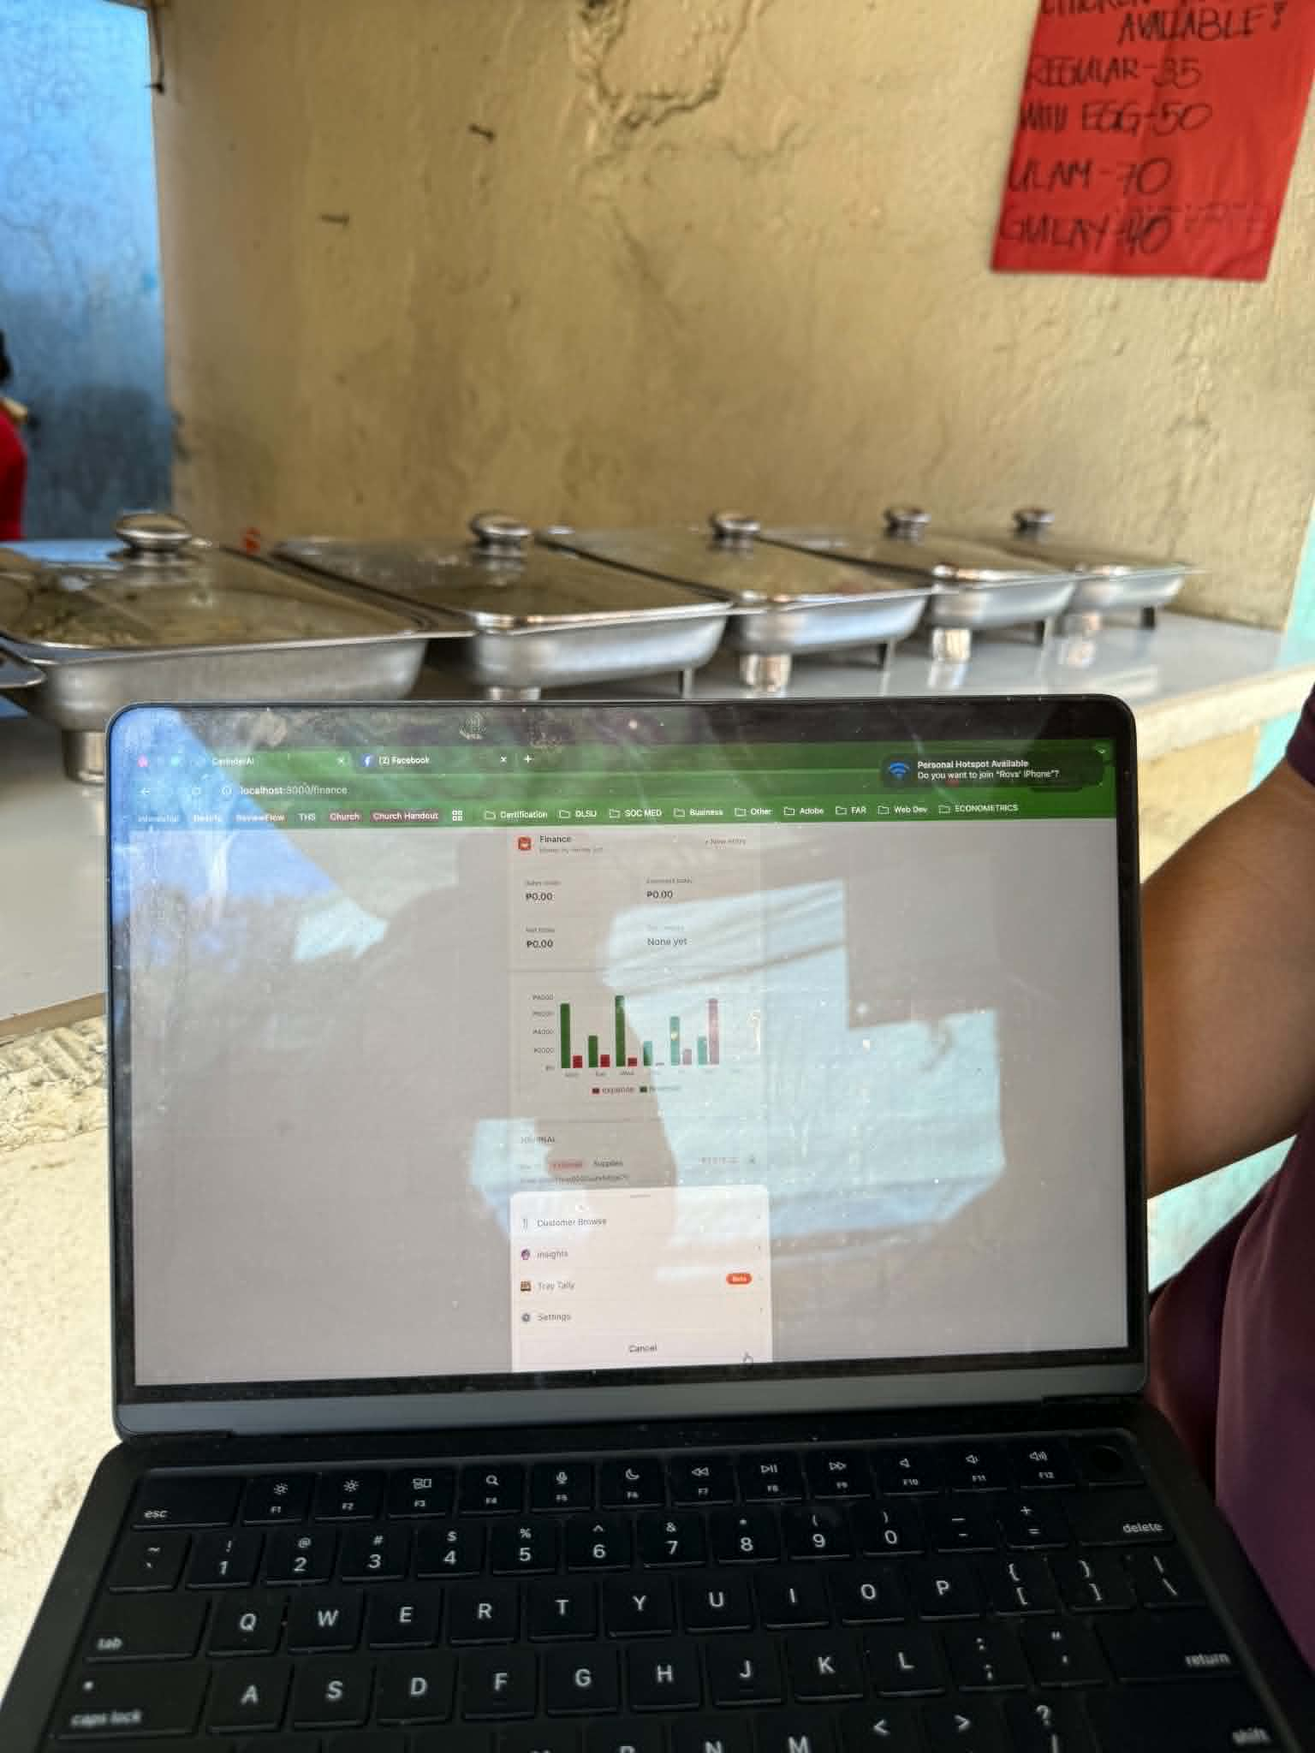
OUR STORY
Traditional eateries like carinderia or turo-turo have always been close to our hearts, yet they remain an industry that has been largely forgotten and ignored.
CarinderAI was born from a simple yet powerful desire to build a platform that empowers carinderia owners and uplift the lives of many Filipinos.
Rovince at a carinderia in Manila

Slide 3
THE PROBLEM
Owners work hard. The system works against them.
📝
🧮
📒
Paper lists
Mental math
No real books
Every purchase starts with a handwritten list that gets lost or misread. No supplier, no price, no stock visibility.
Sales are tallied by hand at the end of the day — hours after the last customer left. Errors compound silently.
"Finance" is a worn-out notebook. Owners can't see which dish is profitable, which supplier is fair, or which day is slow.

Slide 4
THE SOLUTION
Three pillars. One phone.
01
📷
02
📊
03
📹
OCR Logistics
Accounting
Camera POS
Snap handwritten palengke lists. AI reads items, quantities & units, matches to 6 suppliers (28+ Filipino staples), auto-journals as EXPENSE.
Every order auto-creates a double-entry journal. 7-day revenue/expense chart. Edit, delete, log sales — all with Filipino microcopy.
Point camera at a food tray → GPT-4o identifies dishes → auto-tallies receipt. Counter Session watches dishes disappear continuously.

Slide 5
HERO #1 — OCR LIST SCANNING
Paper list → digital supplier order.
📝 Handwritten palengke list
Extracted items
Chicken 5 kg
8 of 8 matched · 5–8 sec
Rice 25 kg
Chicken · 5 kg
Manok
₱1,250
Eggs 3 trays
Rice · 25 kg
Bigas
₱1,375
Cooking oil 2 liters
Eggs · 3 trays
Itlog
₱720
→
Garlic 1 kg
Cooking oil · 2 L
Mantika
₱190
Onion 2 kg
Garlic · 1 kg
Bawang
₱180
Onion · 2 kg
Sibuyas
₱240
Tomato 2 kg
Tomato · 2 kg
Kamatis
₱160
Pork 4 kg
Pork · 4 kg
Baboy
₱1,440
Total to suppliers
₱5,555.00

Slide 6
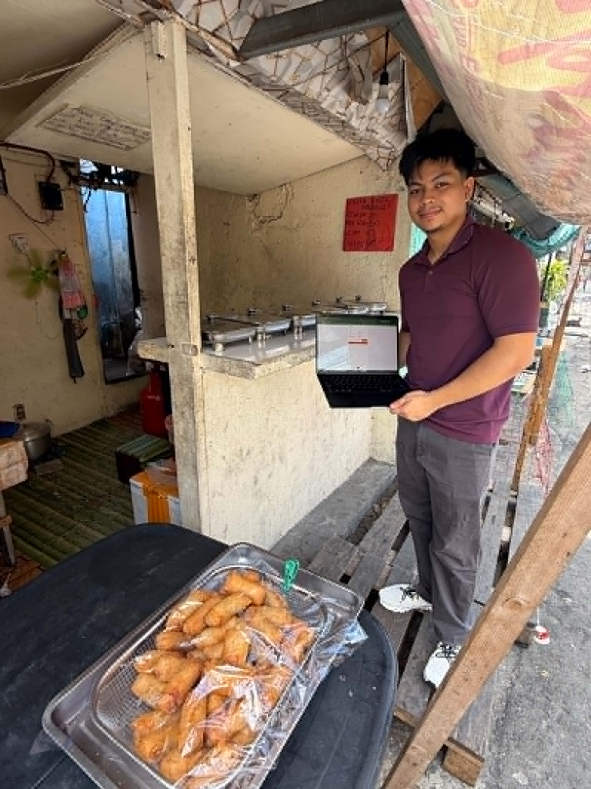
HERO #2 — CAMERA POS
Tray Tally: see a dish, record a sale.
1
2
3
Capture
Recognize
Record
Single-shot or Counter Session mode
GPT-4o identifies 6 menu dishes
Receipt + JournalEntry written
Counter Session Mode: Baseline on frame 1 → diff-based detection every 8s → 3-frame confirmation threshold → sale recorded when count drops.
Finance tab — auto-journaled at the carinderia

Slide 7
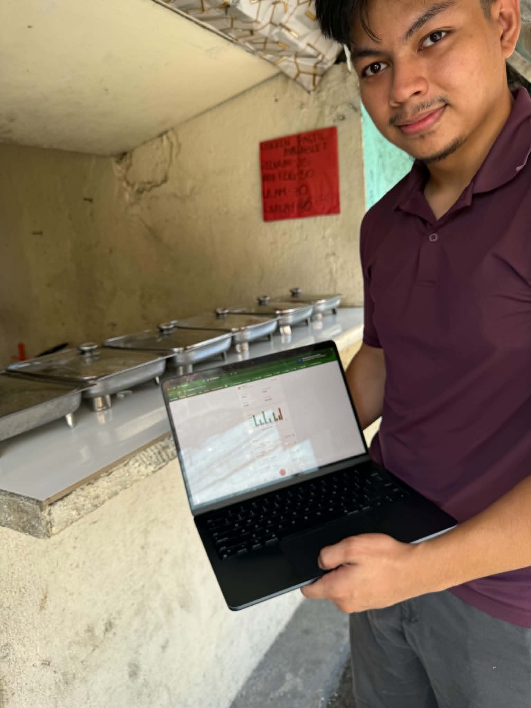
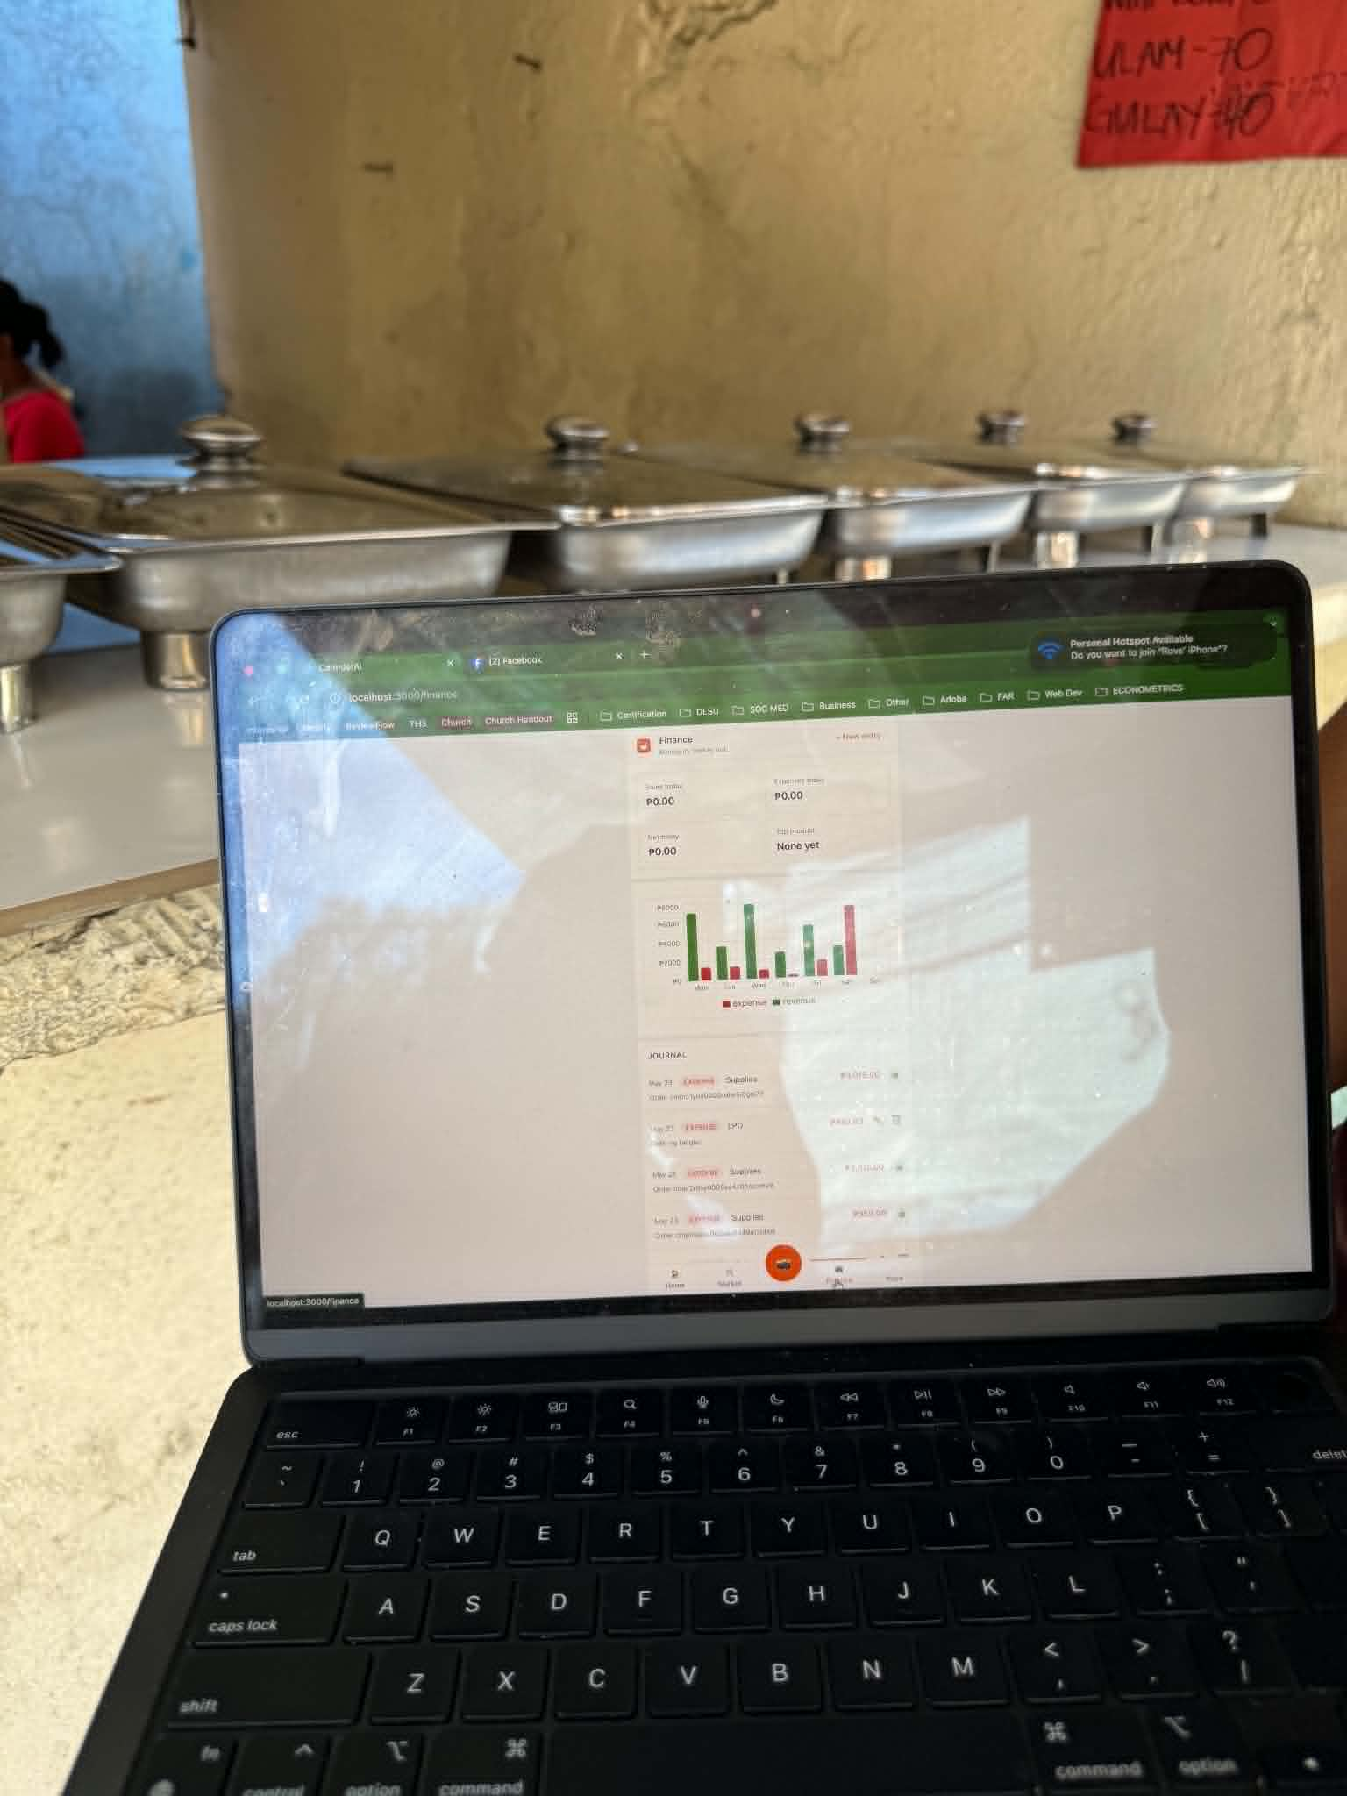
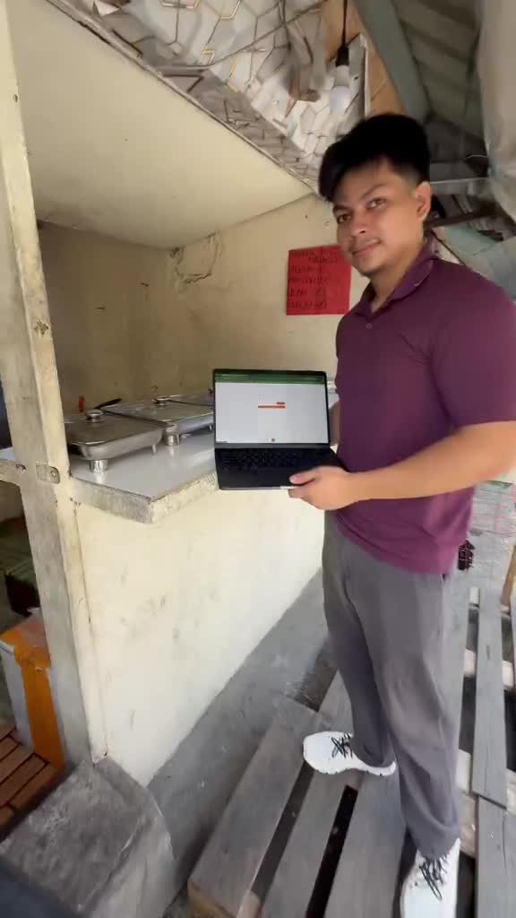
FIELD PROOF
We didn't just code it. We took it to a carinderia.
Demo at a live carinderia
More menu — 7 features accessible
Showing the app in the field

Slide 8
THE APP
Seven tabs. One ledger. Every action logged.
🏠 Home
🛒 Market
📊 Finance
📹 Tray Tally
🏠
🛒
⬤
📊
☰
🏠
🛒
⬤
📊
☰
🏠
🛒
⬤
📊
☰
🏠
🛒
⬤
📊
☰
KPIs + quick
action buttons
Suppliers + nearby
vendors by distance
7-day chart +
auto-journaled entries
Camera POS +
Counter Session

Slide 9
UNDER THE HOOD
Real engineering. Real data. No smoke.
Next.js 14 PWA
Prisma + SQLite
App Router, TypeScript, Tailwind
7 models, transactional writes
GPT-4o Vision
Zustand + react-hot-toast
OCR + dish recognition, JSON-constrained
Cart state, toast notifications
Fuse.js
Recharts
Fuzzy product matching at 0.4 threshold
7-day revenue/expense bar chart
REAL: OCR · Logistics cart+checkout · Journal entries · CV Tray Tally · External merchants · Customer search MOCKED: Predictions (hardcoded)

Slide 10
THE PROCESS
Built spec-first with Kiro in under 48 hours.
01
02
03
04
Requirements
Design
Tasks
Execute
21 EARS-format requirements in requirements.md with explicit acceptance criteria per feature.
Full tech design in design.md — Prisma schema, API contracts, Fuse.js config, seed plan.
37 leaf tasks in tasks.md ordered by tier — Foundation → Logistics → Accounting → OCR → UI.
Batched execution, one phase at a time. Kiro ran self-audits and in-process smoke tests per task.
~12 credits
~42 credits
~10 credits
~540 credits

Slide 11
ROADMAP
Where CarinderAI goes next.
SHIPPED
Phase 1
NEXT
Phase 2
VISION
Phase 3
Camera-first Operations
Edge ML + Real Orders
Full Auto POS
→ OCR palengke list → supplier order
→ Fine-tuned YOLOv8 for Filipino dishes
→ HRNet/RTMPose pose estimation
→ Tray Tally single-shot + Counter Session
→ Faster, cheaper, offline-capable
→ DeepSORT customer re-identification
→ Auto-journal every transaction
→ Real supplier ordering + delivery tracking
→ Hand-object interaction detection
→ External merchants nearby map
→ Merchant marketplace with live inventory
→ Zero-touch checkout from food counter
→ Customer food discovery search
→ Mobile app (iOS + Android)
→ Same architecture as Mashgin ($62M)

Slide 12
THE MARKET
An underserved market hiding in plain sight.
150K+
₱45B
~0%
2 hrs
Carinderia
owners in PH
Estimated
annual GMV
Digital
Penetration
Lost daily to
paper admin
MSMEs, mostly informal
Largely uncaptured
vs Grab/Foodpanda
= ₱500+ in lost time
* Estimates based on MSME development reports and field research. Carinderia count and GMV are working estimates.

Slide 13
Built for owners who still use paper lists, but deserve better tools.
CarinderAI — Lutong bahay, smarter ops.
Salamat! 🙏
Rovince Eduvane
Anthony Seumal

