Slide 1
Scrum Cycle 05: Working in Python or R
Code Crusaders

Slide 2
R Markdown
This is an R Markdown presentation. Markdown is a simple formatting syntax for authoring HTML, PDF, and MS Word documents. For more details on using R Markdown see http://rmarkdown.rstudio.com.
When you click the Knit button a document will be generated that includes both content as well as the output of any embedded R code chunks within the document.

Slide 3
Slide with Bullets
  Bullet 1
  Bullet 2
  Bullet 3

Slide 4
Slide with R Output
 | RefNum | age | job | marital | education | housing
 | Min. :10026141 | Min. :20.00 | blue-collar:387 | divorced:141 | primary :256 | no : 106
 | 1st Qu.:10026426 | 1st Qu.:37.00 | management :154 | married :778 | secondary:648 | yes :1032
 | Median :10026712 | Median :44.00 | technician :153 | single :223 | tertiary :191 | NA’s: 4
 | Mean :10026712 | Mean :43.47 | admin. :149 | NA | NA’s : 47 | NA
 | 3rd Qu.:10026997 | 3rd Qu.:50.00 | services :115 | NA | NA | NA
 | Max. :10027282 | Max. :61.00 | (Other) :179 | NA | NA | NA
 | NA | NA | NA’s : 5 | NA | NA | NA

Slide 5
Summary Cont’d
 | loan | contact | day | month | duration | deposit | balance
 | no :999 | ?? : 2 | Min. : 1.00 | december: 96 | Min. : 5.0 | Min. : 0 | Min. : -252000
 | yes:143 | 123 : 1 | 1st Qu.: 7.00 | january : 96 | 1st Qu.: 124.0 | 1st Qu.: 7421 | 1st Qu.: 19845
 | NA | NA’s:1139 | Median :15.00 | april : 95 | Median : 211.0 | Median : 28460 | Median : 106470
 | NA | NA | Mean :15.22 | august : 95 | Mean : 280.1 | Mean : 48550 | Mean : 252639
 | NA | NA | 3rd Qu.:23.00 | february: 95 | 3rd Qu.: 342.5 | 3rd Qu.: 66299 | 3rd Qu.: 278505
 | NA | NA | Max. :30.00 | july : 95 | Max. :2241.0 | Max. :611885 | Max. :10229580
 | NA | NA | NA | (Other) :570 | NA | NA’s :116 | NA

Slide 6
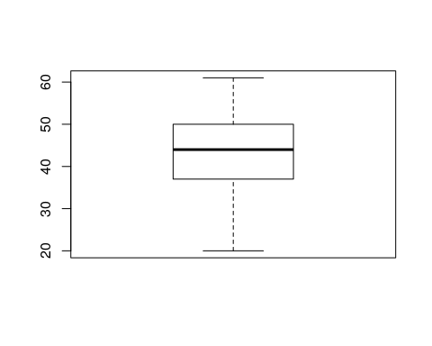
Box Plot of Age feature

