Slide 1
They Say · GroundTruth
Every claim has a citation trail. We trace it to the ground truth.
Graph database + LLM pipeline that tracks how scientific claims mutate as they spread —
and finds the papers that unknowingly keep them alive.
rowan121.github.io/they-say · github.com/Rowan121/they-say

Slide 2
THE PROBLEM
"Common knowledge" is often not true —
and nobody checks the citation trail
• Claims harden into “common knowledge” through repetition, not verification.
• By the time a claim is on every blog, the original paper is buried — and often never said it.
• Each new citation makes the claim look more established than it is.
• The people best positioned to catch it — the authors citing it — can’t see how the claim evolved over time.
• Today there is no tool that answers: “what did the source actually find, and when did the claim drift?”

Slide 3
CASE STUDY · THE HUMMINGBIRD 1:4 RULE
“Hummingbirds need 1 part sugar to 4 parts water.”
Everyone knows it. Every feeder site repeats it. So we traced every citation back.
• 20 documents tracked: blogs, magazines, government pages, and the underlying science.
• The papers everyone cites for 1:4 never prescribed it — a 2008 field study got misread, and the misreading went viral.
• Audubon, Cornell, the Smithsonian: all repeat 1:4, none cite the actual sucrose-preference research.
• Blem et al. 2000 found hummingbirds prefer ~50% sucrose — and sits alone, essentially uncited.
• Result: a “rule of nature” that was never made by anyone. It mutated into existence.

Slide 4
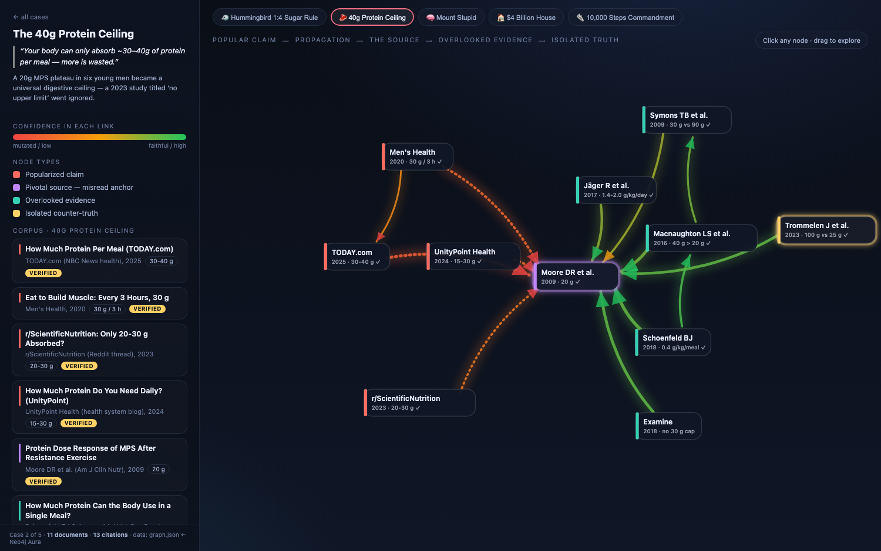
THE EVIDENCE
One claim, traced end to end
Live interactive graph — every node links to its real source.
• Red (left): popularized claims
• Center: the misread anchor paper
• Right: overlooked evidence
• Far right: the isolated counter-truth, uncited
• Edge color = how faithful the citation is

Slide 5
HOW IT WORKS
Graph database + LLM claim extraction
1 · Ingest
2 · Store
3 · Track time
4 · Update
Chunk papers, posts & pages. An LLM splits each chunk into verifiable claim triples (subject–predicate–object), tagged with source and date.
Claims, authors, publications = nodes. cites / supports / refutes = edges, in a graph DB (Neo4j/ArangoDB) + vector store for semantic search.
Every claim carries valid_from / valid_until. New evidence can flag an old claim as superseded — “what was consensus in 2010 vs today?”
New documents flow through the same pipeline continuously. No manual curation.
Hybrid retrieval: vector similarity finds the claims, graph traversal shows the evidence chain.

Slide 6
IT'S NOT ONE BAD APPLE
Five “facts,” same pattern
Claim everyone repeats | What the source actually said
Hummingbird sugar water must be 1:4 (~20%) | Cited papers never prescribed it; real preference data says ~50% — uncited
You absorb only ~40g protein per meal | A 20g plateau in six young men; later work found no upper limit
Dunning-Kruger: least skilled are most overconfident | Four small studies + an internet-fabricated curve; random noise reproduces it
World's most expensive house: $4 billion | A compounded projection; no $4B transaction has ever existed
You need 10,000 steps a day | A 1965 pedometer brand's product name; benefits plateau far lower
If five household “facts” collapse under tracing, the market is every claim on the internet.

Slide 7
THE PRODUCT
GroundTruth: a claim tracker for your field
• Upload a corpus — a field's key papers, your own bibliography, a literature review.
• Get back every claim, its origin, who mutated it, and who refuted it — as a time-aware graph.
• Authors see the ground truth behind claims they cite before they publish.
• Journals & platforms could check citations at review time instead of after.
• Built on open-source graph + LLM stack — no black box, reproducible end to end.

Slide 8
TARGET USERS · THE GO-TO-MARKET
The tool finds its own customers
Every paper that cites a mutated claim is a self-identifying lead.
• The pipeline already surfaces dozens of papers supporting false claims — because the authors can't see how the claim evolved.
• Each one is a warm lead: an author who will discover GroundTruth by discovering their own citation is wrong.
• Outreach writes itself: “your paper cites X — here is what the source actually found, and when the claim drifted.”
• Same engine serves researchers, fact-checkers, journals, and eventually search/AI answer engines that need claim provenance.
Finding users is not the hard part. The hard part is the one we already built.

Slide 9
UNDER THE HOOD
Working prototype, not a mockup
// graph schema (backend/schema.cypher)
(:CaseStudy)-[:HAS_DOCUMENT]->(:Document
{case_id, stance, authors, year, url})
(:Document)-[:CITES {strength, confidence,
kind}]->(:Document)
(:Document)-[:CONTAINS_CLAIM]->(:Claim
{text, semantic_type, ratio_value, valid_from})
# ingestion: LLM chunks -> claims -> Aura (import_backend.py)
# case builder merges curated JSON -> graph.json (build_cases.py)
# frontend: D3 force graph, one node per source
• Live demo + full source public on GitHub.
• Neo4j Aura graph: 5 cases, 63 documents, 71 scored citation edges.
• GraphRAG layer: 840 LLM-extracted claims from source PDFs.
• Next: open-source pipeline (proposal in this folder).

Slide 10
Claim provenance is a missing layer of the internet.
We can already show a “rule of nature” that no one ever made.
The product turns that into ground truth for every claim, in every field.
In this folder: pitch deck · system architecture report · hummingbird trace report · source code
rowan121.github.io/they-say · github.com/Rowan121/they-say

