Slide 1
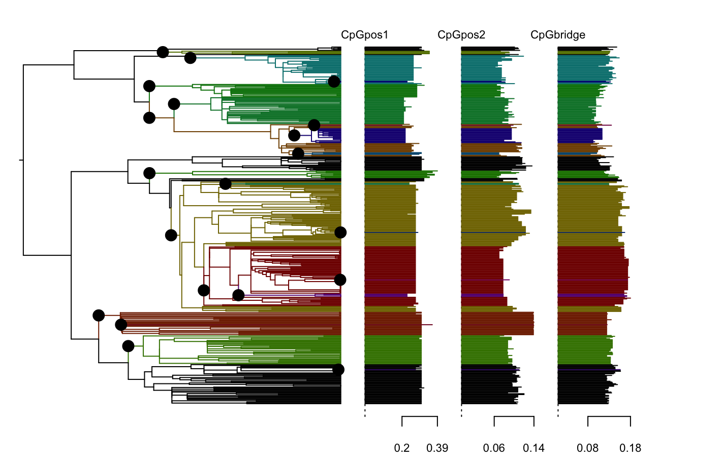
RAC-SK SCSK
Bat EF-E2
Bat LC
Bat TB1
Bat DR
Arctic A
Cosmo AM2a
Cosmo AF1b
Asian SEA2a
Asian SEA2b
Asian SEA2a

