Slide 1
Bat LC
RAC-SK SCSC
Bat EF-E2
Bat TB1
Bat DR
Cosmo AM2a
Cosmo AF1b
Asian SEA2a
Asian SEA2b
Asian SEA2a

Slide 2
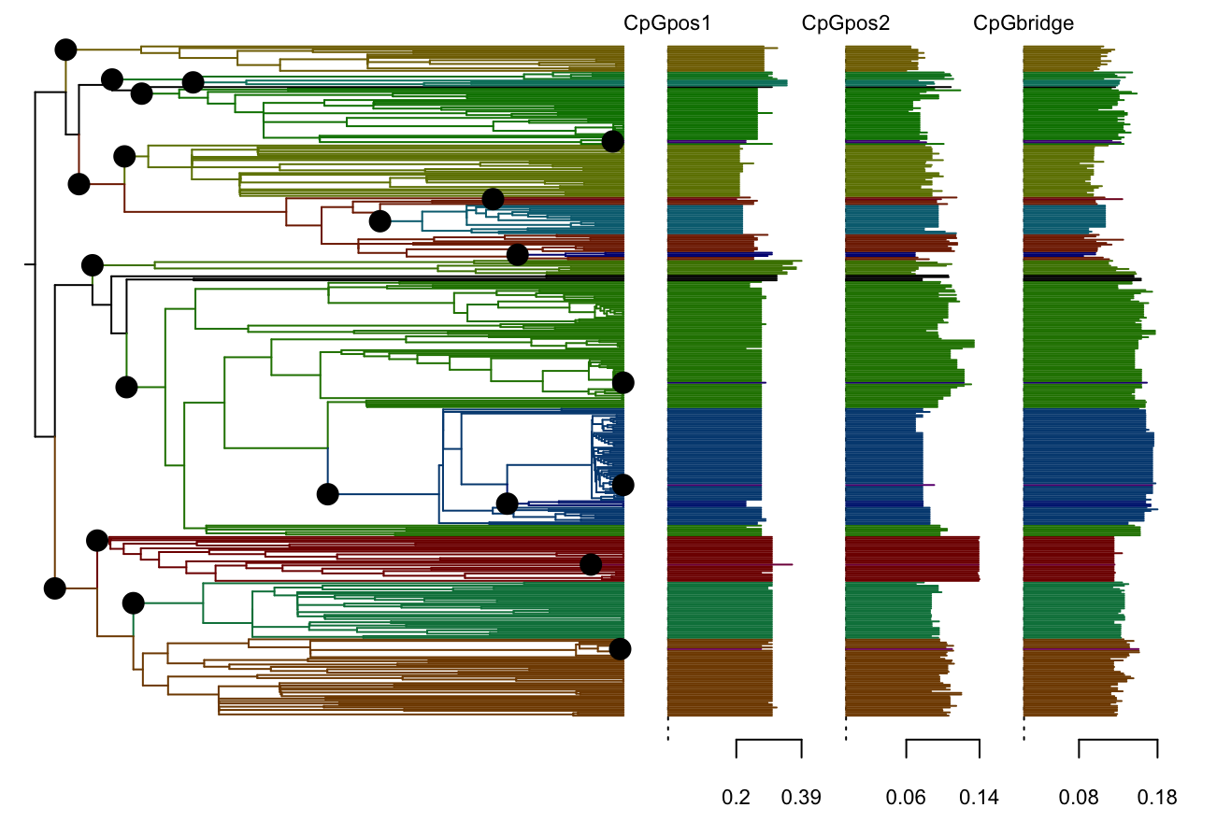
Bat LC
RAC-SK SCSK
Bat EF-E2
Bat TB1
Bat DR
Cosmo AM2a
Cosmo AF1b
Asian SEA2a
Asian SEA2b
Asian SEA2a

