Slide 1
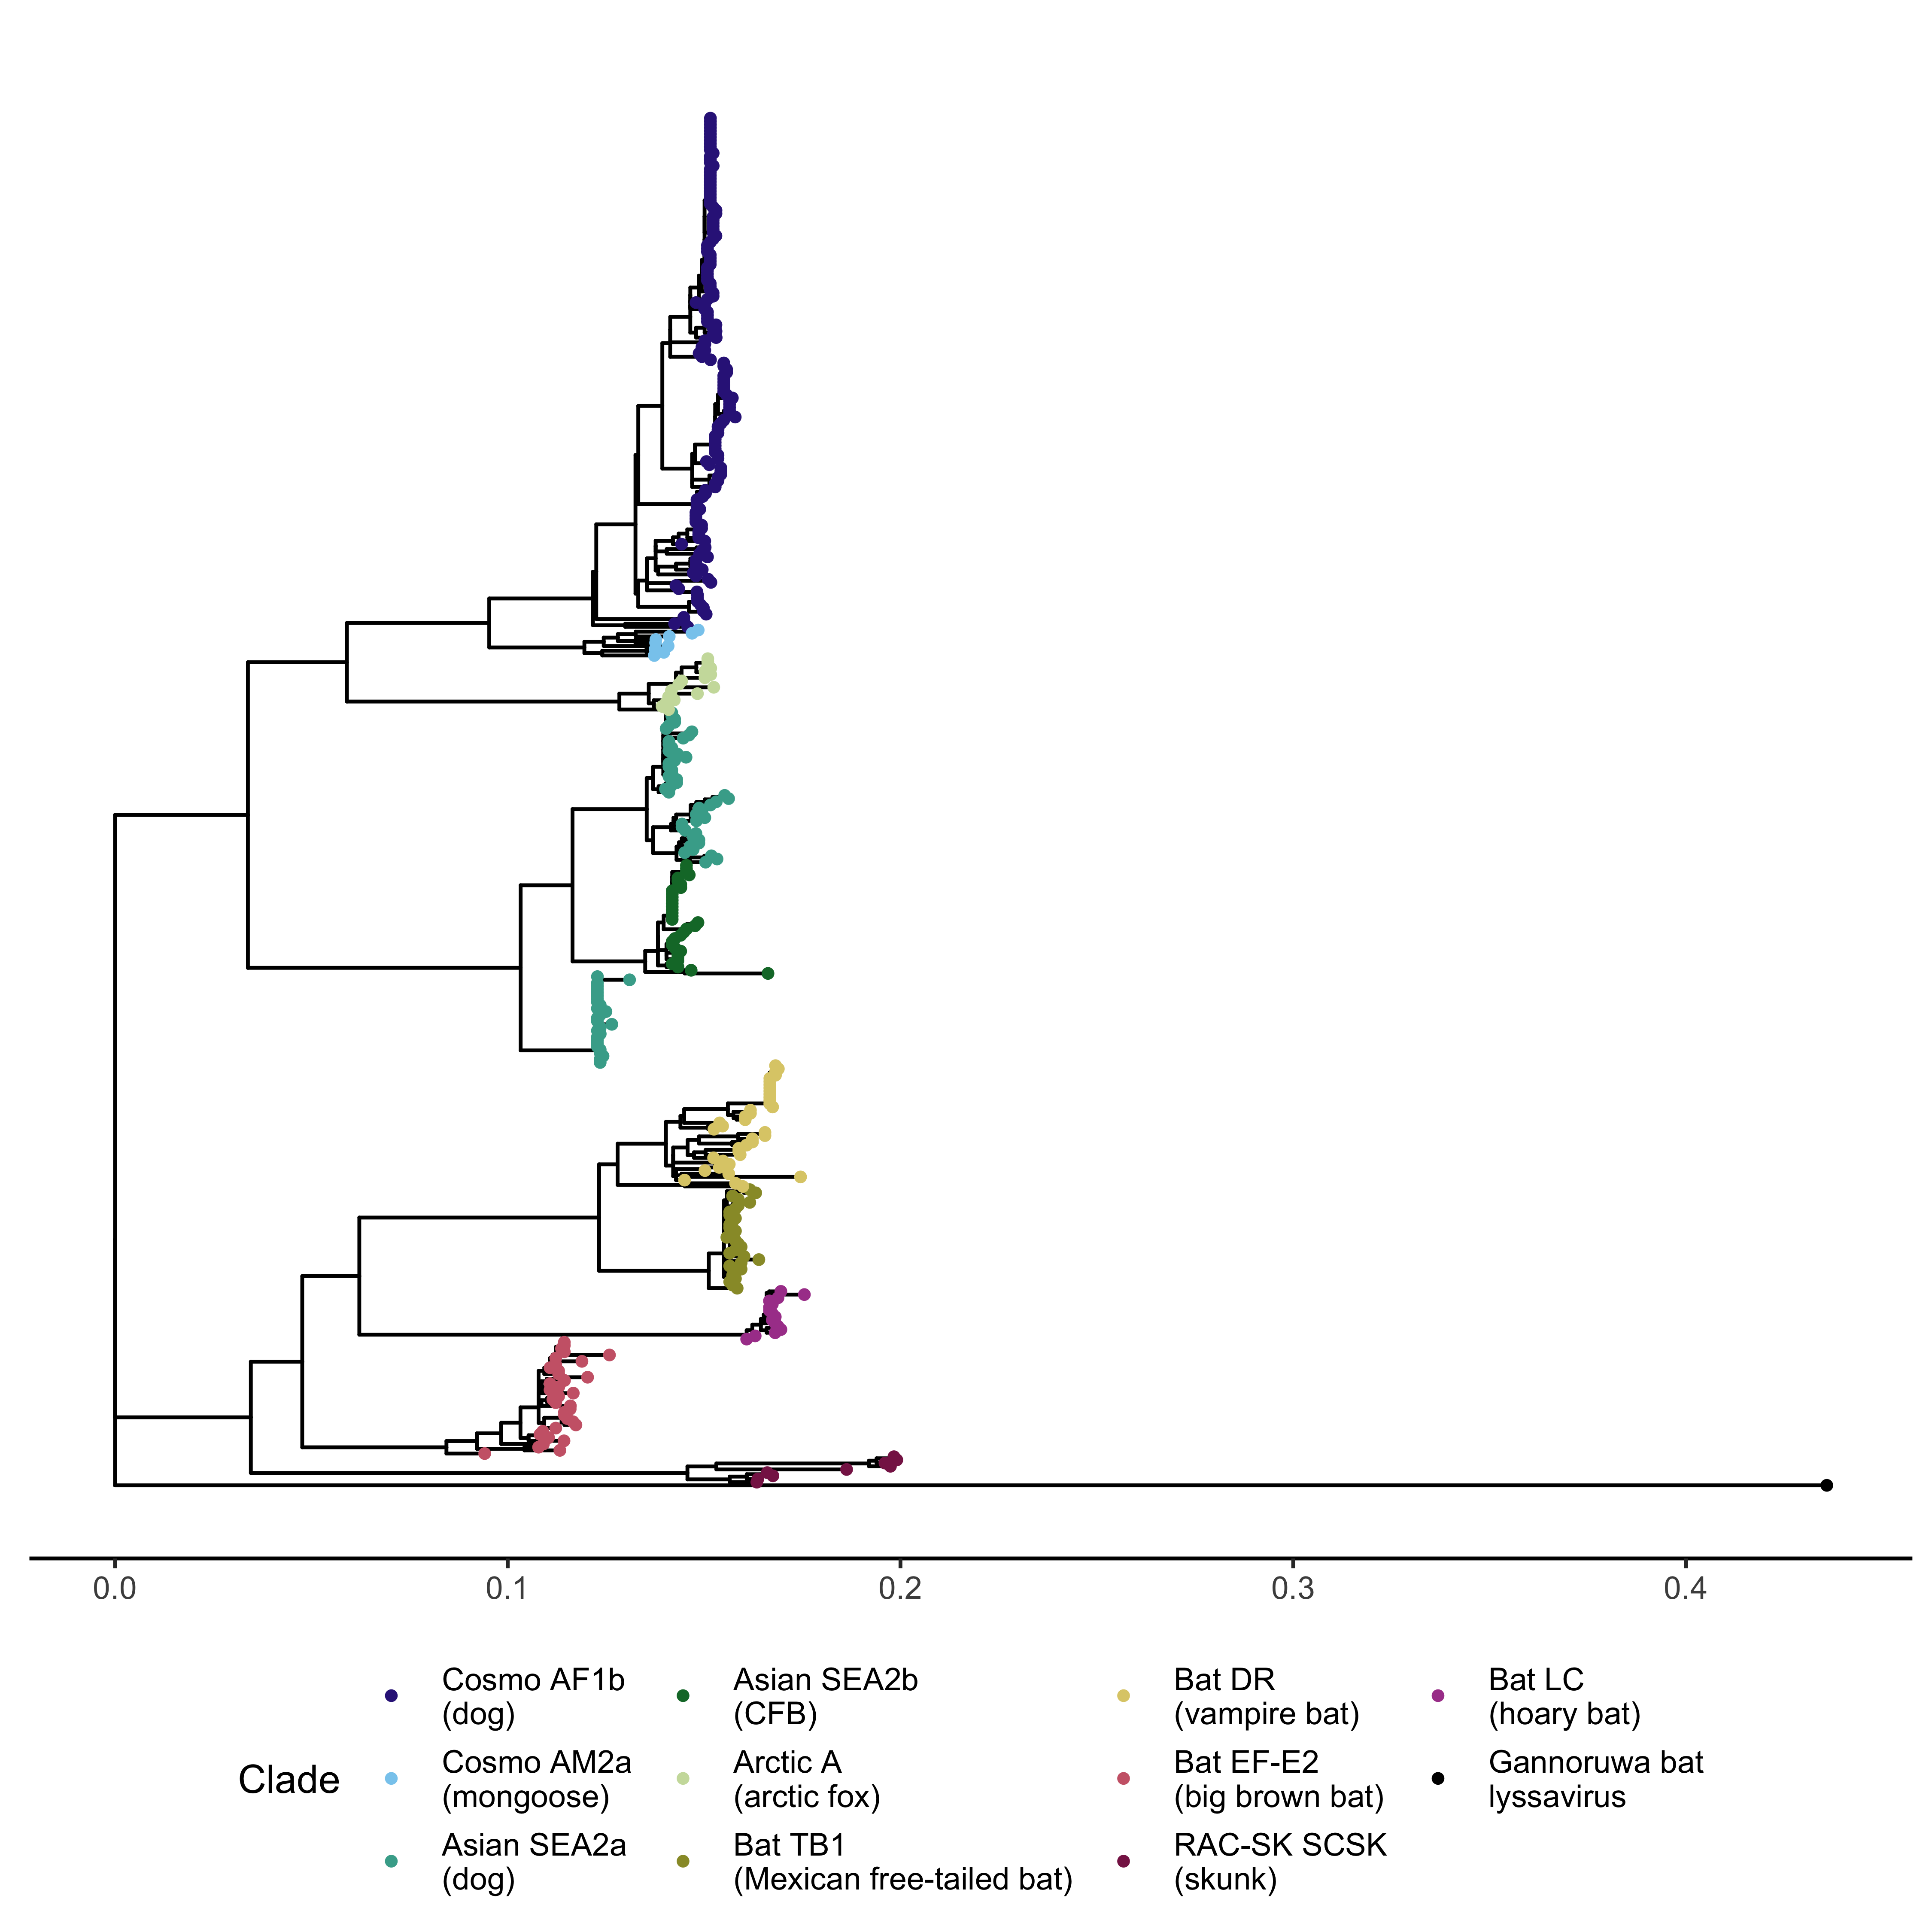
Cosmopolitan AF1b
Cosmopolitan AM2a
Arctic A
Asian SEA2a
Asian SEA2b
Asian SEA2a
Bat DR
Bat TB1
Bat LC
Bat EF-E2
RAC-SK SCSK
NC_031988

