Slide 1
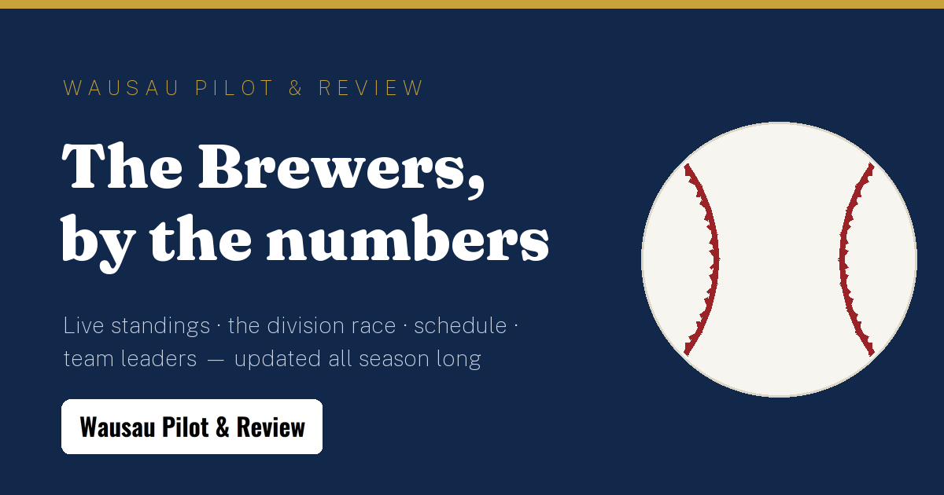
WAUSAU PILOT & REVIEW · SPONSORSHIP KIT
The Brewers,
by the numbers
A live, season-long Milwaukee Brewers stats experience inside Wisconsin's most local news brand — with your name on it.
wausaupilotandreview.com · sales@wausaupilotandreview.com

Slide 2
THE OPPORTUNITY
Seven months of reasons to come back
162
60s
7
0
games a season — a daily content engine from April to October
data refresh — scores, standings and leaders are always live
sellable sponsor surfaces on one page
cookies — no consent banner between a reader and your brand
Wisconsin pride, hyperlocal trust
Editorial quality, not ad clutter
Wausau Pilot & Review is where central Wisconsin looks first for news — and the Brewers are the state's shared summer obsession. This page puts your brand inside that habit, not beside it.
One designed page — no programmatic ads, no pop-ups. Sponsor lockups are part of the page's design language, so your brand reads as the patron of the coverage, the way print sponsorship used to work.

Slide 3








THE PRODUCT
What readers get, all season
Live game hero
Standings + form
Score, bases, win probability and latest plays, refreshed every 45 seconds
NL Central with last-10 form strips and run differential
The division race
Schedule + box scores
Games-back chart of the whole season, day by day
Two weeks of games; every final opens a full box score
First-pitch forecast
This day in history
Ballpark weather for upcoming home games
A daily highlight from 55+ Brewers seasons
Milestone watch
Alerts + calendar
Players closing in on round numbers — a daily check-in hook
Game-time alerts and a one-click season calendar download

Slide 4
THE INVENTORY
Seven surfaces, sold like print
Masthead + Brewers banner
Title sponsorship
SOLD
Navy banner lockup + hero credit + calendar-event credit
TITLE SPONSOR LOCKUP
Live game hero · credit
First-pitch forecast
OPEN
“Presented by” credit on the hero's ballpark forecast
First-pitch forecast · credit
Division race section
Season pulse + standings
OPEN
Lockup beside the season-long race chart
Division race chart
Team leaders section
Schedule + box scores
OPEN
Lockup beside batting & pitching leaders
Where to watch · venue listing
Where to watch
OPEN
Team leaders section
A full venue listing: photo, amenities, game-day specials
Title slot shown for scale — section credits start small, and every slot is one config line to activate.
■ sold □ open □ editorial

Slide 5




DISTRIBUTION
Reach that compounds beyond the page
Lives in their calendar
The season-schedule download carries the title sponsor's credit into ~80 calendar events on readers' own phones
Installs like an app
Add-to-home-screen and opt-in game-time alerts pull fans back every game day
Spreads on social
One-tap share plus a branded card preview wherever links land — Facebook, texts, group chats
The share card readers post — every share is a branded impression.
Renews itself daily
Live games, This Day in history and milestone watch give readers a new reason to return every day

Slide 6




ACCOUNTABILITY
Measured, not promised
Privacy-first analytics
Plausible — cookieless, GDPR-clean, no consent banner. Page views are your impressions.
YOUR SLOT · MONTHLY REPORT
12,400
Click-throughs per slot
Every sponsor click is tagged with its placement, so you see exactly which surface works
sponsored impressions
318
Your own live dashboard
click-throughs to your site
A public link to your numbers — check impressions and clicks any day of the season
Illustrative figures
UTM-tagged traffic
Visits from the tracker arrive labeled in your own analytics, end to end

Slide 7
NEXT STEPS
Put your brand in the box score.
Packages run from a single-section credit to title sponsorship of the page. Slots activate the same day they're sold, and your live dashboard link comes with the first invoice.
sales@wausaupilotandreview.com
715-301-5539 · 602 Ruder St., Wausau, WI 54403
Wausau Pilot & Review — Where Locals Look First For News

