Slide 1
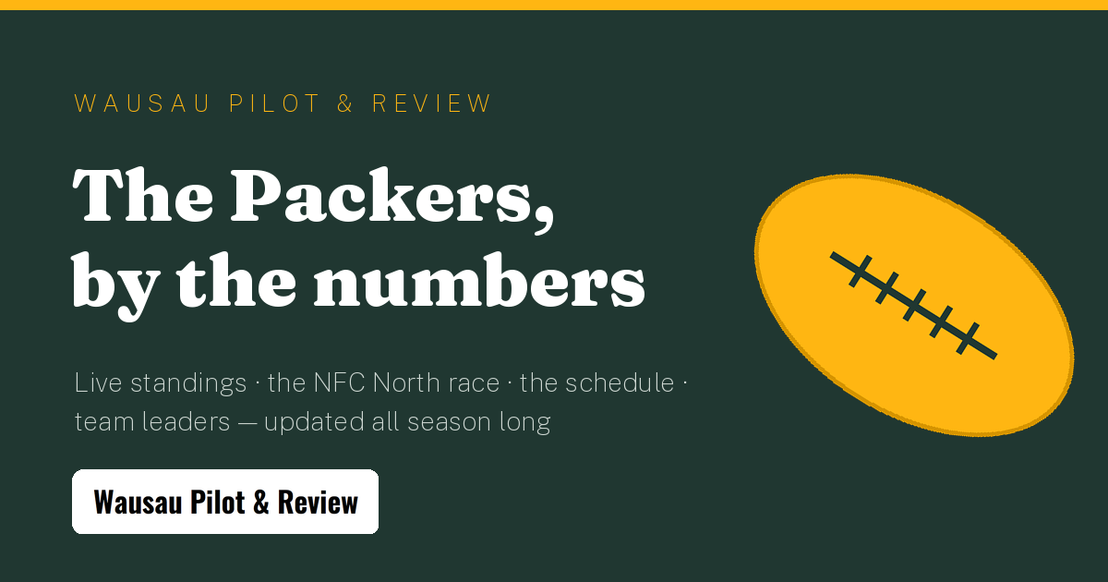
WAUSAU PILOT & REVIEW · SPONSORSHIP KIT
The Packers,
by the numbers
A live, season-long Green Bay Packers stats experience inside Wisconsin's most local news brand — with your name on it.
wausaupilotandreview.com · weber.chris@wausaupilotandreview.com

Slide 2
THE OPPORTUNITY
Wisconsin's biggest weekly audience
7 days
30s
5
0
of anticipation around every game — countdown, injuries, matchup, film room
data refresh — score, situation and win probability are always live
sponsor slots on one page, from a section credit to the title
cookies — no consent banner between a reader and your brand
Green and gold is the state religion
Editorial quality, not ad clutter
Wausau Pilot & Review is where central Wisconsin looks first for news — and no team owns this state's attention like the Packers. This page puts your brand inside that Sunday habit, not beside it.
One designed page — no programmatic ads, no pop-ups. Sponsor lockups are part of the page's design language, so your brand reads as the patron of the coverage, the way print sponsorship used to work.

Slide 3








THE PRODUCT
What readers get, all season
Live game hero
Standings + the race
Score, down & distance, win probability and latest plays, refreshed every 30 seconds
NFC North with form strips, and the division race charted week by week
Playoff odds
The full schedule
A 4,000-simulation forecast of the January picture, run right in the browser
All 18 weeks with kickoff, TV and venue; every final opens a box score
Lambeau forecast
The film room
Kickoff weather for home games — half the story of December football
Every game replayed: win-probability chart, scoring plays, 20+ yard chunk plays
Leaders + player cards
Alerts + calendar
Offense and defense leaders with NFL rank chips; tap any player for their card
Kickoff alerts and a one-click season calendar download

Slide 4
THE INVENTORY
Five slots, sold like print
Masthead + Packers banner
Title sponsorship — the flagship
OPEN
Banner lockup + hero credit + email digest logo
TITLE SPONSOR LOCKUP
Live game hero · credit
Lambeau kickoff forecast
OPEN
“Presented by” credit on the hero's weather line
Lambeau forecast · credit
Division race section
Season pulse + standings
OPEN
Lockup beside the season-long NFC North race chart
Division race chart
Leaders section
Schedule + box scores
OPEN
Lockup beside the offense & defense leader boards
Game-day guide · venue listings
Game-day guide
OPEN
Leaders + film room
Venue listings sold per listing: photos, amenity chips, game-day specials
Every slot is one config line to activate — and one link to preview: add ?demo to the page URL and your prospect sees their placement filled, live.
■ title package □ open slots □ editorial

Slide 5
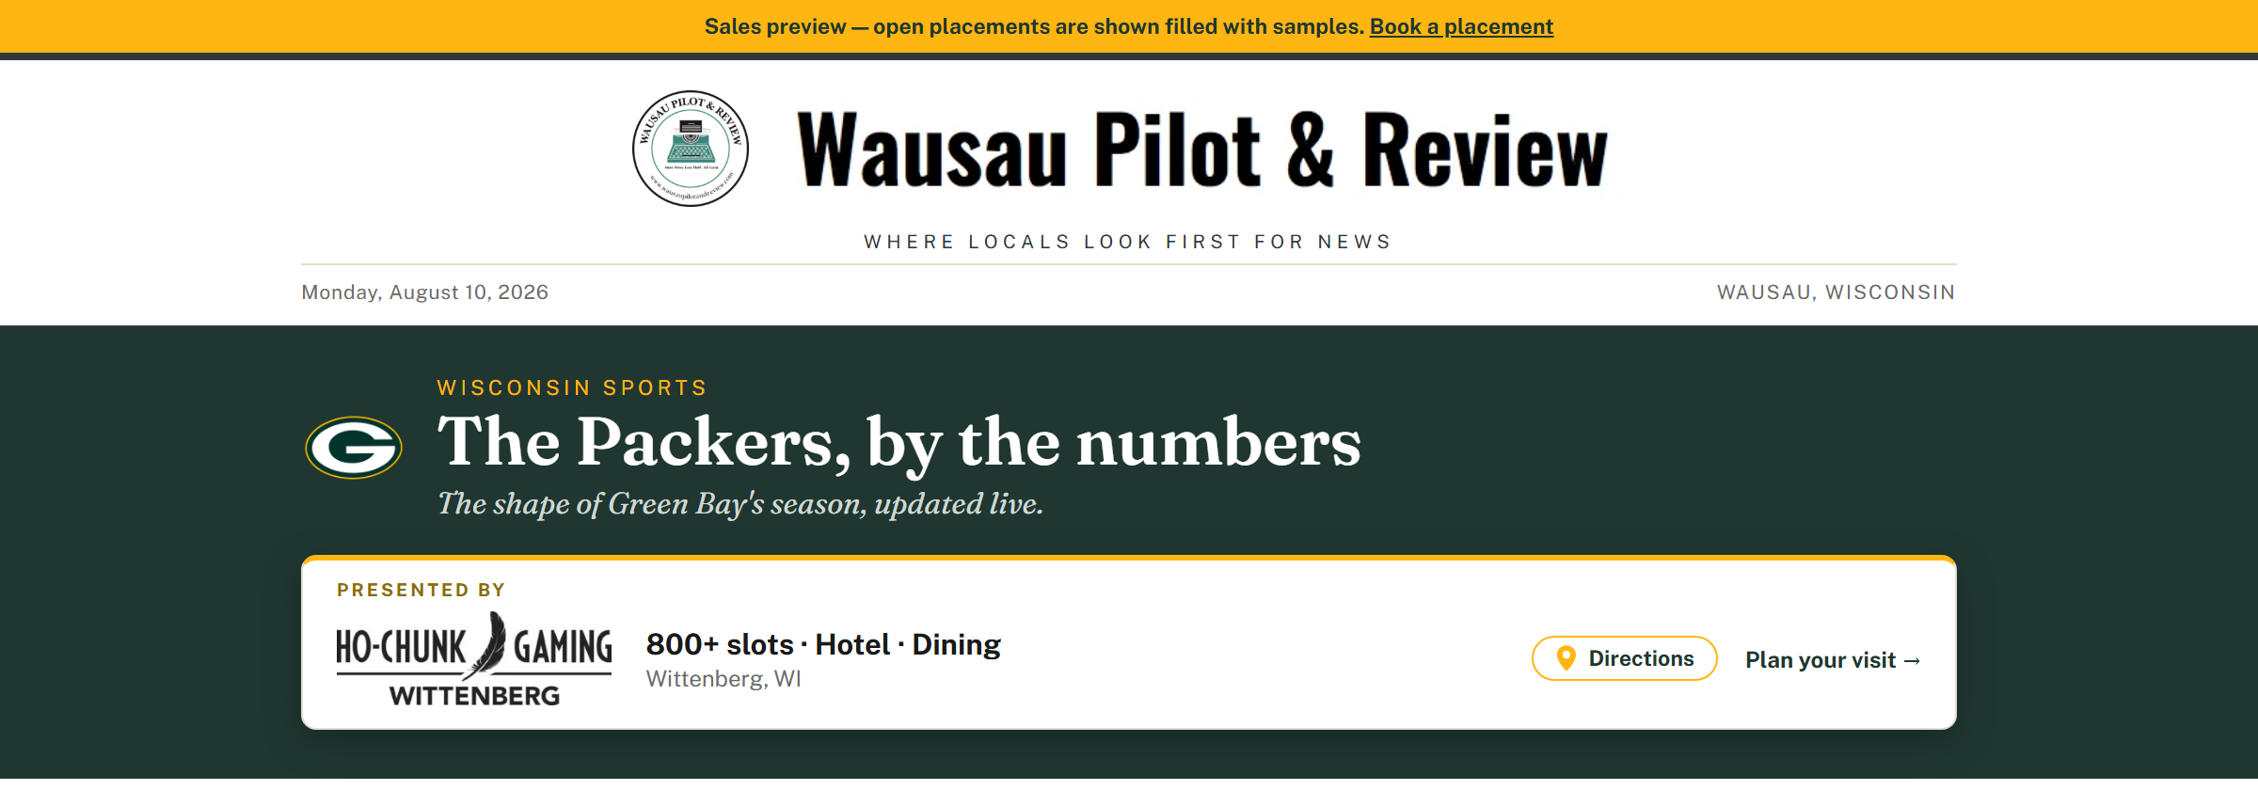
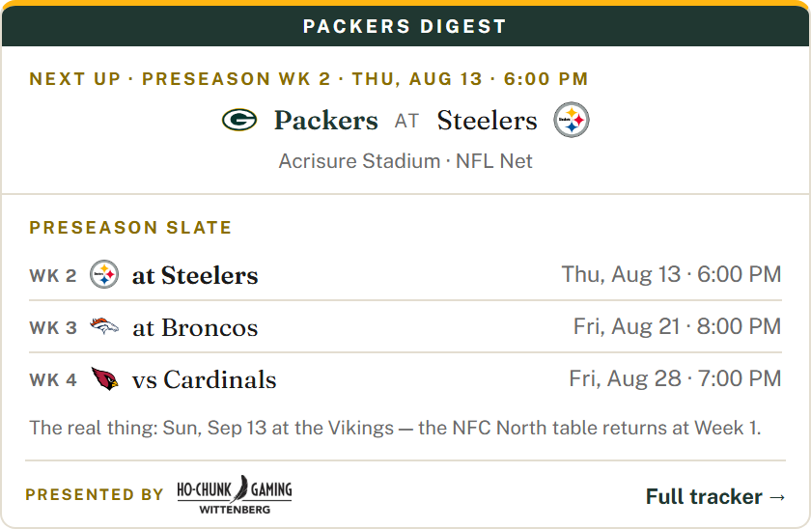
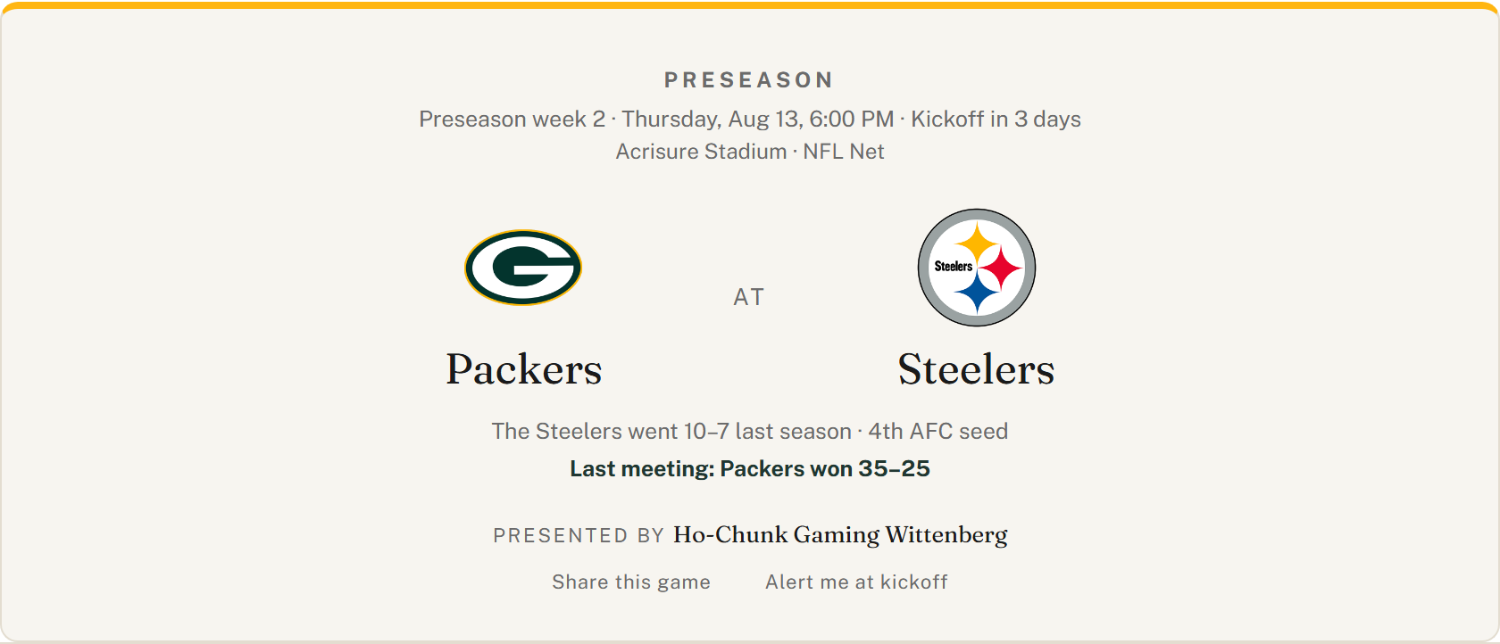
SEE IT LIVE
Your brand in place, on live data
Left: the title lockup + game hero in sales-demo mode (?demo). Right: the newsletter digest — your logo rides along twice a day.

Slide 6




DISTRIBUTION
Reach that compounds beyond the page
Lives in their calendar
The season-schedule download carries the title sponsor's credit into every kickoff on readers' own phones
Installs like an app
Add-to-home-screen and opt-in kickoff alerts pull fans back every game day
Spreads on social
One-tap share plus a branded card preview wherever links land — Facebook, texts, group chats
The share card readers post — every share is a branded impression.
Rides the newsletter
The digest is baked into a fresh image twice a day for email — your logo included, in every inbox

Slide 7




ACCOUNTABILITY
Measured, not promised
Privacy-first analytics
Plausible — cookieless, GDPR-clean, no consent banner. Page views are your impressions.
YOUR SLOT · MONTHLY REPORT
14,800
Click-throughs per slot
Every sponsor click is tagged with its placement, so you see exactly which surface works
sponsored impressions
360
Your own live dashboard
click-throughs to your site
A public link to your numbers — check impressions and clicks any day of the season
Illustrative figures
UTM-tagged traffic
Visits from the tracker arrive labeled in your own analytics, end to end

Slide 8
NEXT STEPS
Put your brand in the huddle.
Packages run from a single-section credit to title sponsorship of the page. Slots activate the same day they're sold — before Week 1 puts the whole state on this page — and your live dashboard link comes with the first invoice.
weber.chris@wausaupilotandreview.com
715-301-5539 · 602 Ruder St., Wausau, WI 54403
Wausau Pilot & Review — Where Locals Look First For News

