Slide 1
Detect Qualified Leads USE-CASE

Slide 2
CONTENT
1. The Problem
2. Data Dectionary
3. Products and operations
4. Data Summarization
5. Missing Values
6. Encoding Categorical Data
7. Emputing Missing Data
8. Remove Duplicates
9. Handle Outliers
10. Data Visualization
11 . Handling Unbalanced Data
12 . Next Steps

Slide 3

Problem
In Nawy we are initiating targeting campaigns on a daily basis to generate Real estate leads.
The main pain is generating qualified leads.So we need to build a model to classify the received
leads into two categories: low qualified and high qualified leads.

Slide 4
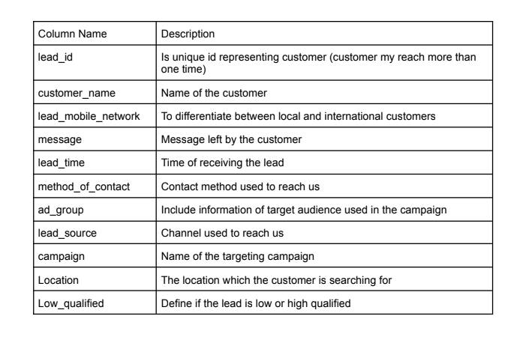
Data Dectionary

Slide 5
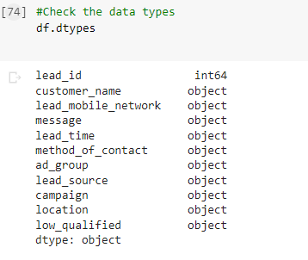
Data Types
It contains only categorical variables

Slide 6
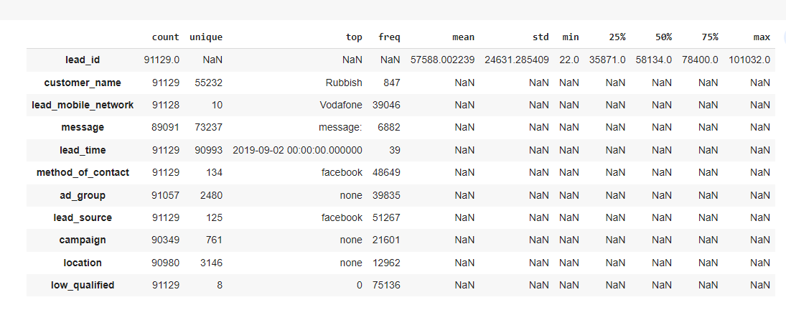
Data Summarization

Slide 7
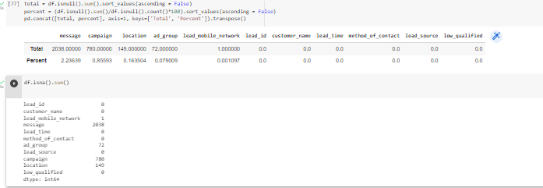
Missing Values
message , campaign , locaion ,ad_group , lead_mobile_network
contains missing values

Slide 8
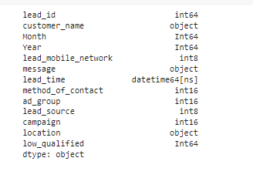
Encoding Categorical Vars
Label Encoding:
This approach is very simple and it involves converting each value in a column to a number.

Slide 9
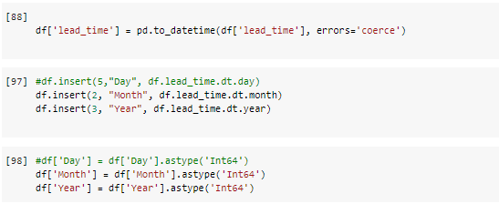
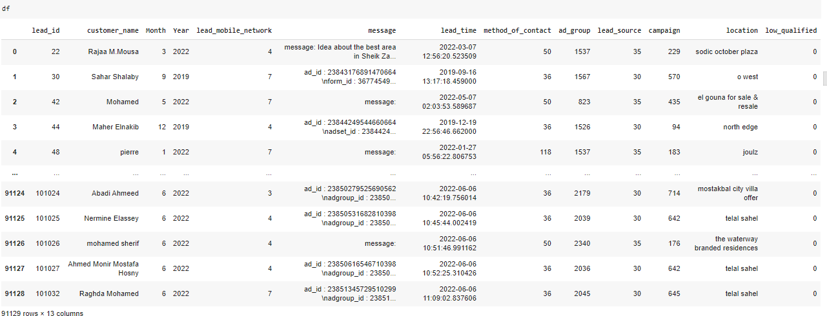
Extract Year & Month
Extract Year & Month to see more information about the relation between them & the qualified_leads

Slide 10
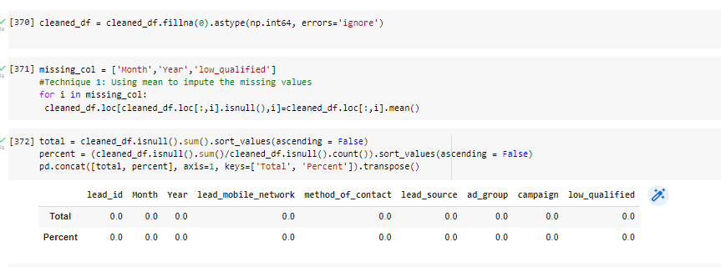
Empute Missing Values with the Mean

Slide 11
Empute Missing Values with the Mean
Now We’re gonna separate the qualified_leads and low_qualified_leads to look into differences between them.

Slide 12
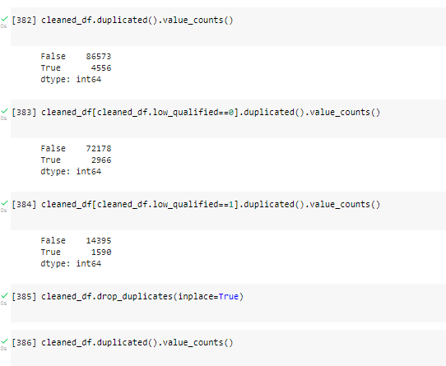
Check Duplecats
Here WE see that Qualified Leads have 2966 duplicats while low_qualified leads have 1590 duplicates

Slide 13
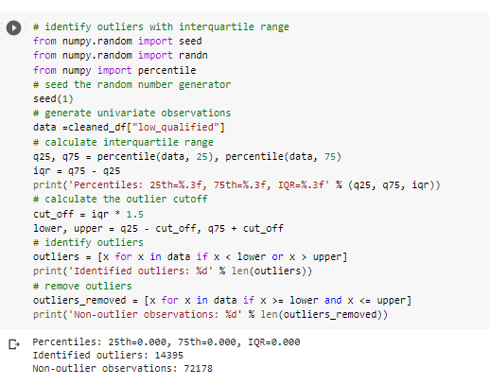
Handling Outliers
Before we see that there is outliers in the data , so we’re gonna handle them using IQR
from this we get :
Identified outliers: 14395
Non-outlier observations: 72178

Slide 14
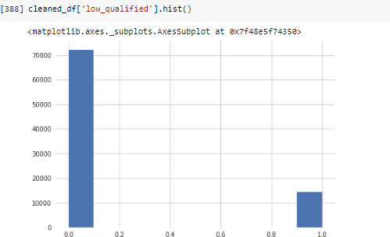
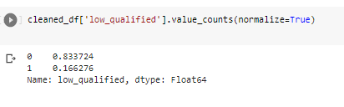
Check If The Data is Unbalanced
This dataset is unbalanced which means using the data as it is might result in unwanted behaviour from a supervised classifier. To make it easy to understand if a classifier were to train with this data set trying to achieve the best accuracy possible it would most likely label every transaction as a non-fraud

Slide 15
Check If The Data is Unbalanced
To answer this problem we could use the oversampling principle or the undersampling principle The undersampling principle should be used only if we can be sure that the selected few tuples are representative of the whole dataset.

Slide 16
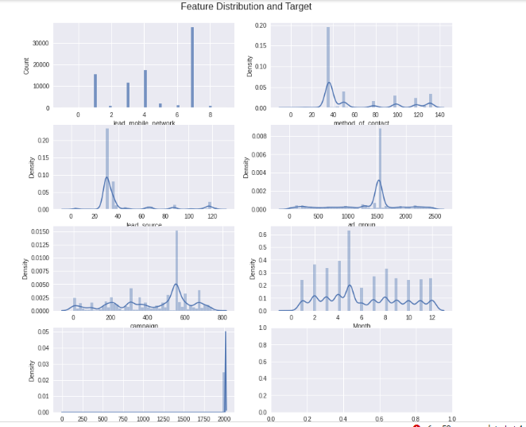
Features Distribution VS Target

Slide 17
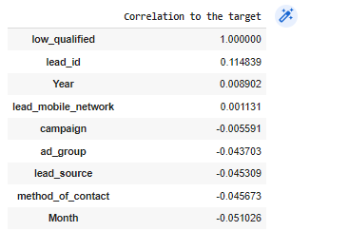
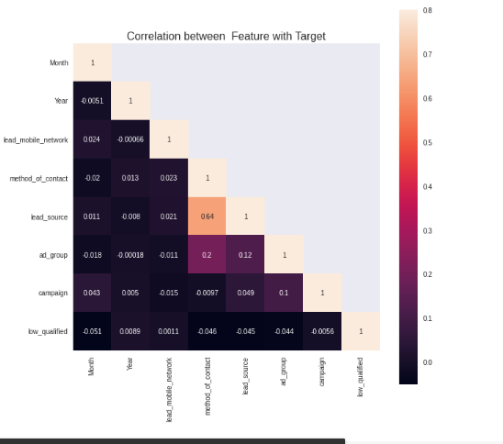
Correlation of Features

Slide 18
Explore the relation between the features and the target

Slide 19
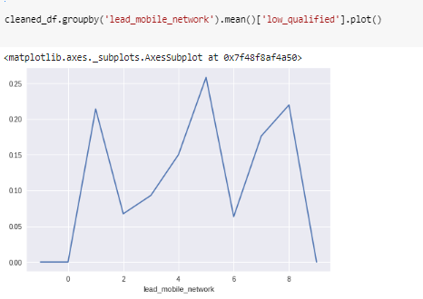

Slide 20
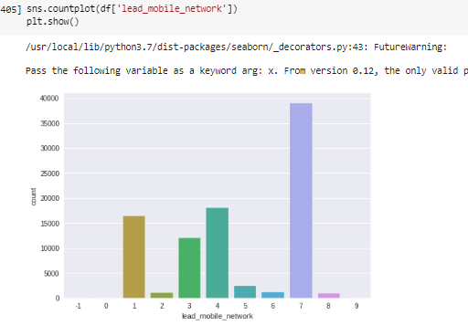

Slide 21
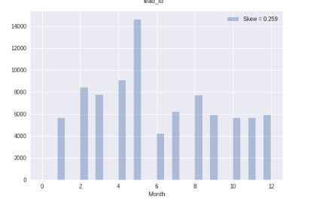

Slide 22
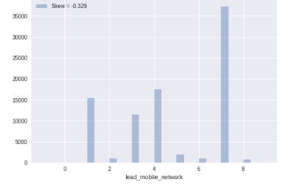

Slide 23
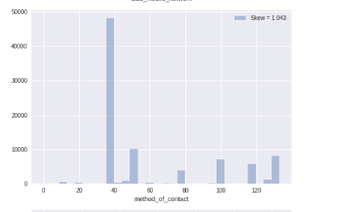

Slide 24
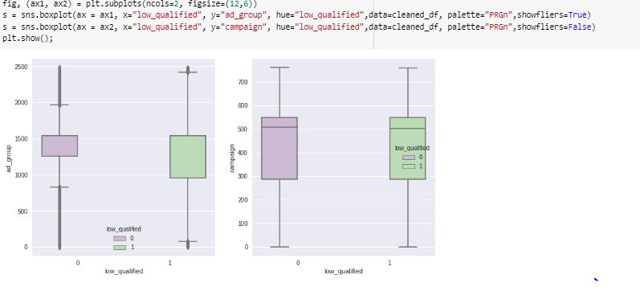

Slide 25
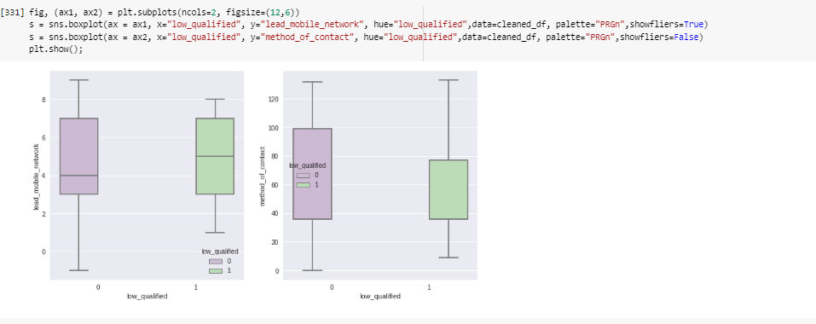

Slide 26
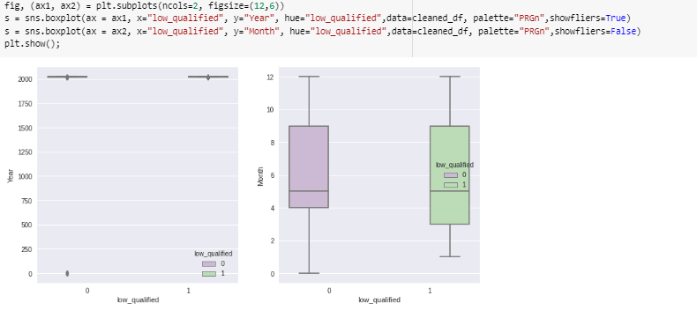

Slide 27
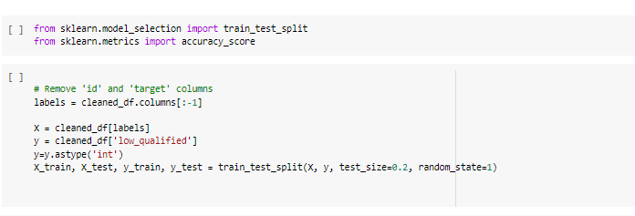
Split the data
Split the train data and the test data
Do Sampling only for the train data

Slide 28
No under or oversampling
First, we need a baseline metric with a simple logistic regression trained on the original unbalanced data.
Since we want to avoid false negatives, recall is what we should to look at.

Slide 29
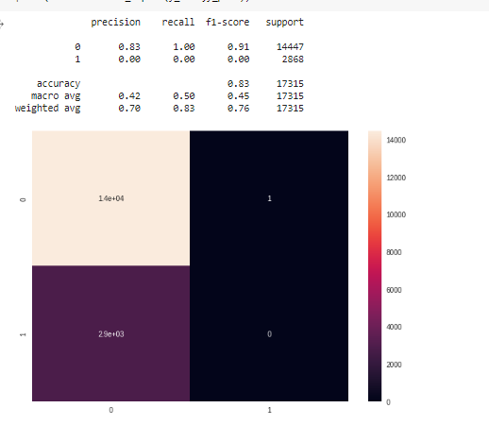
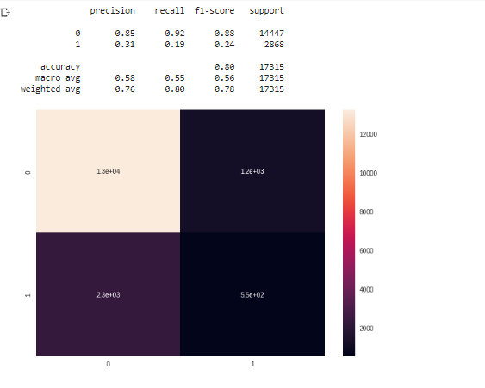
No under or oversampling

Slide 30
No under or oversampling
We see that without under or over sampling, we achieve a mere 85% recall on the test set with logistic regression. As expected, random forest classifier works better than logistic regression even without hyperparameter tuning due to its ensemble nature.

Slide 31
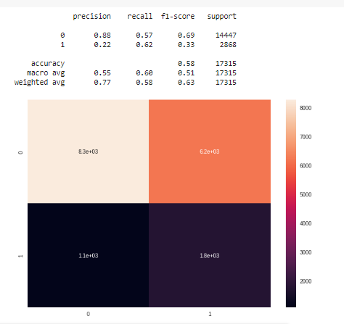
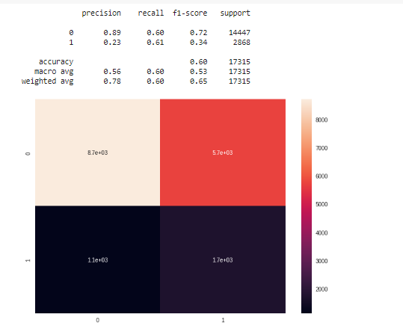
Undersampling
Here we will undersample the majority class without replacement to match the number of the minority class

Slide 32
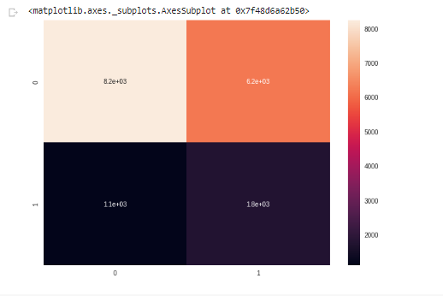
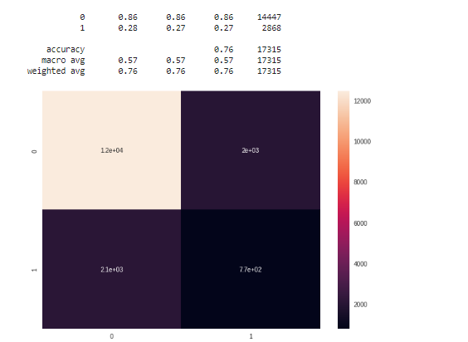
Oversampling
Here we will oversample the minority class with replacement to match the number of the majority class .

Slide 33
Next Stpes
Using K-means clustering to undersample
We will use K-means clustering to reduce the number of majority class instances to match the number of minority class instances. The number of clusters should be equal to the number of minority class instances
Using SMOTE(Synthetic Minority Over-Sampling Technique) to oversample
To oversample, SMOTE chooses the midpoint between a minority sample and one of its k-nearest neighbors, and adds random perturbation to synthesize a new sample It is one of the most popular ways to deal with imbalanced data.

