Slide 1

Planning your IATI project
(based on the Netherlands Red Cross open data project)

Slide 2
Focus of IATI publication
Communication
External obligation
Business intelligence
Transparency
Rode Kruis

Slide 3
Broad team
Internationale Hulpverlening
Marketing & Fondsenwerving
Webteam
Finance & control
Legal
ICT
Communicatie

Slide 4
Phases & key questions
Strategy & planning
Mapping the data
Realisation
Publication & Use
Why you want to publish IATI data?
What do you already know?
What data do you already have?
Where is that data in your organisation now?
What do you need to do to make it suitable for publication (and for your desired outcomes)
Which systems need to change in order to produce the desired IATI data?
Which processes need to change?
Setting up your accounts for
publishing data
Verifying your data
Publishing your data
About your team
What is an ‘activity’ in your organisation
Reasons not to publish activities
Coverage of activities
Permissions and licenses
September - October
October- November
December- February
Q1 2015
Based on Netherlands Red Cross project planning

Slide 5
Choices
Emphasis on desired USE of IATI data “Start with the end in mind”
Produce a ‘prototype’ IATI data set ASAP “Open data is not rocket science” and to manage expectations early

Slide 6
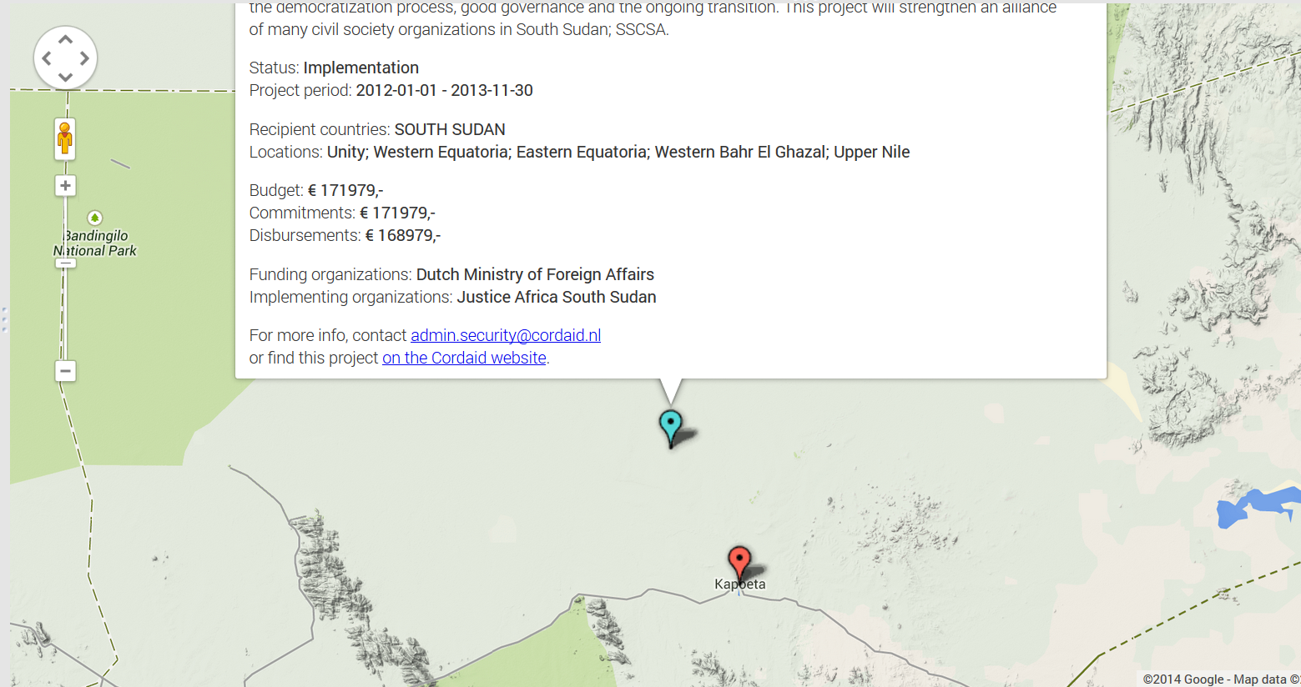

Slide 7
Overall planning
Strategy & planning
Mapping the data
Realisation
Publication & Use
Adaptation
Require-ments analysis
Analyse systems changes
Systems changes
Planning IATI publication
Mapping IATI data
Test process
Publication
Systems/ info assessment
Analyse process changes
Process changes
Legal/licenses, Exclusions, Communication planning, …
September - October
October- November
December- February
Q1 2015
Based on Netherlands Red Cross project planning

Slide 8
Tot eind van dit jaar
Strategy & planning
Mapping the data
Realisation
Publication & Use
Adaptation
Require-ments analysis
Analyse systems changes
Systems changes
Planning IATI publication
Mapping IATI data
Test process
Publication
Systems/ info assessment
Analyse process changes
Process changes
Legal/licenses, Exclusions, Communication planning, …
September - October
October- November
December- February
Q1 2015
Based on Netherlands Red Cross project planning

Slide 9
Plan your own project
Which activities are not relevant for your organisation? (e.g because of the size of your organisation)
Which steps would you add?
What is needed to involve:
Communication
The Legal department
…
Do you think prototyping will work in your organisation?

Slide 11


