Slide 1

Oregon Extended Assessment (ORExt):
Qualified Trainer Training

Slide 2
WELCOME

Slide 3
Purpose
3
Every student should have an equal opportunity to show what s/he knows and can do. Common training ensures:
Reliability
from one assessor to another
from one occasion to another
from one district to another
Validity:
the results are an accurate reflection of student knowledge and skill
the outcome is a reflection of what we intended to measure

Slide 4
Capacity and Allocations
Districts are responsible for ensuring they have the capacity to assess all students who will be taking the ORExt.
Allocations to support this responsibility were committed to districts based on the following estimates:
Number of Qualified Trainers: 137
Number of Qualified Assessors: 1030
Number of students assessed: ~4,000
Notes:
Number of QTs: 137
Number of QAs: 1030
Number of students assessed: ~4,000
2017-18: Per a review of district claims trends and recent budget constraints, sub grant allocations to districts and ESDs in support of assessing students with disabilities were reduced from last year’s.

Slide 5
QA & QT Qualifications and Expectations
Qualified Assessor (QA)
Prerequisite Qualification:
Licensed/certificated staff (i.e., teacher, school psychologist, etc.)
Creates and keep a current QA account
Prepares materials and setting for individual administration of the assessment
Administers assessments directly to students
Scores student responses fairly
Delivers scores to online data entry system(s)
Interprets results for student, family, or educational team
Maintains security status through District Security Administrator
Attend annual district test security training
Qualified Trainer (QT)
In addition to QA responsibilities:
Serves as the local point person
Provides training and coaching to local Qualified Assessors
Manages QA Training and Proficiency accounts
Fluent in updates and changes
Awards certificates (per district policy)
First-time QTs must notify ODE of their status following their participation in the November QT training and having passed their refresher proficiency assessment.

Slide 6
QA Training Requirements
Who | What | AND…
New Qualified Assessors | Attend one of the live trainings hosted by a local Qualified Trainer who has re- qualified for the current school year. | Review all training sections (under Training tab) and pass the four proficiency tests* on the training and proficiency website. Attend district’s annual test security training and ensure current, signed confidentiality agreement on file with district.
Returning Qualified Assessors | May opt to attend a live training provided by a current Qualified Trainer. | Review the required training sections and pass the refresher proficiency tests on the training and proficiency website. Attend district’s annual test security training and ensure current, signed confidentiality agreement on file with district.

Slide 7
QT Training Requirements
Who | What | AND…
New Qualified Trainers (a returning QA identified by his/her school and/or district to become a QT) | Attend one of the five live regional trainings by the Oregon Department of Education. | Review required training sections and pass the refresher proficiency test on the training and proficiency website. Attend district’s annual test security training and ensure current, signed confidentiality agreement on file with the district. Attend triennial QT meeting.
Returning Qualified Trainers | May opt to attend one of the five live regional trainings by the Oregon Department of Education. | Review required training sections and pass the refresher proficiency test on the training and proficiency website. Attend district’s annual test security training and ensure current, signed confidentiality agreement on file with the district. Attend triennial QT meeting.

Slide 8
QA & QT Training Requirements (cont.)
Who | What
Qualified Assessors & Qualified Trainers | Oregon’s current Test Administration Manual: Sections 1.0 - 4.0, 11.0, and Appendix A The Oregon Accessibility Manual: Introduction ORExt accessibility supports Appendices B – E
Notes:
Sections 1.0 - 4.0 and 11.0 of the Test Administration Manual. These sections provide information about test administration roles, student confidentiality, test security, accessibility supports, the test schedule, and information specific to the ORExt.

Slide 9

Oregon Extended Assessment

Slide 10
ORExt: USED AA-AAAS Allowance
Per USED, an allowance was made for states to create an alternate assessment for students with the most significant cognitive disabilities: Alternate Assessment based on Alternate Academic Achievement Standards (AA-AAAS)/Oregon’s Extended Assessment
IEP team decides who participates

Slide 11
Participation by Content Area and Eligibility Category
Participation by Content Area:
While all eligibility categories are represented, the majority of students who participate primarily come from these three:
Subject | Data
English Language Arts | 3,940
Math | 3,940
Science | 1,690
Eligibility | Data
Intellectual Disability | 30-45%
Autism Spectrum Disorder | 28-34%
Other Health Impairment | 11-16%
Notes:
Intellectual Disability (30 - 45%)
Autism Spectrum Disorder (28 – 34%)
Other Health Impairment (11 – 16%)
Communication Disorder (3 – 9%)
Specific Learning Disability (3 – 6%)

Slide 12
Decision-Making
Among the numerous instructional decisions, IEP teams determine the student’s statewide assessment option:
General assessment
ORExt
Use guidance document on eligibility for ORExt (cf. next slide)
ELPA21
If ELL, how they will participate in ELPA21?
Types of accessibility supports to provide during the assessment
Consult the current Oregon Accessibility Manual
NB: A decision to use unapproved assessment accessibility supports is a decision to modify and, therefore, invalidate the student’s test for all reporting (AMO) purposes.

Slide 13
Eligibility Guidelines
Guidelines are posted on the:
Statewide Alternate (Extended) Assessment website at http://www.oregon.gov/ode/educator-resources/assessment/AltAssessment/Pages/default.aspx,
ORExt Training and Proficiency website at https://or.k12test.com/, and in the
ORExt Administration Manual (“Selecting the Assessment”)
Notes:
Only students with the most significant cognitive disabilities (SWSCD) are allowed to take the ORExt
If eligible for the ORExt, the SWSCD will participate in all content areas; that is, mixed participation is no longer an option.
New ESSA 1% participation cap (cf. next slide)

Slide 14
Grade 12 Retake Option
Grade 12 students whose current IEP indicates they are to participate in the ORExt will be afforded the opportunity to retake the ORExt (in ELA and/or Math) if they did not meet proficiency expectations (i.e., receive a “Level 3” or “Level 4”) as 11th graders.

Slide 15
Oregon Accessibility Manual http://www.oregon.gov/ode/educator-resources/assessment/Pages/Assessment-Administration.aspx#main
Background
Smarter Balanced Consortium (i.e., Usability, Accessibility, and Accommodations Guidelines)
Structure
Statewide Assessments Accessibility Supports Tables
Appendices
Change Log
Terminology
Universal Tools, Designated Supports, Accommodations
Embedded, Non-embedded

Slide 16
Administration & Data Entry Windows (http://www.oregon.gov/ode/educator-resources/assessment/Documents/testingschedule.pdf)
Administration:
Opens February 15, 2018 and closes at 5:00 p.m. on April 26, 2018.
Assessment materials are available for download one week prior to the opening of the administration window (beginning February 8, 2018).
Data Entry:
Grades 3-8 & 11: Opens February 15, 2018 and closes at 5:00 p.m. on May 11, 2018. Performance scores will be available May 25, 2018.
Grade 12 (retake): Opens February 15, 2018 and closes at 5:00 p.m. on April 26, 2018 (to ensure performance scores will be available by May 11, 2017).

Slide 17
Administration Types
20
Paper-Pencil
Use the ODE District Secure website to:
Access the ORExt Student Materials and Scoring Protocol
Access the Oregon Observational Rating Assessment (Orora)
Enter data for both the ORExt (“How-to” Instructions posted) and the ORora
NEW!: Tablet administration (available for students who can successfully access the assessment in a tablet format). Use the tablet to:
Access the ORExt Student Materials.
Data is automatically entered as testing proceeds for the ORExt.
Access the ORora (an option presented to the QA/QT automatically if testing is discontinued)
Notes:
* “How-to” instructions for grades 3-8, HS (grades11 & 12) are included on the ODE District Secure Site.

Slide 18
Tablet Administration Training (cf. or.k12test.com PPT)
Guidelines regarding the administration type
For blind/visually impaired and/or deaf/hard of hearing, tablet administration is likely not appropriate.
Access Requirements
Complete training
Pass proficiency test(s)
Update Training & Proficiency account with accurate information regarding your current district/school
Notes:
Training for QAs
Guidelines regarding the administration type
For blind/visually impaired and/or deaf/hard of hearing, tablet administration is likely not appropriate.
Access Requirements
Complete training
Pass proficiency test(s)
Update Training & Proficiency account with accurate information regarding your current district/school
System Requirements (handout)
Administration
Scoring Writing
Use of the PIN
Data Entry
Paper-pencil – use the ODE District Secure website to access tests and enter data for both the ORExt and the ORora
Tablet – data is automatically entered as testing proceeds for the ORExt. The ORora is an option presented to the QA/QT automatically if testing is discontinued
Lessons Learned: Benefits and Pitfalls
There are five primary benefits of offering the ORExt in a tablet version, according to Focus Group results from both Phases of the pilot tablet administration studies. They fall into three general domains (increased standardization, increased student engagement, and saved time):
The test administration was more standardized, as all students receive the items in the same manner (it is not subject to inter-individual differences related to QAs).
The tablet administration increases student engagement. Students were described as paying a higher level of attention and being more motivated to participate in the assessment.
Because of the level of student engagement, test administration took less time compared to the pencil/paper administration.
Teachers did not have to record student data, which saved teachers valuable instructional and/or work time.
The tablet administration saved paper, as it does not require any printing or management of test materials. This also saved valuable teacher time.

Slide 19
Tablet Administration Training (cont.)
System Requirements (handout)
Administration
Scoring Writing
Use of the PIN
Data Entry
Lessons Learned: Benefits and Pitfalls
Notes:
Training for QAs
Guidelines regarding the administration type
For blind/visually impaired and/or deaf/hard of hearing, tablet administration is likely not appropriate.
Access Requirements
Complete training
Pass proficiency test(s)
Update Training & Proficiency account with accurate information regarding your current district/school
System Requirements (handout)
Administration
Scoring Writing
Use of the PIN
Data Entry
Paper-pencil – use the ODE District Secure website to access tests and enter data for both the ORExt and the ORora
Tablet – data is automatically entered as testing proceeds for the ORExt. The ORora is an option presented to the QA/QT automatically if testing is discontinued
Lessons Learned: Benefits and Pitfalls
There are five primary benefits of offering the ORExt in a tablet version, according to Focus Group results from both Phases of the pilot tablet administration studies. They fall into three general domains (increased standardization, increased student engagement, and saved time):
The test administration was more standardized, as all students receive the items in the same manner (it is not subject to inter-individual differences related to QAs).
The tablet administration increases student engagement. Students were described as paying a higher level of attention and being more motivated to participate in the assessment.
Because of the level of student engagement, test administration took less time compared to the pencil/paper administration.
Teachers did not have to record student data, which saved teachers valuable instructional and/or work time.
The tablet administration saved paper, as it does not require any printing or management of test materials. This also saved valuable teacher time.

Slide 20
Administration
20
Logistical Considerations:
Review assessment(s) and prepare any materials in advance
Arrange substitute time as needed
Consider
reward system (as necessary)
seating arrangements based on student need
setting (one-on-one, limit distractions)
timing (as appropriate)
assistance (as required)
Maintain awareness of the level of support student needs to access an item on an item-by-item basis (not directly assessed this year)

Slide 21

Administration (cont.)
Consequential validity survey results suggest that the length of assessment administration takes on average .75 to 1.5 hours per content area
Average length of data entry (~10-15 minutes)
Average length of time associated with materials preparation (varies)

Slide 22
ORExt Format
10
Three subject areas ( English Language Arts (ELA) [Reading, Writing, Language], Mathematics, & Science)
Grade leveled assessments in ELA and Math (3-8 & 11)
Grades 5, 8, & 11 assessed in Science

Slide 23
ORExt Scoring
Entry Code | Administration note | Definition
0 | No credit | Student response is incorrect. Student answers incorrectly in any of several ways, including (but not limited to): incorrect answer, refusal, no response, adverse behavioral response, or incomplete response.
1 | Full credit | Student response is correct based on rubric. Exact match for Reading, Language, Math, and Science items or correct based on rubric criteria for Writing items.

Slide 24
Minimum Participation Rule
To count toward AMO Participation a student must take at least 10 items.
If a student misses 10 items at any point within the administration of the first 15 items, QAs should consider discontinuation.
All accessibility supports and appropriate provisions should be considered thoroughly prior to discontinuing an ORExt administration.
If the ORExt is discontinued, the QA (or teacher who knows the student best) are expected to complete the ORora (only one ORora per student must be completed).
Notes:
Any general assessment submission is considered the highest score and will override an ORExt submission for the purposes of AMO.

Slide 25
Oregon Observational Rating Assessment
(ORora)
The ORora is for SWSCD who are not able to access the academic demands of the ORExt, despite the provision of extensive supports and test design features founded in the concepts of universal design for assessment. It provides:
instructional and functional information for teachers and parents
information on attention, math concepts, and receptive & expressive communication

Slide 26
ORora Completion
The ORora is not a performance assessment; it is a rating scale founded in the teacher’s observations of the most current levels of student functioning.
It is completed by the QA during the test window, but the student does not need to be present during its completion.
There is a comprehensive user guide, which provides definitions for each aspect of the scale, as well as examples, published on the Training and Proficiency site at https://or.k12test.com/

Slide 27
ORora Domains & Sub-domains
The ORora is composed of two domains with two sub-domains under each:
Level of Independence (LOI) = Attention + Basic Math Concepts
Attention
Basic Math Concepts
Communication (COM) = Receptive + Expressive
Receptive Communication
Expressive Communication
The administrative directions for the ORora are posted in the QT Materials section of Oregon’s Extended Assessment Training & Proficiency website at or.k12test.com

Slide 28
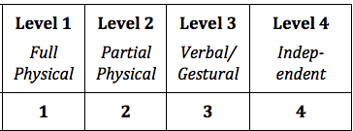
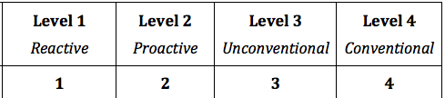
ORora Scales
Level of Independence Rating Scale
Communication Rating Scale

Slide 29
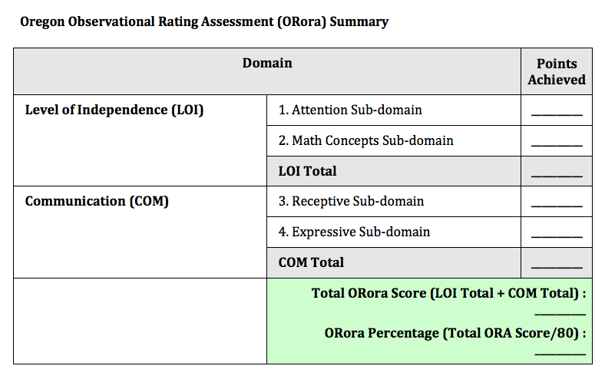
ORora Scoring

Slide 30
ORora Narrative Summary
Teachers can address or identify areas such as:
Prerequisite skills that allow the student to access instruction,
Sensory support needs (i.e., hearing, vision, orthopedic, medical),
Effective use of Assistive Technology (AT) (e.g., alternative communication devices),
Relevant functional skills that have developed over the past year, and, generally,
Areas of growth that educators have noted in the prior year (e.g., comparing current to prior ORora scores, if available, or any context for determining the Present Levels of Academic Achievement and Functional Performance [PLAAFP] for SWSCDs).

Slide 31
ORora Data Entry
The paper/pencil version of the ORora is on the same page as the paper/pencil ORExt materials on the ODE District Secure Website
All data entry for the paper/pencil version is completed on the ODE District Secure Website
NOTE: keep the tablet administration separate; we do not want any duplicate records

Slide 32
Use of ORora Scores
The ORora yields:
Four sub-domain scores (Attention, Basic Math Concepts, Receptive Communication, and Expressive Communication),
Domain summary scores for the LOI and COM domains; and,
A summary score composed of both domain scores.
These scores can be used for diagnostic purposes to represent student learning and change across time.
Individualized Education Program (IEP) teams are encouraged to use the results as one data source to develop appropriate and meaningful Present Levels of Academic and Functional Performance (PLAAFP) descriptions, as well as IEP goals and objectives.

Slide 33
Reports and Scores
While ORExt performance scores (and Individual Student Reports) are not available until May, student’s frequency of responses are available under the “Reports” tab in Data Entry in both “Individual Student Reports” and “Class Roster Reports” formats.
Teachers who are interested in accessing students’ performance scores are encouraged to work with your School Test Coordinator.
An interpretation guide for ORExt scaled scores is available at http://www.oregon.gov/ode/educator-resources/assessment/AltAssessment/Pages/default.aspx .

Slide 34
Discussing Test Results with Parents
Can and should always discuss performance and growth with respect to IEP short-term objectives and classroom assignments based on grade-level content.
Can discuss qualitative skills that are demonstrated at a task or item level (e.g., “Out of five items that assessed your son’s knowledge and skills with respect to Interdependence of Organisms in the Environment, your son was able to answer one correctly”)

Slide 35
Discussing Test Results with Parents
(continued)
Emphasize that the ORExt is a summative assessment that is used to evaluate schools and programs and is not an adequate substitute for other forms of classroom progress monitoring
Emphasize that the ORExt is an alternate assessment and as such performance is not comparable to performance categories on the general assessment (OAKS Online)
Do not discuss “performance” (i.e. meets, does not meet, exceeds, etc.) until final reports are available.

Slide 36
QA Training Section Requirements
NEW! Updates for 2017-18
NEW! Tablet Administration
Introduction
Information for Assessors: Alternate Academic Achievement Standards (AAAS)
Selecting an Assessment
Administration of the ORExt
Appropriate/Inappropriate Administration Examples
Minimum Participation Rule
Administration of the ORora

Slide 37
News
Every Student Succeeds Act
https://www2.ed.gov/documents/essa-act-of-1965.pdf (See Section 1111(b)(2)(D), beginning p. 27)
Assessment Regulations
https://www.gpo.gov/fdsys/pkg/FR-2016-12-08/pdf/2016-29128.pdf (See Sections 200.6(c) and 200.6(d) on pp. 88934-88936)
ESSA Participation Requirement
https://nceo.umn.edu/docs/OnlinePubs/NCEOBrief12OnePercentCap.pdf
Notes:
ESSA changed 1% cap to be based on the participation rate rather than the proficient rate.
ESSA placed the 1% cap on the state participation rate for each content area, based on the total number of all students in the state assessed in the content area.
States cannot place a cap on participation rates of districts.
State must make LEA data publicly available (as long as no Personally Identifiable Information is shown).
LEAs projected to exceed the 1% participation cap must submit information to the SEA justifying the need to exceed the cap and the state must provide oversight of district.
Parents of students being considered for participation in the alternate assessment (as part of the IEP process) must be clearly informed about the nature of the assessment and potential affect on diploma options:
That their child’s academic achievement will be measured based on alternate achievement standards.
How participation in the alternate assessment may delay or otherwise affect completing requirements for a regular high school diploma.

Slide 38
News (cont.)
Essentialized standards are available for instruction. They are published at http://www.brtprojects.org/publications/training-modules (see 2015), along with a User Guide that explains their intended uses and applications.
Curriculum and Instruction website provides:
Lesson templates that are aligned to Essentialized Standards
Supporting videos
Scripts
A PLAAFP development training module*
An IEP goals and objectives development training module
PLAAFP and IEP development is aligned to the essentialized standards
* Training modules include voiceover PPTs and scripts, as well as relevant resources.

Slide 39
Four Key Websites
Oregon Department of Education’s Statewide Alternate (Extended) Assessments Website: http://www.oregon.gov/ode/educator-resources/assessment/AltAssessment/Pages/default.aspx
Oregon Extended Assessment Training and Proficiency Website: https://or.k12test.com/
Oregon Department of Education District (Secure) Website:https://district.ode.state.or.us/
Curricular & Instruction Resource Website (including Present Levels of Academic Achievement and Functional Performance and Individualized Education Program goals and objectives training modules): http://lms.brtprojects.org

Slide 40
ODE Supports
Oregon Department of Education | BRT/University of Oregon
Policy Guidelines Assessment and Participation Rules Administration rules Secure Test/Data Entry issues General complaining | ORExt/ORora test design or.k12test.com website/ training issues Technical aspects of the ORExt/ORora

Slide 41
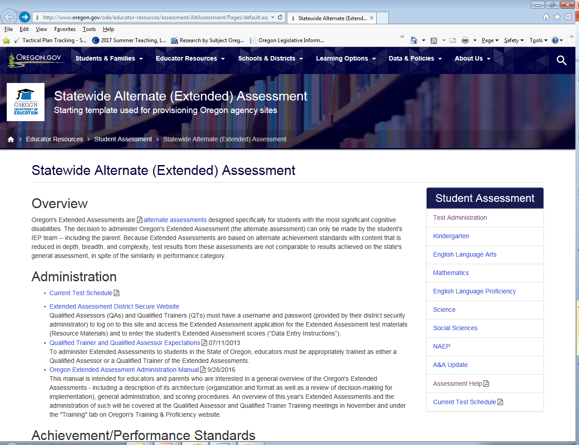
ODE Contacts
Brad Lenhardt
Brad.Lenhardt@state.or.us
Regional Assessment Support Partners
http://www.oregon.gov/ode/educator-resources/assessment/Documents/esdpartners.pdf

Slide 42
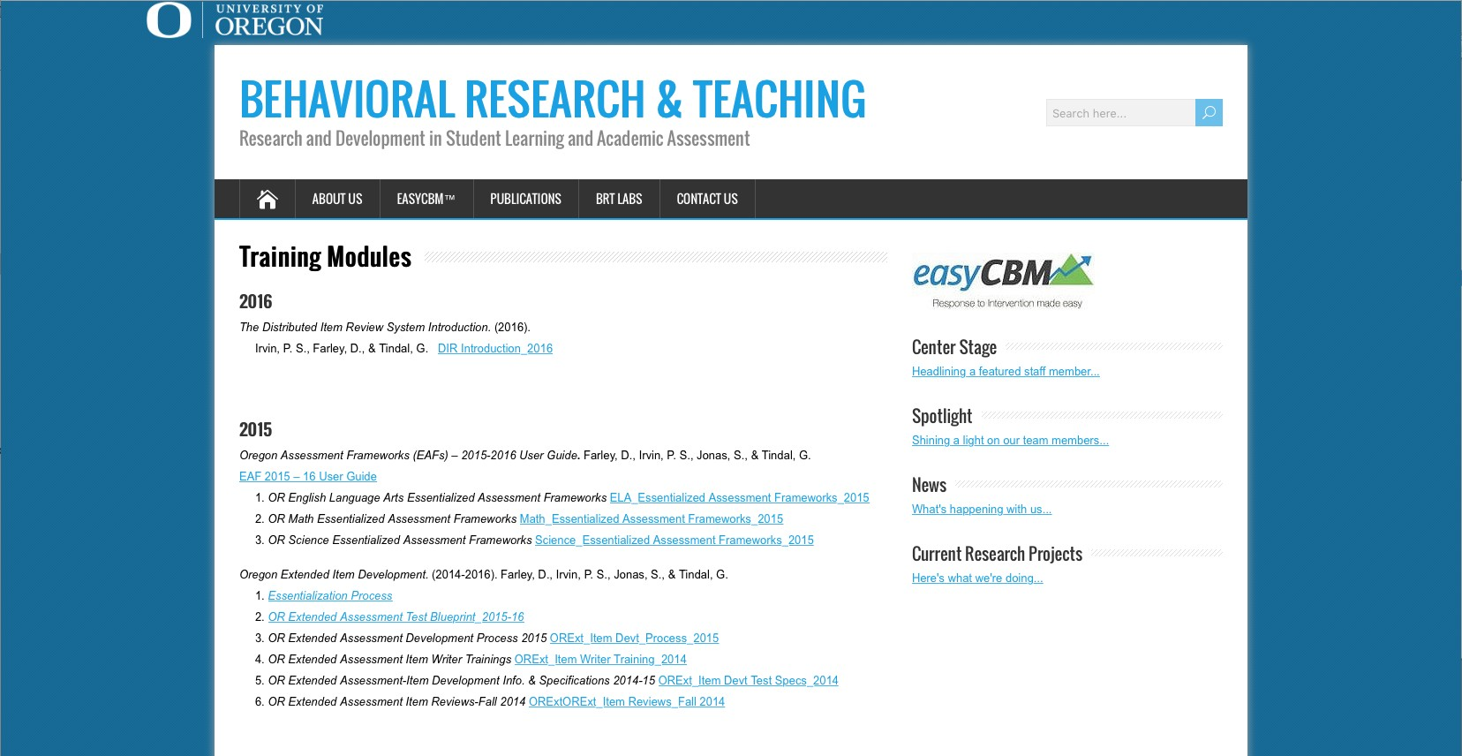
BRT Contacts
Dan Farley
dfarley@uoregon.edu
Sevrina Tindal
orextended@k12test.com

