Slide 1
Identification Difficulties of the populations to find apartments to rent.

Slide 2
Impact
high cost for the service of the canvasser
The choice is limited

Slide 3
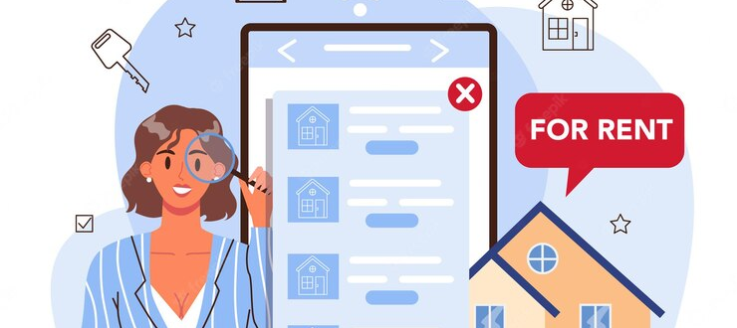
Solution
A platform to link owners and people looking for an apartment. The customer can already visit the apartments on the site and sort before contacting the owner for visits

