Slide 1
The Imperva SYN Flood Attack
Bare Minimum Bandits
Notes:
Name? = DDOS Attacks (as we now have more than just a SYN flood and the attack wasn't actually in Imperva directly

Slide 2
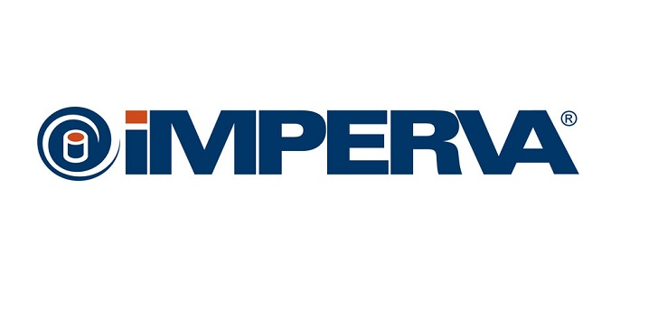
What is...
Notes:
- Cyber Security company providing support and products to businesses
- Categories: data security and application security (generalised for web app and DDoS protection)
- Based in the USA but do have global locations including Sydney and Melbourne

Slide 3
Overview of Attack
Distributed Denial of Service (DDoS) attack
Mix of a regular SYN flood and a large SYN flood
First to wear down CPU
Second to saturate the network
Attack exceeded 500 million packets per second
4 times the packets sent at GitHub in 2018
Has been deemed the 'largest DDoS attack'
Packets per second (PPS) vs size of the attack
Notes:
- January 10
- Syn packet normally ~40 bytes, large flood ranged between 800-900 bytes
GitHub had 1.3 terrabits per second transferred

Slide 4
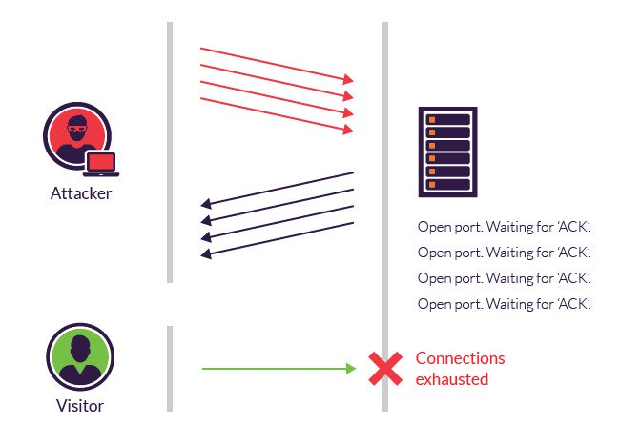
What is a SYN Flood?
What is a TCP Handshake?
What is a SYN Flood?
How does it work?

Slide 5
Impact on the Business
Makes websites and servers unavailable to legitimate users for hours up to months
Loss of revenue
Damage customer trust
Reputation damage
Large compensation costs

Slide 6
High Bandwidth vs High PPS
High bandwidth
e.g. GitHub attack (129.6m PPS)
More collateral damage to bystanders
High Packets Per Second (PPS)
Intensity of attack
More difficult to generate
Requires more compute resources
Imperva attack (500m PPS)
Do not saturate links as often
Impact of attack depends on the vector and vulnerability of the target
Both can be equally damaging
Multivector attacks are the most damaging

Slide 7

"In reality, size isn't the best reflection of how difficult attacks are to mitigate or how damaging they can be. Packets per second (PPS) is actually a better indicator.”
- Tomer Shani, Security Researcher at Imperva

Slide 8
Attack Mitigation Techniques
Different vectors have different mitigation challenges
High Bandwidth – Greater provisioning of network bandwidth
Larger than largest known/observed DDoS attack
Reduces effectiveness of attack
Mitigating PPS is more difficult
Requires much higher capacity on routers and switches than usual
Organizations more concerned with size of attack (number of packets) rather than the PPS
Microblocks
SYN Cookies
RST Cookies
Stack tweaking

Slide 9
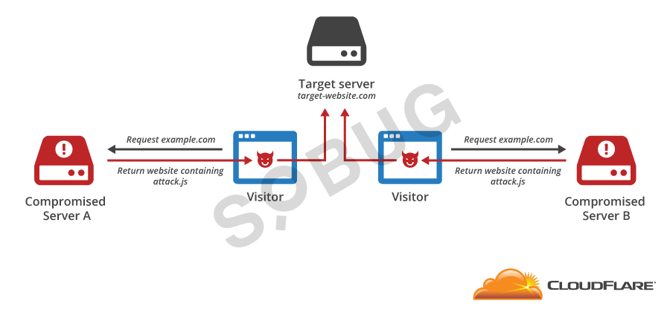
Browser Based Bots
What are browser based bots?
How do they work?
Why are they dangerous?
Advantages
How to defend it?

Slide 10
References
https://www.darkreading.com/attacks-breaches/massive-ddos-attack-generates-500-million-packets-per-second/d/d-id/1333766
https://www.imperva.com/docs/DS_Incapsula_The_Top_10_DDoS_Attack_Trends_ebook.pdf
https://www.imperva.com/blog/this-ddos-attack-unleashed-the-most-packets-per-second-ever-heres-why-thats-important/
https://www.incapsula.com/ddos/attack-glossary/syn-flood.html
https://www.incapsula.com/ddos/denial-of-service.html
https://sobug.com/article/detail/22

