Slide 1
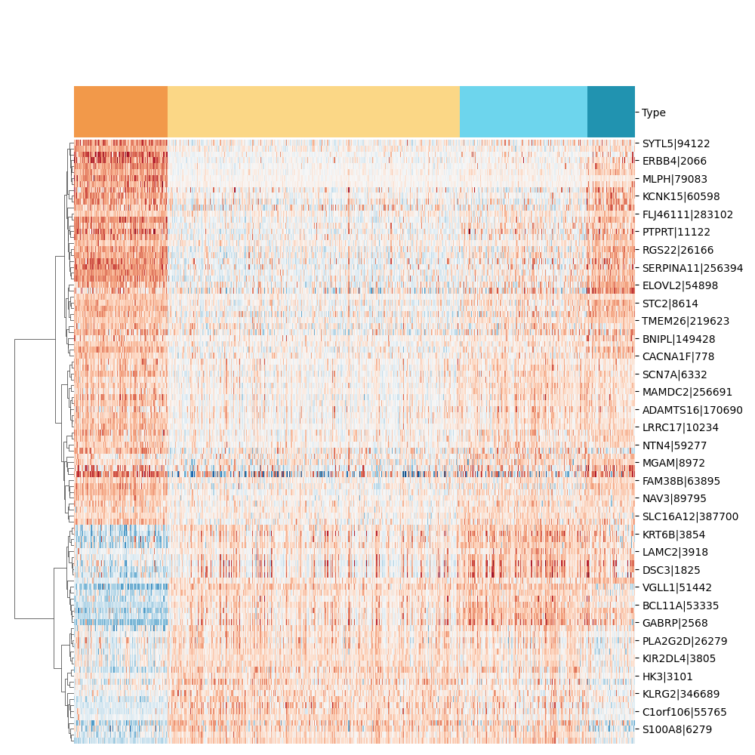
Basal
LumA
LumB
Her2

Slide 2
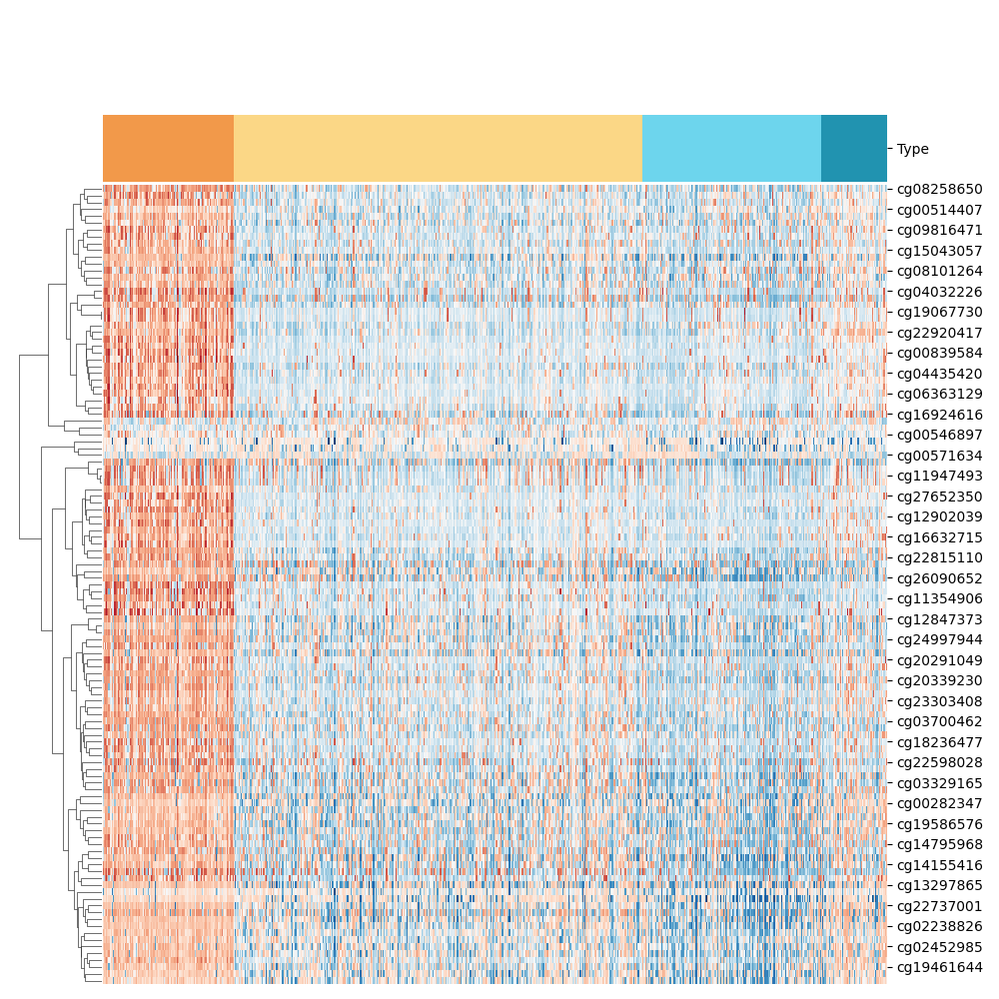
Basal
LumA
LumB
Her2

Slide 3
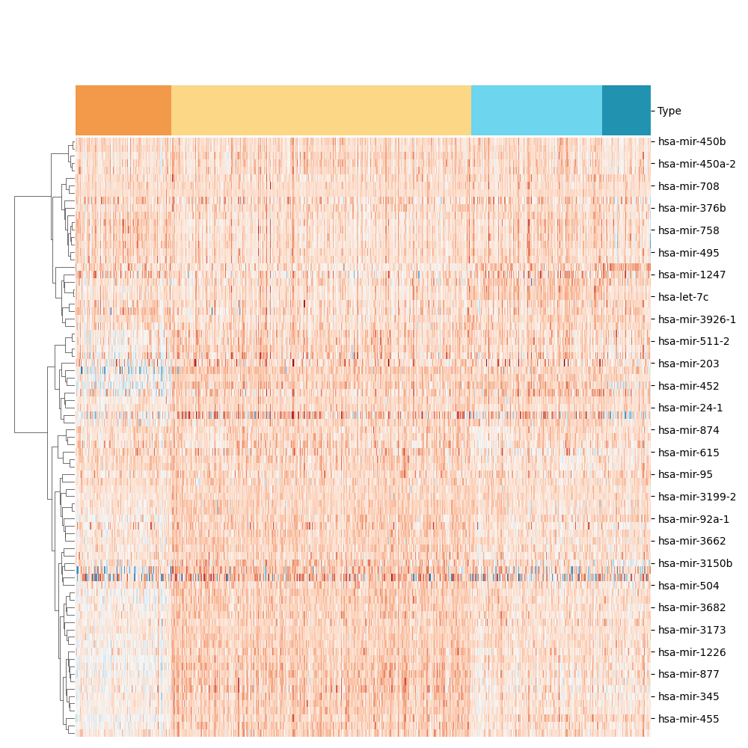
Basal
LumA
LumB
Her2

