Slide 1
PRODUCT STRATEGY AND ROADMAP
RightRoom
Career event discovery for
NYC job seekers
Current design and proposed hosted pilot
Roxanne Lai
RightRoom October 13 2026
01
Notes:
Current-state snapshot on October 13, 2026. Inspected branch codex/pm-discovery-plan, revision d1e0946. This is not a deployment claim. Proposed requirements and pilot targets need approval. Repository: https://github.com/RoxanneLai/rightroom
Sources: README.md, config/career.json. This deck reflects Roxanne's product direction and AI-assisted implementation, not a claim of solo hand-coded development.

Slide 2
USER PROBLEM
The event decision
Which room is worth
my limited time?
Initial audience
NYC career entrants with a technical background exploring PM and technical-PM roles.
Listings rarely make career relevance, conversation opportunities and attendance access equally clear.
Technical project and program roles remain secondary opportunities.
RightRoom October 13 2026
02
Notes:
Current-state snapshot on October 13, 2026. Inspected branch codex/pm-discovery-plan, revision d1e0946. This is not a deployment claim. Proposed requirements and pilot targets need approval. Repository: https://github.com/RoxanneLai/rightroom
Sources: README.md Product overview, config/career.json, docs/CAREER-EVENTS.md Product acceptance feedback. The problem is grounded in the product lead's experience, not market-size research.

Slide 3
SCOPE AND TRADEOFFS
Product decisions
Decision | Reason | Tradeoff
Start with NYC career events | A focused decision for a specific user | Limited geography and profiles
Explain the evidence | Users need to judge fit and uncertainty | More information to read
Human publication review | Models can return plausible errors | Operator effort limits throughput
Local-first SQLite | No database server for local use | Hosting needs persistent storage
RightRoom October 13 2026
03
Notes:
Current-state snapshot on October 13, 2026. Inspected branch codex/pm-discovery-plan, revision d1e0946. This is not a deployment claim. Proposed requirements and pilot targets need approval. Repository: https://github.com/RoxanneLai/rightroom
Sources: README.md, docs/STORAGE.md, docs/CAREER-EVENTS.md. These are implemented decisions. A hosted service is future work.

Slide 4
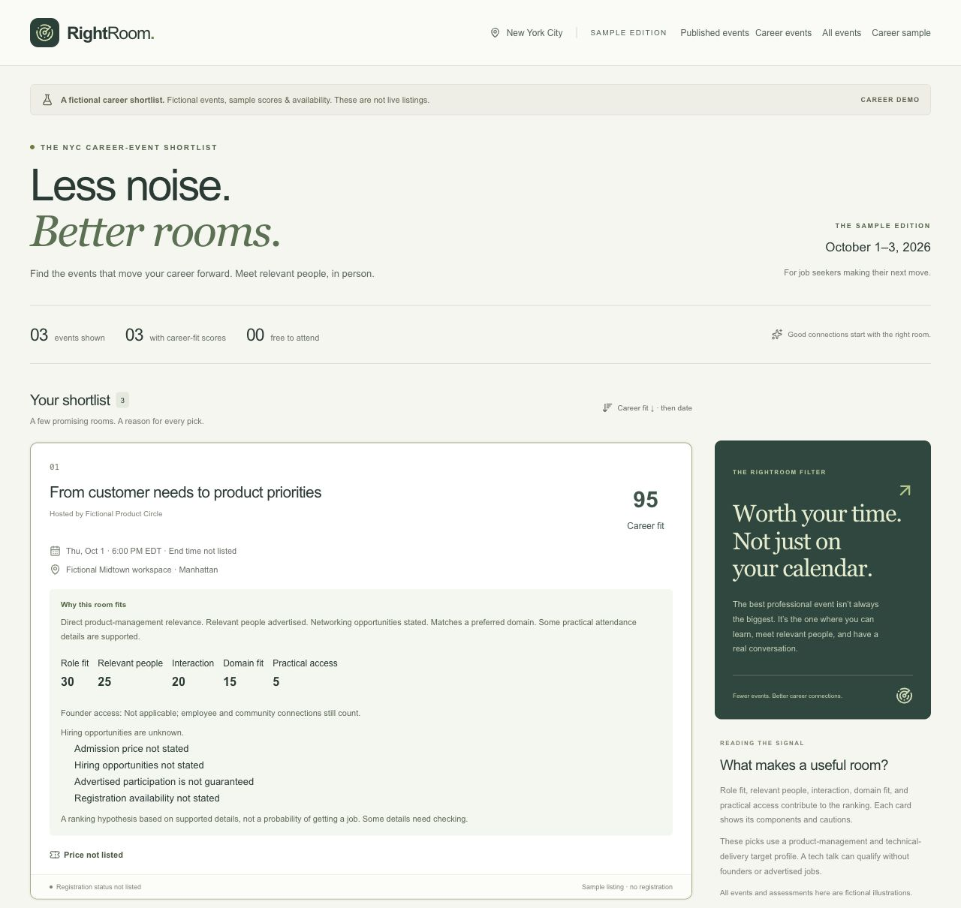
IMPLEMENTED LOCAL PRODUCT
The current experience
Ranked, source-linked career cards
Visible access and uncertainty cautions
Interested, Maybe and Not for me
Original registration link
Fictional sample screenshot. Attendance controls were added later.
RightRoom October 13 2026
04
Notes:
Current-state snapshot on October 13, 2026. Inspected branch codex/pm-discovery-plan, revision d1e0946. This is not a deployment claim. Proposed requirements and pilot targets need approval. Repository: https://github.com/RoxanneLai/rightroom
Source image: docs/images/rightroom-career-sample.jpg, screenshot of fictional sample edition. It predates the attendance control addition. Sources: README.md, docs/ATTENDANCE-SHORTLIST.md. No live inventory or user-impact claim.

Slide 5
HIGH LEVEL DESIGN
Current system architecture
Layer | Responsibility | Data boundary
Collection and review | OpenRouter research, extraction and review | Private leads and drafts
Shared validation and storage | Evidence, scoring, transactions and history | SQLite or selected Postgres
Next.js public feed | Read approved, upcoming NYC events | Validated public fields only
Browser shortlist | Save choices for loaded public IDs | Local device only
Backend selection does not transfer data or silently fall back.
RightRoom October 13 2026
05
Notes:
Current-state snapshot on October 13, 2026. Inspected branch codex/pm-discovery-plan, revision d1e0946. This is not a deployment claim. Proposed requirements and pilot targets need approval. Repository: https://github.com/RoxanneLai/rightroom
Sources: README.md, docs/STORAGE.md, docs/SOURCE-EVIDENCE.md, docs/REVIEW-PUBLISH.md, docs/ATTENDANCE-SHORTLIST.md. Private path uses OpenRouter, local public-page capture, shared validation and interchangeable storage adapters. Diagram is expressed as an editable native table.

Slide 6
TRUST AND SAFETY
The event lifecycle
Stage | What changes | Required check
Private lead | A listing is discovered and captured | Supported identity and safe retrieval
Private draft | Normalized event facts are saved | Evidence, relevance, time and NYC attendance
Published event | Approved public fields become visible | Human approval of the current snapshot
A conditional repair fixes structure while preserving facts. It cannot establish truth or replace review.
RightRoom October 13 2026
06
Notes:
Current-state snapshot on October 13, 2026. Inspected branch codex/pm-discovery-plan, revision d1e0946. This is not a deployment claim. Proposed requirements and pilot targets need approval. Repository: https://github.com/RoxanneLai/rightroom
Sources: docs/INGESTION.md, docs/SOURCE-EVIDENCE.md, docs/REVIEW-PUBLISH.md, docs/RECOVERY.md. At most one research request, one tool-free extraction request if source captures succeed, and one conditional tool-free repair request. No automatic retries or publication.

Slide 7
CURRENT MATURITY
What is proven today
Implemented and checked | Still unproven
308 deterministic offline tests Last full checkpoint October 9 | Repeatable PM-event discovery Broad community coverage
Small live runs produced drafts Human publication workflow works | Calibrated recommendation quality Time saved or career outcomes
Local shortlist and failure recovery Production-page checks passed | Hosted operations and freshness Self-serve profile selection
Software correctness and product usefulness need different evidence.
RightRoom October 13 2026
07
Notes:
Current-state snapshot on October 13, 2026. Inspected branch codex/pm-discovery-plan, revision d1e0946. This is not a deployment claim. Proposed requirements and pilot targets need approval. Repository: https://github.com/RoxanneLai/rightroom
Sources: README.md, docs/ATTENDANCE-SHORTLIST.md October 9 checkpoint, docs/CAREER-EVENTS.md October 5 checkpoint. Test result is dated, not rerun for this deck. No current hosted demo or user cohort is established.

Slide 8
QUALITATIVE EVIDENCE
Early product feedback
Event | User decision | Reason
Supabase and Grafana | Maybe | Relevant to technical background
Agentic AI on AWS | No | Company-name requirement creates uncertainty
Lenny PM meetup | Interested | User interest in a PM-community listing
Career relevance and practical access must remain separate.
RightRoom October 13 2026
08
Notes:
Current-state snapshot on October 13, 2026. Inspected branch codex/pm-discovery-plan, revision d1e0946. This is not a deployment claim. Proposed requirements and pilot targets need approval. Repository: https://github.com/RoxanneLai/rightroom
Sources: docs/CAREER-EVENTS.md Product acceptance feedback October 5. User Interested response and private pm-event-review-2026-10-11-KfWOqU review pack updated October 13. Lenny interest is not an ingestion, publication or RSVP. Access requirement is uncertainty, not proof of exclusion. Three responses from one user do not calibrate ranking.

Slide 9
PROPOSED HOSTED NYC PILOT
The first finished product
A current, reviewed NYC event feed
Understandable fit and attendance caveats
Local saves and original registration links
A small set of approved career targets
Safe operator access and maintainable freshness
No automatic RSVP, outreach or hiring promises.
RightRoom October 13 2026
09
Notes:
Current-state snapshot on October 13, 2026. Inspected branch codex/pm-discovery-plan, revision d1e0946. This is not a deployment claim. Proposed requirements and pilot targets need approval. Repository: https://github.com/RoxanneLai/rightroom
Recommendation, not approved scope. The user asked for a roadmap to the final product. We assume a focused hosted NYC PM/technical-PM pilot before broader cities and roles. Proposed PRD FR1-FR7.

Slide 10
PROPOSED RELEASE GATES
Roadmap
Milestone | Focus | Exit gate
1 Useful PM discovery | Budget policy and verified coverage | Repeatable relevant leads
2 Decision quality | Target-user evaluation and calibration | Useful, understood decisions
3 Hosted NYC pilot | Storage, operator access and freshness | Safe hosted journey
4 Self-serve product | Feedback-led profile and save features | Sustained usefulness and viable cost
Set dates after policy, deployment and pilot scope decisions.
RightRoom October 13 2026
10
Notes:
Current-state snapshot on October 13, 2026. Inspected branch codex/pm-discovery-plan, revision d1e0946. This is not a deployment claim. Proposed requirements and pilot targets need approval. Repository: https://github.com/RoxanneLai/rightroom
Recommendations in RightRoom PRD. Sequence rather than committed calendar dates. Resolve policy before paid tests. Hosting and self-serve capabilities are not implemented. Broader geographies are later and outside the initial pilot.

Slide 11
PROPOSED TARGETS NO MEASURED BASELINE
Pilot success measures
Measure | Proposed pilot threshold
Useful event decision | 70% find one event they would consider
Repeatable coverage | Two verified leads in two of three evaluations
Explanation comprehension | 80% distinguish fit from access and hiring
Published factual quality | 100% core facts agree at review time
Safety | Zero private leaks or unauthorized publication
Start with moderated tasks before adding consent-based telemetry.
RightRoom October 13 2026
11
Notes:
Current-state snapshot on October 13, 2026. Inspected branch codex/pm-discovery-plan, revision d1e0946. This is not a deployment claim. Proposed requirements and pilot targets need approval. Repository: https://github.com/RoxanneLai/rightroom
Proposed hypotheses from PRD, not completed results or approved commitments. Five users and two weeks are a suggested research design. Small cohort proportions are learning signals, not population estimates. Factual and safety thresholds are proposed release requirements.

Slide 12
CURRENT BLOCKER
The spending policy decision
$0.15
Keep strict refusal until a bound is proven
Separately approve a monitored one-shot policy
Scope application-controlled search
Approved hard ceiling
The guarded PM runner refuses the current hosted-search envelope.
Historical low bills do not prove a hard ceiling.
RightRoom October 13 2026
12
Notes:
Current-state snapshot on October 13, 2026. Inspected branch codex/pm-discovery-plan, revision d1e0946. This is not a deployment claim. Proposed requirements and pilot targets need approval. Repository: https://github.com/RoxanneLai/rightroom
Source: docs/PM-COST-FEASIBILITY.md October 7 and docs/PM-DISCOVERY-PREPARATION.md. $3.2466 is a dated conservative full-context reservation, not expected invoice. $0.15 remains the approved hard ceiling. Historical ~$0.03 reported costs are unverified billing and not a hard guarantee. No new paid attempt is authorized by this deck.

Slide 13
RISK MANAGEMENT
Launch risks
Risk | Product response
Sparse or repeated listings | Measure community coverage and distinct useful results
Plausible factual errors | Capture sources and require semantic human review
Scores imply certainty | Separate relevance, access and evidence confidence
Stale published facts | Design change detection and explicit re-review
Hosted privacy or data loss | Authorize operators and verify backup restoration
RightRoom October 13 2026
13
Notes:
Current-state snapshot on October 13, 2026. Inspected branch codex/pm-discovery-plan, revision d1e0946. This is not a deployment claim. Proposed requirements and pilot targets need approval. Repository: https://github.com/RoxanneLai/rightroom
Sources: docs/SOURCE-EVIDENCE.md, docs/STORAGE.md, docs/PM-COST-FEASIBILITY.md, docs/ATTENDANCE-SHORTLIST.md. Mitigations reflect retained current safeguards or proposed launch requirements, not a claim of hosted readiness.

Slide 14
RECOMMENDED PRIORITIES
Next product decisions
Approve the pilot scope and spending policy
Verify repeatable PM coverage against original listings
Test event decisions with five target users
Choose the hosted storage and review operating model
The next milestone is useful, repeatable discovery before more infrastructure.
RightRoom October 13 2026
14
Notes:
Current-state snapshot on October 13, 2026. Inspected branch codex/pm-discovery-plan, revision d1e0946. This is not a deployment claim. Proposed requirements and pilot targets need approval. Repository: https://github.com/RoxanneLai/rightroom
Sources: RightRoom PRD recommendations, docs/PM-COST-FEASIBILITY.md and the October 13 user response. None of these decisions authorizes paid calls, real-data changes or deployment. Roxanne leads product definition, prioritization and acceptance through AI-assisted implementation.

