Slide 1
WE are on to you!
A prediction on credit card holders in default.
By Roxanne Salinas, Cambry Sullivan , Ambassador Negash, and Kevin Sablan

Slide 2
Goal
Use the data to predict whether a person is in default on their credit card payments

Slide 3
Background information
The data is from customersa based in Taiwan from April 2005 to September 2005.
Collected data on:
Credit limit
Gender
Education
Marriage status
Payment history
Billed amount
Payment amount
Default status

Slide 4
Background information
Payment history (Pay_1 represents the number of months late on payment as of Sept. 2005, Pay_2 represents the number of months late on payment as of Aug. 2005, etc.)
Billed amount (bill_amt1 represents the amount billed as of Sept. 2005, bill_amt2 represents the amount billed as of Aug. 2005, etc.)
Payment amount (Pay_amt1 represents the amount paid for the month of Sept. 2005, Pay_2 represents the amount paid for the month of Aug. 2005, etc.)

Slide 5
Background information
Education- Grad. School, university, high school, or other
Marriage Status- Single, Married, or other

Slide 6
Data at a glance

Slide 7
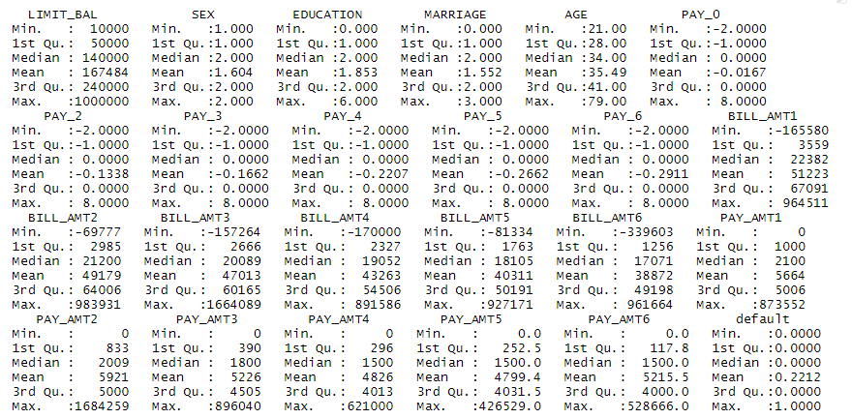
Quick Summary

Slide 8
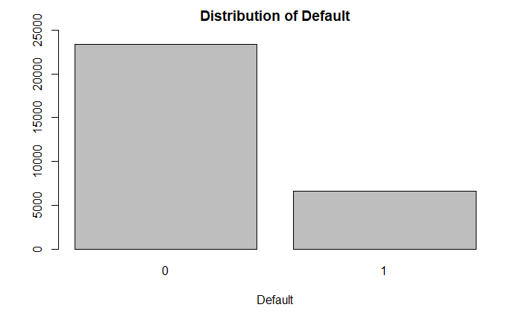
23,364
22.12% of all customers are in default
In this case, a model that predicts all test observations as zero has a 78% accuracy rate.
6636

Slide 9
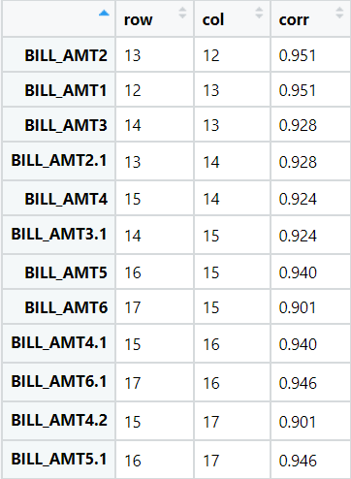
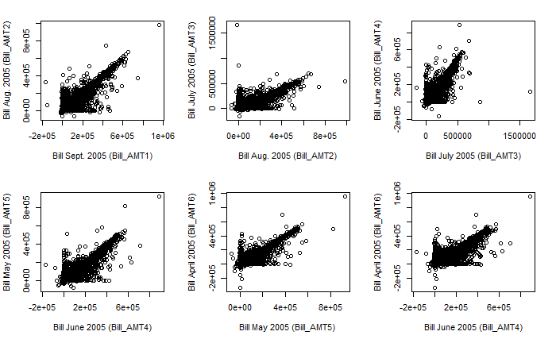
Correlation Check
Even though multicollinearity is not a detrimental problem for forecasting, in estimation problems, it could interfere in the decision to determine the effect of a variable on a response.

Slide 10
Model Selection

Slide 11
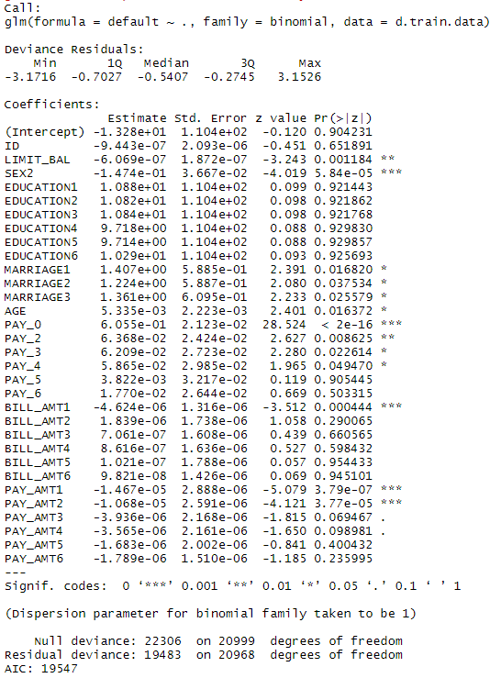
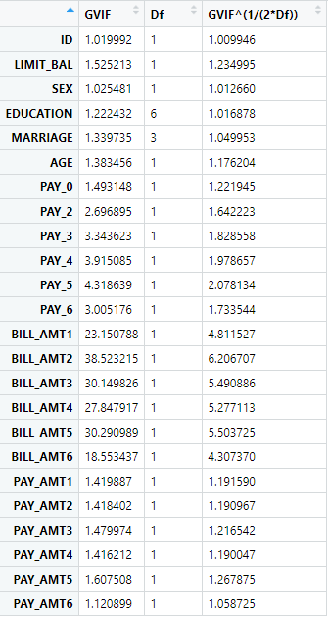
Logistic Regression
The variance inflation factors confirm there is multicollinearity between the monthly bill amounts.

Slide 12
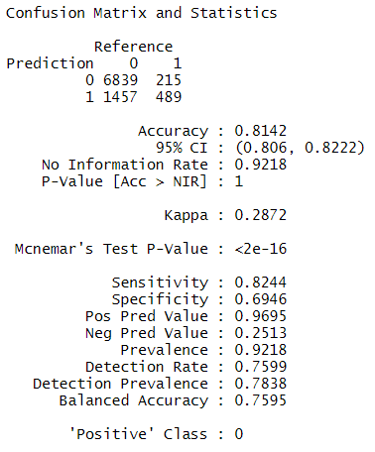
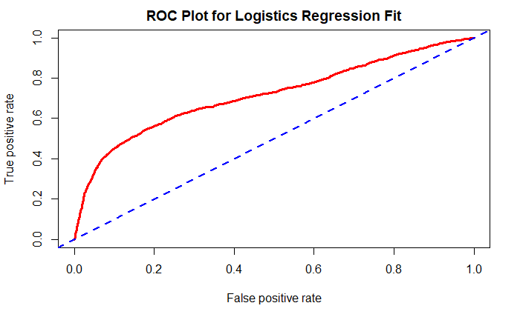
Logistic Analysis
AUC: 0.71628
Testing error: 18.54%
This model places more customers in default status than is observed.

Slide 13
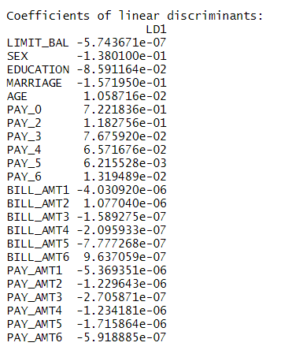
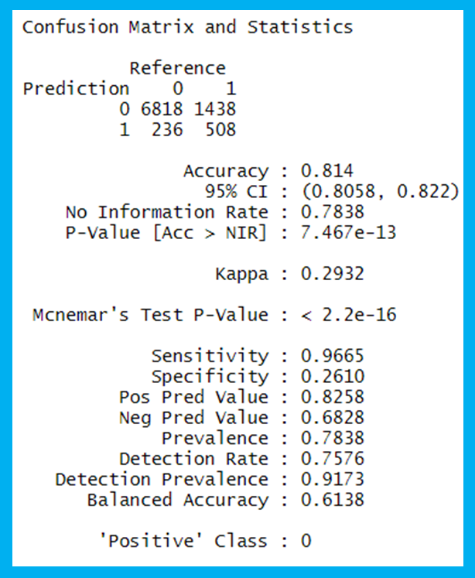
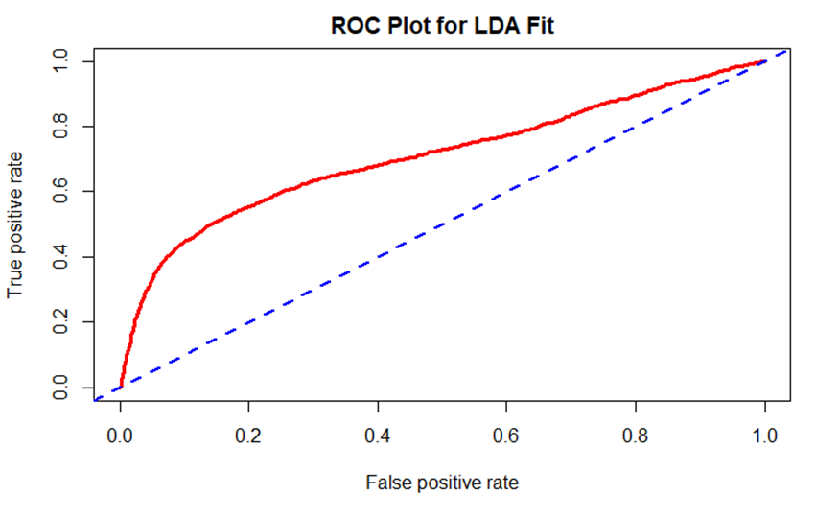
Linear discriminant analysis
AUC = 0.7082072
Testing Error: 18.6%

Slide 14
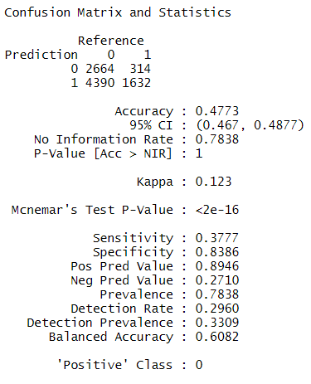
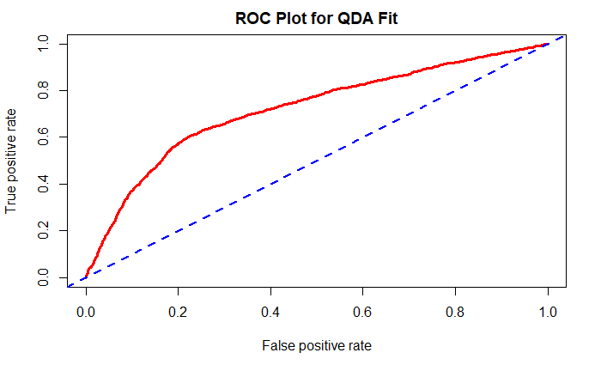
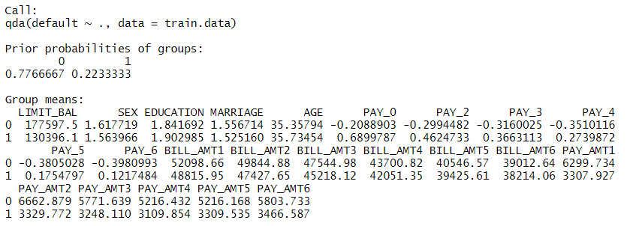
Quadratic discriminant analysis
Testing error: 52.27%
AUC: 0.7213692

Slide 15
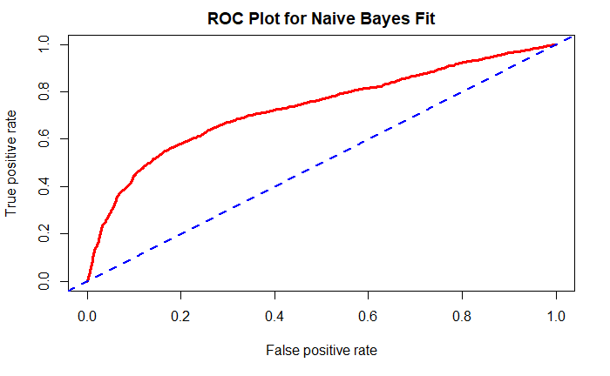
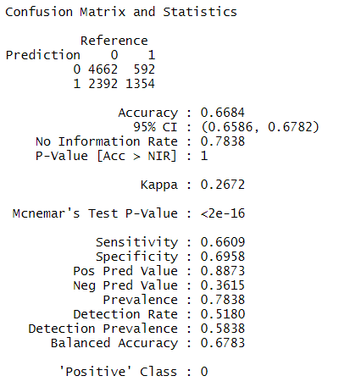
Naïve Bayes
AUC: 0.7320304
Testing Error Rate: 33.16%

Slide 16
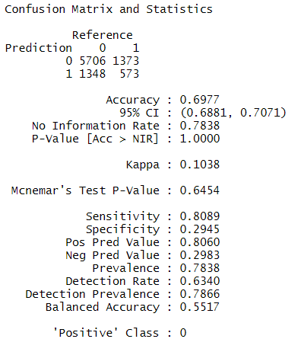
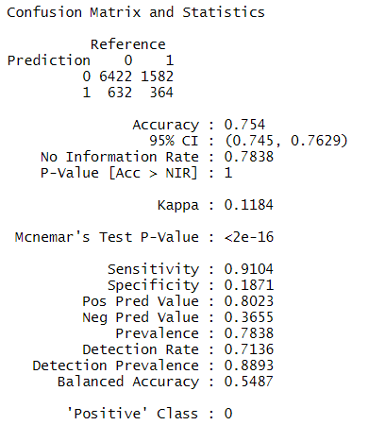
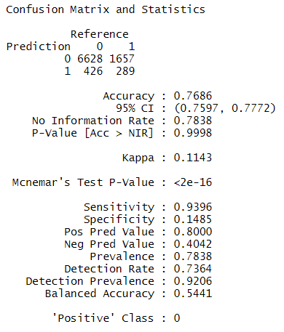
K-nearest neighbor
K=1
Testing Error: 30.23%
K=5
Testing Error: 24.6%
K=10
Testing Error: 23.14%

Slide 17
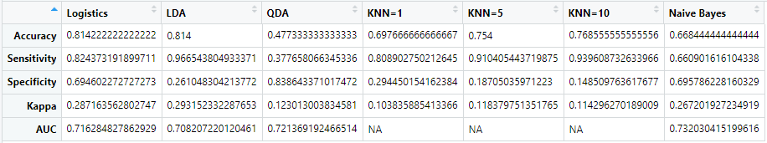
Model Comparison
Based on the criteria above, LDA appears to be the best model at this point.

Slide 18
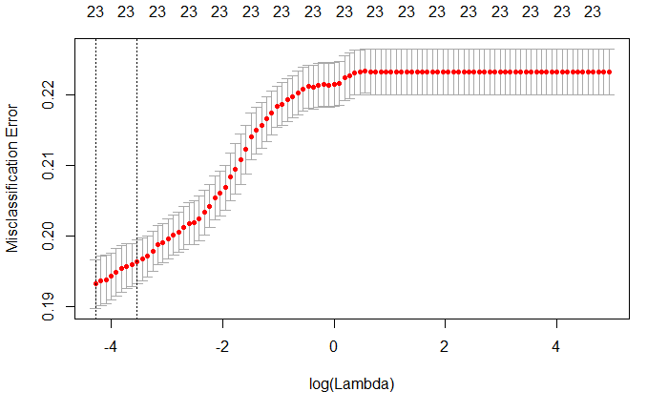
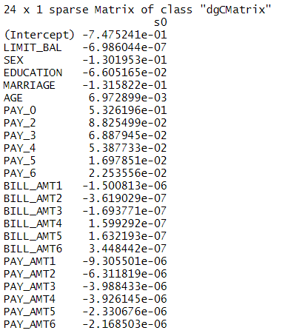
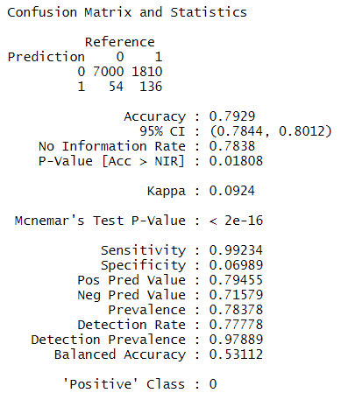
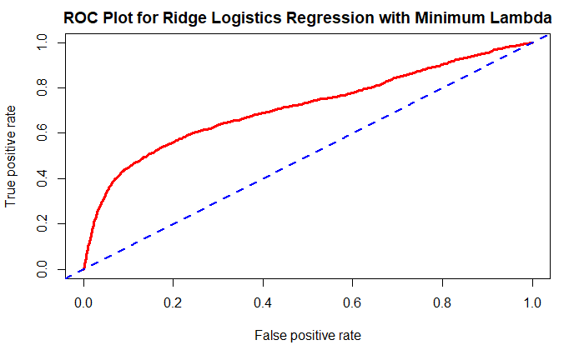
Ridge Regression
With minimum Lambda
Testing error: 20.71%
AUC: 0.7142555

Slide 19
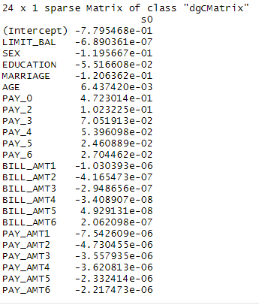
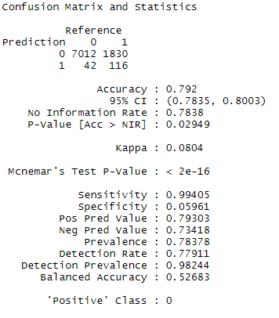
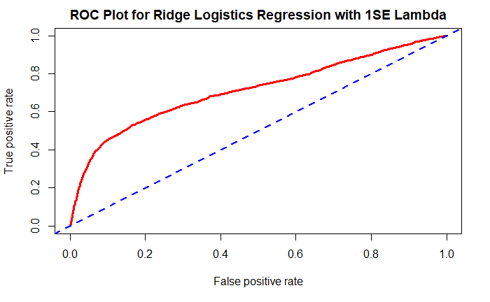
Ridge Regression
With one standard error lambda
AUC: 0.7135831
Testing error: 20.8%

Slide 20
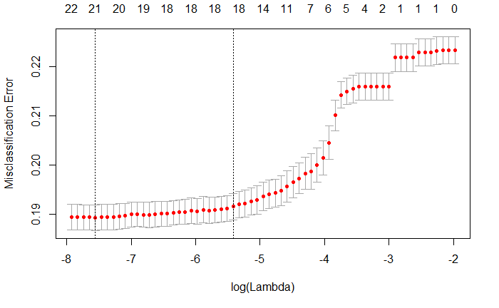
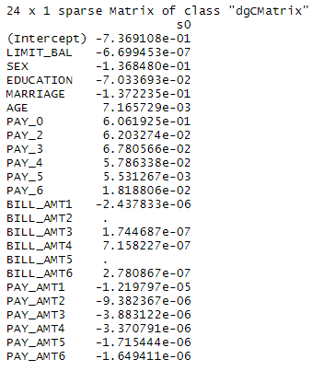
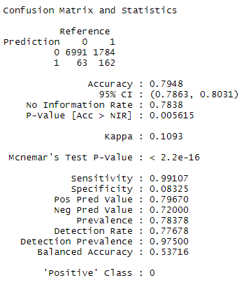
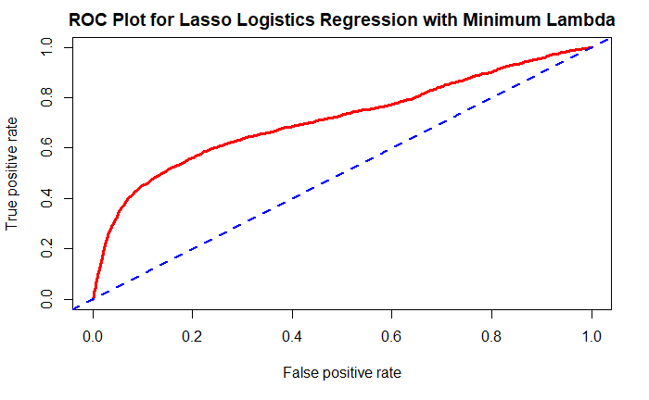
Lasso
Testing error: 20.52%
With minimum lambda
AUC: 0.7131571

Slide 21
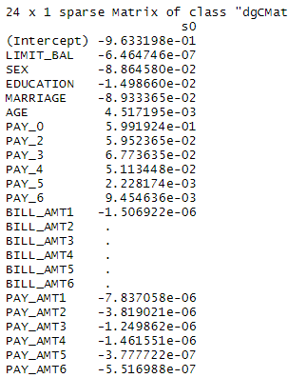
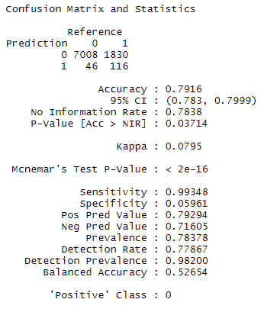
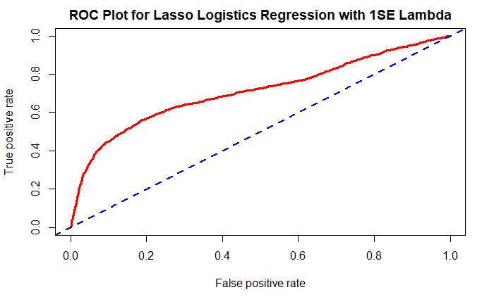
LASSO
With one standard error lambda
Testing error: 20.84%
AUC: 0.7106781

Slide 22
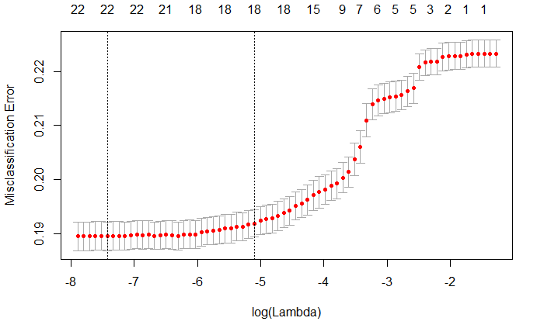
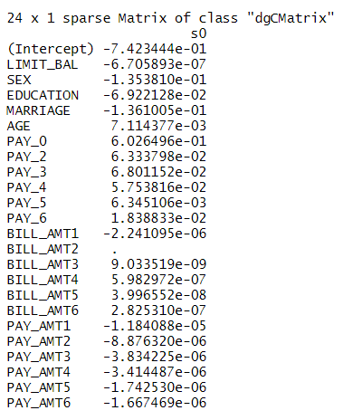
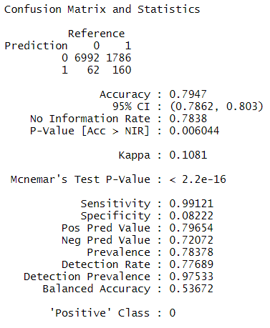


Elastic net
With minimum lambda
$$α=0.5$$
Testing error: 20.52%
AUC: 0.7133414

Slide 23
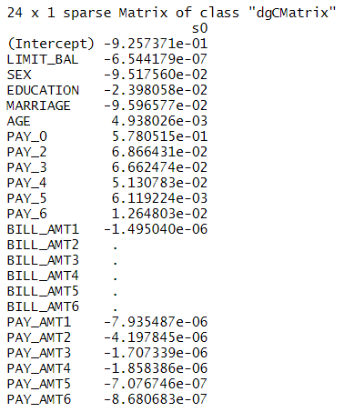
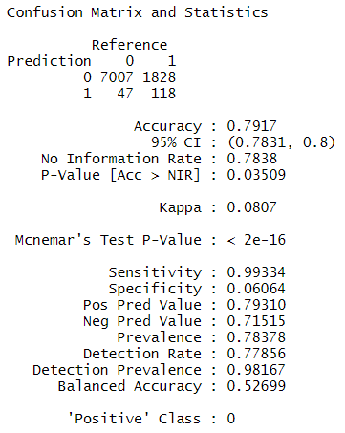
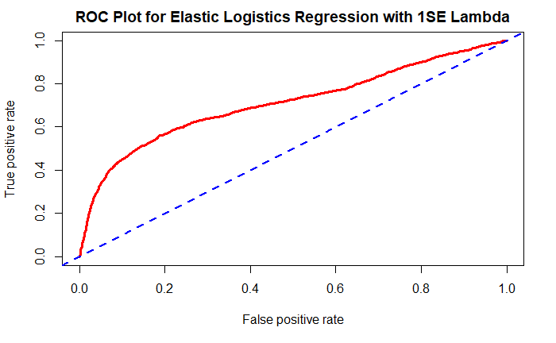

Elastic Net
With one standard error lambda
$$α=0.5$$
Testing error: 20.8%
AUC: 0.7113364

Slide 24
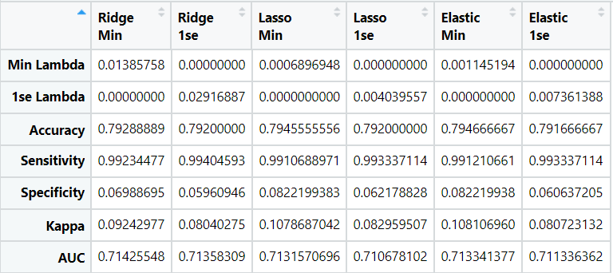
Model Comparison
Even the “best” values are similar to the other values in the same category. No model is standing out above the rest.

Slide 25
Principal Component Analysis

Slide 26
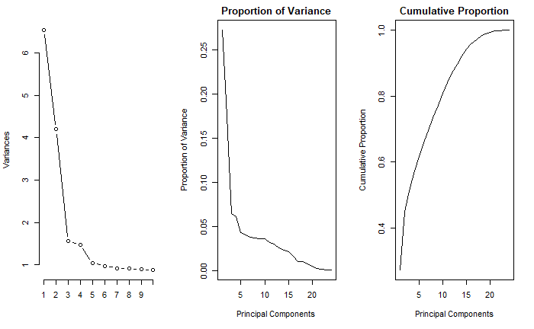
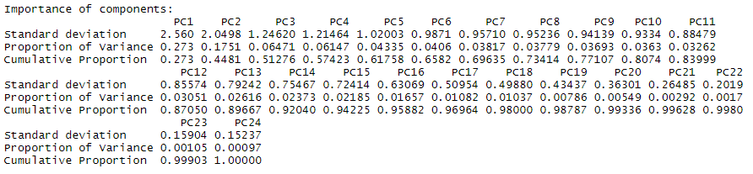
PCA
The 14th principal component explains 92.04% of the variation of the independent variables.

Slide 27
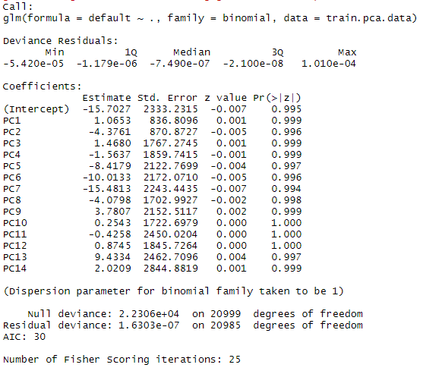
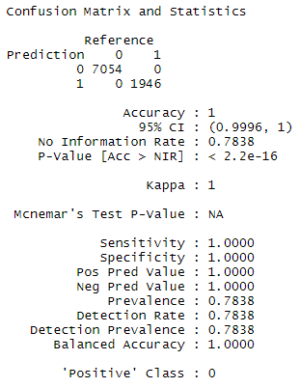
Logistic PCA
We cannot explain the estimations with PCA
Testing error: 0%

Slide 28
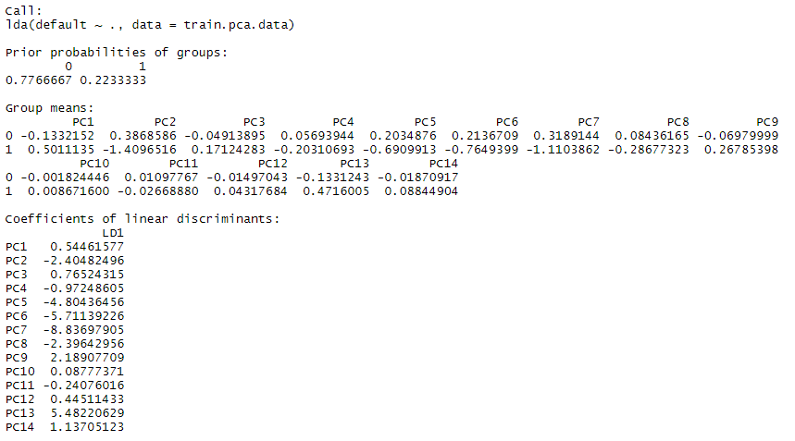
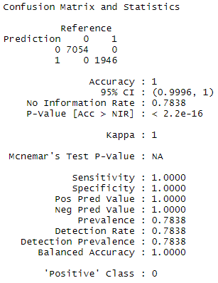
LDPCA
Testing error: 0%

Slide 29
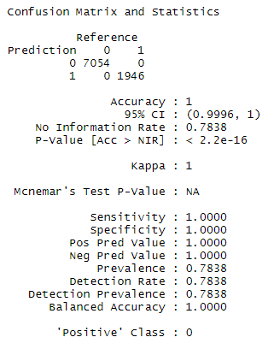
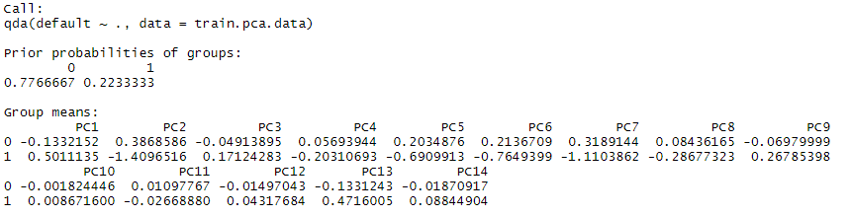
QDPCA
Testing error: 0%

Slide 30
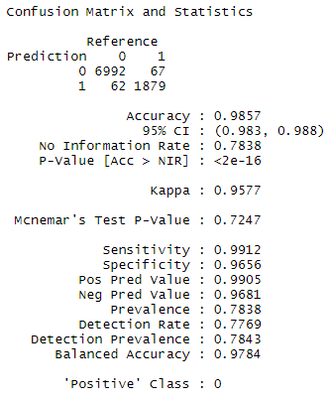
NAÏVE BAYES PCA
Testing error: 1.43%

Slide 31
Conclusion
Multicollinearity played a role in our model before we used principal component analysis
Before principal component analysis our testing error hovered around 20%
After principal component analysis the effects of multicollinearity were removed, and our testing error hovered around zero percent.

