Slide 1
Intervention model to study the effect of the bank's decision by started accepting electronic checks over the internet
Roxanne Salinas & Abeer Ali
STA 6253: Time Series Analysis

Slide 2
Outlines
Introduction.
Types of Interventions.
Goal.
Pre- intervention Model.
Post- intervention Model.
Test for the impact.
Forecast.

Slide 3
Introduction
Intervention analysis, introduced by Box and Tiao (1975), provides a framework for assessing the effect of an intervention on a time series under study. It is assumed that the intervention affects the process by changing the mean function or trend of a time series. Interventions can be natural or man-made, i.e., the series can be effected by a known event that happens at a specific time, such as
fiscal policy changes.
Introduction of new regulatory laws.
Switching suppliers.

Slide 4
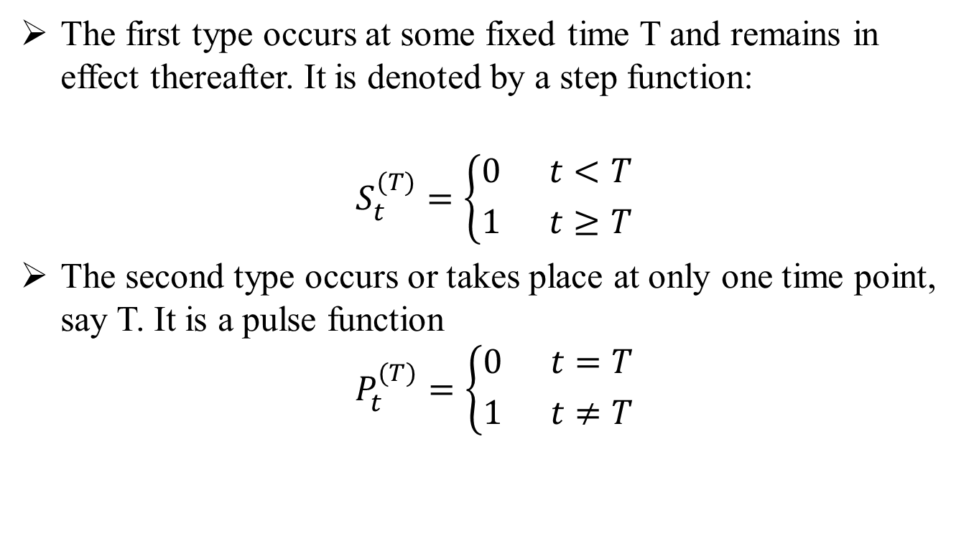
Types of Interventions.
The first type occurs at some fixed time T and remains in effect thereafter. It is denoted by a step function:
$$S_{t}^{(T)}=\left\{{0 t<T \atop 1 t≥T}\right.$$
The second type occurs or takes place at only one time point, say T. It is a pulse function
$$P_{t}^{(T)}=\left\{{0 t=T \atop 1 t≠T}\right.$$

Slide 5
Goal
A national bank started accepting electronic checks over the internet in January 2006. Prior to that date only paper checks were accepted. A local branch collected the data on weekly number of checks processed at that branch from Jan. 2004 to Jan. 2008.
Our goal is to fit an intervention model to study the effect of the bank's decision.
For this problem we will use the step function since the banks still accepting electronic checks until now.

Slide 6
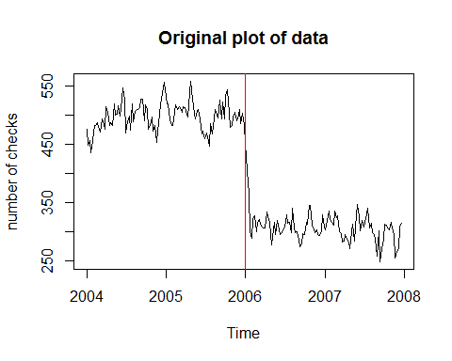
Plot of the original data
From the plot, we can see that there is a Sharp decrease in using the paper checks after 2006.

Slide 7
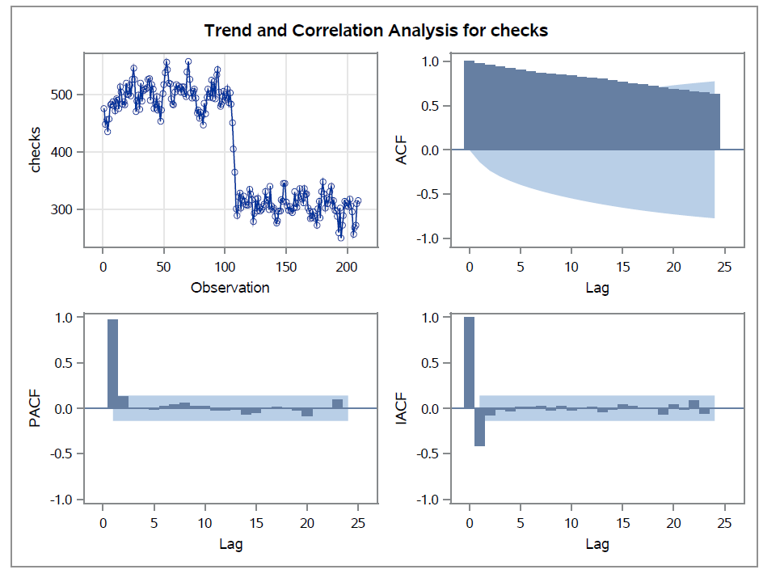
Stationarity
From the plot, we can see that the autocorrelation function is dying slowly which indicates non-stationarity, and indicate a need to take a first difference.

Slide 8
pre-intervention Data
Now, we check the stationarity for the pre-intervention data.
From the plot, we can see that the autocorrelation function is dying slowly which indicates non-stationarity, and indicate a need to take a first difference.

Slide 9
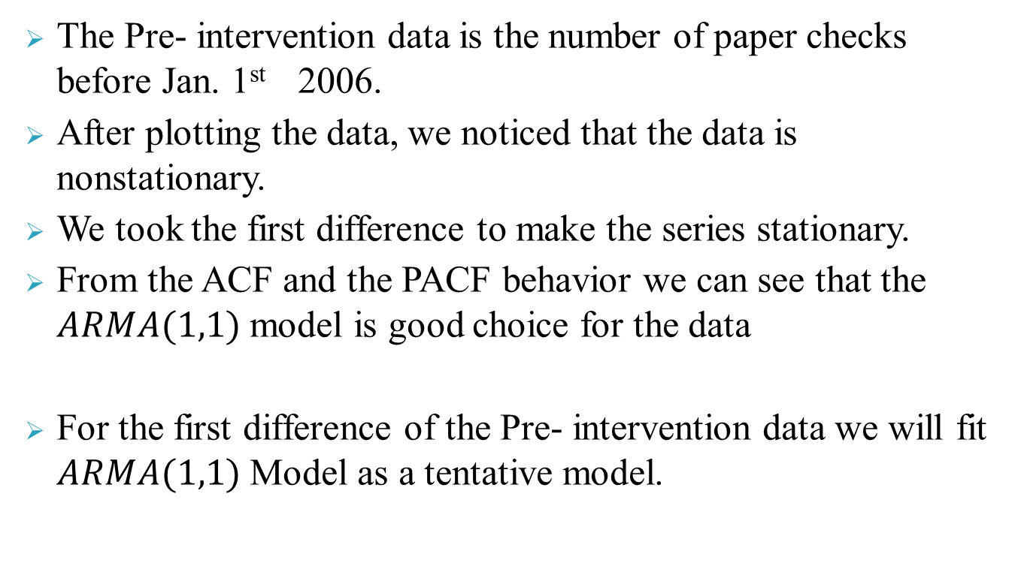
Pre- intervention data
The Pre- intervention data is the number of paper checks before Jan. 1st 2006.
After plotting the data, we noticed that the data is nonstationary.
We took the first difference to make the series stationary.
From the ACF and the PACF behavior we can see that the $ARMA(1,1)$ model is good choice for the data
For the first difference of the Pre- intervention data we will fit $ARMA(1,1)$ Model as a tentative model.

Slide 10
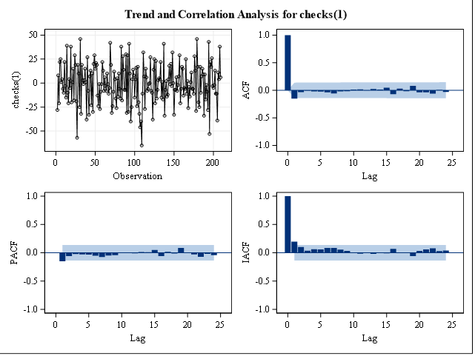
Stationarity
After taking the first difference, we can see form the plots that the stationarity of the series is met, and the autocorrelation function is dying fast.

Slide 11
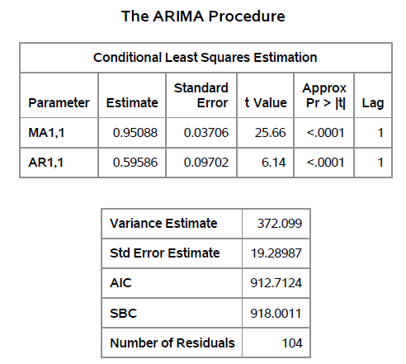
Model: Parameters

Slide 12
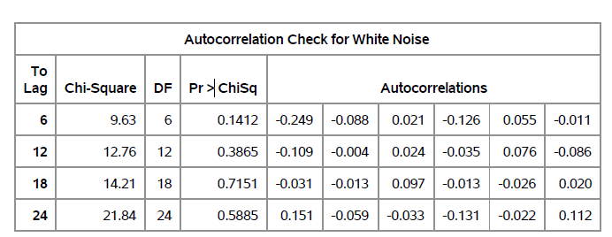
Model: Checking for the white noise
By looking at the table below, we can conclude that residuals are white noise

Slide 13
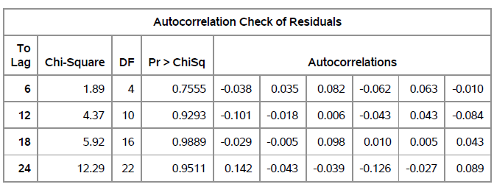
Model
By looking at the table above, we can conclude that parameters are significant.
We will check for residual diagnostics. According to the table below, there is no significant p-values from the Ljung-Box table.

Slide 14
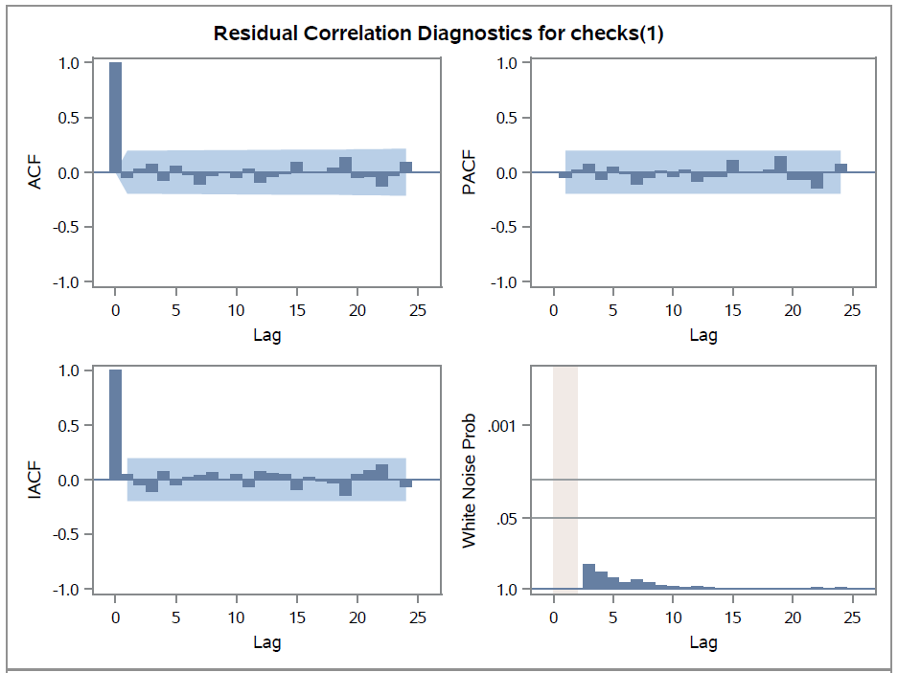
Residual Diagnostics

Slide 15
Residual Diagnostics
The significant spikes are seen in the ACF at lag 1, and on the IACF at lags 1.
Also, below we see no significant spikes in the white noise probability plot.
Next, we turn to the normality assumption. We assume the residuals are normally distributed with a constant variance. Below we show a Histogram and Normal QQ-plot.
With the exception of one outlier on the QQ-plot, the data seems to satisfy the normality assumption.

Slide 16
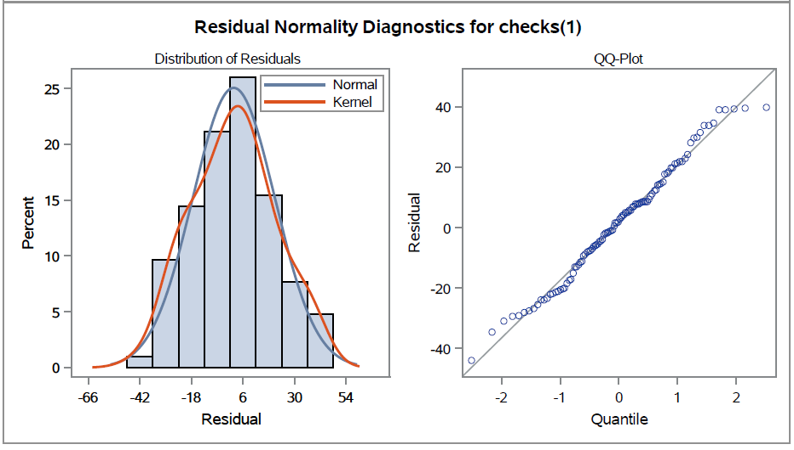
Residual Diagnostics

Slide 17
Post- intervention data
Now, we will test for the Post- intervention data
Next, we create an impact variable which is equal to zero for year before 2006 and equal to 1 afterwards. The CCF plot is shown below.
The plot below shows a significant spike at lag 1, followed by spike at lag 3.
We will check behavior of the ACF and PACF of the residuals.

Slide 18
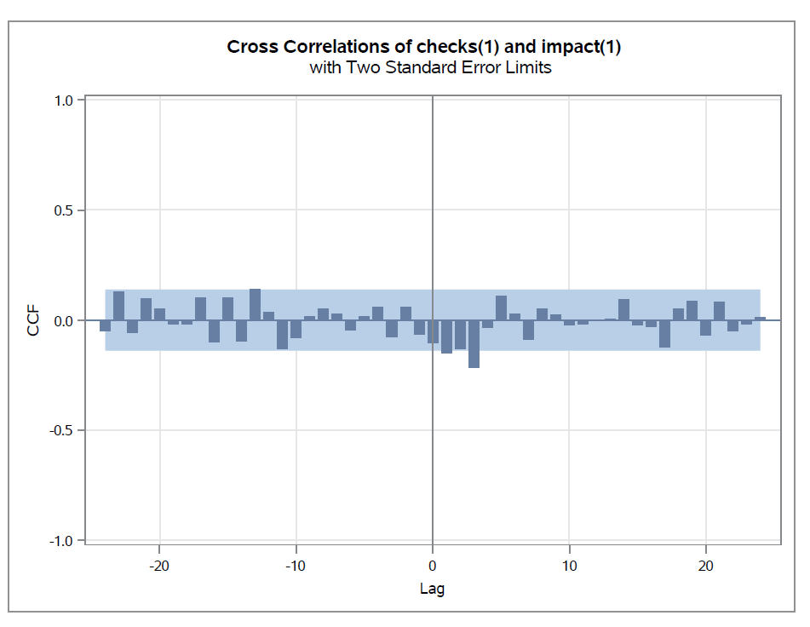
CCF for Impact(1) and Check(1)

Slide 19
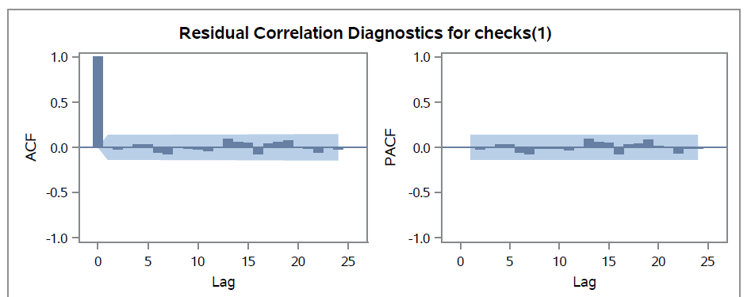
Behavior of the ACF and PACF of the residuals

Slide 20
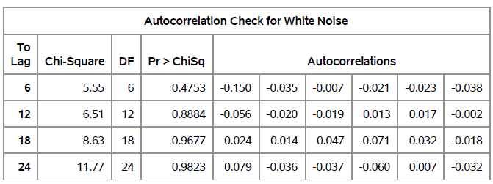

Post- intervention Model
The significant spikes are seen in the ACF at lag 1. After attempting several different combinations of p and q, ultimately the most appropriate noise model appeared to be and $ARMA(1,1)$ at the non-seasonal level.
By looking at the table below, we can conclude that residuals are white noise.

Slide 21
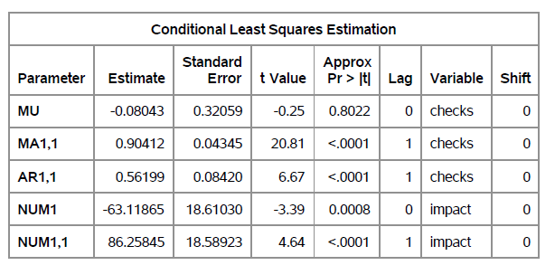
Post- intervention Model
The parameter estimates for the model above are shown in Table below.

Slide 22
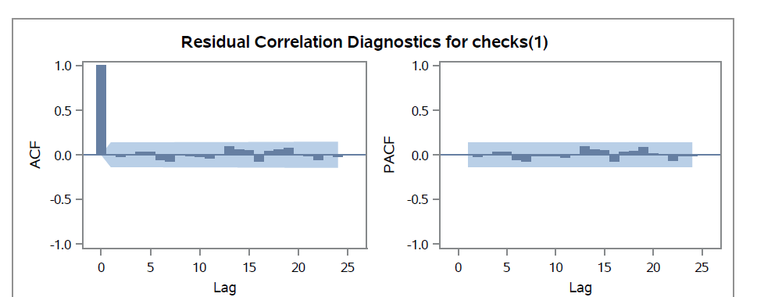
Post- intervention Model
All of the parameters are significant.
Check the behavior of the ACF and PACF of the residuals. From the plot below we can see that The ACF and PACF plots look good, with no significant spikes.

Slide 23
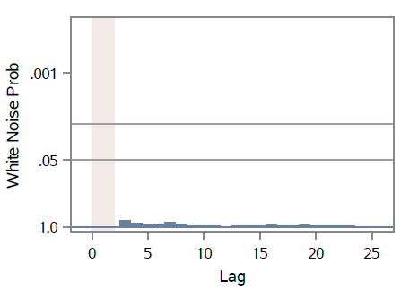
Residual Diagnostics
Check if the residuals are white noise. From the plot below, the white noise probability plot and Ljung-Box table do not show any significance in the autocorrelations.

Slide 24
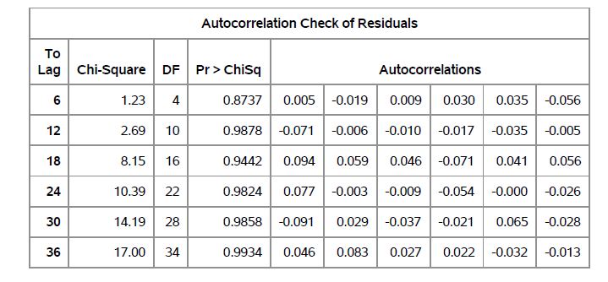
Residual Diagnostics
From the table below we can see that the residuals are not correlated.

Slide 25
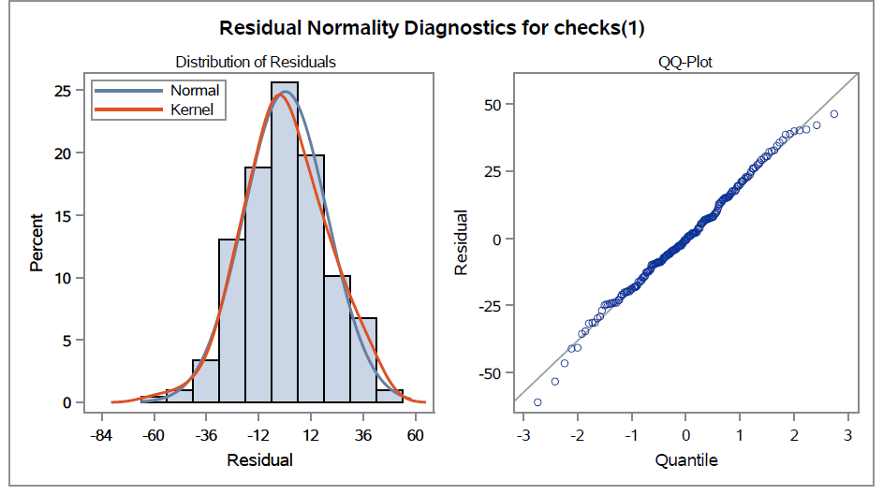
Post- intervention Model
Next, we turn to the normality assumption. We assume the residuals are normally distributed with a constant variance. Below we show a Histogram and Normal QQ-plot.

Slide 26
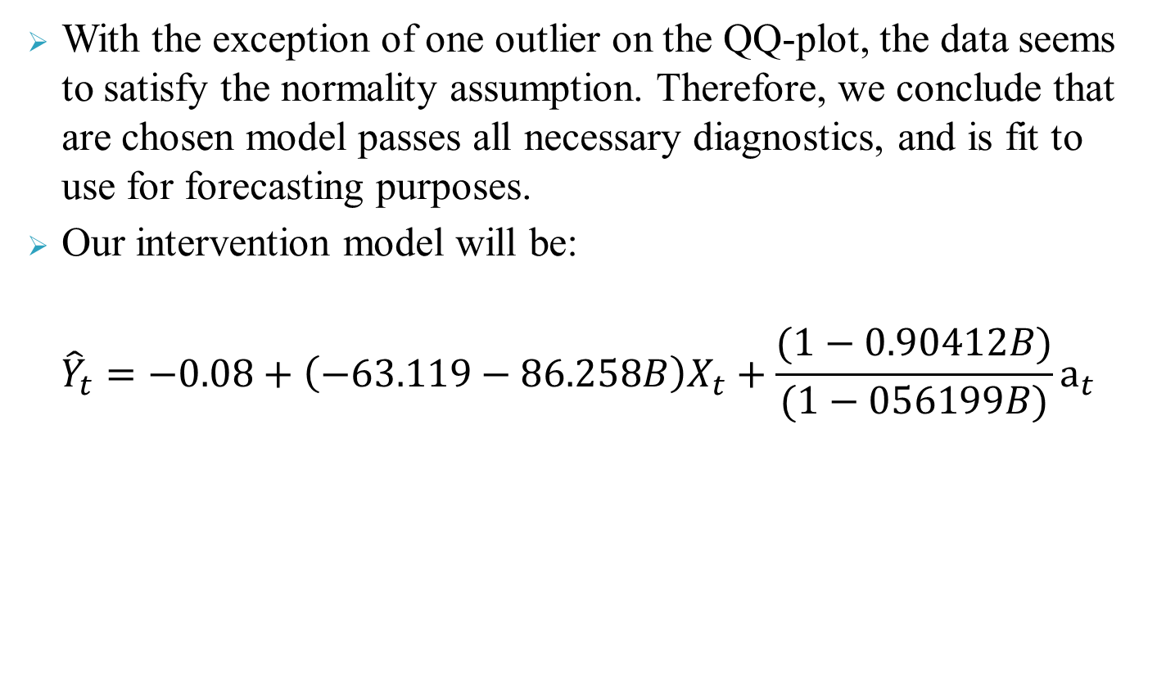
Post- intervention Model
With the exception of one outlier on the QQ-plot, the data seems to satisfy the normality assumption. Therefore, we conclude that are chosen model passes all necessary diagnostics, and is fit to use for forecasting purposes.
Our intervention model will be:
$${\hat{Y}}_{t}=−0.08+\left(−63.119−86.258B\right)X_{t}+\frac{(1−0.90412B)}{(1−056199B)}a_{t}$$

Slide 27
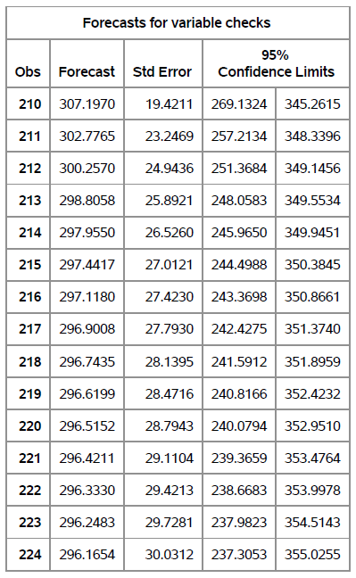
Forecast: forecasted number of the paper checks for 15 week a head

Slide 28
