Slide 1
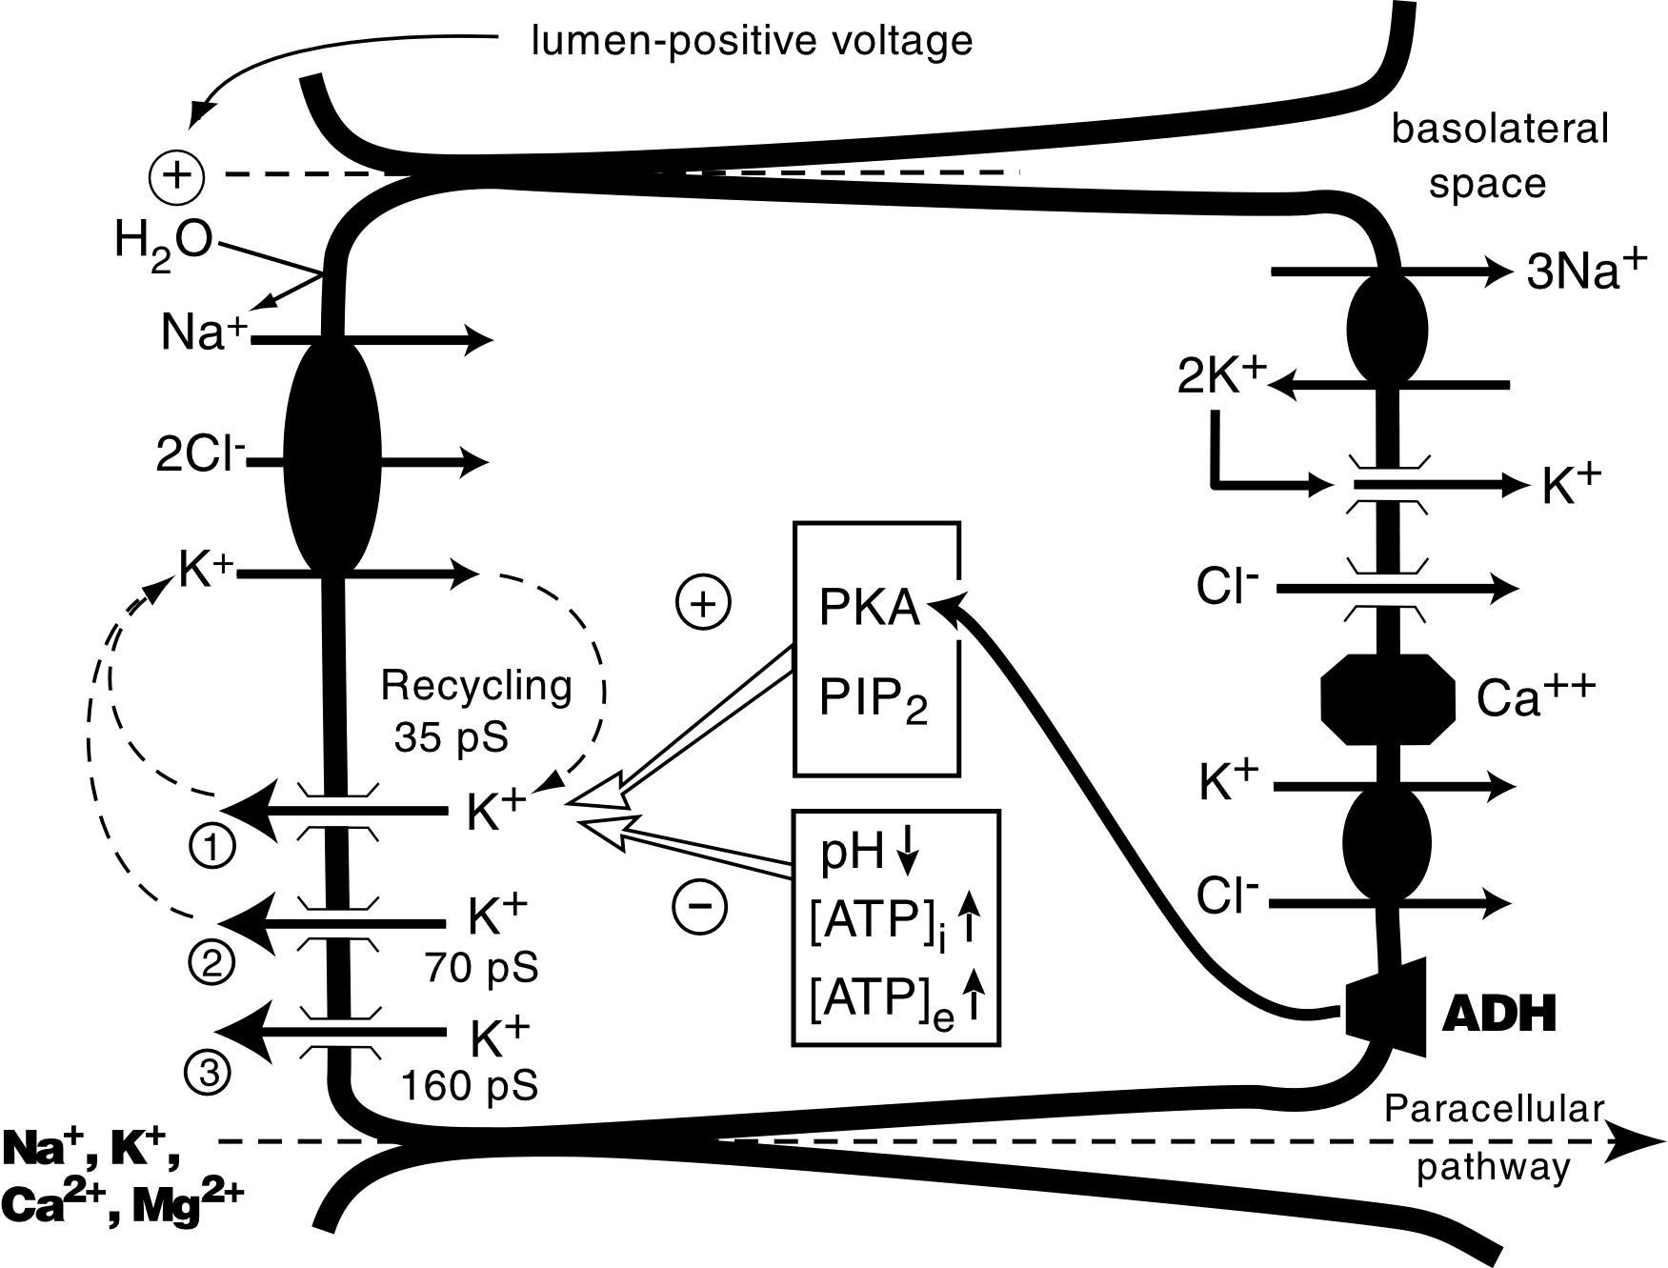
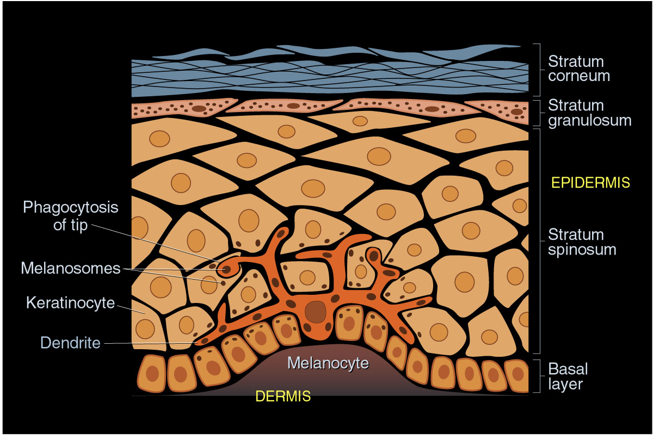
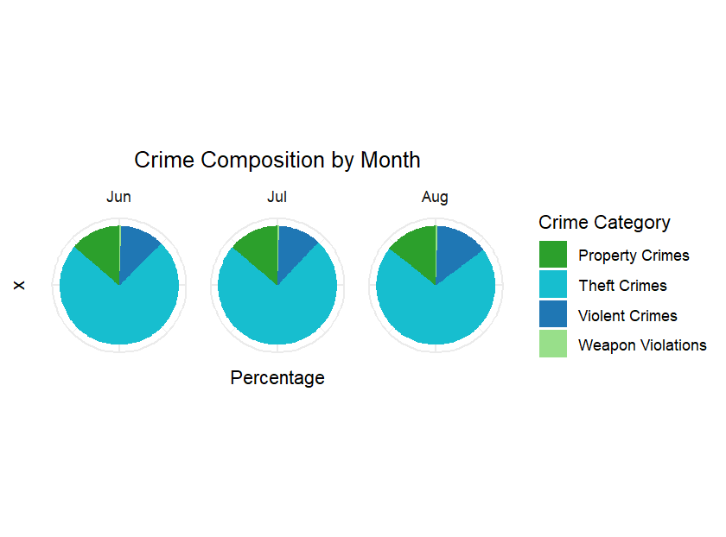
New Haven City Crime Prediction – A Bayesian approach
Shuqi Lin, Ruoxi Teng
Department of Biostatistics, Yale School of Public Health
Affiliations
Introduction
Results
With a crime rate of 39 per one thousand residents, New Haven is one of the most dangerous cities in Connecticut, making crime analysis essential for maintaining community safety. Crime often exists in patterns and is highly correlated with demographics, socioeconomic and physical environment factors. Our study applies a spatio-temporal Bayesian model to analyze local crime patterns over time and space and aims to provide scientific insights to inform targeted prevention and control strategies.
This is a body of text that will repeat over and over until it fills up the page. It requires little thought but says a great deal about layout design for the purpose of this discussion. This is a body of text that will repeat over and over until it fills up the page. It requires little thought but says a great deal about layout design for the purpose of this discussion. This is a body of text that will repeat over and over until it fills up the page. It requires little thought but says a great deal about layout design for the purpose of this discussion. This is a body of text that will repeat over and over until it fills up the page. It requires little thought but says a great deal about layout design for the purpose of this discussion. This is a body of text that will repeat over and over until it fills up the page. It requires little thought but says a great deal about layout design for the purpose of this discussion. This
Table 1. Made in PP
120
1745
3754
195
543
1745
3754
195
543
100
80
Series1
3622
1765
57
5743
3622
1765
57
5743
60
Series2
435
Whatever
Series3
1200
3465
480
1200
3465
435
480
40
436
658
8343
4555
436
658
8343
4555
20
Data Source and Manipulation
0
1
2
3
4
5
6
7
8
9
10
In our study, we leverage real-world data source in crime rate, census tracts and bus stop locations. The crime data comes from CompStat platform of New Haven Police Department. Census tracts data comes from United States Census Bureau, and the location of bus stops come from CT Transit. We geocoded the spatial information to map the exact location through Software .
We consider the following covariates in the model.
Things
100
120
90
100
80
80
70
60
Series1
Whatever
Series2
60
40
Series3
Conclusion
50
20
40
0
This is a body of text that will repeat over and over until it fills up the page. It requires little thought but says a great deal about layout design for the purpose of this discussion. This is a body of text that will repeat over and over until it fills up the page. It requires little thought but says a great deal about layout design for the purpose of this discussion. This is a body of text that will repeat over and over until it fills up the page. It requires little thought but says a great deal about layout design for the purpose of this discussion. This is a body of text that will repeat over and over until it fills up the page. It requires little thought but says a great deal about layout design for the purpose of this discussion. This is a body of text that will repeat over and over
30
1
2
3
4
5
6
7
8
9
10
20
Things
10
0
First
Second
Third
Fourth
Figure 2: Crime Composition by Month
Acknowledgement
This is a body of text that will repeat over and over until it fills up the page. It requires little thought but says a great deal about layout design for the purpose of this discussion. This is a
Figure 1. This is the legend for an image of any kind.

