Slide 1
Biweekly Progress Summary
Rupak Roy

Slide 2
Single Call Data Transfer
Sent the data to GPU at the very beginning and processed it the whole time in the cuda kernel without transferring back to host(CPU)
Used dynamic parallelism for global functions
Observation(Advantages):
- If large chunk of data is sent at a time, it would take a lot less time compared with the small repetitive data transfer.
Observation(Disadvantages):
-dynamic memory allocation takes too much time inside cuda kernel
-blocks and threads cannot be set for device functions
-Applying dynamic parallelism will add too much overhead

Slide 3
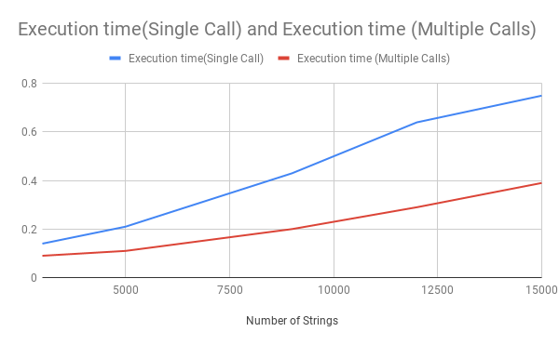
Evaluation of the partial implementation

Slide 4
GPU Data Offloading
Kept a small portion of data in the gpu and measured the execution time
Observation(Advantages):
-Cuda_kernel_launch time and data transfer time reduced significantly
-Execution time decreased almost linearly with the percentage of offloaded data
Observation(Disadvantages):
GPU has been underutilized

Slide 5
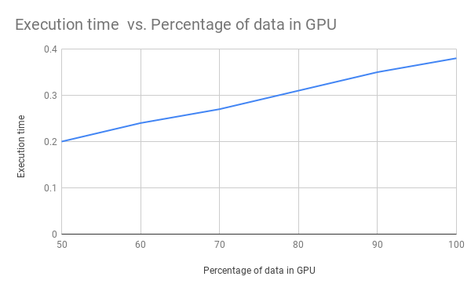
Evaluation of Data Offloading

Slide 6
Memory Management Exploration
Wrote the main points of the paper “vDNN: Virtualized Deep Neural Networks for Scalable, Memory-Efficient Neural Network Design”
Link:https://docs.google.com/document/d/1bgkFKwc_J4I5UwVMnK3PwDOtZn7TDKhl1eYCMY5geKs/edit

