Slide 1
Subhadeep Bhattacharya, Fahim Chowdhury, Rupak Roy
Towards Clustering Graph Representation of Geographic Dataset for Distributed Systems

Slide 2
Outline
Research Problem
Literature Survey
Methodology
Implementation
Experiments
Future Plans
References

Slide 3
Outline
Research Problem
Literature Survey
Methodology
Implementation
Experiments
Future Plans
References

Slide 4
Research Problem
Graph – popular for representing real-world problems e.g. shortest path, community detection
Problems:
Complex connectivity among nodes
High inter-node dependency makes the problems sequential and harder to parallelize
Harder to extract required data efficiently e.g. Max Independent Set is NP-Hard
Incompatible with modern distributed HPC systems
Notes:
The major problems associated with these graph representations are
Some of the nodes connected to multiple nodes. Some of them have no eges, no certain pattern can be found

Slide 5
Research Problem
Research Challenges:
Application of clustering techniques in real world graph to extract data
Improve parallelism to increase compatibility with HPC
Performance maximization using distributed system
Solving real world problems e.g. sssp with high accuracy
Accelerate the existing graph algorithms e.g. Dijkstra, A*
Notes:
The challenges that we faced to approach the graph related problems

Slide 6
Outline
Research Problem
Literature Survey
Methodology
Implementation
Experiments
Future Plans
References

Slide 7
Literature Survey
Improving graph algorithms: Bogle et. al.[1] presents a new distributed-memory, BFS based parallel algorithm, for improving the convergence of iterative solvers.
Improving graph clustering: Dhillon et. al.[2] shows semi-supervised learning can improve the graph clustering results. Kulis et. al.[3] proposes SS-KERNEL KMEANS to optimize a semi-supervised clustering.
Detecting densely connected group: SA-Cluster proposed by Zhou et. al.[4] considers heterogeneous vertex properties (structural and attribute similarities) for clustering.
Notes:
The idea that we find most similar is the idea proposed by Bogle
Dhillon et. al.~\cite{kernel_kmeans} shows semi-supervised learning can improve the graph clustering results and states an objective function for weighted kernel k-means by using Hidden Markov Random Fields, certain class of constraint penalty function and squared Euclidean Distance. Kulis et. al.~\cite{semi_supervised_graph_clustering} proposes SS-KERNELKMEANS to optimize a semi-supervised clustering objective for graph-base inputs by proposing a more generalized formulation and also exhibits an equivalence between the kernel k-means objective function and a special case of the HMRF-based semi-supervised clustering objective.

Slide 8
Outline
Research Problem
Literature Survey
Methodology
Implementation
Experiments
Future Plans
References

Slide 9
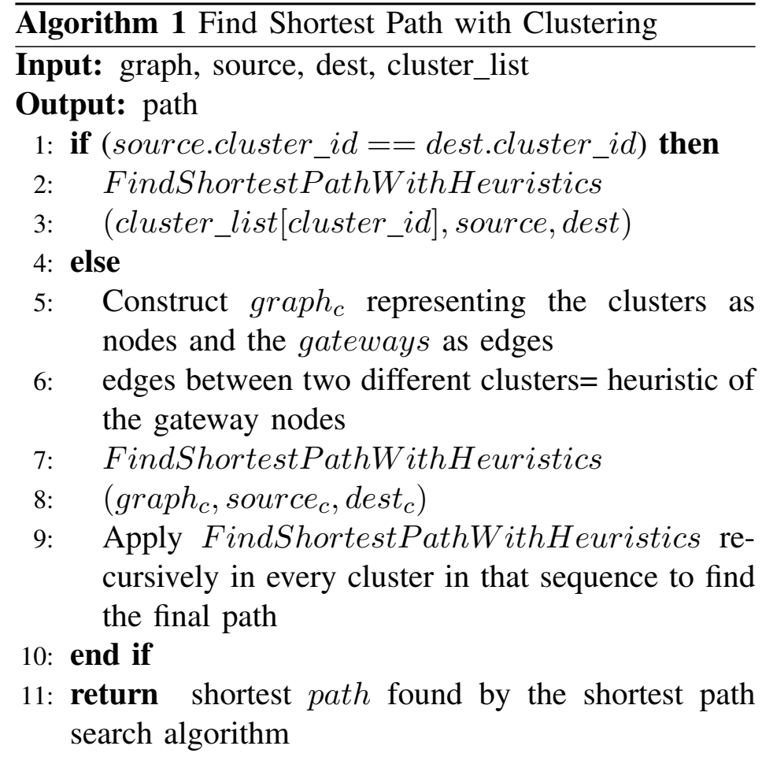
Algorithm Description

Slide 10
Algorithm overview
Step 1: Clustering graph
D
S
Step 2: Gateway Detection
Gateway node
D
S
Gateway edge

Slide 11
Algorithm Overview
Step 3: Intra-cluster Shortest path detection:
D
S
Step 4: Inter-cluster Shortest path detection:
D
S

Slide 12
Outline
Research Problem
Literature Survey
Methodology
Implementation
Experiments
Future Plans
References

Slide 13
Distributed System Architecture
mpi_communication
Master Process
M
Clustered subgraph
Intra-cluster shortest path
C=Cluster ID
C=1
C=2
C=3
Child Processes

Slide 14
Tools
Python 3.7.3
Packages
osmnx: provides api’s for OSM XML data importing
networkx: graph abstraction and algorithms
scikit-learn: clustering algorithms
pickle: dumping binary data after clustering
mpi4py: python support for distributed systems

Slide 15
Dataset
OpenStreetMap: free map geographic map data
Given parameters: node, way, relation/attributes
Data Format: XML
Map used for prototype evaluation:
Tallahassee, Florida
~100MB raw XML data

Slide 16
Outline
Research Problem
Literature Survey
Methodology
Implementation
Experiments
Future Plans
References

Slide 17
Results
Experimental Setup:
The experiments were run on innovation cluster
Number of nodes were varied based on number of clusters e.g., 8 nodes were used for k=8
One process per node
Each datapoint is achieved by taking the average of 10 iterations to find shortest path between random source and destination

Slide 18
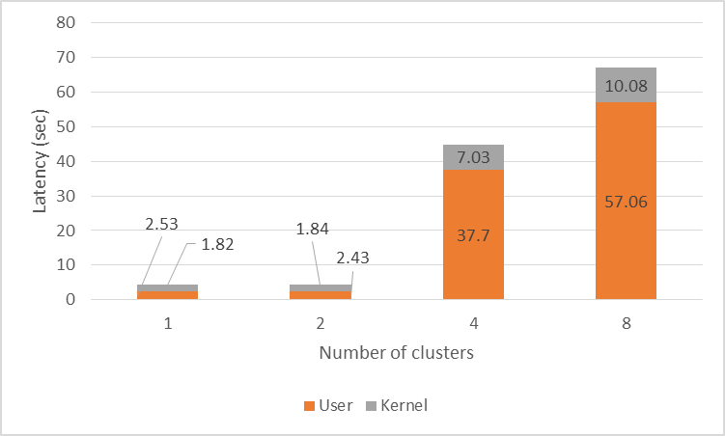
K-means Clustering (Latency)
Latency increases with increasing number of clusters
K-means clustering still has huge inter-cluster dependencies
Could not leverage HPC resources due to solving dependencies

Slide 19
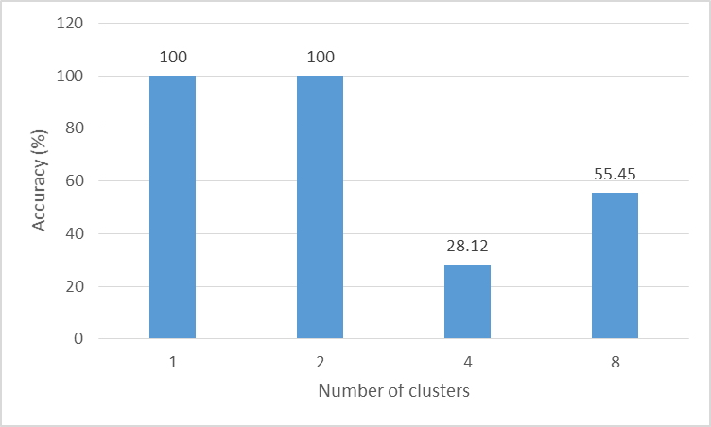
K-means Clustering (Accuracy)
Accuracy drastically drops with increasing number of clusters
Probably many internal connectivity were compromised providing a suboptimal result

Slide 20
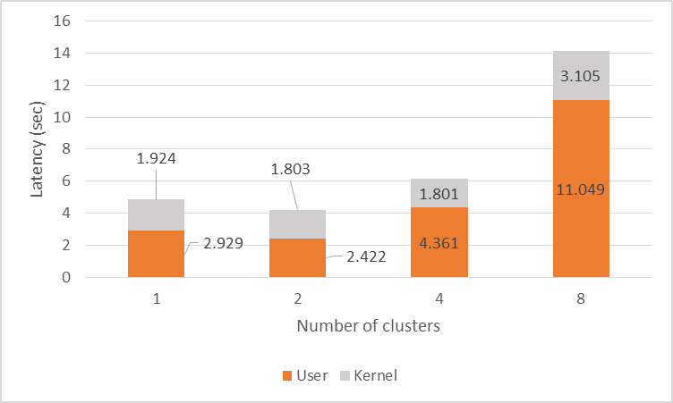
Agglomerative Clustering (Latency)
Latency increases with increasing number of clusters
Agglomerative clustering have lower inter-cluster dependencies than K-means
Still could not leverage HPC resources
Showed better results than K-means

Slide 21
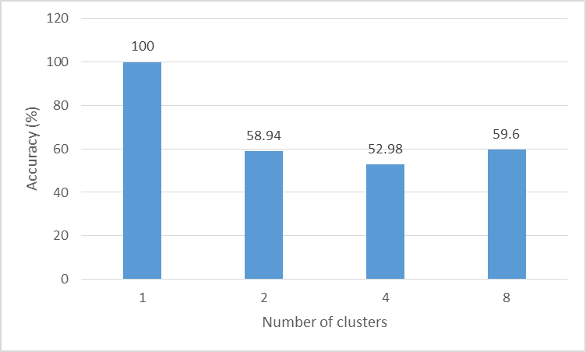
Agglomerative Clustering (Accuracy)
Accuracy drops with increasing number of clusters
Internal connectivity were compromised
Agglomerative clustering results show better accuracy than K-means clustering

Slide 22
Outline
Research Problem
Literature Survey
Methodology
Implementation
Experiments
Future Plans
References

Slide 23
Next Steps
Apply techniques on clustering algorithms to reduce inter-cluster edges
Optimize the gateway detection algorithm further
Evaluate our approach for heuristic based shortest path algorithm, e.g, A*
Evaluate the performance for other clustering algorithms, e.g., Spectral clustering
Notes:
As of now we are considering all the inter cluster edges. For the next step we would like use a heuristic to reduce inter-cluster edges to make the computation faster

Slide 24
Outline
Research Problem
Literature Survey
Methodology
Implementation
Experiments
Future Plans
References

Slide 25
References
[1] Bogle, Ian, et al. "A Parallel Graph Algorithm for Detecting Mesh Singularities in Distributed Memory Ice Sheet Simulations." Proceedings of the 48th International Conference on Parallel Processing. ACM, 2019.
[2] Dhillon, Inderjit S., Yuqiang Guan, and Brian Kulis. "Kernel k-means: spectral clustering and normalized cuts." Proceedings of the tenth ACM SIGKDD international conference on Knowledge discovery and data mining. ACM, 2004.
[3] Kulis, Brian, et al. "Semi-supervised graph clustering: a kernel approach." Machine learning 74.1 (2009): 1-22.
[4] Zhou, Yang, Hong Cheng, and Jeffrey Xu Yu. "Graph clustering based on structural/attribute similarities." Proceedings of the VLDB Endowment 2.1 (2009): 718-729.

Slide 26
Thank you

Slide 27
Questions?

