Slide 1
Capstone Project-2: Supervised ML - Regression
Project Title: SGEMM GPU Kernel Performance Team Members Subhankar Roy Debatra Das Sujoy Das Anupam Ghosh

Slide 2

Presentation Outline:
Problem Statement
Project Objective
Exploring the dataset
Methodology
EDA and Data Processing
ML Model – Regression
Conclusion

Slide 3
Problem Description:
This data set measures the running time of a matrix-matrix product A∗B=C, where all matrices have size 2048 x 2048, using a parameterizable SGEMM GPU kernel with 241600 possible parameter combinations. For each tested combination, 4 runs were performed and their results are reported as the 4 last columns. All times are measured in milliseconds*.
There are 14 parameter, the first 10 are ordinal and can only take up to 4 different powers of two values, and the 4 last variables are binary. Out of 1327104 total parameter combinations, only 241600 are feasible (due to various kernel constraints). This data set contains the results for all these feasible combinations.
The experiment was run on a desktop workstation running Ubuntu 16.04 Linux with an Intel Core i5 (3.5GHz), 16GB RAM, and a NVidia Geforce GTX 680 4GB GF580 GTX-1.5GB GPU. We use the 'gemm_fast' kernel from the automatic OpenCL kernel tuning library 'CLTune' ([Web Link]).
* Note: for this kind of data sets it is usually better to work with the logarithm of the running times

Slide 4

Objective of our Project:
Predicting the running time for multiplying two 2048 x 2048 matrices using a GPU OpenCL SGEMM kernel with varying parameters.

Slide 5

Exploring the Dataset

Slide 6
Data Summary:
There are 14 parameter, the first 10 are ordinal and can only take up to 4 different powers of two values, and the 4 last variables are binary. Out of 1327104 total parameter combinations, only 241600 are feasible (due to various kernel constraints). This data set contains the results for all these feasible combinations.
Columns name:
'MWG', 'NWG', 'KWG', 'MDIMC', 'NDIMC', 'MDIMA', 'NDIMB', 'KWI', 'VWM', 'VWN', 'STRM', 'STRN', 'SA', 'SB', 'Run1 (ms)', 'Run2 (ms)', 'Run3 (ms)', 'Run4 (ms)'

Slide 7
Variable Breakdown:
Independent variables:
MWG, NWG: per-matrix 2D tiling at workgroup level: {16, 32, 64, 128} (integer)
KWG: inner dimension of 2D tiling at workgroup level: {16, 32} (integer)
MDIMC, NDIMC: local workgroup size: {8, 16, 32} (integer)
MDIMA, NDIMB: local memory shape: {8, 16, 32} (integer)
KWI: kernel loop unrolling factor: {2, 8} (integer)
VWM, VWN: per-matrix vector widths for loading and storing: {1, 2, 4, 8} (integer)
STRM, STRN: enable stride for accessing off-chip memory within a single thread: {0, 1} (categorical)
SA, SB: per-matrix manual caching of the 2D workgroup tile: {0, 1} (categorical)
Output:
Run1, Run2, Run3, Run4: performance times in milliseconds for 4 independent runs using the same parameters. They range between 13.25 and 3397.08.

Slide 8
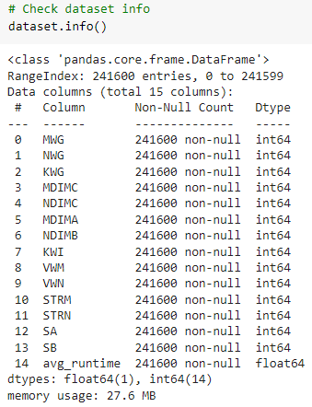
Attribute information: data type

Slide 9
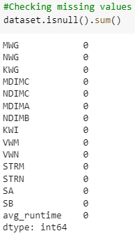
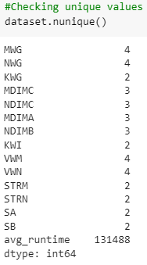
Attribute information: missing value and unique value count

Slide 10

METHODOLOGY

Slide 11
Approach:
Identify Dependent Variable
Missing Value & Outlier Detection
Variable Transformation
EDA
Train-Test Split
Model Building
Model Evaluation
Model Validation
Final Model

Slide 12

EDA and Data Processing

Slide 13
Defining the Target Variable:
We have four different run time in our target variable (Run1, Run2, Run3, Run4). we calculate the average to convert this four runtimes into a single runtime name ‘avg_runtime’.
Then we see that there is a large variation in the 'avg_runtime' feature and avg_runtime mean (217.57) >> median (69.79), that means our target variable is positively skewed.
To remove this skewness we apply log transformation and make the target variable looking normally distributed.

Slide 14
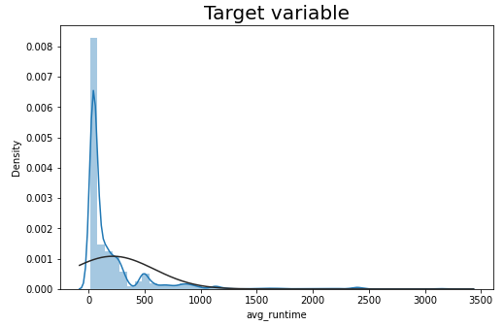
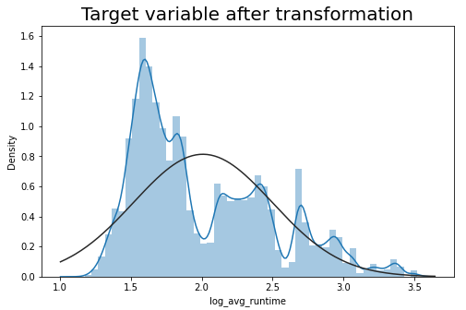
Defining the Target Variable:
We see that after log transformation, our target variable avg_runtime is normally distributed.

Slide 15
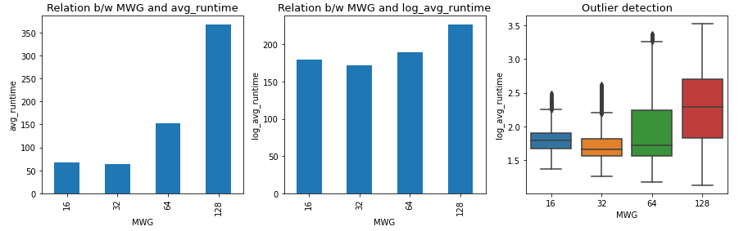
Analysis on: MWG
Before the log transformation on target variable, MWG is negatively distributed whereas after transformation, MWG is normally distributed.

Slide 16
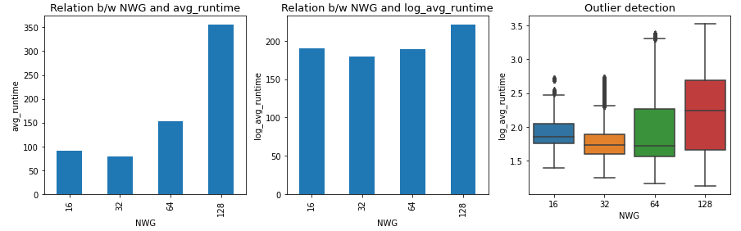
Analysis on: NWG
Before the log transformation on target variable, NWG is negatively distributed whereas after transformation, NWG is normally distributed.

Slide 17
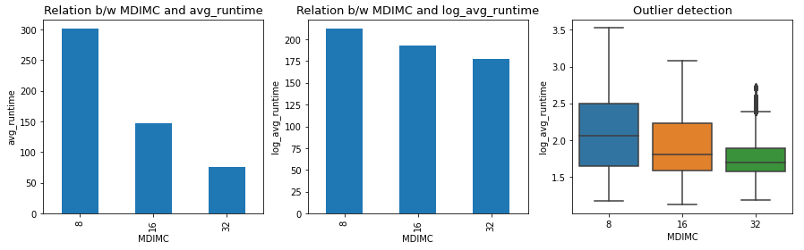
Analysis on: MDIMC
Before the log transformation on target variable, MDIMC is positively distributed whereas after transformation, MDIMC is normally distributed.

Slide 18
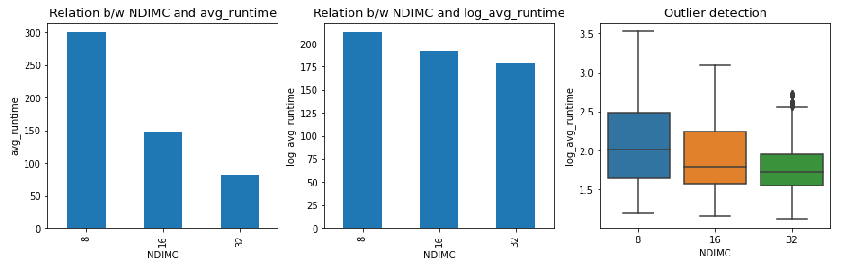
Analysis on: NDIMC
Before the log transformation on target variable, NDIMC is positively distributed whereas after transformation, NDIMC is normally distributed.

Slide 19
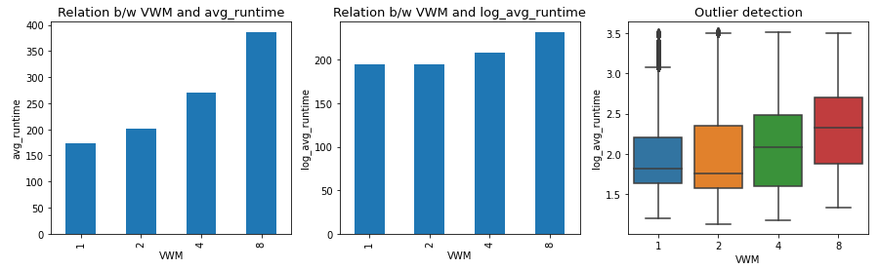
Analysis on: VWM
Before the log transformation on target variable, VWM is negatively distributed whereas after transformation, VWM is normally distributed.

Slide 20
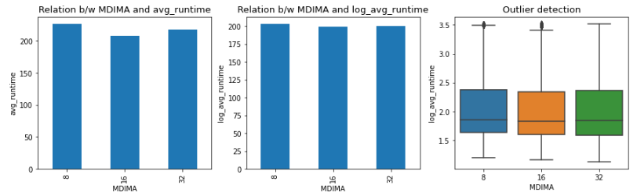
Analysis on: MDIMA
Before and after the log transformation MDIMA is normally distributed.

Slide 21
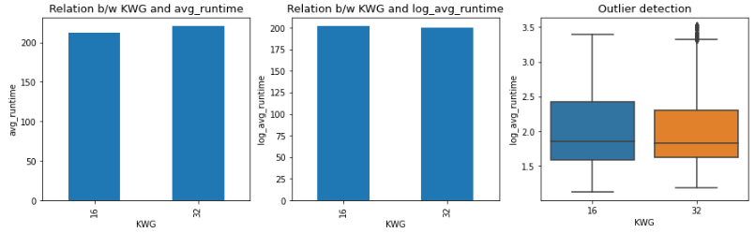
Analysis on: KWG
Before and after the log transformation KWG is normally distributed.

Slide 22
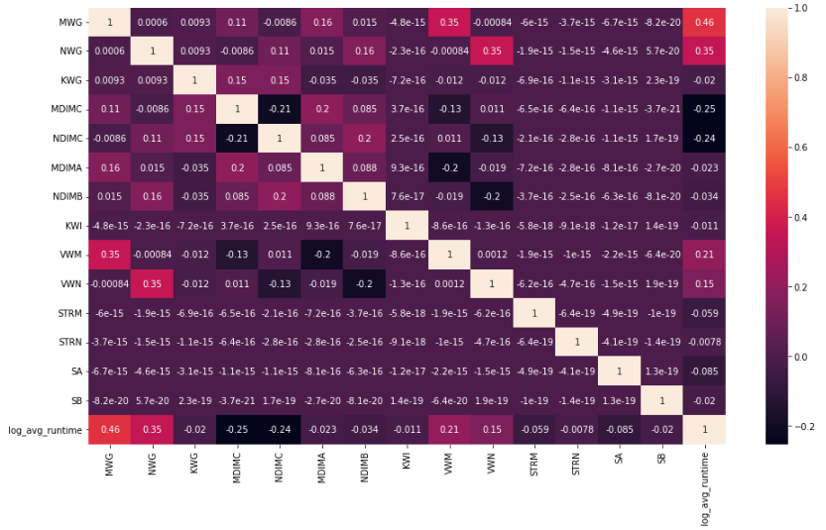
Analysis on : Correlation Heat map

Slide 23
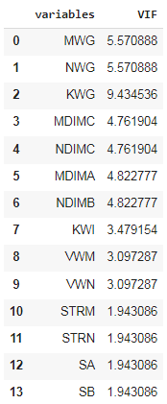
Multicollinearity Check
There is no severe multicollinearity present between exploratory variables.
From the previous heat map, we can observe there is no strong correlation between KWG and the other explanatory variables, thus we can allow KWG in our final model despite having slightly higher VIF score

Slide 24

ML Model – Regression

Slide 25
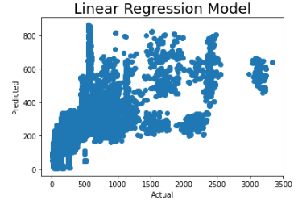
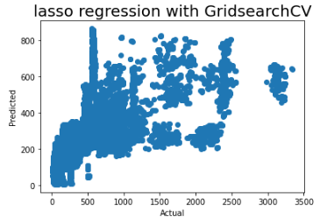
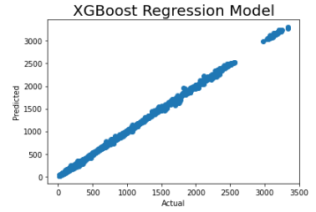
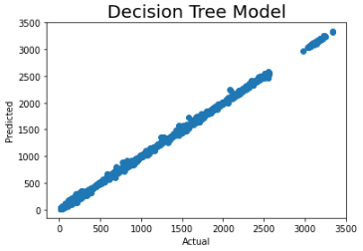
ML Model: Actual v/s Predicted

Slide 26
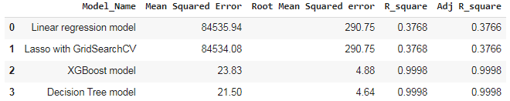
Model Comparison based on performance:
We know, the lesser the value of MSE, RMSE, the better is the algorithm and the higher the value of R-sq and Adjusted R-sq, the better is the algorithm.
From the above comparison table, we can see, Decision Tree model has the least MSE, RMSE scores and the highest R-sq and Adjusted R-sq scores.
Therefore we can conclude that Decision Tree model is yielding best results for this particular project.

Slide 27
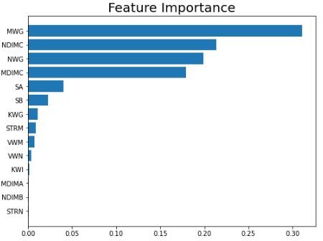
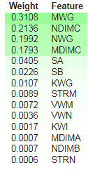
Feature Importance:
We see that MWG,NDIMC,NWG,MDIMC are the top 4 most important features and STRN, NDIMB, MDIMA are 3 least important features.

Slide 28
Conclusion:
Since the Decision Tree model has the least MSE, RMSE scores and the highest R-sq and Adjusted R-sq scores, hence we can conclude Decision Tree model as our final model for this project.
In this model MWG,NDIMC,NWG,MDIMC are the top 4 most important features and STRN, NDIMB, MDIMA are the 3 least important features.

Slide 29
Thank you

