Slide 1

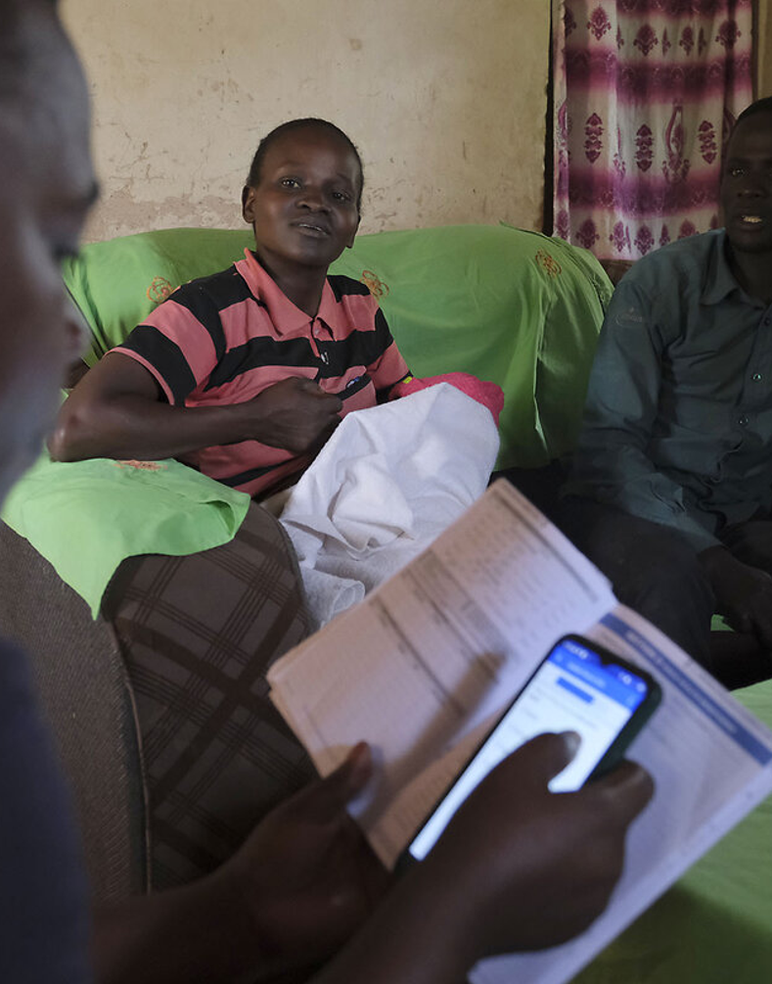


HACK FOR HUMANITY · WITH QWEN
Msaada
Help reaches the household first.
A home-visit mental-health triage platform for Kenya’s 90,000+ Community Health Volunteers — capture a natural observation, structure it safely, route the right workflow, track the outcome.
♥
Built for CHVs, not chatbots
Roy Wanyoike · msaada — CHV triage system
github.com/Roy-Wanyoike/msaada
Notes:
- Opening line: "Msaada means help — this is help that reaches the household first."
- Why we built it: 90% of Kenyans who need mental-health support never reach the system — yet a CHV already walks past their door every week.
- One-breath pitch: capture a natural observation, structure it safely, route the right workflow, track the outcome.
- Credit the builder: Roy Wanyoike — code at github.com/Roy-Wanyoike/msaada; live demo comes later in the deck.

Slide 2
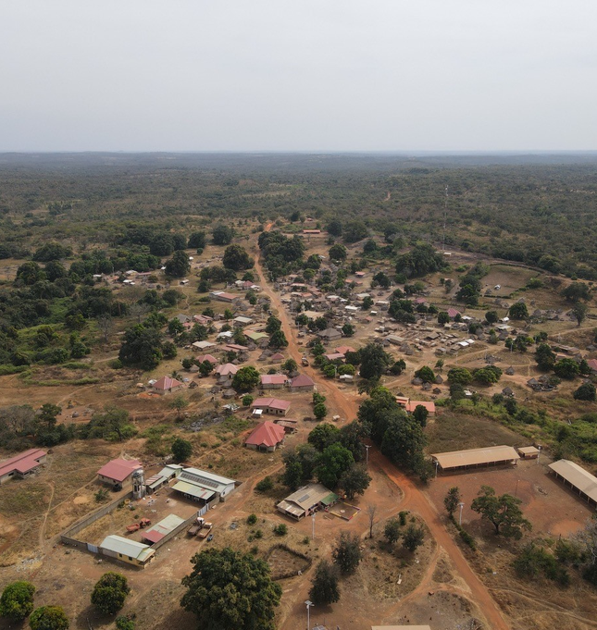

THE PROBLEM
Kenya’s mental-health gap is not a treatment failure — it is a detection & routing failure.
90%+
of Kenyans who need mental-health support never receive it (Kenya Mental Health Policy 2015–2030)
90,000+
CHVs across all 47 counties, each covering 100–500 households — volunteers with paper notebooks and no routing tool
0
structured records of the earliest household signals: a mother who stopped sleeping, a child withdrawn from school, a father expressing hopelessness
By the time a signal reaches the health system it has usually escalated into an acute incident a facility must react to. The facilities exist. The CHVs exist. The policy framework exists. What is missing is the connective tissue.
◎
Rural & informal-settlement households: Kibra, Mathare, Mukuru — where stigma blocks self-referral and the CHV is the only observer.
Notes:
- 90% treatment gap — the pipeline fails long before treatment ever starts.
- 90,000+ CHVs are often the only observer inside the household — armed with paper notebooks, no routing tool.
- The earliest signals — a sleepless mother, a withdrawn child, a hopeless father — are captured nowhere; zero structured records.
- Reframe for judges: not a treatment failure, a detection & routing failure — the connective tissue is missing.

Slide 3

“
WHAT WE ARE BUILDING
“We are not building an AI therapist. We are building an intelligence and safety layer around the frontline healthcare workforce — so the earliest signals in a community become visible, actionable and trackable.”
— Msaada product thesis
◖
◯
⚖
◆
CHVs speak naturally — Kiswahili, Sheng or English
AI structures the observation into WHO-aligned triage flags — never the CHV’s job
deterministic safety policy decides what happens next — the model never decides
de-identified trends give counties visibility before crisis
Notes:
- Core contrast: consumer mental-health chatbots talk TO people — Msaada instruments the workforce that already talks WITH them.
- The workforce already exists (90,000+ CHVs); Msaada adds the intelligence and safety layer around it.
- Read the thesis verbatim; pause on "visible, actionable and trackable".
- The four cards preview the demo: natural input, AI structuring, deterministic policy, county-level trends.

Slide 4
HOW IT WORKS
From a spoken sentence to a tracked outcome in one visit.
01
◖
02
☰
03
◯
04
⚖
05
✦
Speak or type
Scrub
Structure
Decide
Route & track
CHV dictates the visit naturally (English / Kiswahili / Sheng)
→
PII scrubber strips names, phones, landmarks before anything is stored; the raw observation is NEVER persisted
→
Qwen (ModelScope) extracts classification, observed indicators, aggregate tag, confidence
→
versioned deterministic policy engine evaluates: routine / follow-up / referral / crisis_override
→
referral lifecycle + follow-ups + de-identified county dashboard
⇄
BEFORE
·
AFTER
notebook → pocket → acute incident at facility
observation → structured signal → early community-level intervention
Notes:
- Walk the five steps left to right in under a minute, using one concrete example sentence.
- Emphasise steps 2 and 4 are NOT AI steps — deterministic code and a versioned policy engine.
- Step 2: the raw observation is never persisted; PII is stripped before anything is stored.
- Step 4: crisis_override fires by rule, not by model confidence.
- Land on the BEFORE→AFTER strip: notebook-to-acute-incident becomes early community-level intervention.

Slide 5

SAFETY BY DESIGN
The model extracts signals. Deterministic policy controls the escalation.
AUTOMATIC · NON-DISMISSABLE
⚠
⚖
AI interprets, policy controls safety, humans control care
crisis_override
The architecture consensus from global AI-in-health failures — implemented literally.
When the observation contains suicidality or crisis indicators, a non-dismissable crisis panel fires at the point of observation — the AI's classification is bypassed by rule, not by model confidence.
⛨
PII never persisted
The raw observation is discarded by construction — dashboards never read indicator text.
☎
Kenya Red Cross 1199
✦
Befrienders Kenya +254 722 178 177
✦
Policy engine is versioned & auditable v1.0.0
Every decision records which policy version decided.
♟
Instruction: do not leave the household unaccompanied
Notes:
- This slide is our answer to "is AI in mental health safe?" — the model never decides.
- crisis_override fires by deterministic rule at the point of observation; model confidence plays no role in escalation.
- The panel is non-dismissable: Kenya Red Cross 1199, Befrienders Kenya +254 722 178 177, and the do-not-leave-the-household instruction.
- PII is discarded by construction — dashboards never read indicator text.
- Policy engine v1.0.0 is versioned and auditable: every decision records which policy version decided.

Slide 6
CONTINUITY OF CARE
“Referral created” is not “help received”.
⌘
Typical tools stop here
✦
Msaada tracks the lifecycle
＋
Referral created
REFERRAL LIFECYCLE
↓
CREATED
›
SENT
›
ACKNOWLEDGED
›
IN_PROGRESS
›
COMPLETED
▣
Record closed
↓
⊘
County never learns the outcome
FOLLOW-UPS
PENDING
›
DONE
/
MISSED
✿
Households are linked to encounters, encounters to triage records, records to referrals — the full identity chain is queryable for audit and supervision.
Notes:
- Core claim: "referral created" is not "help received" — typical tools close the record and go dark.
- Msaada tracks the full lifecycle: CREATED, SENT, ACKNOWLEDGED, IN_PROGRESS, COMPLETED — plus follow-ups PENDING, DONE or MISSED.
- Outcome-tracking is what counties actually buy: visibility into results, not activity.
- Volunteers get follow-up reminders instead of forgotten cases.
- Households → encounters → triage records → referrals: the identity chain is queryable for audit and supervision.

Slide 7
BUILT FOR THE SYSTEM
Aligned with the policy window — not against it.
⚑
01
✦
02
Kenya Mental Health Policy 2015–2030
Community Health Strategy & eCHIS
Explicitly calls for community-level mental-health integration — the exact layer Msaada fills.
The CHV platform is being digitised nationally; Msaada adds the intelligence + safety layer on top.
⛨
03
✿
04
ODPC-aligned by construction
Institution-led onboarding
De-identification at the data layer — sensitive personal data handled per the Data Protection Act.
County admin → community health officers → CHVs; no self-signup, every account traces to an institution.
Notes:
- We ride the eCHIS digitisation wave instead of inventing a parallel system.
- Kenya Mental Health Policy 2015–2030 explicitly calls for community-level integration — the exact layer Msaada fills.
- ODPC alignment is by construction: de-identification at the data layer, sensitive personal data handled per the Data Protection Act.
- Institution-led onboarding: county admin → community health officers → CHVs; no self-signup, every account traces to an institution.

Slide 8
FIELD-FIRST ENGINEERING
Works in a ward with no network.
Syncs when it returns.
◌
WORKS WITHOUT NETWORK
1
Draft locally
Encounter drafts are queued on-device the moment a visit ends.
DRAFT
›
QUEUE
›
SYNC
2
Sync automatically
Drafts flush to Supabase when connectivity returns — upsert by client UUID, duplicates impossible.
3
Never lose a signal
INPUT MODES
A crisis observed offline is still captured, timestamped and routed on sync.
◖
Spoken dictation
✎
Typed notes
⇄
Eng / Swa / Sheng mixed
Connectivity is not a luxury in informal settlements and rural wards — the tool assumes it will disappear.
Notes:
- Connectivity is not a luxury — the tool assumes the network will disappear mid-visit.
- Drafts queue on-device the moment a visit ends; they flush to Supabase on reconnect (upsert by client UUID, duplicates impossible).
- Draft-queue flush reasons are explicit: offline / not configured / not signed in.
- A crisis observed offline is still captured, timestamped and routed on sync — no lost signals.
- Input modes: spoken dictation, typed notes, Eng/Swa/Sheng mixed.

Slide 9
THE BUILD
A working product, not a prototype.
15
✦
30+
✦
13/13
✓
pages & flows shipped
API endpoints
end-to-end smoke checks passing
report, dashboard, cases, referrals, households, admin, supervisor, audit…
incl. /api/triage, /api/health, offline-sync
on every release (live Qwen triage, auth, sync, crisis override)
v1.0.0
⚖
100%
✦
0
⚿
deterministic policy engine
tsc-clean TypeScript, ESLint
secrets in the repo
versioned & auditable
CI on every push
keys resolve lazily, config fails fast in production
STACK
Next.js 16 (Turbopack)
Qwen via ModelScope (OpenAI-compatible)
Supabase SSR auth
Prisma
Tailwind 4
Notes:
- Judged on engineering: typed, tested, audited, deployable.
- 13/13 end-to-end smoke checks run on every release — live Qwen triage, auth, sync, crisis override included.
- Policy engine v1.0.0 is versioned and auditable: every decision records which policy version decided.
- Zero secrets in the repo — keys resolve lazily and config fails fast in production.
- Stack: Next.js 16 Turbopack, Qwen via ModelScope, Supabase SSR auth, Prisma, Tailwind 4.

Slide 10
LIVE DEMO
Three clicks to the hardest workflow.
☁
1
Sign in as a CHV
☁
demo@msaada.health / msaada123 — fresh deployments seed this automatically.
Deploys itself
2
Report a visit
ON A FRESH DEPLOYMENT
/report: type or dictate a mixed Sheng/English observation about a mother with suicidal ideation.
✓
Database self-provisions
✓
Demo data seeds automatically
✓
Zero manual setup for judges
3
Watch crisis_override fire
non-dismissable crisis panel with 1199 + Befrienders line + do-not-leave instruction, case created ready for assignment.
4
See the system react
CHV DEMO ACCOUNT
/dashboard county trends, /cases assignment flow, /admin onboarding (county.admin@msaada.health), /status live health probes (database / Qwen / Supabase).
demo@msaada.health / msaada123
☻
Notes:
- Rehearse the exact Sheng observation before presenting.
- fallbackUsed=false means the live model answered, not a canned response.
- Crisis panel is non-dismissable: 1199, Befrienders line, do-not-leave instruction.
- Fresh deployments seed demo data automatically — zero manual setup for judges.
- Walk /dashboard, /cases, /admin and /status only if time allows.

Slide 11
ROADMAP
Shipped today, designed for what’s next.
NOW
NEXT
THEN
LATER
➤
SHIPPED
◖
◌
⚖
Working MVP
Voice notes
Reach
Haki integration
This demo: triage, crisis override, referrals, dashboards, offline sync.
ASR via DashScope escape hatch — chat stays on ModelScope, speech runs on qwen3-asr.
SMS/USSD fallback for feature phones, PWA install, Kiswahili-first UI.
Companion governance/legal-rights product, deliberately deferred so Msaada ships focused.
01
02
03
04
⛨
Every stage reuses the same deterministic safety layer — new input channels, unchanged guarantees.
Notes:
- NOW is shipped — everything else is design intent on a working core.
- Voice: chat stays on ModelScope; speech via DashScope qwen3-asr escape hatch.
- Name Haki as a conscious scope decision, not vaporware.
- Same deterministic safety layer at every stage — new input channels, unchanged guarantees.

Slide 12

MSAADA · HELP, BEFORE CRISIS
The earliest signals are already in the community. We built the layer that finally hears them.
90,000+ CHVs · 47 counties · one deterministic safety layer.
✦
github.com/Roy-Wanyoike/msaada · Demo: seeded automatically, works on first load
☎
Kenya Red Cross 1199 · Befrienders Kenya +254 722 178 177
Notes:
- Thank the judges.
- Invite them to try the demo on their own phone — it is seeded automatically and works on first load.
- Close on the thesis: the earliest signals are already in the community; Msaada is the layer that hears them.
- Crisis lines remain visible: Kenya Red Cross 1199, Befrienders Kenya +254 722 178 177.

