Slide 1
Integrating single cell gene expression datasets
BMI 826-23/CS 838 Computational Network Biology Fall 2019
Erika Da-Inn Lee
https://compnetbiocourse.discovery.wisc.edu
Nov. 5 2019

Slide 2
Goals for today
Biological aim:
Assess whether a new ‘cocktail’ for inducing pluripotency in differentiated cells is more efficient than existing one
Computational aim:
Understand strategies for integrating single cell gene expression datasets from different experiments/timepoints/ contexts

Slide 3
Biological background: pluripotency & reprogramming
Takahashi & Yamanaka. Development. 2013

Slide 4
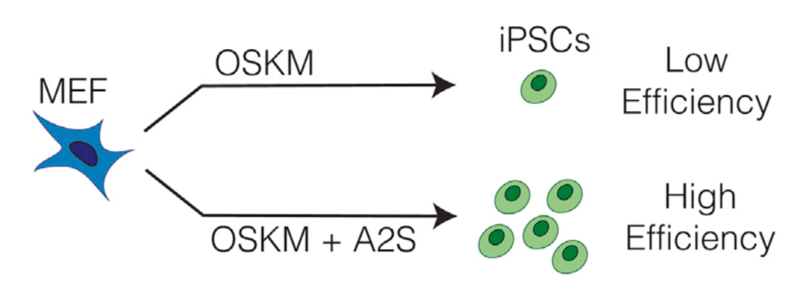
More efficient path to pluripotency?
Tran et al. Cell Reports. 2019

Slide 5
Single-cell datasets from pluripotency engineering process
389 transitioning cells, 6 days into FBS treatment
FBS-Day6-Rep1
144 pluripotent cells induced from FBS system
FBS-mESCs-Rep1
308 MEF cells
MEF-Day0-Rep1
436 pluripotent cells induced from A2S system
A2S-mESCs-Rep1
223 transitioning cells, 6 days into A2S treatment
A2S-Day6-Rep1
Tran et al. Cell Reports. 2019

Slide 6
Integrating single cell gene expression datasets
Given: single-cell gene expression datasets from different experiments/timepoints/ contexts
Project all cells into a common space
Connect cells in the common space, creating a graph
Downstream analyses:
Cluster cells using their relationship/connections in the graph
Developmental trajectory analysis
Context-specific gene regulatory network construction

Slide 7
Conos vs. LIGER
 | Conos (Barkas et al. 2019) | LIGER (Welch et al. 2019)
1. Project all cells from different experiments/ timepoints/contexts into a common space | Joint NMF | Integrative NMF
2. Connect cells in the common space, creating a graph | Correlation-based nearest-neighbor graph | Nearest-neighbors-get-votes graph

Slide 8
Let’s get started…
Get materials: https://github.com/Roy-lab/compnetbio-singlecell-integration
ON THE BIOSTAT SERVER
cd to the directory with notebook and datasets
Start up Jupyter notebook using specified environment
BACK ON YOUR COMPUTER
Open command line/terminal, claim the port
Copy and paste the localhost:port URL into a browser

Slide 9
Takeaway points
As more and more single-cell datasets are generated, integrating them across multiple sources remains an important task for understanding dynamic changes underscoring the heterogeneity of cells.

Slide 10
Takeaway points
As more and more single-cell datasets are generated, integrating them across multiple sources remains an important task for understanding dynamic changes underscoring the heterogeneity of cells.
We looked at two different pipelines:
Conos: joint NMF to project cells to same space, correlation-based nearest neighbor graph to connect cells in common space
LIGER: intergrative NMF to project cells to same space, nearest-neighbor-votes graph to connect cells in common space

Slide 11
Takeaway points
As more and more single-cell datasets are generated, integrating them across multiple sources remains an important task for understanding dynamic changes underscoring the heterogeneity of cells.
We looked at two different pipelines:
Conos: joint NMF to project cells to same space, correlation-based nearest neighbor graph to connect cells in common space
LIGER: intergrative NMF to project cells to same space, nearest-neighbor-votes graph to connect cells in common space
More challenges/active areas of research:
How to identify differential gene expression and/or relationships in different groups of cell populations?
How to integrate known cell type/label information to classify unknown, new cell types?

