Slide 1
Integrating single cell gene expression datasets
BMI 826-23/CS 838 Computational Network Biology Fall 2019
Erika Da-Inn Lee
https://compnetbiocourse.discovery.wisc.edu
Nov. 5 2019

Slide 2
Goals for today
Biological aim:
Assess whether a new ‘cocktail’ for inducing pluripotency in differentiated cells is more efficient than existing one
Computational aim:
Understand strategies for integrating single cell gene expression datasets from different experiments/timepoints/ contexts

Slide 3
Biological background: pluripotency & reprogramming
Takahashi & Yamanaka. Development. 2013

Slide 4
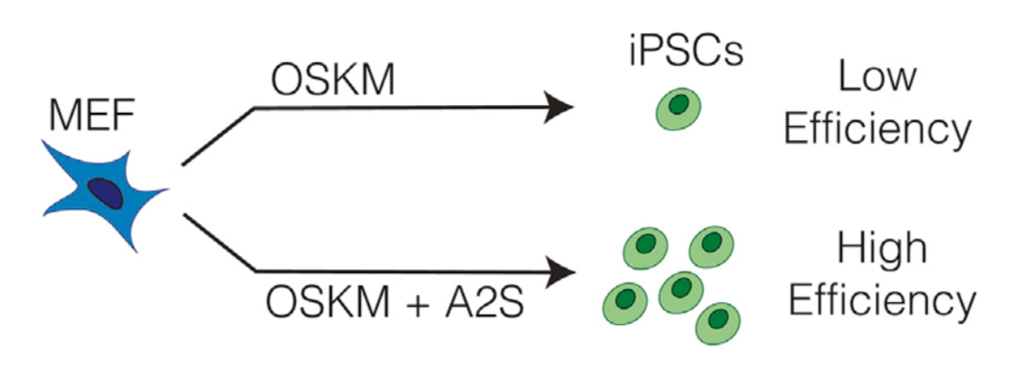
More efficient path to pluripotency?
Tran et al. Cell Reports. 2019

Slide 5
Integrating single cell gene expression datasets
Given: single-cell gene expression datasets from different experiments/timepoints/ contexts
Project all cells into a common space
Connect cells in the common space, creating a graph
Downstream analyses:
Cluster cells using their relationship/connections in the graph
Developmental trajectory analysis
Context-specific gene regulatory network construction

Slide 6
Conos vs. LIGER
 | Conos (Barkas et al. 2019) | LIGER (Welch et al. 2019)
1. Project all cells from different experiments/ timepoints/contexts into a common space | Joint NMF | Integrative NMF
2. Connect cells in the common space, creating a graph | Correlation-based nearest-neighbor graph | Nearest-neighbors-get-votes graph

Slide 7
Let’s get started…
Get materials: https://github.com/Roy-lab/compnetbio-singlecell-integration
ON THE BIOSTAT SERVER
cd to the directory with notebook and datasets
Start up Jupyter notebook using specified environment
BACK ON YOUR COMPUTER
Open command line/terminal, claim the port
Copy and paste the localhost:port URL into a browser

Slide 8
Takeaway points
As more and more single-cell datasets are generated, integrating them across multiple sources remains an important task for understanding dynamic changes underscoring the heterogeneity of cells.

Slide 9
Takeaway points
As more and more single-cell datasets are generated, integrating them across multiple sources remains an important task for understanding dynamic changes underscoring the heterogeneity of cells.
We looked at two different pipelines:
Conos: joint NMF to project cells to same space, correlation-based nearest neighbor graph to connect cells in common space
LIGER: intergrative NMF to project cells to same space, nearest-neighbor-votes graph to connect cells in common space

Slide 10
Takeaway points
As more and more single-cell datasets are generated, integrating them across multiple sources remains an important task for understanding dynamic changes underscoring the heterogeneity of cells.
We looked at two different pipelines:
Conos: joint NMF to project cells to same space, correlation-based nearest neighbor graph to connect cells in common space
LIGER: intergrative NMF to project cells to same space, nearest-neighbor-votes graph to connect cells in common space
More challenges/active areas of research:
How to identify differential gene expression and/or relationships in different groups of cell populations?
How to integrate known cell type/label information to classify unknown, new cell types?

