Slide 1
Integrating single cell gene expression datasets
Special Topics in Computational Network Biology
Nov. 5 2019
Erika Lee

Slide 2
Goals
Biological aim:
Assess whether a new ‘cocktail’ for inducing pluripotency in differentiated cells is more efficient than existing one
Computational aim:
Understand strategies for integrating single cell gene expression datasets from different experiments/timepoints/contexts

Slide 3
Biological background: pluripotency reprogramming
Takahashi & Yamanaka. Development. 2013

Slide 4
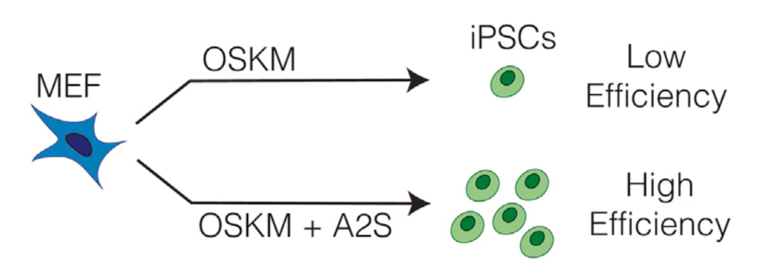
More efficient path to pluripotency?
Tran et al. Cell Reports. 2019

Slide 5
Integrating single cell gene expression datasets
Project all cells from different experiments/timepoints/contexts into a common space
Connect cells in the common space, creating a graph
Downstream analysis:
Cluster cells using their relationship/connections in the graph
Developmental trajectory analysis
Context-specific gene regulatory network construction

Slide 6
Conos and LIGER
 | Conos (Barkas et al. 2019) | LIGER (Welch et al. 2019)
1. Project all cells from different experiments/timepoints/contexts into a common space | Joint NMF | Integrative NMF
2. Connect cells in the common space, creating a graph | Correlation-based nearest-neighbor graph | Nearest-neighbors-get-votes graph

Slide 7
Let’s get started
Get materials: https://github.com/Roy-lab/compnetbio-singlecell-integration
ON THE BIOSTAT SERVER
cd to the directory with notebook and datasets
Start up Jupyter notebook using specified environment
BACK ON YOUR COMPUTER
Open command line/terminal, claim the port:
Copy and paste the localhost:port URL into a browser

