Slide 1
SmileBright Dental
What we have — and where SmileBright Operations takes you
TODAY
WITH SMILEBRIGHT OPERATIONS
› No-shows go unnoticed until the chair sits empty.
› Lapsed patients are recalled by hand, when someone remembers.
› The schedule is rebuilt every morning from three places.
› Fill the schedule automatically and recover the revenue no-shows take with them.
› Automatic recall of lapsed patients
› Same-day gap filling from the waitlist
An AI front-desk that fills the schedule, chases no-shows and recalls lapsed patients automatically.

Slide 2
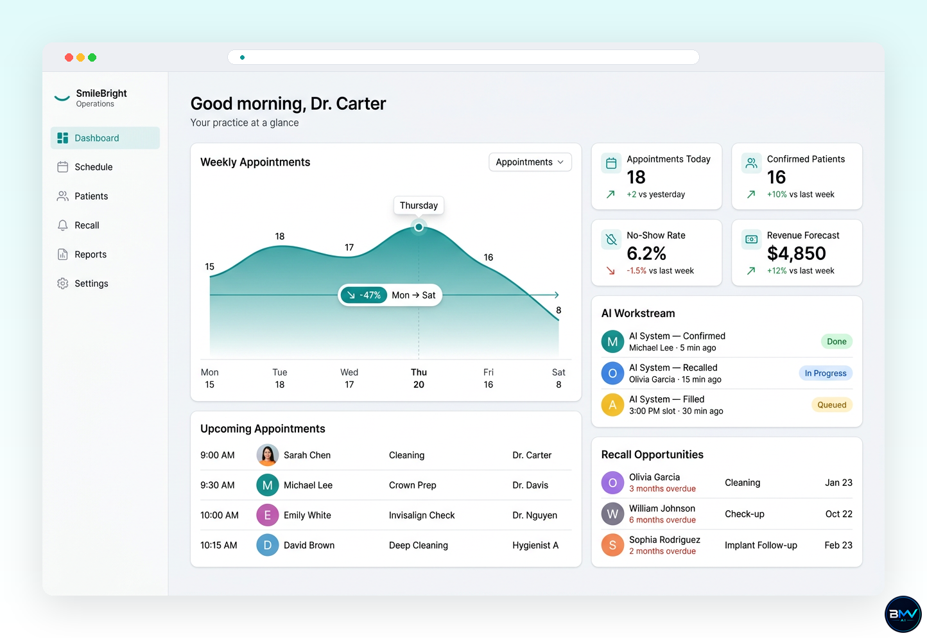
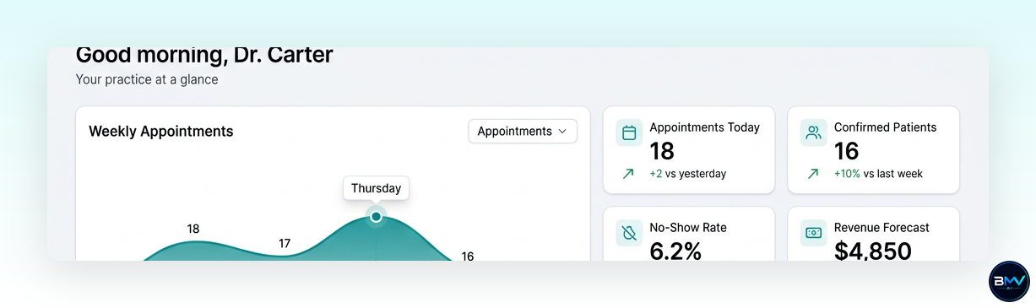
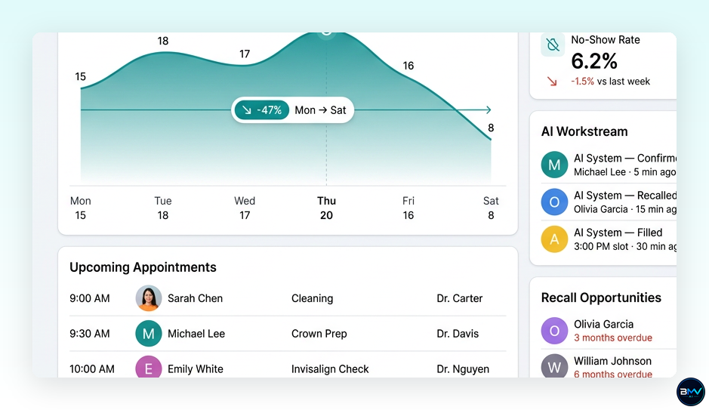
SMILEBRIGHT OPERATIONS · SCREEN 01
Dashboard
IN DETAIL

Slide 3
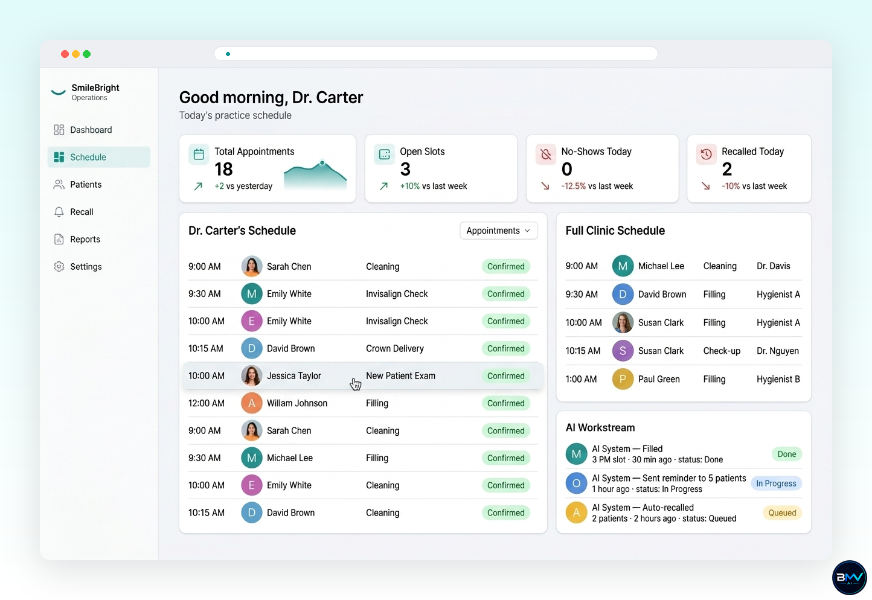
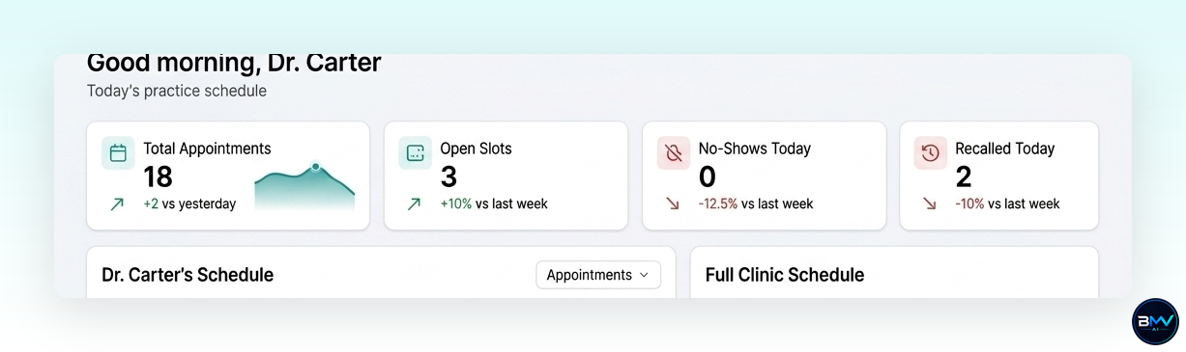
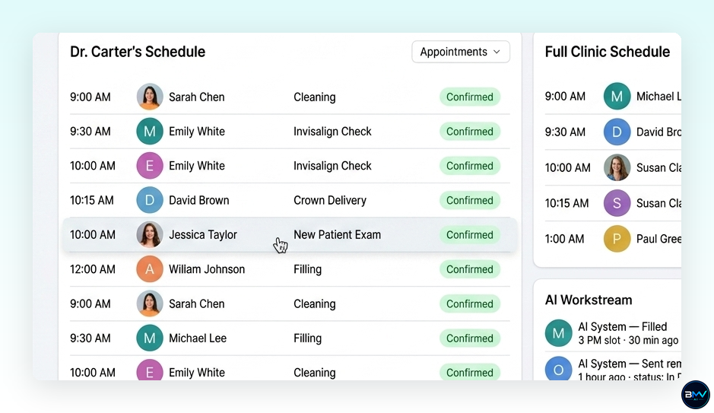
SMILEBRIGHT OPERATIONS · SCREEN 02
Schedule
IN DETAIL

Slide 4
AI EMPLOYEE 01
AI Front Desk
Confirms, reschedules and fills cancellations without anyone picking up the phone.
Dashboard — SmileBright Operations
Prepared for SmileBright Dental

Slide 5
AI EMPLOYEE 02
AI Recall Assistant
Works the lapsed-patient list every day and books the ones who reply.
Schedule — SmileBright Operations
Prepared for SmileBright Dental

Slide 6
The next step
Ready to make SmileBright Operations real?
AI Front Desk
Confirms, reschedules and fills cancellations without anyone picking up the phone.
AI Recall Assistant
Works the lapsed-patient list every day and books the ones who reply.
Prepared exclusively for SmileBright Dental

