Slide 1
Hamra
Mar Mikhael
DISTRIBUTED SYSTEMS · FINAL PROJECT
Ishtirak
120 A
generator
Shared power.
Coordinated safely.
Achrafieh
Go · MQTT · Raft · PostgreSQL · React · Docker
Schematic of the idea, not a measurement
Notes:
Hello everyone. Our project is called Ishtirak, which means subscription in Arabic. In Lebanon, neighborhood generators share one limited supply of power between many buildings. Our question is simple: how can several computers share that supply fairly and safely, even when some of them break? I will show the problem, the idea, how we built it, a live demo where we break the system on purpose, and the measurements. If you only remember one thing: three computers vote, and by design the generator is not overloaded.

Slide 2
THE PROBLEM
One generator, no room for error
Neighborhood generator
120 A in total
1
Overload
Concurrent requests and retries can reserve more than the generator can supply.
Every building asks for amps on its own
2
Single point of failure
One central “boss” computer that crashes leaves every building without a decision.
Hamra
changing demand
Mar Mikhael
changing demand
Achrafieh
changing demand
3
Unsafe replacement
If requests add up to more than 120 A, the generator overloads.
A new coordinator must know which capacity is still authorized and which can be reused.
Conceptual diagram
Ishtirak · Distributed Systems
2 / 16
Notes:
Picture one generator for a whole neighborhood, rated at 120 amps. Three buildings in Beirut, Hamra, Mar Mikhael and Achrafieh, all want power, and their demand changes all day. If each building decides alone, together they can ask for more than 120 amps and overload the generator. The obvious fix is one boss computer that decides for everyone, but if it crashes, nobody gets a decision, and its replacement must know what was already promised. So one computer is not enough. If asked: the physical generator is only simulated, no real breaker is controlled.

Slide 3
THE IDEA
Three votes, expiring tickets, one rule
3
2 of 3
12 s
Three coordinators vote
A majority decides
Short-lived tickets
Three independent programs keep identical copies of the ledger. Raft is the protocol that keeps them in agreement.
A grant counts only when at least two coordinators have written it down. If one is down, the other two carry on.
Power is lent as a lease, a ticket that expires. If it is not renewed, the capacity safely returns to the pool.
THE ONE RULE
Σ granted amps ≤ 120 A
By design, and in every run we observed — even while computers fail
Ishtirak · Distributed Systems
3 / 16
Notes:
Here is the whole idea in plain words. First, we do not trust one computer, we use three coordinators that keep the same record. They use Raft, which is a voting protocol that keeps copies in agreement. Second, a decision only counts when two out of three agree, that is called a majority or quorum. Third, power is given as a lease, a ticket that expires after a short time, so a crashed building cannot hold capacity forever. And one rule never breaks: the sum of granted amps stays at or below 120, even during failures.

Slide 4
ARCHITECTURE
Eleven services, one agreed ledger
METERS
MQTT
QoS 1
BROKER
MQTT
QoS 1
GATEWAYS
HTTP
JSON
RAFT CLUSTER (TCP)
SQL
DATABASE
Meter simulators
50 meters in the demo (10 / 50 / 200 tested)
Mosquitto
MQTT broker, one topic per building
Gateway
Hamra
Coordinator 1
PostgreSQL
audit log and readings (single instance)
Gateway
Mar Mikhael
Coordinator 2
Gateway
Achrafieh
Coordinator 3
HTTP + WebSocket
THE BRIEF’S EXAMPLE COMPONENTS, IN OUR SYSTEM
React dashboard + local controller
Database = PostgreSQL
Application = meters, gateways, coordinators, dashboard
Simplified diagram. All eleven Compose services run on one host.
Logging service = replicated audit log, projected to SQL
Ishtirak · Distributed Systems
4 / 16
Notes:
Read this left to right. Simulated meters send readings through an MQTT broker, which is a message post office, to three gateways, one per building. Each gateway asks the three coordinators for power, and those three keep one shared ledger with Raft. A single PostgreSQL database keeps the history. The React dashboard and a small local controller let us watch and break things. In total, eleven Docker services. The assignment suggested a database, an application and a logging service: ours are PostgreSQL, the whole app, and the replicated audit log. If asked: there is no separate logging process, the coordinators do the logging.

Slide 5
WHY IT IS DISTRIBUTED
Six distributed-systems ideas, all in use
Independent processes
Consensus
Data partitioning
Eleven services; each coordinator has its own log and storage volume. No shared memory.
Raft over three coordinators: a grant commits only after a majority vote.
One gateway per building; MQTT topics split meter telemetry by building.
Communication protocols
Concurrency control
Fault tolerance
MQTT QoS 1, HTTP/JSON, Raft over TCP, SQL and WebSocket.
One ordered log, idempotent request IDs, and an atomic capacity check.
Leader replacement, no grants without a majority, expiring leases.
Honest limit: everything runs on one Docker host. It shows protocols and process or network failures, not the loss of the host.
Ishtirak · Distributed Systems
5 / 16
Notes:
This slide connects our project to the course. One: independent processes, each coordinator has its own storage and they only talk over the network. Two: consensus, Raft, where a majority must agree. Three: partitioning, which means splitting data by some key, here by building. Four: communication protocols, we use five different ones. Five: concurrency control, meaning many requests at once stay in a single order. Six: fault tolerance. To be honest, all of this runs on one laptop with Docker, so we simulate crashes of processes, not of a whole machine.

Slide 6
HOW ONE GRANT HAPPENS
No grant without a majority
1
Request
2
Leader appends
3
Majority commits
4
Lease returned
5
Gateway enforces
Gateway asks for amps with a unique ID
The leader writes the command to its log
At least 2 of 3 have stored it
Reply carries amps and a lease version
Serves the smaller of demand and lease
THE VOTE (ILLUSTRATION)
Same request ID, same result
Follower
stored it
Repeating a request is idempotent: it returns the stored answer and changes nothing.
Leader
writes entry
2 of 3
= committed
Changed payload, rejected
Follower
down
Same ID with different amps is refused as a request ID conflict.
Ishtirak · Distributed Systems
6 / 16
Notes:
Here is what happens for one grant. A building gateway asks for some amps and attaches a unique request ID. The leader coordinator writes the request into its log and sends it to the followers. Once a majority, two of three, has stored it, it is committed, and the gateway gets a lease back. Only then does the gateway serve that power. Notice that one follower can be down and the grant still works. Idempotent means that repeating the same request gives the same answer, so retries are safe. If asked: a changed amount under the same ID is rejected.

Slide 7
SAFETY TIMING
Safe expiry, even when clocks drift
One lease, in seconds on each machine’s monotonic clock (conceptual diagram)
Gateway
Gateway may serve this lease
2 s margin
Coordinator
Coordinator keeps the capacity reserved (12 s hold)
then expiry is committed
0 s
original send
10 s
gateway stops
12 s
earliest reclaim
Retries never restart the clock
A new leader restarts holds
Only clock rates matter
A retry or a duplicate reply keeps the original first-send time. Late or mismatched replies are rejected.
Expiry is a committed command fenced by building, lease version and Raft term: a stale leader cannot erase a newer lease.
At most 1% rate error: gateway stops within about 10.10 s, coordinator waits at least about 11.88 s (real time).
Ishtirak · Distributed Systems
7 / 16
Notes:
This is the heart of safety. A lease lasts twelve seconds, but the gateway only trusts it for ten seconds, counted from when it first sent the request. The coordinator waits the full twelve before it takes the capacity back. That two-second gap is a safety margin, so the gateway has stopped before anyone else can be given the same amps. We assume clocks run at nearly the same speed, within one percent. Absolute clock time does not matter, only how fast they tick. If asked: a new leader restarts the twelve-second hold, which only makes it safer.

Slide 8
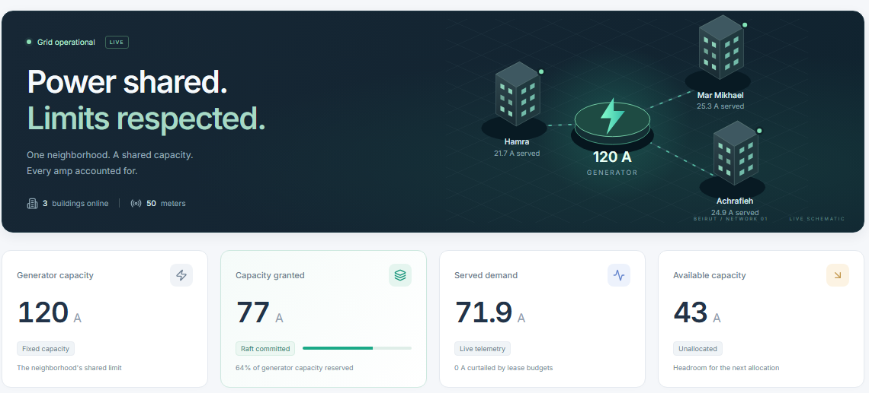
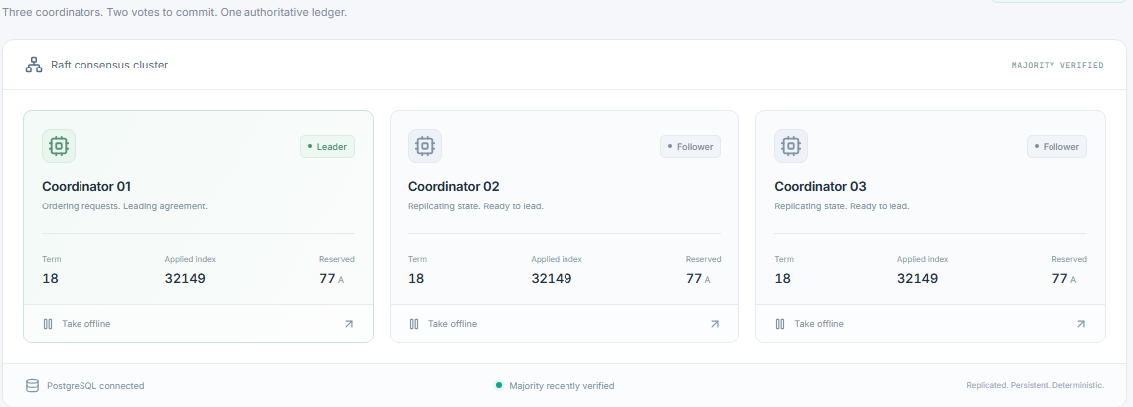
THE LIVE DASHBOARD
Everything you see is a real observation
1
Grid at a glance
The generator and the three buildings it feeds, with live status.
1
2
Capacity cards
Fixed 120 A limit, amps granted, served demand, amps still available.
2
3
Raft cluster
Leader and followers with their term and applied index; majority status.
+
Further down the page
3
Building lease timers and a searchable audit log with JSON export.
No synthetic history.
Ishtirak · Distributed Systems
8 / 16
Notes:
This is the dashboard you will see in the demo. At the top, the hero shows the generator and our three buildings. Below it, the cards show the fixed 120 amp limit, how much is granted, how much is actually served, and how much is left. Lower on the page, the Raft cluster shows which coordinator is the leader and the term, which is the current election round. Every number is a real observation from polling the running system. We did not fake any history. If asked: it may lag slightly, so it is not a perfect view of the whole system.

Slide 9
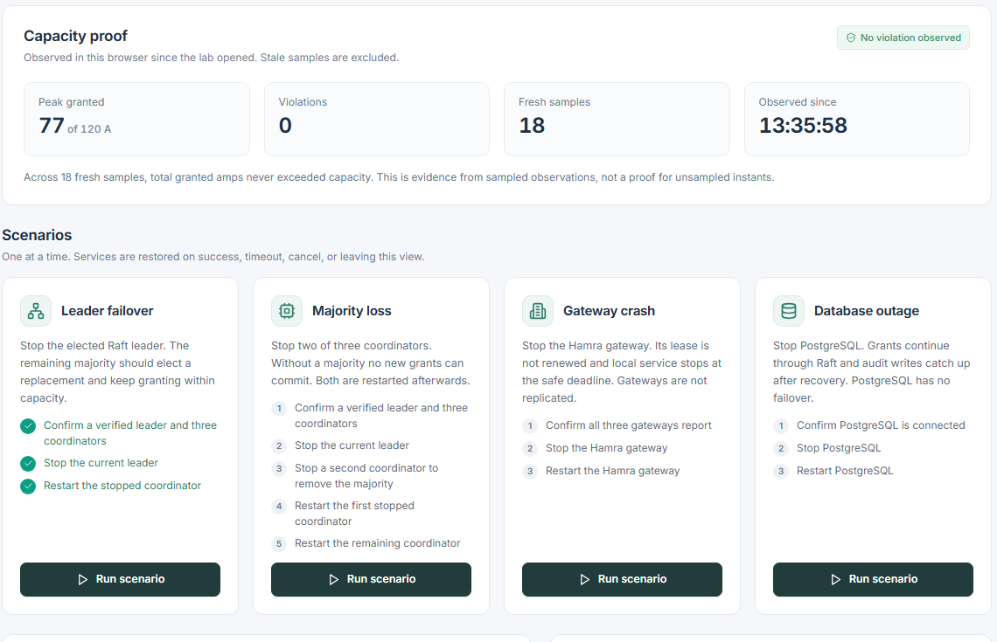
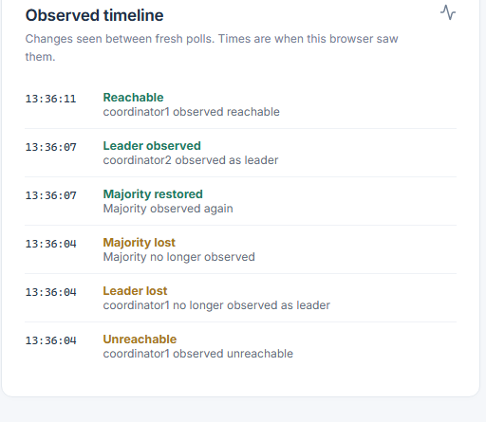
LIVE DEMO · RESILIENCE LAB
Break it on purpose. Watch the invariant hold.
FOUR GUIDED SCENARIOS
Leader failover
Majority loss
Stop the elected leader; a replacement takes over.
Stop two of three; new grants must stop.
Gateway crash
Database outage
Its lease expires and capacity is reclaimed.
Grants continue; audit catches up later.
WHAT TO WATCH
Peak granted stays at or below 120 A, violations stay at 0.
The timeline shows the leader lost and a new one observed.
Real capture: the lab after a completed leader failover
Ishtirak · Distributed Systems
9 / 16
Notes:
Now the part I like most, the Resilience lab. The page says: break it on purpose, watch the invariant hold. It has four buttons: stop the leader, stop two of three coordinators, crash a gateway, or stop the database. While we do that, the capacity proof panel shows the peak granted amps compared to 120 and the number of violations, which should stay at zero. The timeline lists when a leader was lost and a new one observed. Every scenario puts everything back afterward. For the live demo I will run leader failover first.

Slide 10
FAULT TOLERANCE RESULTS
Failures handled, capacity limit intact
Scenario | Measured result
Gateway crash (3 trials) | Lease reclaimed in 12.34 s on average (range 10.80–14.25 s); each restart got a fresh session
Leader failure (3 trials) | A replacement accepted a grant after 4.82 s on average (range 4.05–6.34 s)
Majority loss | 3 new requests returned HTTP 503; simulated service fell to 0 A after 13 s
PostgreSQL outage | Grant accepted while SQL was down; its audit event appeared once after recovery
Capacity stress | 40 requests of 7 A: 17 accepted, 23 rejected, 119 A committed (limit 120 A)
Duplicate / conflict | A duplicate preserved the lease; a changed payload under the same ID was rejected
Sampled during the run: 243 overviews and 708 coordinator snapshots, no violation, maximum observed grant 119 A.
Ishtirak · Distributed Systems
10 / 16
Notes:
These are measured results from our live evaluation run against the real Docker stack. When a gateway crashed, its lease was reclaimed in about twelve seconds. When the leader was stopped, a new one accepted a grant in about five seconds on average, three trials each. When we stopped two coordinators, new requests failed with an error, which is the correct choice. In the stress test, forty requests of seven amps: seventeen accepted, total 119, under 120. If asked: reclamation time is observed through Docker, not an exact internal timer.

Slide 11
RANDOMIZED FAULT CHECK
A randomized fault run: zero violations
1,529
284
1,183
62
requests sent
accepted
rejected
unknown outcomes
134
120 A
0
22,808
capacity samples
max observed (the limit, not above)
violations
same applied index on all 3 coordinators
Unknown outcome is not a rejection
Evidence, not proof
A 503 or timeout may still have committed, so it is counted separately. The client retries with the same request ID. The 1,183 rejections were 1,182 capacity refusals and 1 deliberate changed-payload replay.
One seed, 90 s, eight workers. A fixed fault schedule stopped coordinators and gateways, including a ~15 s majority-loss window. Sampling cannot rule out a transient between samples.
Ishtirak · Distributed Systems
11 / 16
Notes:
To go beyond hand-picked tests, we wrote a small randomized fault checker, in the spirit of Jepsen. With a fixed seed it sends over fifteen hundred requests while services are stopped and restarted, including a window when two coordinators are down together. Result: 284 accepted, 1,183 rejected, and 62 unknown outcomes. Unknown does not mean rejected: the request may have committed, so we retry with the same ID. Max granted 120, never above, zero violations, and all coordinators ended at the same log position. This is evidence from one seed, not a proof.

Slide 12
PERFORMANCE
Decision latency is the same at 10, 50 and 200 meters
Allocation-decision latency (ms), mean of 5 trials
Mean ± sd over 5 trials
Meters | p50 ms | p95 ms | Readings/s
10 | 79.5 ± 1.0 | 113.3 ± 4.4 | 9.7
50 | 78.3 ± 0.6 | 112.9 ± 2.3 | 57.8
200 | 79.4 ± 1.4 | 114.1 ± 3.9 | 193.9
20× the meters, same latency
Gateway readings rose from 9.7 to 193.9 per second while decision p50 stayed near 78–80 ms. Each trial: 200 requests, 4 concurrent clients, all accepted, no errors.
Caveat: the decision benchmark itself does not exercise meter volume; the readings-per-second column shows the volume.
Ishtirak · Distributed Systems
12 / 16
Notes:
For performance, we measured how long one allocation decision takes with ten, fifty and two hundred simulated meters. Median latency, called p50, is about 78 to 80 milliseconds every time, and p95, the time within which 95 percent of requests finish, is about 113 milliseconds. Each number is the mean of five trials. Meanwhile the readings flowing through the gateways grew from about ten to about one hundred ninety-four per second. To be careful: the decision test does not itself generate meter load, so the readings column is what shows the volume.

Slide 13
SCALABILITY LIMIT
Throughput plateaus near 50 decisions/s
Decisions per second vs concurrent clients
Median latency (p50, ms) vs concurrent clients
The cause was not profiled
Telemetry: 0.67 s end to end
Fits one leader ordering every grant, but the dashboard proxy and the Python client are also in the path. A measured ceiling, not an identified bottleneck.
A demand change became visible in 0.38–0.83 s (mean 0.67 s, 5 samples, polled every 0.1 s). An upper bound at that resolution.
Ishtirak · Distributed Systems
13 / 16
Notes:
We also pushed the system harder by adding more concurrent clients: one, four, sixteen and sixty-four. Throughput climbs and then flattens at about fifty decisions per second, while latency keeps growing. That is what you expect when requests queue behind one serialized step, and every grant does go through one Raft leader. But I want to be honest: we did not profile it, so we cannot say the leader is the bottleneck. Separately, a change in demand showed up on the dashboard in about two thirds of a second on average.

Slide 14
CHALLENGES AND TRADE-OFFS
Every safety choice has a cost
Challenge | Our answer | What it costs
Unknown outcomes | Retry with the same request ID; keep the original send time | A valid grant may arrive too late to use
Duplicate requests | Idempotent IDs: same ID, same stored result | Request history keeps growing
Stale leader | Expiry fenced by building, lease version and term | Reclamation is deliberately conservative
Clock differences | Monotonic durations; assume ≤ 1% rate error | Conservative 2 s margin; host suspend not covered
Safety vs availability | No majority, no new grants | Service stops (0 A after 13 s in the test)
Utilization vs safety | Renewals never shrink a reservation | Starvation seen after a 200-meter run; safe shrink is future work
After the starvation we saw, a reset script restarts the gateways so old reservations expire and buildings return to their current demand.
Ishtirak · Distributed Systems
14 / 16
Notes:
Here are the hard problems and what each fix costs. When a request times out we cannot know whether it committed, so we retry with the same ID. Duplicates are handled by idempotency. A stale leader cannot erase a newer lease because expiry is tied to the lease version and term. For clocks we only rely on durations. If no majority exists we refuse grants: that is safety over availability. The biggest weakness: renewals never shrink, so after our 200-meter test one building kept a big reservation and starved the others. Capacity stayed safe, fairness did not. A safe shrink rule is future work.

Slide 15
CRITICAL EVALUATION AND LIMITS
What these results do not show
Not measured
Stated limits
Next steps
One host, short windows, concurrent local activity
Trials are repeats on one stack, not independent samples
No network-delay or packet-loss injection
Sampling is evidence, not a proof
No gateway replication
One PostgreSQL, no failover
Readings may be lost while a gateway is down
No fairness guarantee; no production authentication or TLS design
Multi-host and clock experiments
Profile the commit path
Fair admission and a safe shrink rule
Bounded history retention; authenticated deployment
No formal verification, and no external review of the safety design, has been done.
Ishtirak · Distributed Systems
15 / 16
Notes:
I want to be clear about what we have not shown. All tests ran on one machine, with repeats on one stack, so they are not independent samples, and we did not inject network delay or packet loss. The project also has stated limits: gateways are not replicated, there is a single PostgreSQL database, and readings can be lost while a gateway is down. There is no fairness guarantee either. Next steps would be testing on several machines, profiling the commit path, a safe way to shrink reservations, and a properly secured deployment.

Slide 16
TAKEAWAYS
Three things to remember
1
2
3
A majority decides
Leases keep it safe
Measured, not assumed
Every grant needs 2 of 3 coordinators.
Expiring tickets keep the total at or below 120 A through crashes.
Failover in 4.82 s on average, 0 violations observed, about 50 decisions/s ceiling.
Questions?
Three independent coordinators vote on every grant, so by design a neighborhood generator is not overloaded — even when computers fail.
Ishtirak · Distributed Systems
Ishtirak · Distributed Systems
16 / 16
16 / 16
Notes:
To finish, three takeaways. One: a majority decides, every grant needs two of the three coordinators. Two: leases, the expiring tickets, keep the total at or below 120 amps through crashes and delays. Three: we measured it. A new leader accepted grants in under five seconds on average, we saw no violation, and the decision rate tops out around fifty per second. In one sentence: three independent coordinators vote on every grant, so by design a neighborhood generator is not overloaded, even when computers fail. Thank you, I am happy to take questions.

