Slide 1
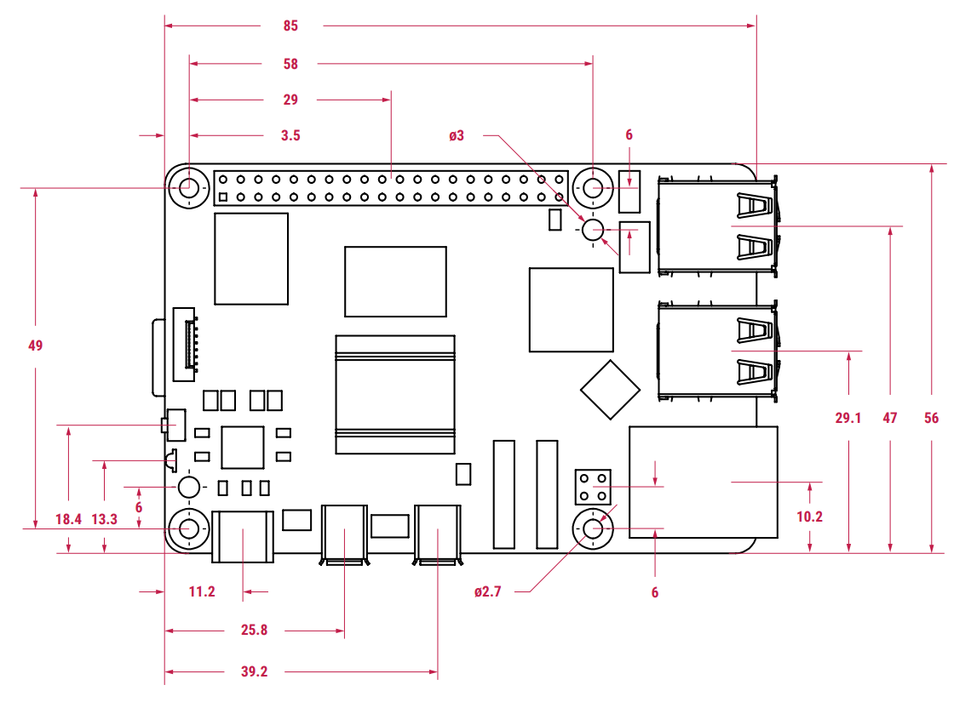
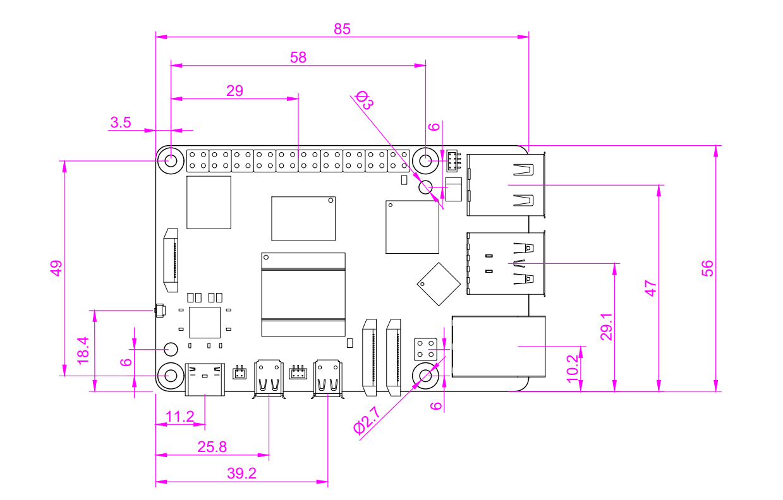
Drawn by Raspberry Pi Ltd
Drawn by Me

Slide 2
