Slide 1
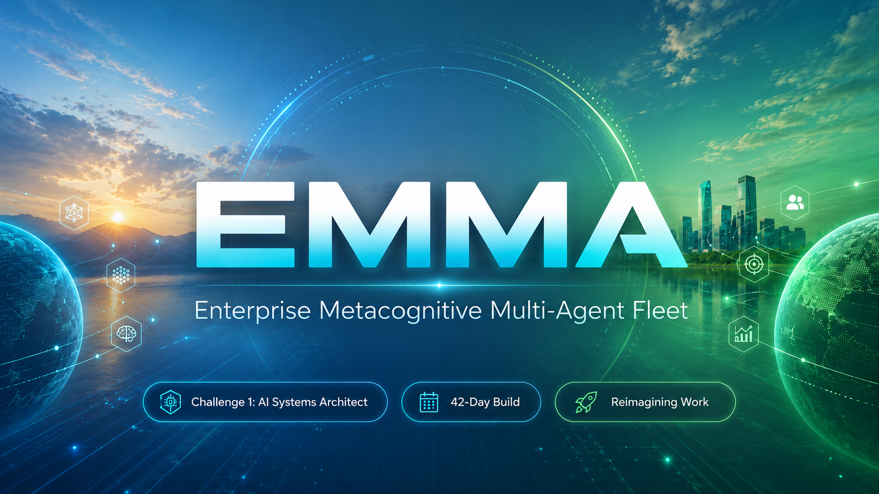
A safe, self-correcting, and collectively evolving AI agent workforce — built to automate complex, long-running enterprise tasks with mathematical alignment guarantees.
01 / 11

Slide 2

◈ India Runs Hackathon · Redrob AI · Track 2: Ideathon · Challenge 1
EMMA
Enterprise Metacognitive Multi-Agent Fleet
A safe, self-correcting, and collectively evolving AI agent workforce — built to automate complex, long-running enterprise tasks with mathematical alignment guarantees.
Challenge 1 · AI Systems Architect
42-Day Build · EMMA Command Center
Reimagining Work

Slide 3
◈ THE CHALLENGE
The Silent Crisis of Enterprise Copilots
⚠ The 80% Completion Cap
🧱 Siloed Workflow Intelligence
LLM agents lack intrinsic self-reflection. Without knowing their own knowledge boundaries, they silently hallucinate and cascade token errors — causing 60–80% of complex autonomous tasks to fail before delivery.

