Slide 1

Z-Fed: Privacy-Enhanced ZKP Framework for Balanced Federated Learning
Stefano Marzo
21264466
stefano.marzo2@mail.dcu.ie
Dublin City University Dublin
Royston Pinto
20210611 royston.pinto2@mail.dcu.ie Dublin City University Dublin

Slide 2
Contents
Introduction & Motivations
Research Questions & Contributions
Design of Z-Fed
Data & Design of experiments
Evaluation
Results overview
Conclusions

Slide 3
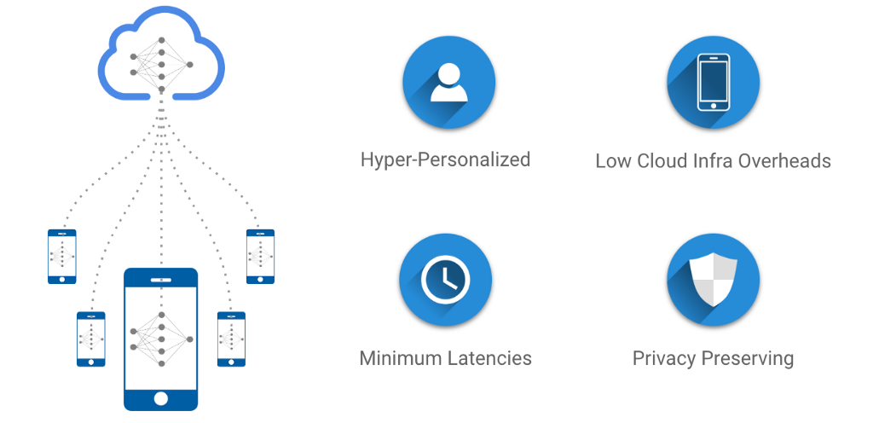
Federated Learning
Environments
Introduction & Motivations - 1/6
Scalable
Privacy-oriented
Fair?

Slide 4

Research in
Federated Learning
Introduction & Motivations - 2/6
Reduce communication overhead
Enforce privacy during aggregation
Deal with accuracy reduction due to imbalance data
Deal with Fairness due to imbalance data?
[5],[6],[11]-[17]

Slide 5
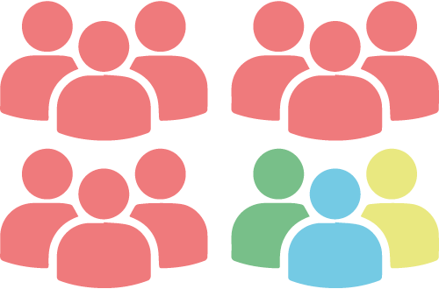
Some groups can be under-represented
Introduction & Motivations - 3/6
In Federated Learning
E.g. Demographic disparity
unfairness

Slide 6

Research in
Imbalance Data
Introduction & Motivations - 4/6
Ensemble methods to reduce bias in imbalanced data learning, suffer the presence of outliers typical of FL
Oversample, requires access to data
Undersample: suitable with limitations
[18]-[20]

Slide 7

ZKP:
Trust, no exchange of privacy protected data
Introduction & Motivations - 5/6
If a subgroup label is encrypted, how can one trust it?
Zero Knowledge Proof techniques

Slide 8
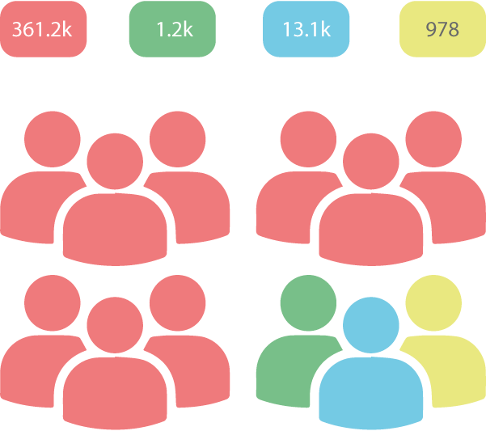
Research in ZKP
Introduction & Motivations - 6/6
Enhance data privacy in online communication
Non-iterative ZKP is used for authentication
No privacy protected data exchange
Prove a statement without revealing it
Suitable for counting subgroups in FL
[7]-[9], [21]

Slide 9
Research Questions:
Research Questions & Contributions - 1/2
To what extent is it possible to mitigate federated learning bias according to GDPR and EU guidelines for data ethics and trustworthy AI?
To what extent can ZKP inferred data about the proportions of population groups generated in a federated learning environment be used to enhance trustworthiness in FL AI?

Slide 10
Main Contributions
Research Questions & Contributions - 2/2
Observation that imbalanced datasets lead to degradation in FL training [6], [17]-[20].
Design of a self-balancing ZKP FL framework implementing zero knowledge authentication to mitigate the bias introduced by uneven distribution.
Implementation of ZKP to measure the data distribution and use it to allow data augmentation and rejection of imbalanced updates to counter effect bias.
Evaluation of Z-Fed based on an SGD ANN.

Slide 11
Z-Fed: a ZKP Framework for Self-Balancing Federated Learning
Design - 1/8
Unequal treatments due to imbalances drove to design a reworked self-balancing ZKP FL environment called Z-Fed to support a fair learning process and enhance demographic parity.

Slide 12
Framework Initializer
Design - 2/8
Considering a subset of features in the data it is possible to identify subgroups:
ASIAN FEMALE ASIAN MALE BLACK FEMALE BLACK MALE INDIAN FEMALE INDIAN MALE WHITE FEMALE WHITE MALE
These subgroups should be balanced.
To do so, it is possible to create a ZKP Client Prototype to represent the workers.
In this experiment, every subgroup will have a pair of ZKP Clients, creating different signatures. The ZKP Server uses signatures to create Tokens.
INDIAN MALE
ZKP Client (“INDIAN”) ZKP Client (“MALE”)

Slide 13
ZKP Client & ZKP Server (Prover & Verifier)
Design - 3/8
Elliptic Curve e.g. secp256k1, Weirerstrass curve: y²=x³+a*x+b
Generator (point on the curve)
ZKP Client
&
ZKP Server
Hash: Hash function of choice, e.g. sha256
Salt: public big integer number
Signature: public object to register/authenticate
n: private number

Slide 14
ZKP Client & Server
Design - 4/8
ZKP Client
Feature: e.g. “ETHNICITY”, “GENDER”
Label: e.g. “ASIAN” … “WHITE”, “FEMALE”, “MALE”
Secret: private, Hash(Label | n)
Encrypted label: public, Hash(n | Label)
ZKP Server
Password: private string
Tokens: a collection of objects obtained by countersigning ZKP client signatures. ZKP Clients must generate a proof compatible with at least one of the tokens to be authenticated.

Slide 15
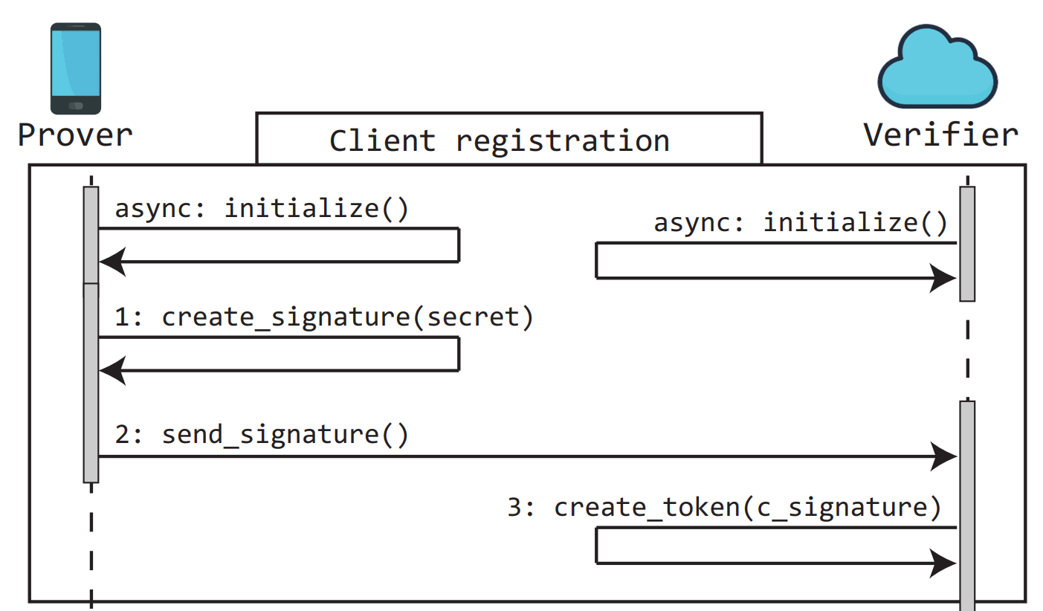
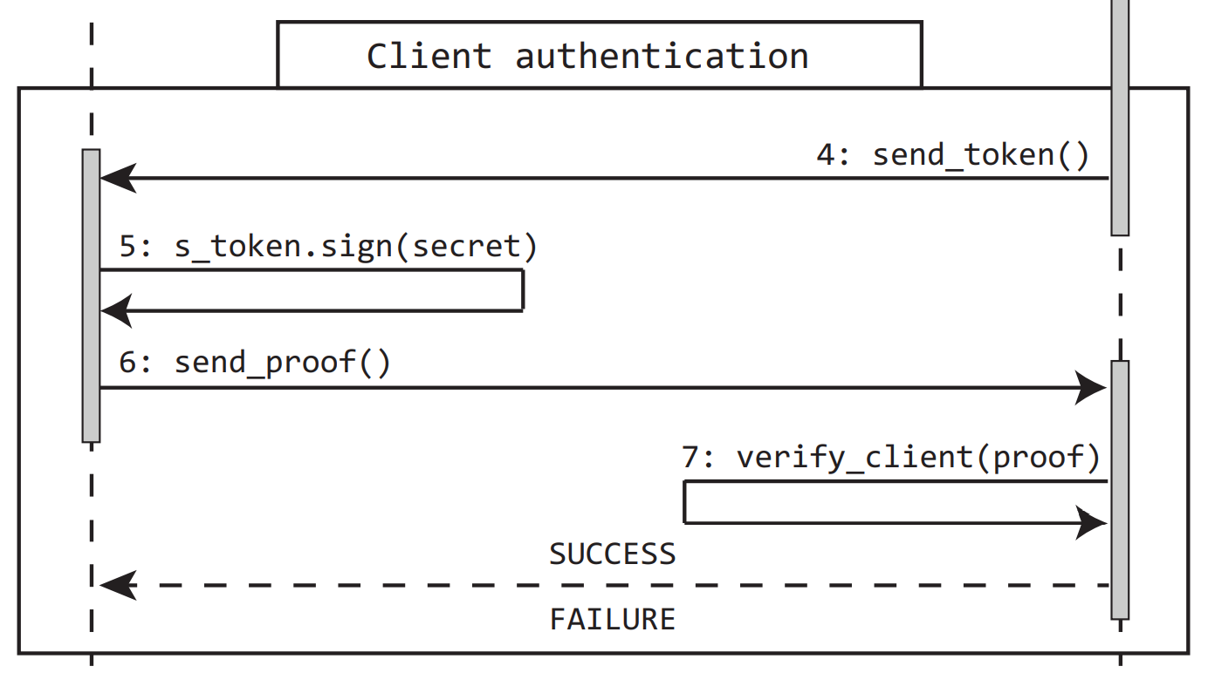
ZKP Client & Server: Registration and Authentication
Design - 5/8

Slide 16
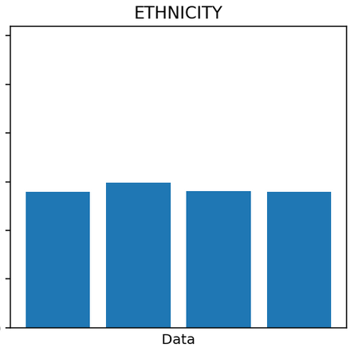
Exchange of encrypted labels
Design - 6/8
361.2k
1.2k
13.1k
978
ZKP
Encrypted Labels
C
S

Slide 17
ZKP:
Only trusted updates accepted
No knowledge of individuals
Design - 7/8

Slide 18
Z-Fed
Design - 8/8
Z-Fed identifies subgroups and accepts only updates that do not perturb the balance.
Imbalance individuals can be stored in a queue and called later for model update.

Slide 19
Fairness measurements in FL
Data & Design of experiments - 1/4
scientific research presenting fairness measurements against imbalanced datasets could not be found for benchmark.
Therefore, an exploratory search was conducted based on the following hypothesis: in a federated environment, an ANN shows bias if the training dataset is class imbalanced.

Slide 20
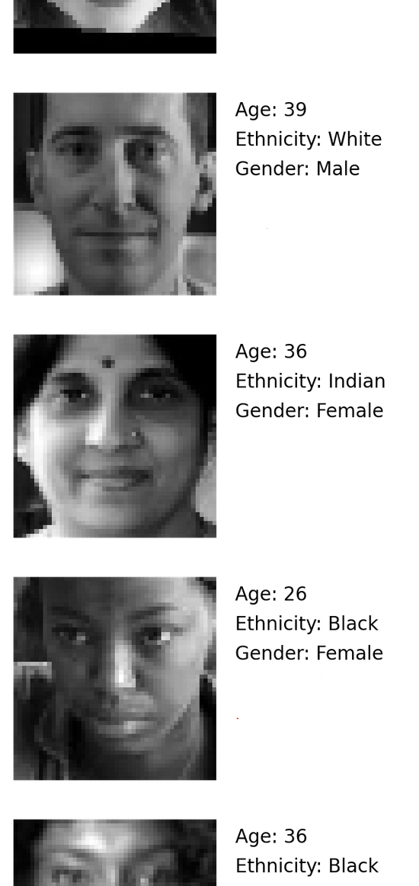
UTK Dataset
Description
Age:
From 0 to 116
Ethnicity:
Categorical
Asian
Black
Indian
White
Image:
48X48 pixels
b&w: luminance 0 - 1
Gender:
Categorical
Female
Male

Slide 21
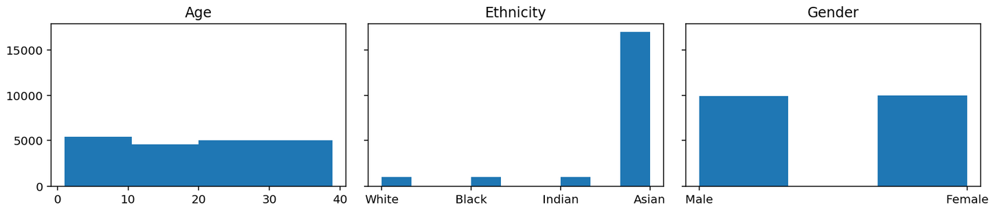
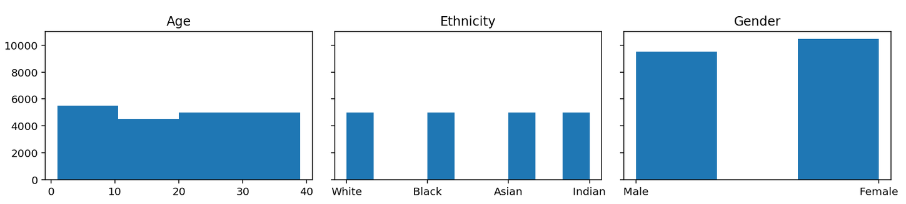
Design of imbalanced datasets: 20,000 samples
Data & Design of experiments - 3/4
One ethnicity will represent the Privileged (PR) group, and consequently, the other ethnicities will be called Unprivileged groups. The proportions are: 85% Privileged, 15% others. We design 5 datasets:
ASIAN-PR (85% asian)
BLACK-PR (85% black)
INDIAN-PR (85% indian)
WHITE-PR (85% white)
BAL (balanced)

Slide 22
Design of the learning model
Data & Design of experiments - 4/4
0-9 years
.
.
.
.
.
.
10-19 years
FCL
Sigmoid activation
FCL
Sigmoid activation
20-29 years
30-39 years
48X48 neurons
Input layer
96 neurons
Hidden layer
4 neurons
Output layer
SGD, MSE, learning rate: 0.025, epochs: 1, bias neuron in each FCL: 1

Slide 23
Metrics overview
SPD:
Statistical Parity Difference
EOD:
Equal Odd Difference
EPD:
Equal Opportunity Difference
the difference of probability to get true positive and false positives between privileged and unprivileged groups
difference in rate of favorable outcomes for unprivileged groups with respect to privileged groups
the difference in rate of true positive prediction between privileged and unprivileged groups
Evaluation - 1/5

Slide 24
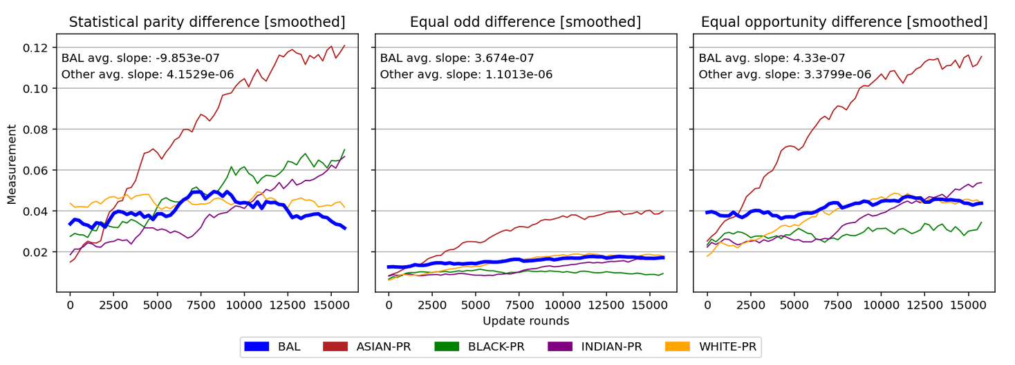
Fitting the model
Evaluation - 2/5
Each dataset was splitted in Train and Test subsets with proportions 80%-20% respectively

Slide 25
Results
Evaluation 3/5
Experiment | SPD | EOD | EPD | Accuracy variance
ASIAN-PR | 15.02% | 5.17% | 15.01% | 3.22%
BLACK-PR | 11.63% | 1.7% | 6.66% | 1.22%
INDIAN-PR | 8.15% | 1.69% | 5.72% | 0.7%
WHITE-PR | 1.85% | 1.3% | 2.79% | 0.06%
BAL | 1.81% | 1.8% | 4.6% | 0.09%

Slide 26
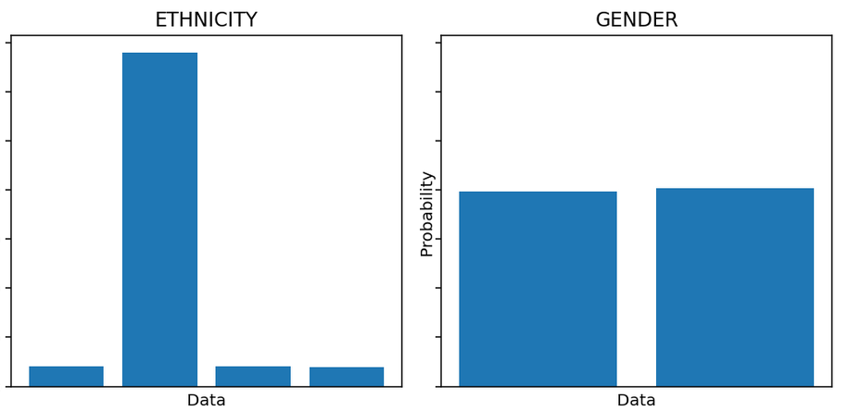
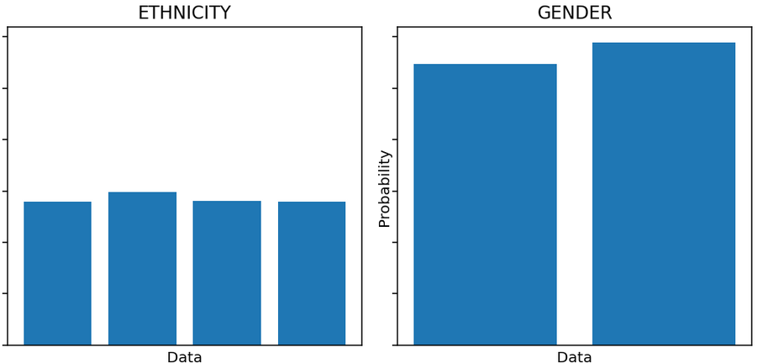
Experiments
Evaluation - 4/5
Z-Fed rebalances the updates by self balancing (SB). We runned the following experiments:
ASIAN-PR ASIAN-SB
BLACK-PR BLACK-SB
INDIAN-PR INDIAN-SB
WHITE-PR WHITE-SB
Rebalancing without exchange of privacy protected data

Slide 27
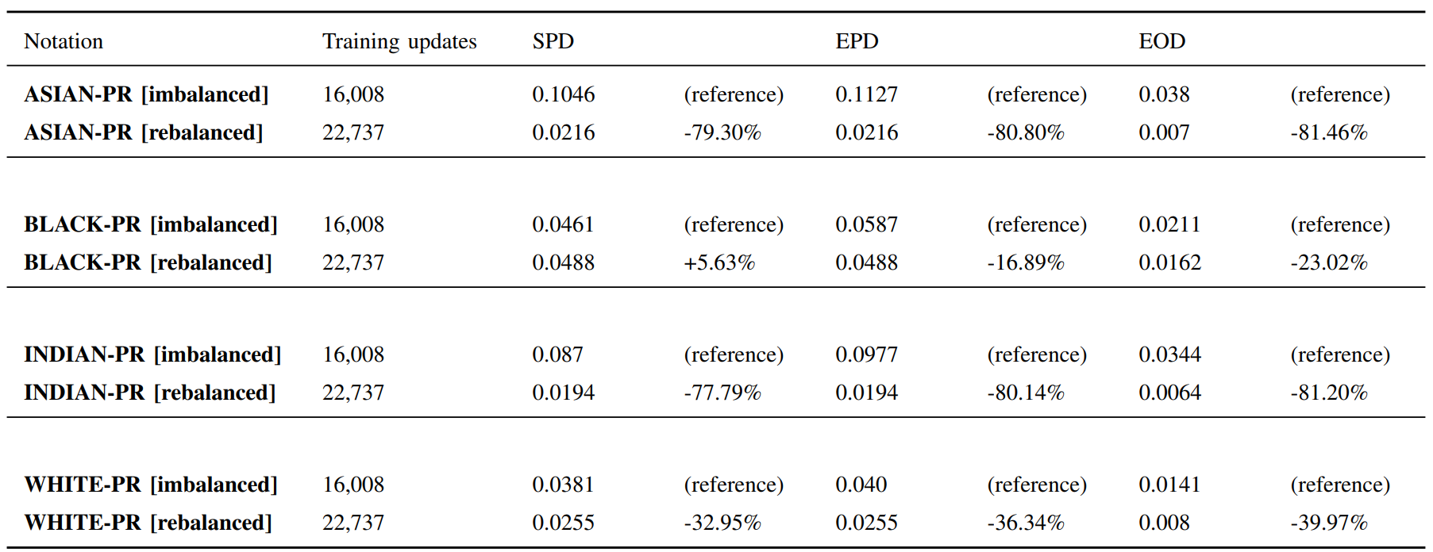
Results
Evaluation - 5/5

Slide 28
Results overview
SPD
EOD
EPD
-46.1%
-56.4%
-53.5%

Slide 29
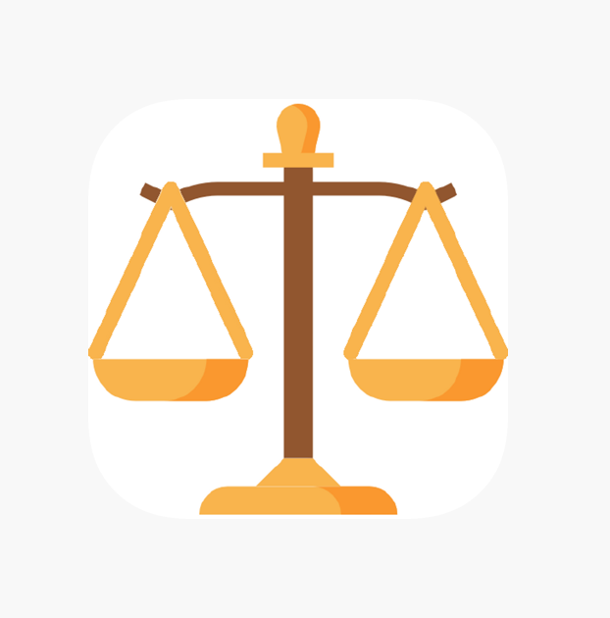
Conclusions
Z-Fed is able to mitigate FL bias by reducing disparities according to the EU guidelines for data ethics and trustworthy AI without compromising privacy.
On average, Z-Fed improves the EPD of 53.54%, the EOD of 56.41%, and the SPD of 46.1% on imbalanced UTK datasets.

Slide 30
Main Contributions
Stefano Marzo
State of Art
Federated learning environment
Design of Z-Fed
ZKP implementation
Design of experiments
Software engineering
Design of metrics and evaluation
Royston Pinto
State of Art
Design of the ANN model
Design of experiments
Software engineering
Conclusion and future works

Slide 31
Thank You
We are glad to answer your questions!

Slide 32
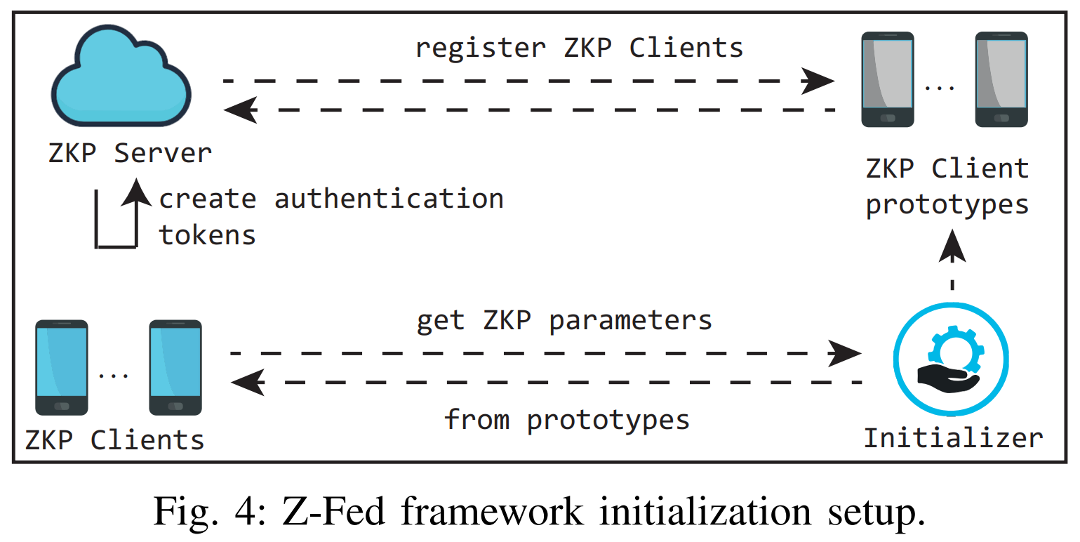
Extras

Slide 33
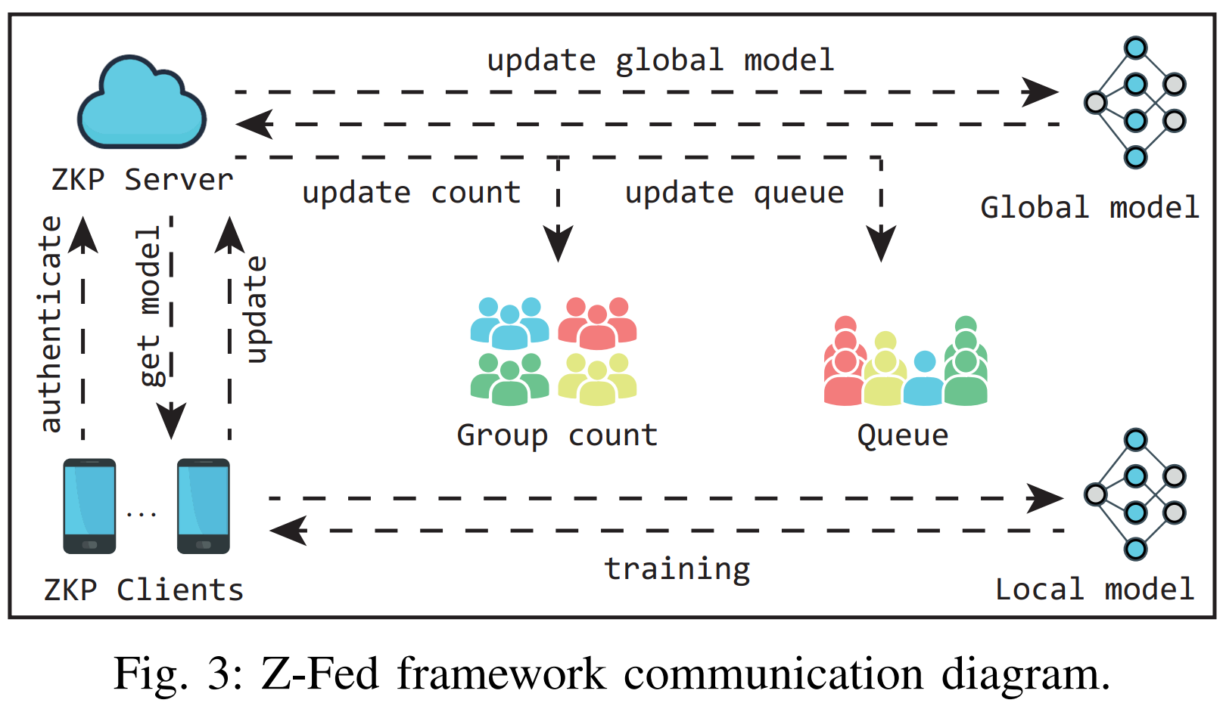
Extras

Slide 34
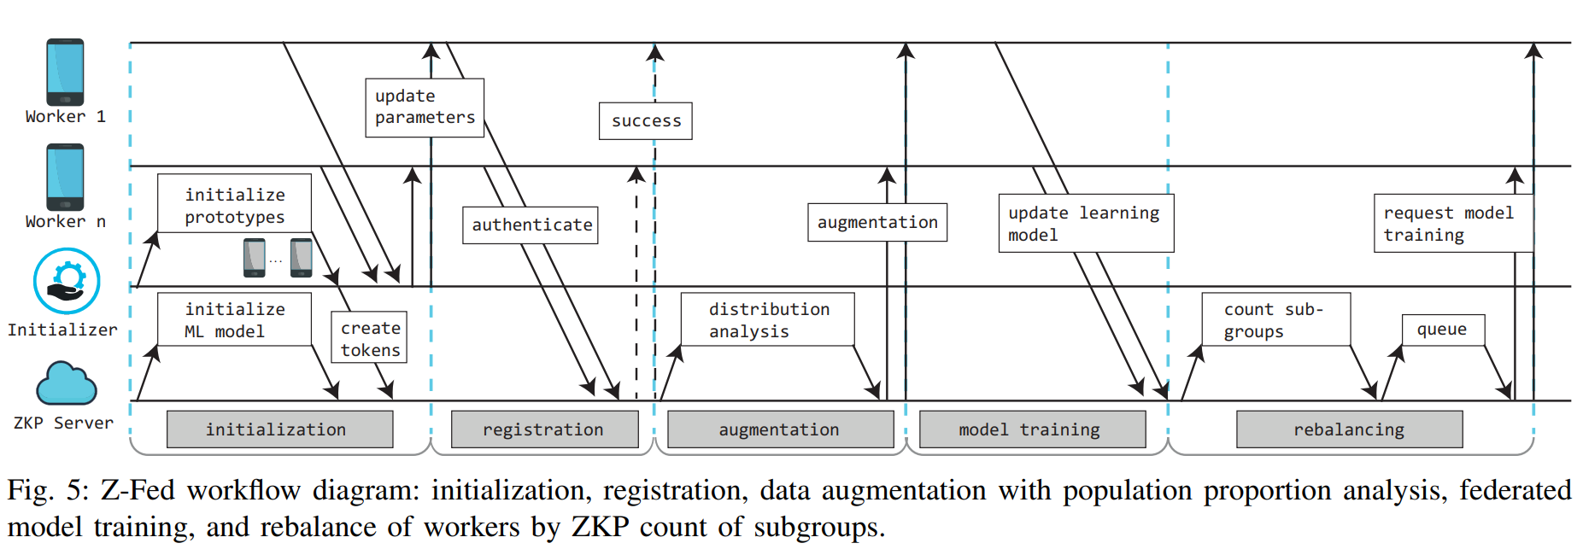
Extras

