Slide 1
Image Captioning
Mentor : Prof. Dipali Koshti
Chinmay Paralkar 7957
Royston Pinto 7963
Kajal Sapkal 8126

Slide 2

Introduction
All of us humans have the ability to recognize things around us and we are able to identify significant objects in our background. This ability can be given to a computer with some effort.
Image captioning is a problem where a model must generate a brief human-readable text for a given photograph. Hence, with the help of this problem statement we can program our computer to recognize salient stuff in the image.

Slide 3
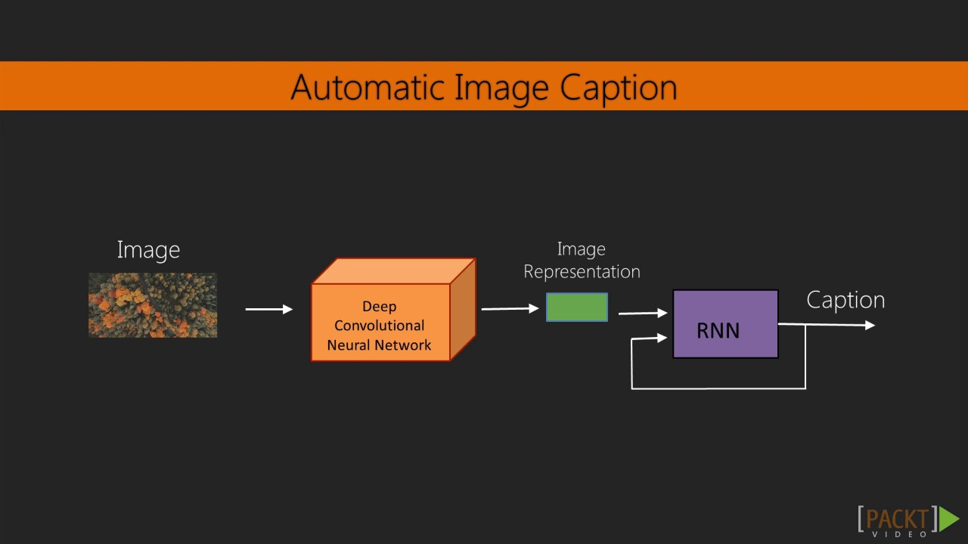
Literature Review
Background : Here for our reference purpose we are using a study called Image Captioning with Keras - Teaching Computers to describe pictures. We get our data set from here and necessary reference material.
Literature Review : From the material we learn about using Keras, CNN model called InceptionV3, and how to code a Image captioning program.
Summary Of Literature : The provided dataset, reference codes and their explanation help us to learn about using CNN in Image Captioning.

Slide 4
Motivation
We must first understand how important this problem is to real world scenarios. Let’s see few applications where a solution to this problem can be very useful.
Self driving cars — Automatic driving is one of the biggest challenges and if we can properly caption the scene around the car, it can give a boost to the self driving system.
Aid to the blind — We can create a product for the blind which will guide them travelling on the roads without the support of anyone else. We can do this by first converting the scene into text and then the text to voice. Both are now famous applications of Deep Learning.
CCTV cameras are everywhere today, but along with viewing the world, if we can also generate relevant captions, then we can raise alarms as soon as there is some malicious activity going on somewhere. This could probably help reduce some crime and/or accidents.

Slide 5
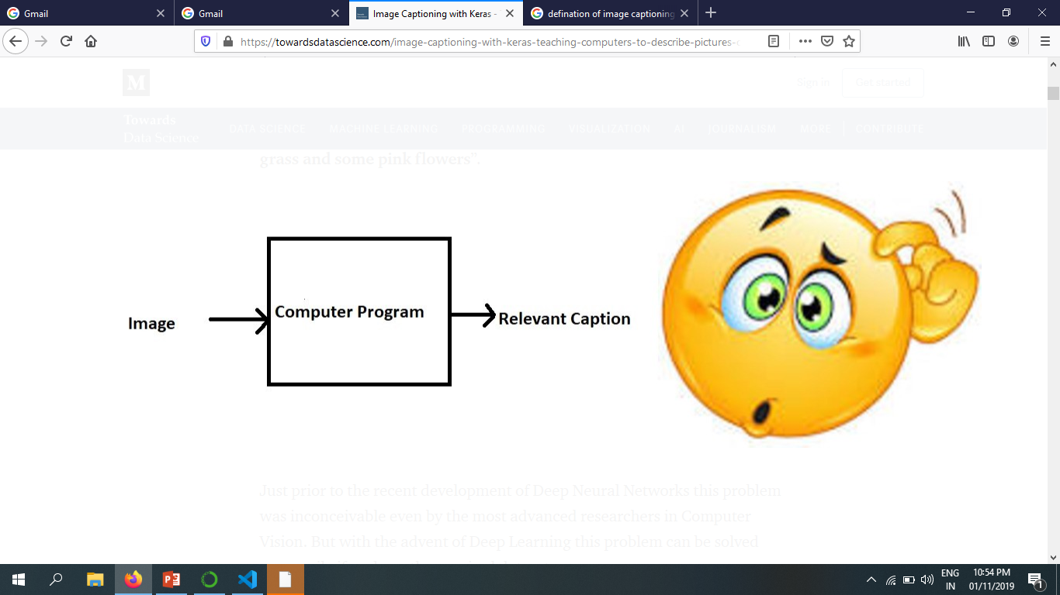
Problem Statement
Image Captioning is the process of generating textual description of an image. If we upload any image so this system is generate relevant caption for it.
You have to write a computer program that takes an image as input and produces a relevant caption as output.

Slide 6
In this project we have to use CNN (Convolution Neural Network) model called InceptionV3 and dataset Flickr-8k.
We are using an open source dataset called Flickr-8k (containing 8000+ images). Here each image has 5 captions defining it. Now we bifurcated as follows : Training Set - 6000 images, Dev Set - 1000 images, Test Set -1000 images approx.
Convert each image into unique size fed into InceptionV3 Model of CNN.
Next we need to gather data for captions, here we make a vocabulary of all words used in captions of the images and also separate captions for Training Set.
Then we feed the Training Images and Caption Vocabulary to the model and input Test images.

Slide 7
Objectives
A better reader of images
Using large dataset for better efficiency
Uploading any picture you want; this system will generate a caption for it.

Slide 8
Applications
1.SkinVision : Lets you confirm weather a skin condition can be skin cancer or not. 2. Google Photos: Classify your photo into Mountains, sea etc. 3. Deepmind: Achieved superhuman level playing Game Atari. 4. Facebook: Using AI to classify, segmentate and finding patterns in pictures. 5. A U.S. company is predicting crop yield using images from satellite. 6. Fed Ex and other courier services: Are using hand written digit recognition system from may times now to detect pin code correctly. 7. Picasa : Using facial Recognition to identify your friends and you in a group picture. 8. Tesla/Google Self Drive Cars: All the self drive cars are using image/video processing with neural network to attain their goal. 9. Automatic Image captioning requires both Image analysis and neural network.

Slide 9
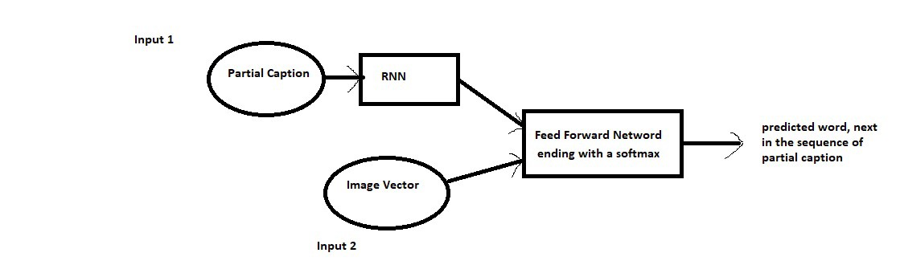
Proposed Architecture of system

Slide 10
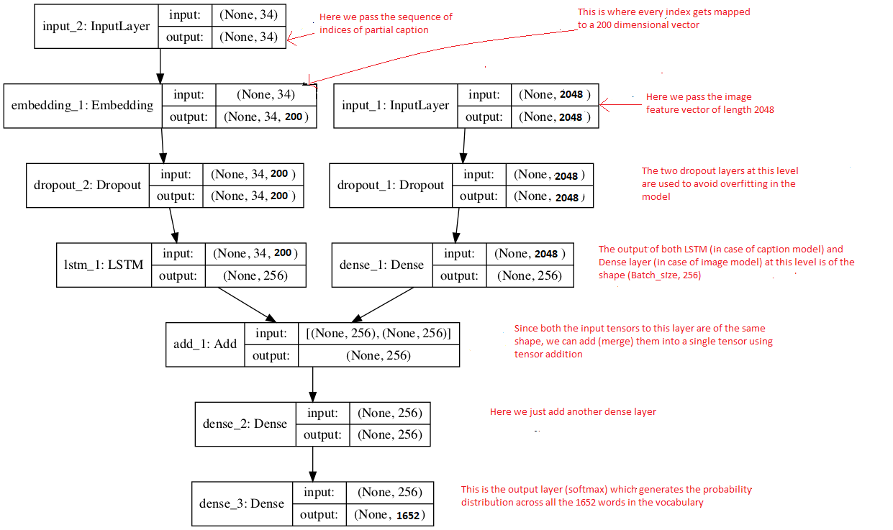
Flowchart of Architecture

Slide 11
Methodology
This is method that we followed while making our project:-
Data collection
Understanding the data
Data Cleaning
Loading the training set
Data Preprocessing — Images
Data Preprocessing — Captions
Data Preparation using Generator Function
Word Embeddings

Slide 12
Hardware and Software Requirement
Technologies : VisualStudioCode IDE for programming, Python Data Structures, Libraries called Pandas, Numpy, Skilearn, Keras, CNN model InceptionV3. We use Flickr-8k dataset provided by the reference.
Hardware : System Model : HP Laptop 15-bs0xx. PC credentials : Processor Intel(R) Core(TM) i3-7020U CPU @ 2.30GHz, 2300 Mhz, 2 Core(s), 4 Logical Processor(s), 64GB RAM.

Slide 13
Conclusion
Using a larger dataset.
Changing the model architecture, e.g. include an attention module.
Doing more hyper parameter tuning (learning rate, batch size, number of layers, number of units, dropout rate, batch normalization etc.).
Use the cross validation set to understand overfitting.
Using Beam Search instead of Greedy Search during Inference.
Inception v3 is a widely-used image recognition model that has been shown to attain greater than 78.1% accuracy on the flicker8k dataset.

Slide 14
References
https://cs.Stanford.edu/people/karpathy/cvpr2015.pdf
https://arxiv.org/abs/1411.4555
https://arxiv.org/abs/1703.09137
https://arxiv.org/abs/1708.02043
https://machinelearningmastery.com/develop-a-deep-learning-caption-generation-model-in-python/
https://www.youtube.com/watch?v=yk6XDFm3J2c
https://www.appliedaicourse.com/

