Slide 1

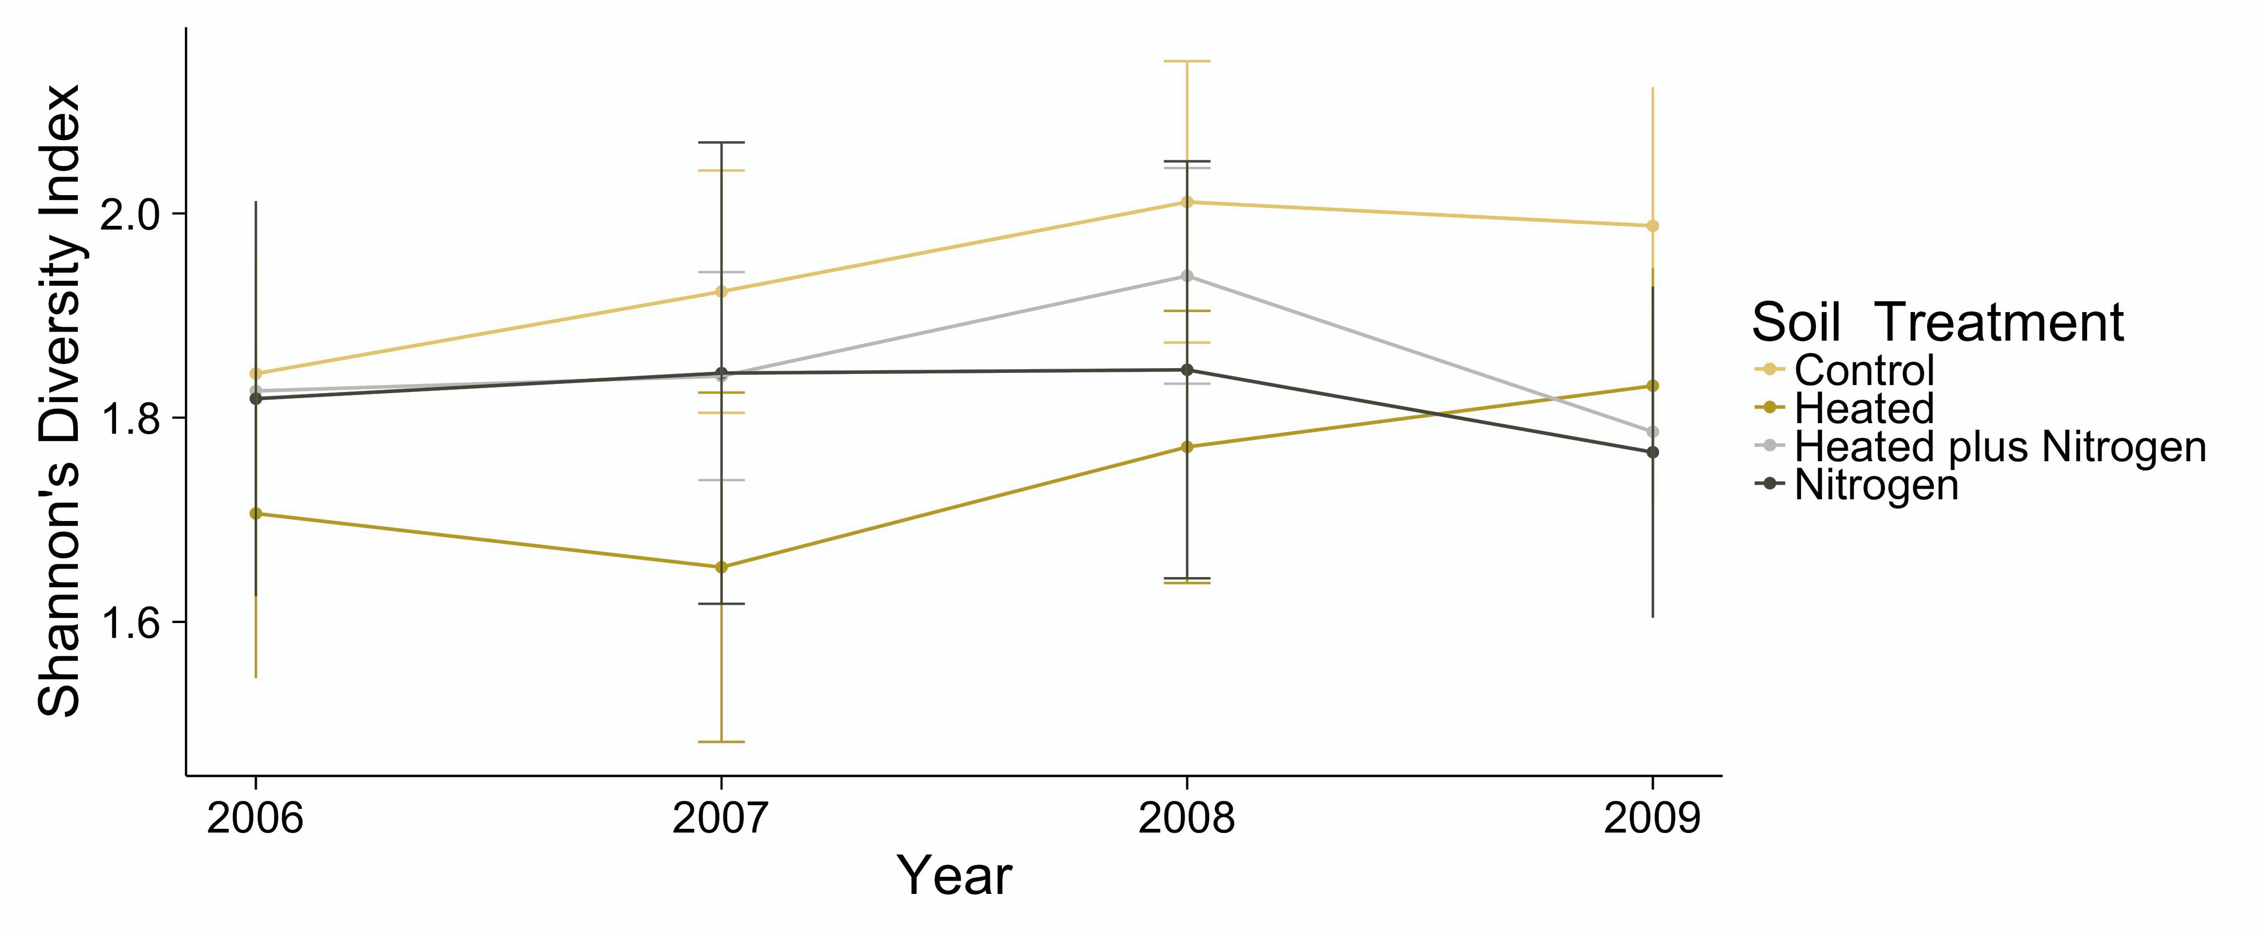
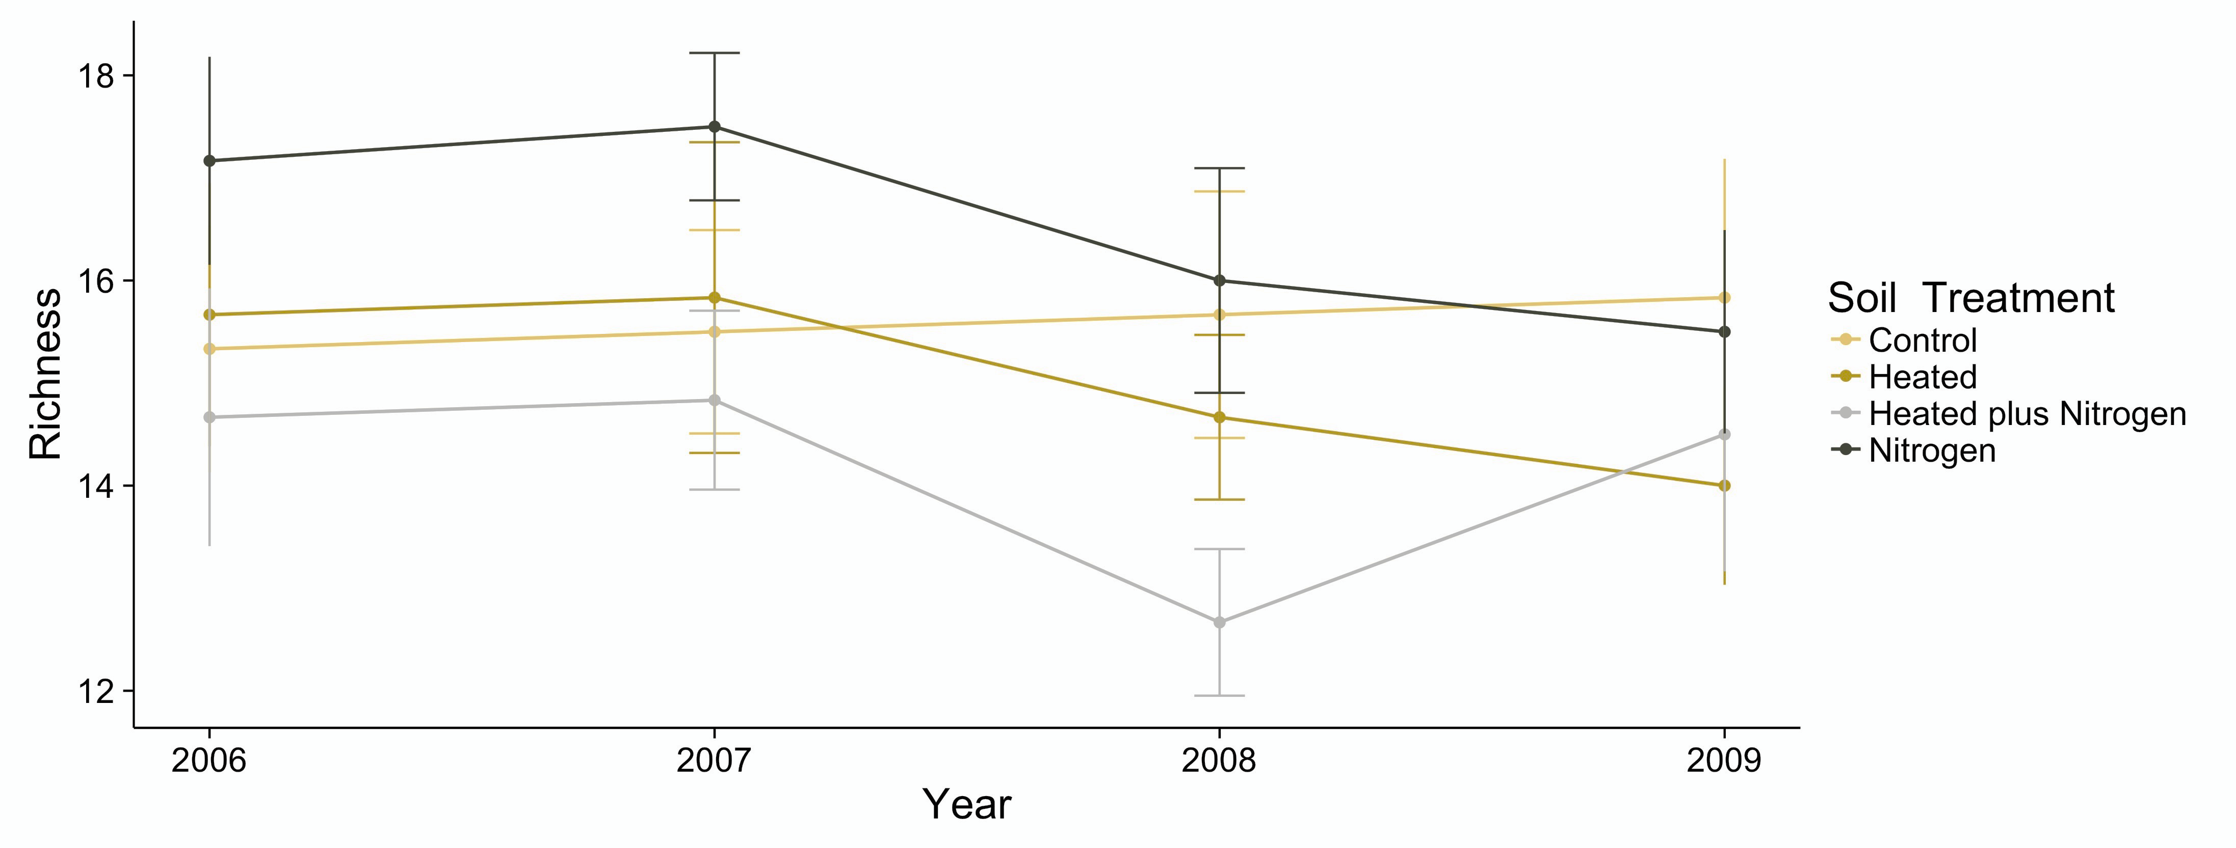
Soil Warming Plus Nitrogen Addition Experiment at Harvard Forest
Source | NumDF | DenDF | F-value | P-value
Intercept | 1 | 90 | 1563 | 0
Treatment | 1 | 2 | 0.368 | 0.61
Year | 1 | 90 | 0.667 | 0.42
Year x Treatment | 1 | 90 | 1.022 | 0.31
Average Plant Diversity
2006-2009

Slide 2
Soil Warming Plus Nitrogen Addition Experiment at Harvard Forest
Source | NumDF | DenDF | F-value | P-value
Intercept | 1 | 90 | 693 | 0
Treatment | 1 | 2 | 0.147 | 0.74
Year | 1 | 90 | 2.77 | 0.09
Year x Treatment | 1 | 90 | 1.14 | 0.29
Average Plant Richness
2006-2009

