Slide 1
CS412 Final Review Classification (Chapters 8, 9)
Jia Wang
12/6/2015
Notes:
Problem with Naïve Bayes in homework

Slide 2
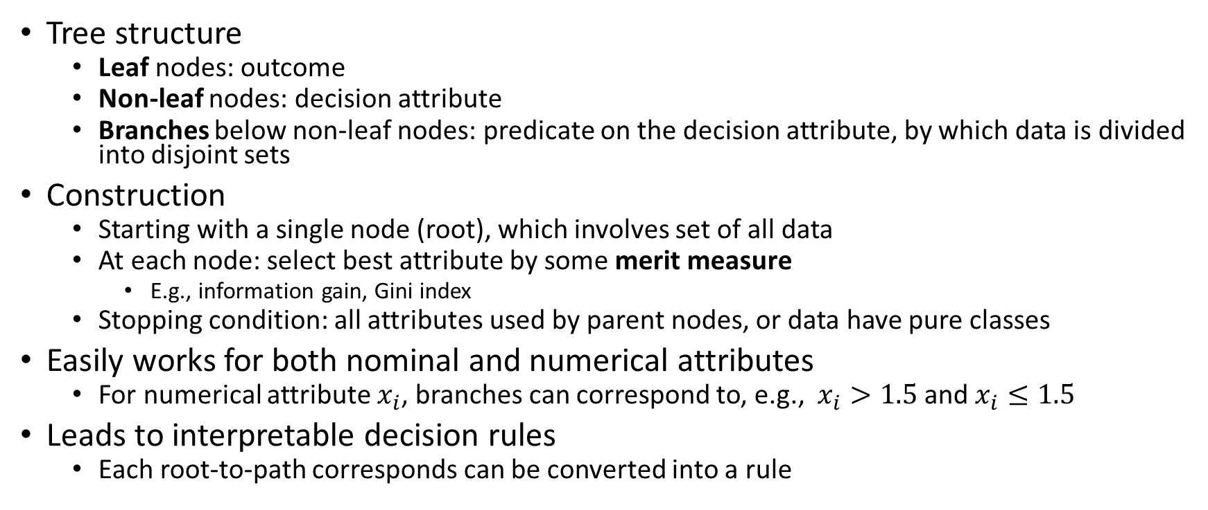
Decision tree
Tree structure
Leaf nodes: outcome
Non-leaf nodes: decision attribute
Branches below non-leaf nodes: predicate on the decision attribute, by which data is divided into disjoint sets
Construction
Starting with a single node (root), which involves set of all data
At each node: select best attribute by some merit measure
E.g., information gain, Gini index
Stopping condition: all attributes used by parent nodes, or data have pure classes
Easily works for both nominal and numerical attributes
For numerical attribute $x_{i}$, branches can correspond to, e.g., $x_{i}>1.5$ and $x_{i}≤1.5$
Leads to interpretable decision rules
Each root-to-path corresponds can be converted into a rule
Notes:
Attribute selection
Stopping condition
Interpretable rules

Slide 3
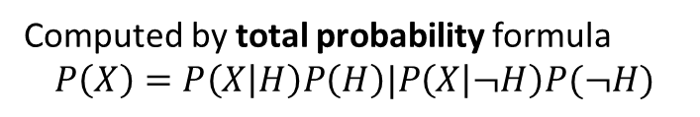
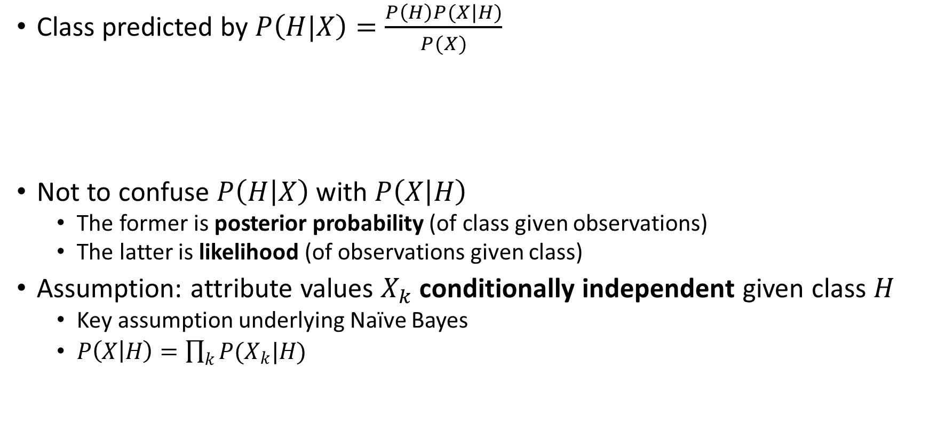
Naïve Bayes
Class predicted by $P\left(H|X\right)=\frac{P\left(H\right)P(X|H)}{P(X)}$
Not to confuse $P\left(H | X\right)$ with $P\left(X | H\right)$
The former is posterior probability (of class given observations)
The latter is likelihood (of observations given class)
Assumption: attribute values $X_{k}$ conditionally independent given class $H$
Key assumption underlying Naïve Bayes
$P\left(X | H\right)=\prod_{k}{P(X_{k}|H)}$
Hypothesis (prediction)
Evidence
Computed by total probability formula
$$P\left(X\right)=P\left(X | H\right)P\left(H\right)|P\left(X | ¬H\right)P(¬H)$$

Slide 4
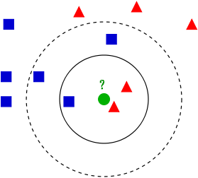
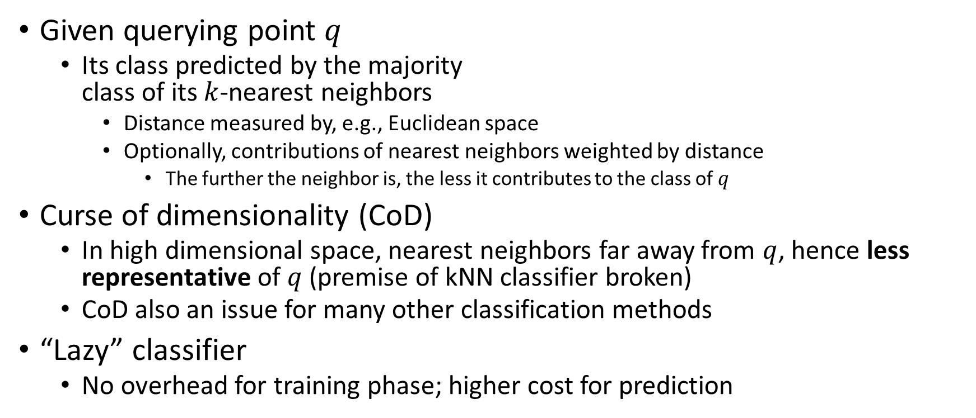
K-Nearest Neighbor
Given querying point $q$
Its class predicted by the majority class of its $k$-nearest neighbors
Distance measured by, e.g., Euclidean space
Optionally, contributions of nearest neighbors weighted by distance
The further the neighbor is, the less it contributes to the class of $q$
Curse of dimensionality (CoD)
In high dimensional space, nearest neighbors far away from $q$, hence less representative of $q$ (premise of kNN classifier broken)
CoD also an issue for many other classification methods
“Lazy” classifier
No overhead for training phase; higher cost for prediction

Slide 5
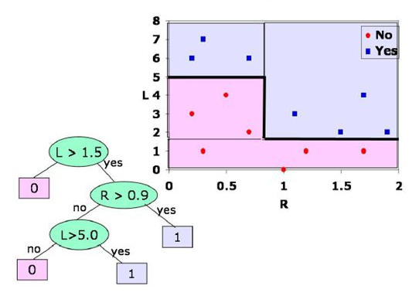
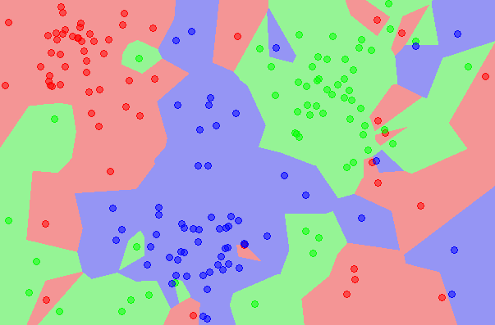
K-Nearest Neighbor
Decision boundary of classifiers
Hypersurfaces that partitions feature space into subsets, one for each class
E.g., Curves in 2-D spaces, surfaces for 3-D spaces
A 1NN example
A decision tree example

Slide 6
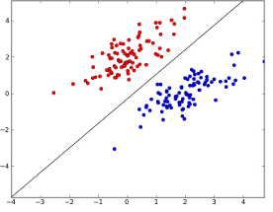

Perceptron
Predict class $+1$ if $w∙x+b>0$; otherwise class $-1$
$w$ and $b$ are parameters, $x$ is input vector
Parameters $w$ and $b$ updated iteratively for each training tuple
Linear decision boundary only

Slide 7
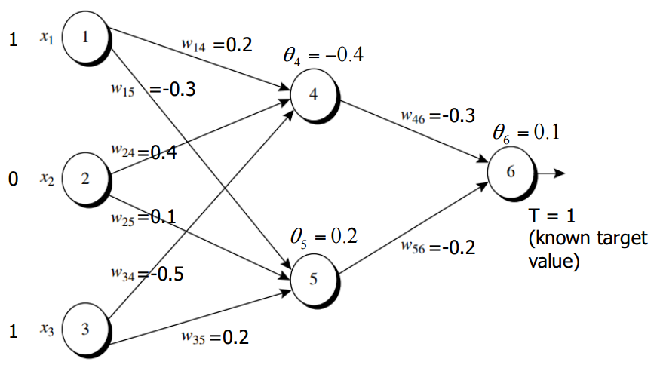
Multilayer Neural Network
Topology
Input layer, hidden layer(s), output layer
Each layer consists of units (neurons)
Units linked to some units in the next layer
Prediction by feedforwarding
Each neuron takes input as the biased weighted sum of outputs from neurons in the previous layer, and calculates output with the activation function
Examples of activation function: sign, threshold (step), sigmoid, tanh, etc.
Parameter determined by backpropagation
Parameters include weights on the connections and biases on the units

Slide 8
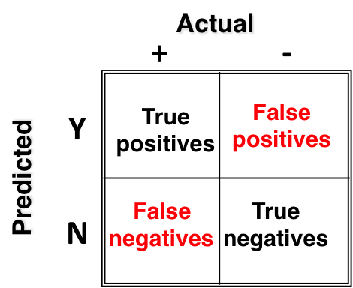
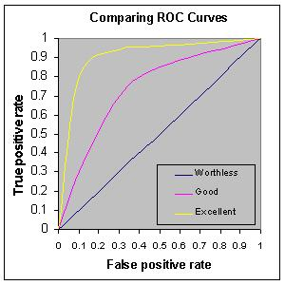
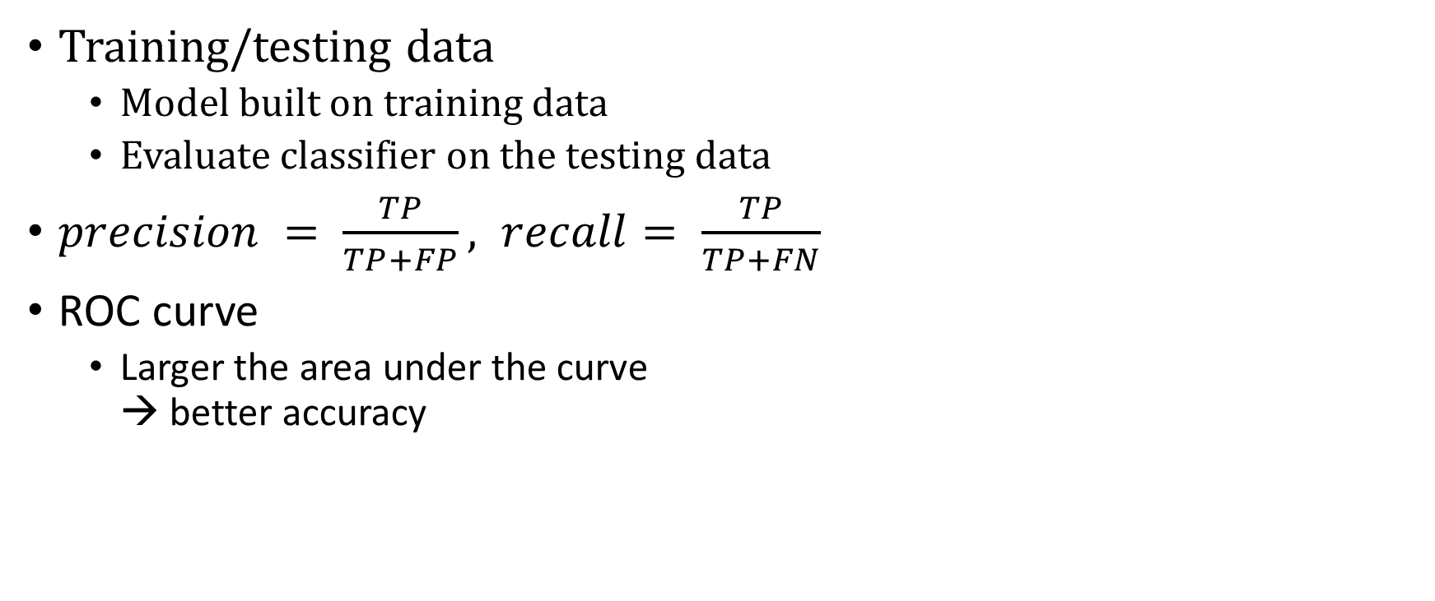
Evaluating classifiers
Training/testing data
Model built on training data
Evaluate classifier on the testing data
$precision = \frac{TP}{TP+FP}, recall= \frac{TP}{TP+FN}$
ROC curve
Larger the area under the curve → better accuracy

Slide 9
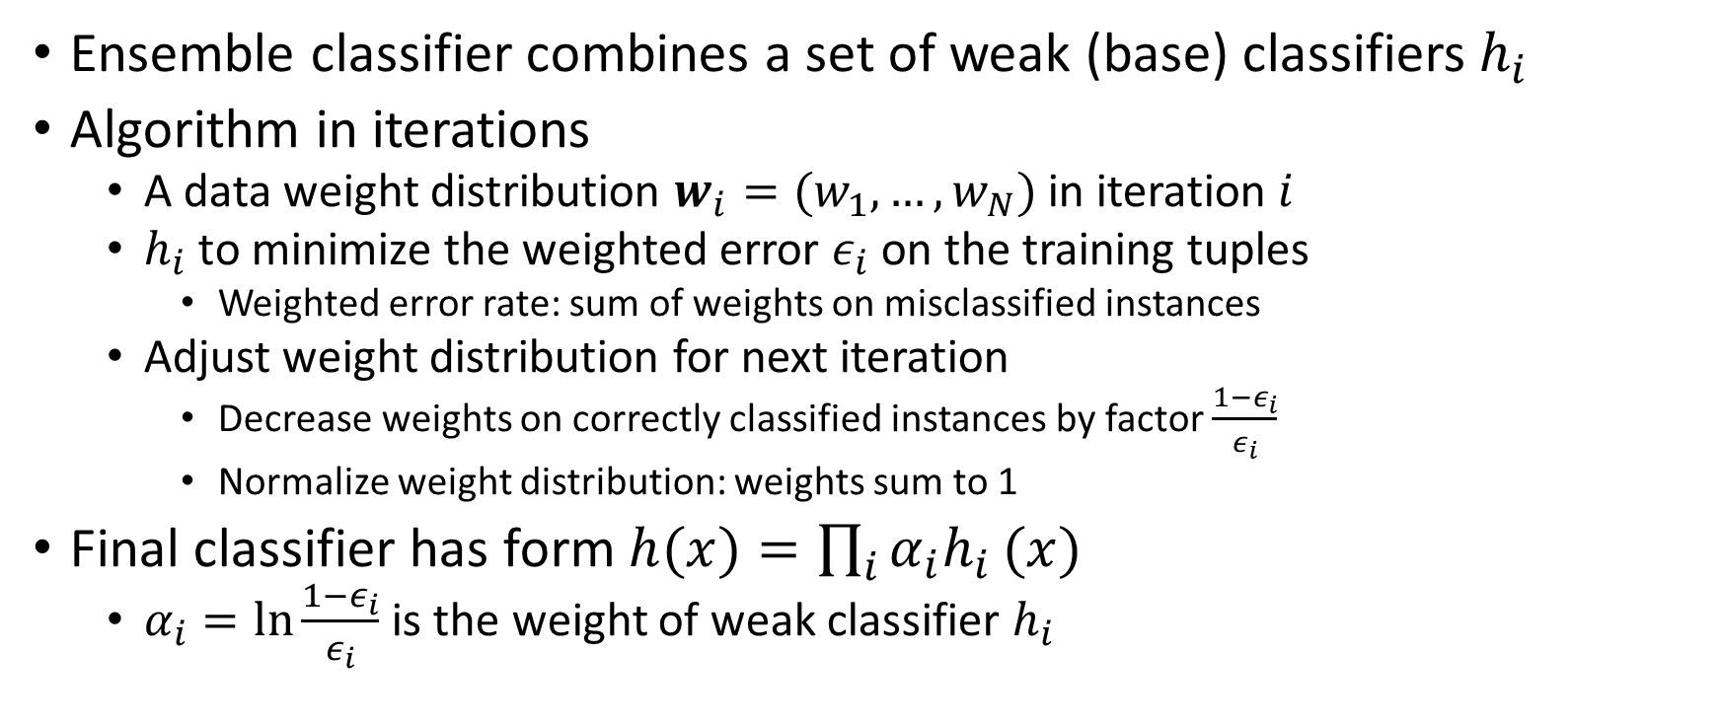
AdaBoost
Ensemble classifier combines a set of weak (base) classifiers $h_{i}$
Algorithm in iterations
A data weight distribution $w_{i}=(w_{1},…,w_{N})$ in iteration $i$
$h_{i}$ to minimize the weighted error $ε_{i}$ on the training tuples
Weighted error rate: sum of weights on misclassified instances
Adjust weight distribution for next iteration
Decrease weights on correctly classified instances by factor $\frac{1−ε_{i}}{ε_{i}}$
Normalize weight distribution: weights sum to 1
Final classifier has form $h(x)=\prod_{i}{{α_{i}h}_{i}}(x)$
$α_{i}=\ln{\frac{1−ε_{i}}{ε_{i}}}$ is the weight of weak classifier $h_{i}$

