Slide 1
Goal – recreate the basic results of enhance supperradiance
- use sr results to affect plasmonice wave guides
Tool – markovian simulation of simple SR system.
Interesting results –
after stimulating a system we can see that the emmition rate is different for different initial condition for the same <m> value.
after p/2 pulse the is no superpois distribution.

Slide 2
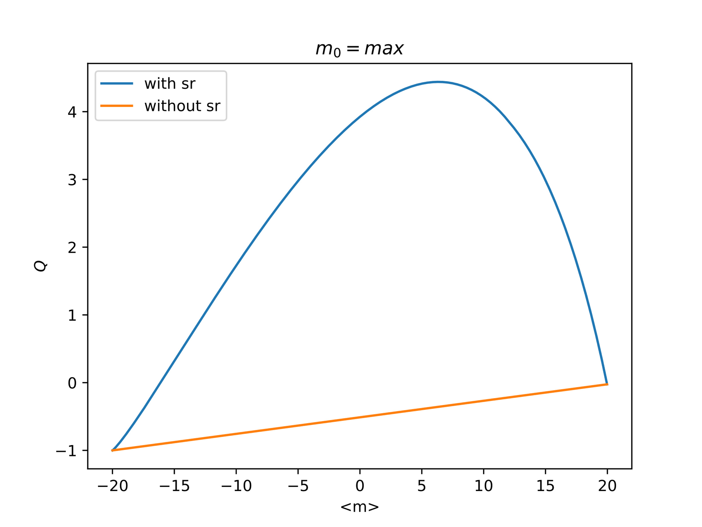
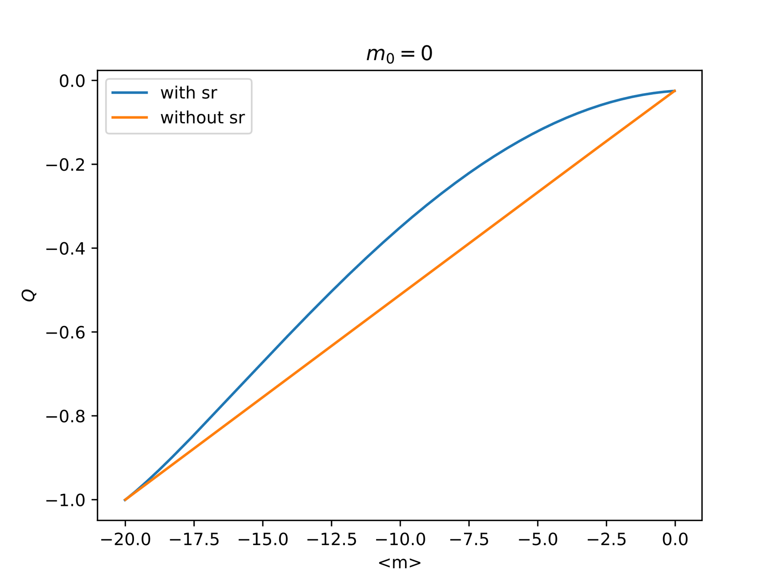
Goal – simple derivation and simulation of SR
Interesting results:
Comparison of emitted light distribution to poisson distribution as measured by $Q=\frac{\left(\left\langle {\left(Δ\hat{n}\right)}^{2}\right\rangle −\left\langle Δ\hat{n}\right\rangle \right)}{\left\langle Δ\hat{n}\right\rangle }$

Slide 3
Future goal using SR for stimulating specific mode in plasmonic waves.
- Spatial organization of emitters to get enhance emission rate at preferred direction

