Slide 1
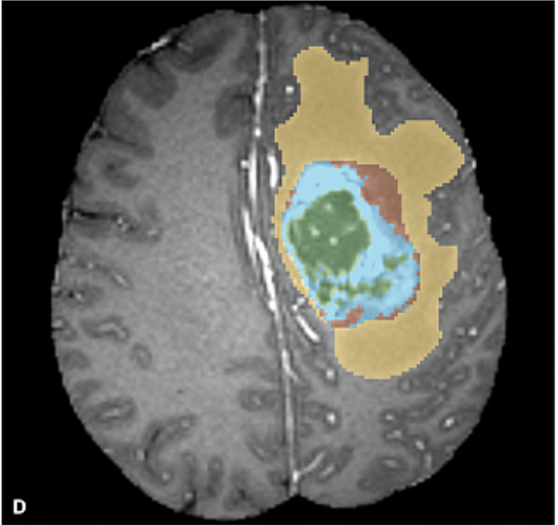
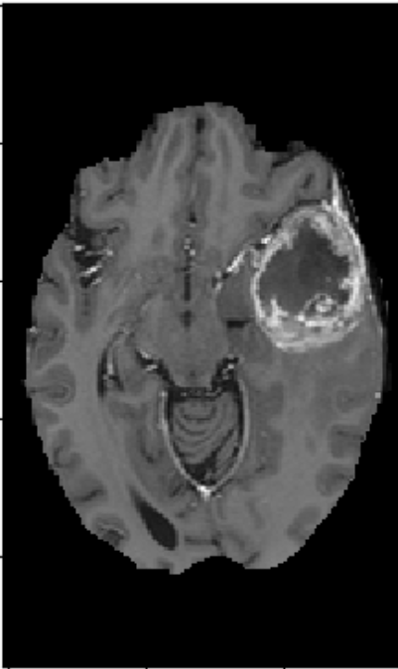
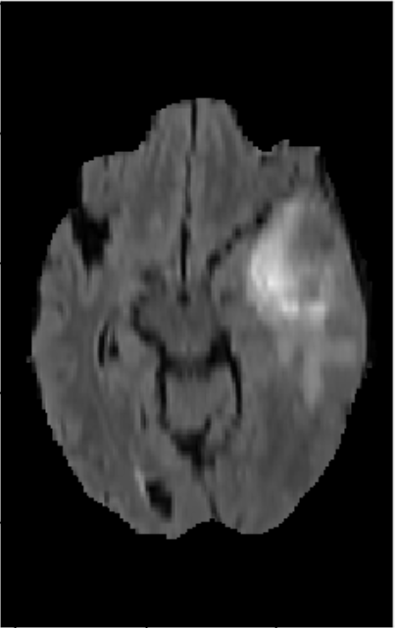
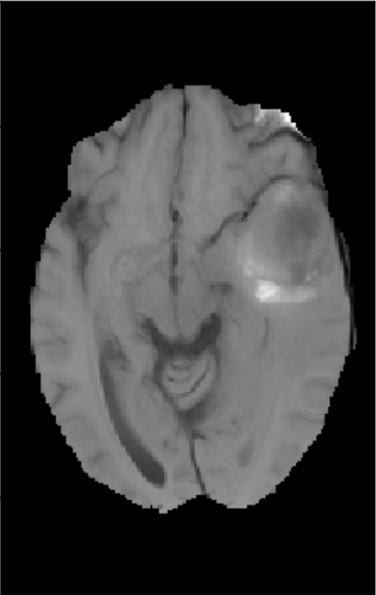
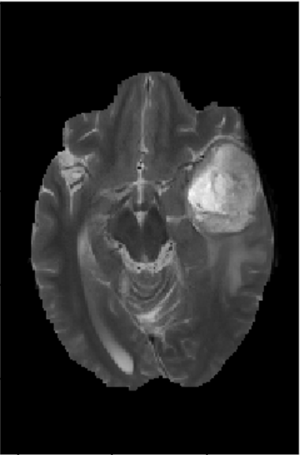
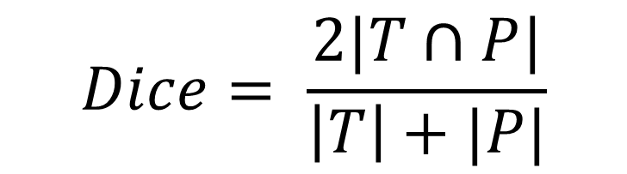
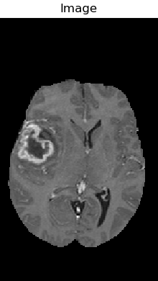
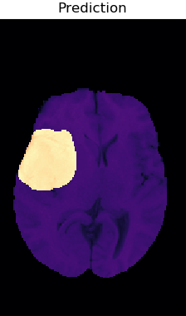
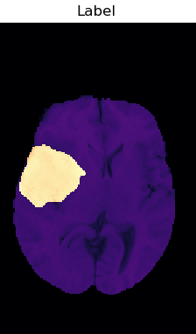
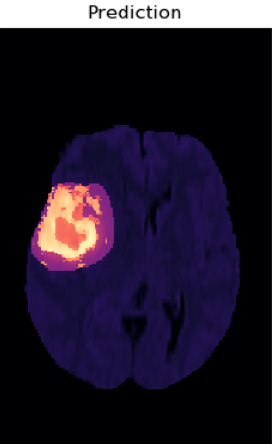
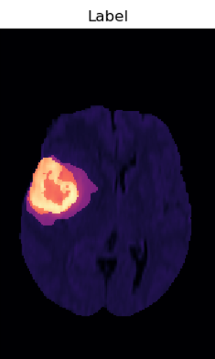
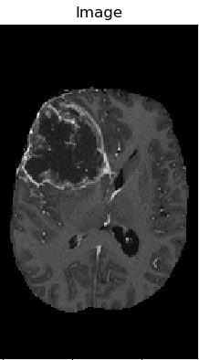
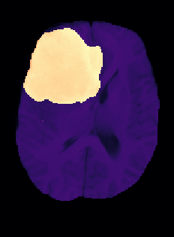
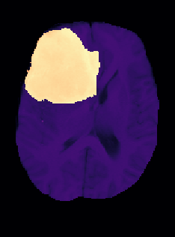
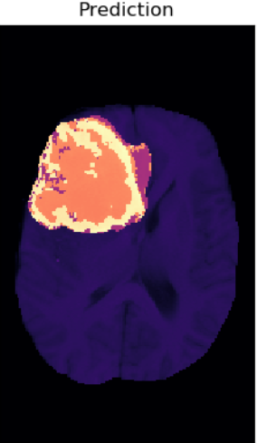
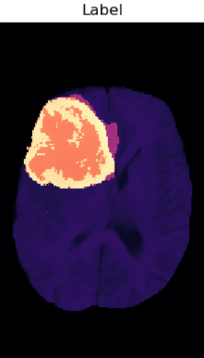
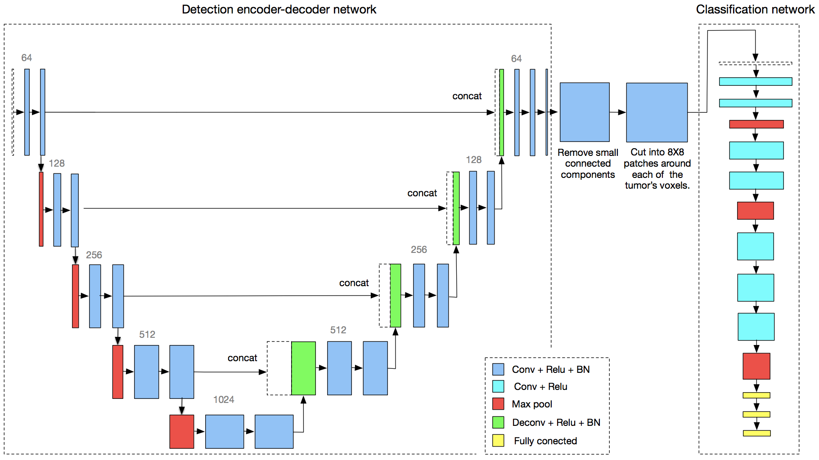
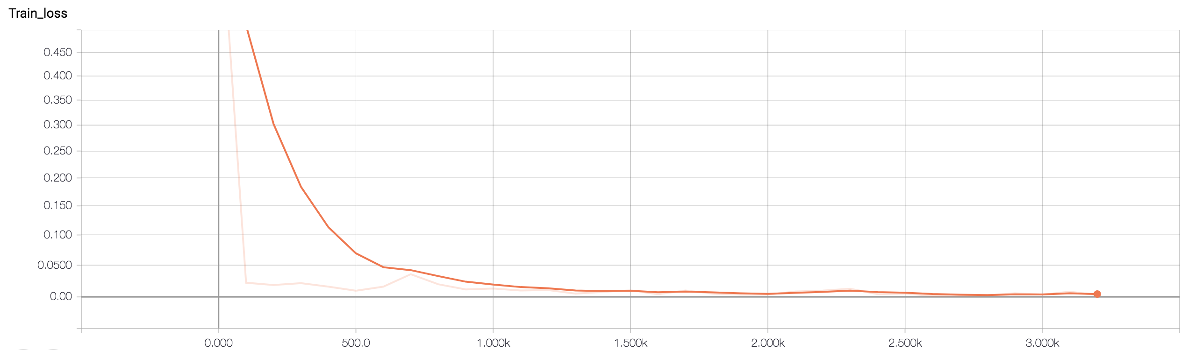
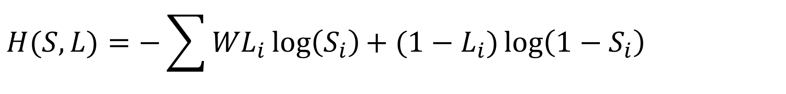
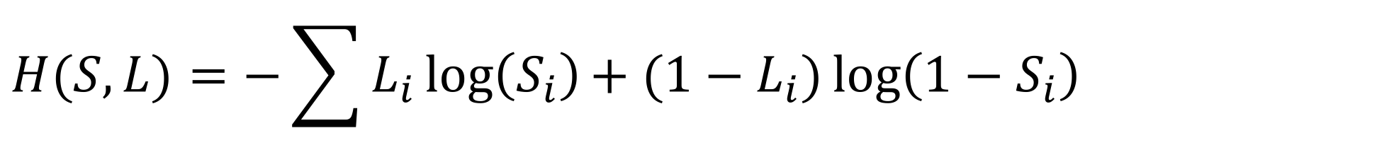
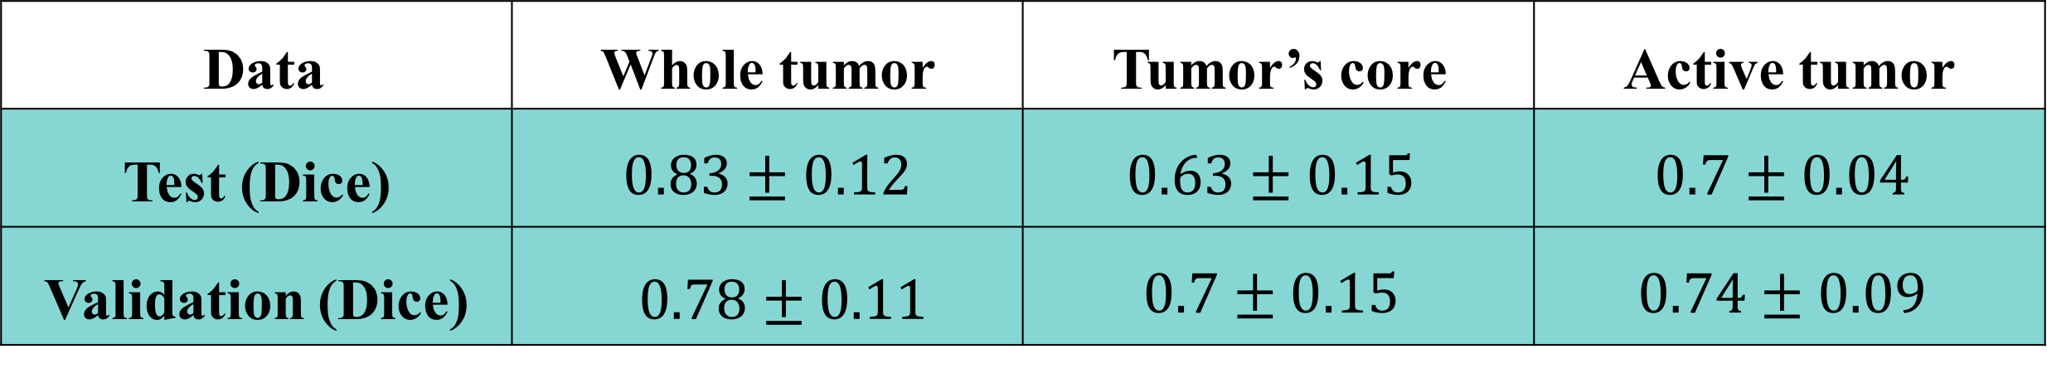
P-2018-049
Faculty of Engineering Sciences
Department of Electrical & Computer Engineering
יש למקם כאן את הברקוד
Brain tumor segmentation using deep learning
Roy Hirsch, Ori Chayoot
Advisors: Dr. Riklin Raviv Tammy
Introduction
The data
Glioma is the most common brain tumor type among adults. MR images are wildly used in order to evaluate the disease’s progression and treatment. Today the resulting images are evaluated manually. Replacing the current procedure with an automated analysis has great potential for improving and accelerating the analysis process.
In this project we present two methods to solve the problem, classical method and deep learning method.
The model was trained and tested over the “The Multimodal Brain Tumor Image Segmentation Benchmark (BRATS)”. The dataset consists of multimodal 30 scans, each scan was labeled manually by experts to the following classes:
The data was divided to train (20), validation (6) and test (4).
Yellow – edema
Red - non-enhancing core
Green - necrotic/cystic core
Blue - enhancing core
Project’s goal
Develop an algorithm for semantic segmentation of the different tumors’ sub-regions using neural networks.
Fig [2] BRATS dataset
The classical model
Fig [3] Histogram of the intensity values of the tissue
Classical image processing model:
Brain tumor defer in color, size, shape and location therefore segmenting them is a challenging task.
Moreover, the intensity values of the healthy and pathological tissues partly overlap, as can be seen in fig [3].
Pre-processing
Contrast enhancement
Auto-thresholding of T2 and FLAIR scans
Otsu’s method
Morphological operations
Deleting small connected components
Active contour for optimized segmentation
“Chan and Vese”
level-set algorithm
The model was trained and tested over the sub-mission
of whole-tumor segmentation, results:
 | Whole tumor
Dice score | 0.75
Results
Dice evaluation method:
T – the ground true label , P – the predicted label
The deep learning model
Data | Whole tumor | Tumor’s core | Active tumor
Test (Dice) | $$0.83±0.12$$ | $$0.63±0.15$$ | $$0.7±0.04$$
Validation (Dice) | $0.78±0.11$ | $$0.7±0.15$$ | $$0.74±0.09$$
Two cascaded neural networks for detection and classification of the tumor region.
The detection network is a deep convolutional “encoder-decoder” neural network fed with 2D slices from the MR image. The net performs detection of the whole tumor area.
The classification network is a convolutional neural networks fed with patches of the tumor area generated from the first network. The net predicts the sub-tissues of the tumor. See fig [1]
Combining the two nets yields end-to-end solution for segmenting the tumor’s regions.
Original image
Whole tumor
Sub-tissues
Training procedure
The two neural networks were trained separately using stochastic gradient decent The first network uses weighted cross-entropy cost function:
The second uses cross-entropy cost function:
Optimization using Adaptive moment estimation - “Adam”.
$$H(S, L)=−\sum{{WL}_{i}\log\left(S_{i}\right){+ (1−L}_{i})\log\left(1−S_{i}\right)}$$
L – ground true label
S – score from the last layer W - weight
$$H(S, L)=−\sum{L_{i}\log\left(S_{i}\right){+ (1−L}_{i})\log\left(1−S_{i}\right)}$$
Train loss
Conclusions
1. The suggested model achieved competitive accuracy and is suggesting a creative and innovative neural network architecture to solve the requested problem.
2. Using batch normalization allows the model to stay stable during training.
3. Using weighted cost function is crucial for optimization of imbalanced data.
4. Deeper model achieves better accuracy.
References
B. H. Menze, A. Jakab״, The Multimodal Brain Tumor Image Segmentation Benchmark (BRATS)״, Med. Im. vol:34 issue: 10
O Ronneberger, P Fischer, U-Net: Convolutional Networks for Biomedical Image Segmentation, BIOSS, 2015
Fig [1] network architecture

