Slide 1
Brain tumor segmentation
Roy Hirsch, Ori Chayoot

Slide 2
Introduction:
Galioma brain tumor:
The most frequent primary brain tumors in adults
Originated from the Glial cells
Divided into Low Grade (LGG) and High Grade (HGG)
MR imaging for tumor detection:
Used for prediction and evolution before and during treatment
Diverse in terms of size, shape, extension and localization
Diverse MRI modalities are used
Project’s goal:
Segmentation of HGG whole tumor region from multi-modal MRI scans.
Notes:
Galiomas represent 24.7% of all primary brain tumors and 74.6% of all malignant tumors.
There are more than 100 histologically distinct types of primary brain and central nervous system tumors.
Because of their unpredictable appearance and shape, segmenting brain tumors from multi-modal imaging data is one of the most challenging tasks in medical image analysis.

Slide 3
Introduction:
BRATS dataset (2012):
Global challenge for brain tumor segmentation
20 HGG and 10 LGG MR multimodal images (T1, T2, T1g, FLAIR)
The images are co-registered and skull stripped
HG-001, slice: 80
Notes:
Post-Gadolinium T1 scan:
Gadolinium (Gd) is a metallic element (atomic number 64) that can be chelated into paramagnetic agents that are injected intravenously during MR imaging.
The gadolinium ion is useful as an MRI agent because it has seven unpaired electrons, which is the greatest number of unpaired electron spins possible for an atom.
Gd molecules shorten spin-lattice relaxation time (T1) of voxels in which they are present.
As a result, on T1-weighted images they have a brighter signal. This can have a number of utilities:
Detection of focal lesions, e.g. tumour, abscess, metastasis
imaging of vessels in MR angiography
characterization of liver lesions, based on enhancement characteristics, e.g. hepatoma and haemangioma
Blood vessels and pathologies with high vascularity appear bright on T1 weighted post gadolinium images.
Gadolinium contrast agents are the most commonly used for enhancement of vessels in MR angiography or for brain tumor enhancement associated with the degradation of the blood–brain barrier. One GD atom can relax million water molecules in a second. GD is a paramagnetic material
Flair scan:
FLAIR: fluid-attenuated inversion-recovery MRI: bright signal of the CSF (cerebrospinal fluid) is suppressed which allows a better detection of small hyperintense lesions.
In FLAIR, the signal from fluid is nullified by using a long effective echo time and long inversion time. Inversion recovery sequence with a long inversion time (TI) of 2000-2500 is used for fluid suppression. This sequence is commonly used in the brain and spinal cord where the lesions are normally covered by bright cerebrospinal fluid (CSF) signals. A long inversion time suppresses the high CSF signal and improve the visualization of small periventricular and spinal cord lesions.

Slide 4
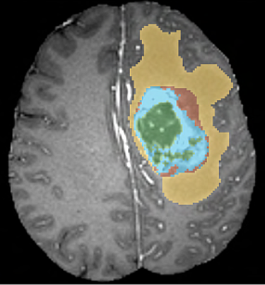
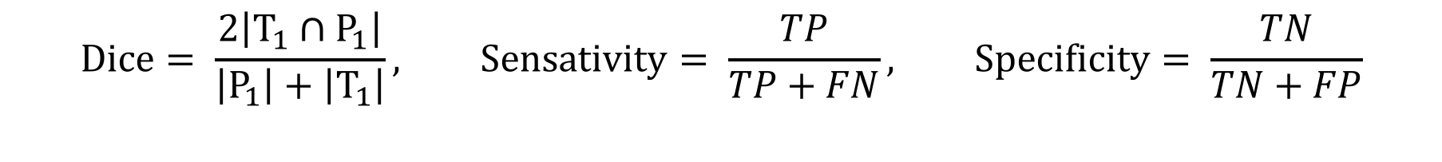
Introduction:
BRATS dataset (2012):
Ground true manual segmentation:
(0) Background
(1 - green) Necrotic center and fluid collections
(2 - yellow) Edema
(3 - brown) On- enhancing tumor
(4 - blue) Enhancing tumor
Measure metrics:
$$Dice= \frac{2\left|T_{1}∩P_{1}\right|}{\left|P_{1}\right|+\left|T_{1}\right|}, Sensativity= \frac{TP}{TP+FN}, \text{Specificity}= \frac{TN}{TN+FP}$$

Slide 5
GMM
Prior assumption to examine – the separability of the data into two classes: background and tumor.
Partial seperability, depends on the modality.
Notes:
Different separtion stages per modality

Slide 6

GMM
Training multimodal GMM model
Experiencing different modalities (best results for T2 and FLAIR)
Adding regularization value. Tuning hyper-parameters (number of iterations, regularization)
D dimensions Gaussian distribution:
$$P\left(x\right|μ, Σ)=\frac{1}{{(2π|Σ|)}^{0.5 }}exp \{−\frac{1}{2}{\left(x−μ\right)}^{T} \left(x−μ\right)Σ^{−1}\}$$
Segmentation map of the model
Prediction Vs. ground true, dice: 0.307
Prediction
Ground true
HG-001, slice: 80
Notes:
We tried several experiments with GMM.

Slide 7
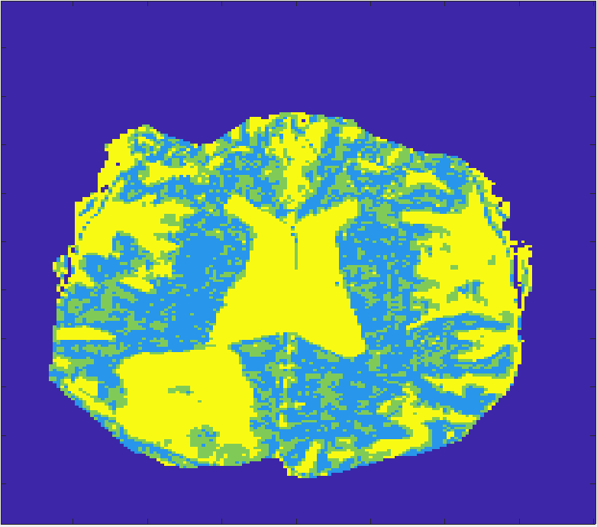
GMM
Training different models per modality and fusion between them.
Initializing the models with mean and variance.
Fusion between T2 and FLAIR tumor segmentation.
Prediction Vs. ground true, dice: 0.496
Segmentation map, FLAIR:
Segmentation map, T2:
AND
HG-001, slice: 80
Dice: 0.209
AND
HG-002, slice: 90
Notes:
We tried several experiments with GMM.

Slide 8
Title
Introduction backroad, motivation, model assumptions, (T1g, FLAIR)
Description of the data (histogram)
Data demonstration
GMM SVM
Outso method
Level-set (intensity correction)
Hyper parameters
Summery of results

