Slide 1
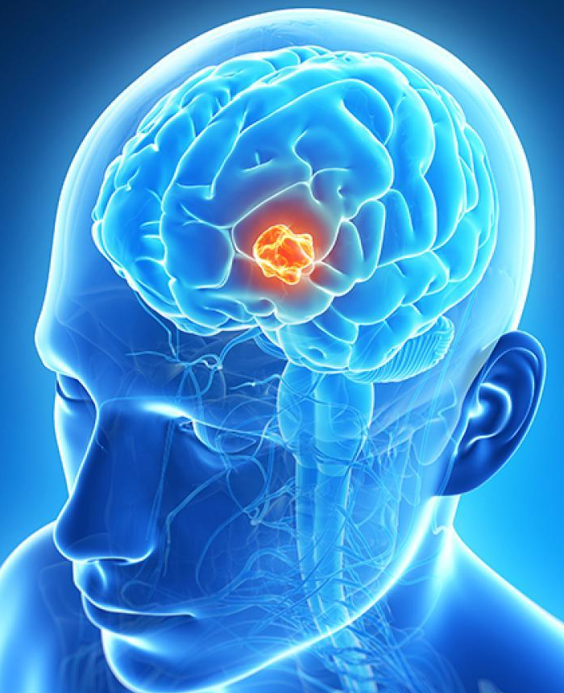
Brain tumor segmentation using deep learning
Pro-2018-049
Advisor: Dr. Tammy Riklin-Raviv
Roy Hirsch, Ori Chayoot

Slide 2



Introduction:
Galioma brain tumor is the most frequent primary brain tumors in adults
MR imaging is used for prediction and evolution of tumors before and during treatment
The tumors are diverse in terms of size, shape, extension and localization
Project’s goal:
Accurate semantic segmentation of different tumor regions from multi-modal MRI scans using deep neural networks.
Notes:
Galiomas represent 24.7% of all primary brain tumors and 74.6% of all malignant tumors.
There are more than 100 histologically distinct types of primary brain and central nervous system tumors.
Because of their unpredictable appearance and shape, segmenting brain tumors from multi-modal imaging data is one of the most challenging tasks in medical image analysis.

Slide 3
Project’s timeline:
Dec 17’ -Feb 18’:
Implementation of classical segmentation algorithm
Mar 18’:
Implementation of Unet NN for BRATS data
Oct 17’:
Literature review
Aug-Sep 17’:
Independent studies of DNN course
Nov-Dec 17’:
Independent studies of TF.
Start building NN framework
Feb 18’:
Implementation of basic Unet NN for toy data

Slide 4
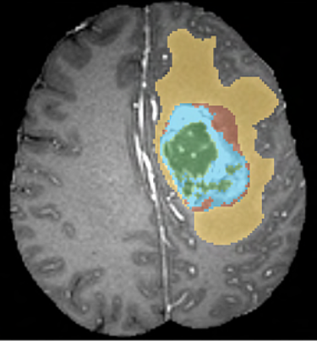
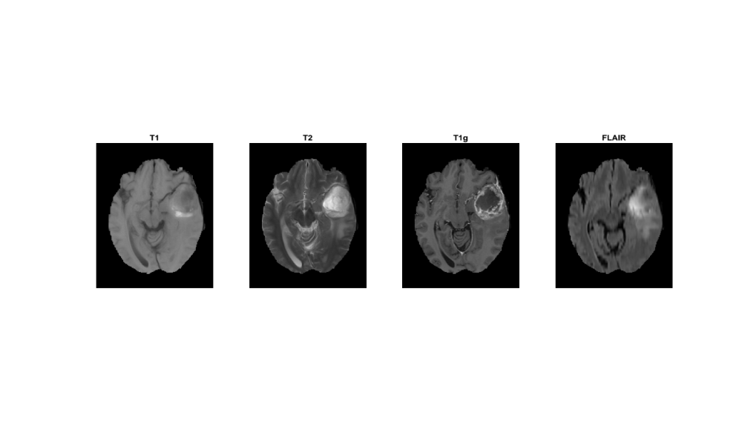
Dataset:
BRATS dataset (2012):
Global challenge for brain tumor segmentation
20 HGG and 10 LGG MR multimodal images (T1, T2, T1g, FLAIR)
The images are co-registered and skull stripped
Notes:
Post-Gadolinium T1 scan:
Gadolinium (Gd) is a metallic element (atomic number 64) that can be chelated into paramagnetic agents that are injected intravenously during MR imaging.
The gadolinium ion is useful as an MRI agent because it has seven unpaired electrons, which is the greatest number of unpaired electron spins possible for an atom.
Gd molecules shorten spin-lattice relaxation time (T1) of voxels in which they are present.
As a result, on T1-weighted images they have a brighter signal. This can have a number of utilities:
Detection of focal lesions, e.g. tumour, abscess, metastasis
imaging of vessels in MR angiography
characterization of liver lesions, based on enhancement characteristics, e.g. hepatoma and haemangioma
Blood vessels and pathologies with high vascularity appear bright on T1 weighted post gadolinium images.
Gadolinium contrast agents are the most commonly used for enhancement of vessels in MR angiography or for brain tumor enhancement associated with the degradation of the blood–brain barrier. One GD atom can relax million water molecules in a second. GD is a paramagnetic material
Flair scan:
FLAIR: fluid-attenuated inversion-recovery MRI: bright signal of the CSF (cerebrospinal fluid) is suppressed which allows a better detection of small hyperintense lesions.
In FLAIR, the signal from fluid is nullified by using a long effective echo time and long inversion time. Inversion recovery sequence with a long inversion time (TI) of 2000-2500 is used for fluid suppression. This sequence is commonly used in the brain and spinal cord where the lesions are normally covered by bright cerebrospinal fluid (CSF) signals. A long inversion time suppresses the high CSF signal and improve the visualization of small periventricular and spinal cord lesions.

Slide 5
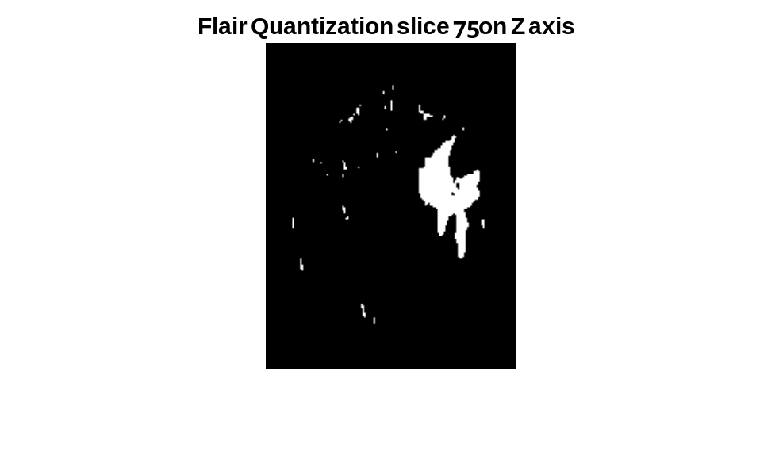
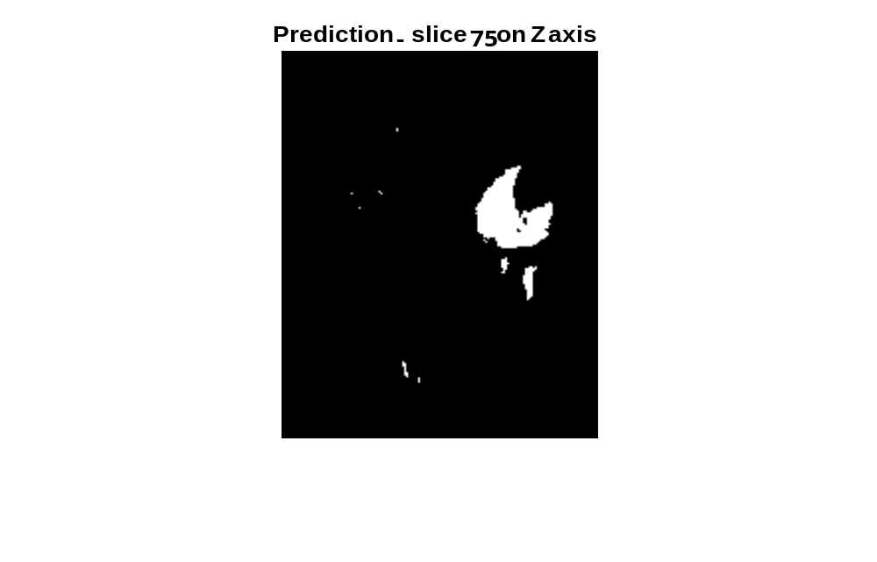
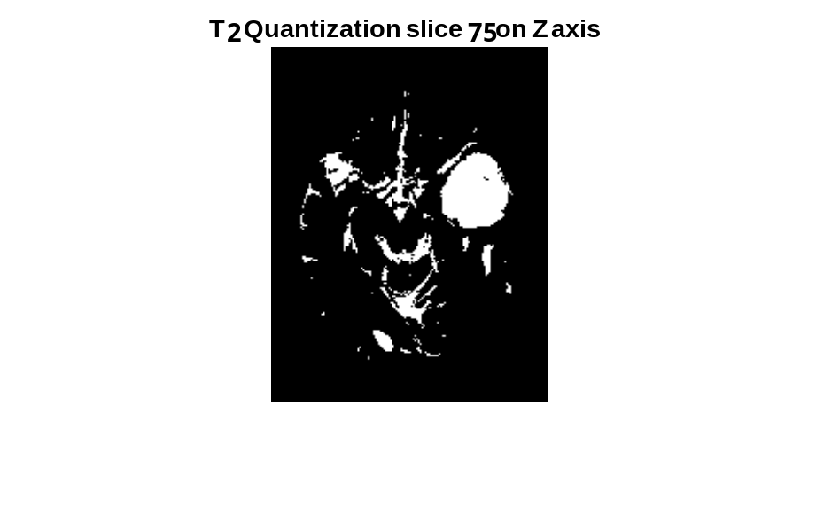
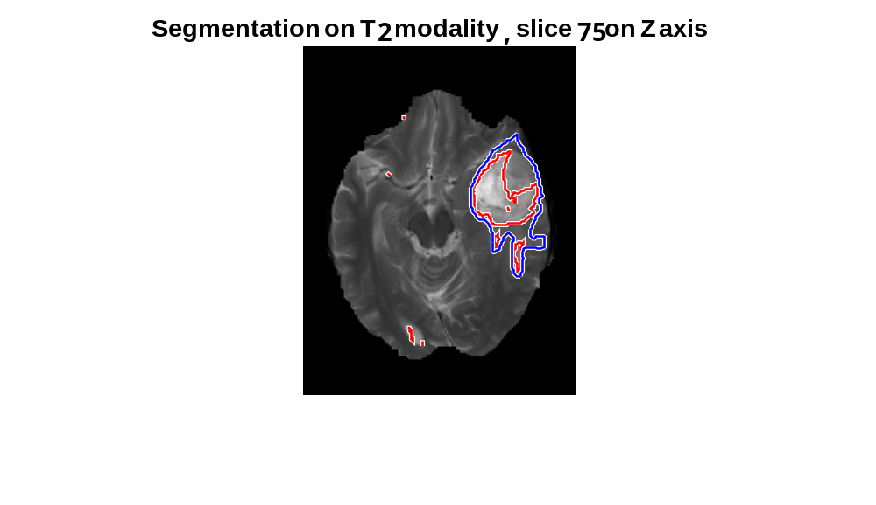
Classical segmentation algorithm:
Morphological operations
Deleting small connected components, gaps filling
Active contour for optimized segmentation
Chan and Vese level-set
Auto-thresholding of T2 and FLAIR scans.
Otsu’s method
Otsu’s method: clustering method, based on finding the thresholds that minimize the intra-class variance of the image histogram.
AND
Dice Score = 0.74
Sensitivity=0.61
Specificty=0.9994
Notes:
Different separtion stages per modality

Slide 6
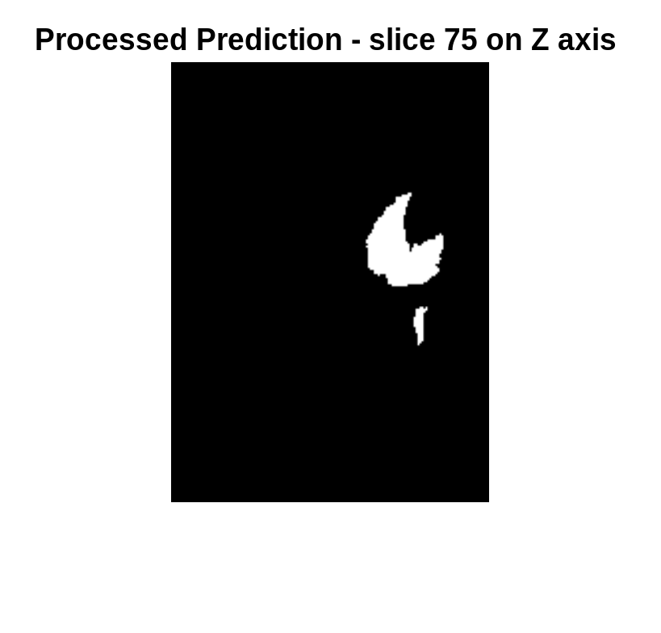
Classical segmentation algorithm:
Morphological operations
Deleting small connected components, gaps filling
Active contour for optimized segmentation
Chan and Vese level-set
Auto-thresholding of T2 and FLAIR scans.
Otsu’s method
Auto-threshold mask:
Cleaned mask:
Notes:
Different separtion stages per modality

Slide 7
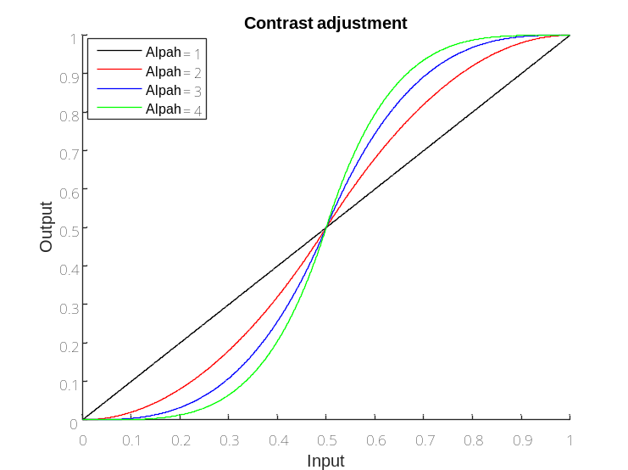

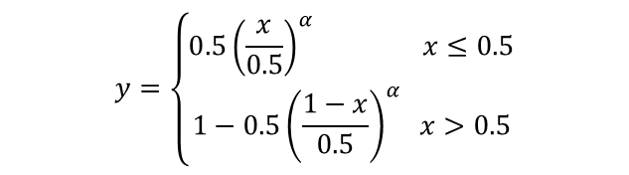

Classical segmentation algorithm:
Morphological operations
Deleting small connected components, gaps filling
Active contour for optimized segmentation
Chan and Vese level-set
Auto-thresholding of T2 and FLAIR scans.
Otsu’s method
Cost function:
Euler–Lagrange equation :
Active Contours Without Edges , Chan and Vese, IEEE, 2001
Notes:
Different separtion stages per modality

Slide 8
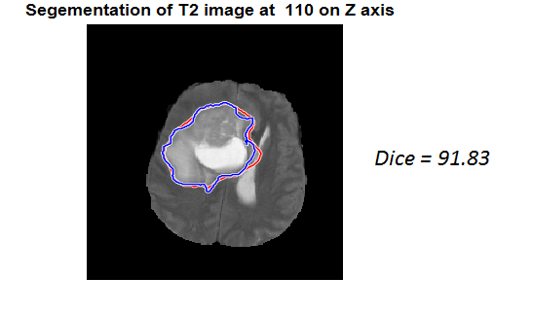
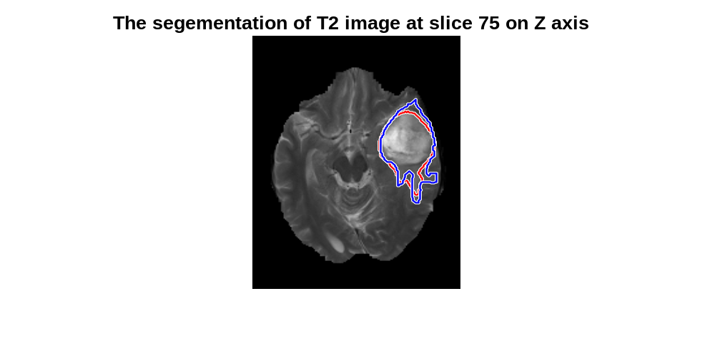
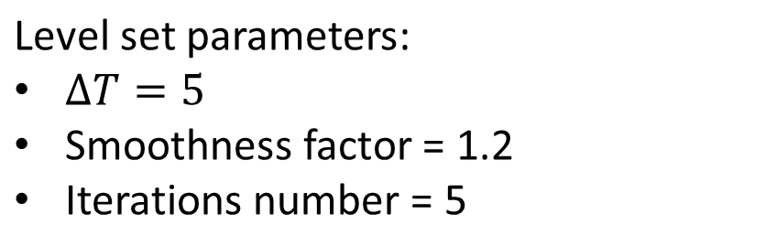
Final Results:
Dice=0.8416
score | 1 | 2 | 3 | 4 | 5 | 6 | 7 | 8 | 9 | 10 | 11 | 12 | 13 | 14 | 15 | 16 | 17 | 18 | 19 | 20 | AVG
Dice % | 82 | 88 | 86 | 92 | 66 | 92 | 68 | 83 | 83 | 5 | 91 | 59 | 46 | 82 | 89 | 88 | 74 | 93 | 74 | 84 | 76
Sens % | 77 | 91 | 87 | 86 | 51 | 94 | 70 | 85 | 79 | 2 | 94 | 54 | 57 | 70 | 91 | 90 | 94 | 92 | 63 | 88 | 75
Spec | 0.993 | 0.998 | 0.996 | 0.999 | 0.999 | 0.998 | 0.997 | 0.994 | 0.996 | 1.0 | 0.997 | 0.999 | 0.998 | 0.999 | 0.995 | 0.998 | 0.994 | 0.999 | 0.999 | 0.994 | 0.997
Notes:
בחרנו בגישה קצת נאיבית שמניחה חוסר תלות בין הפרמטרים למרות שזה לא נכון ולקחנו את הערכים שהביאו למקסימום בכל סריקת פרמטר כלשהו. באופן מפתיע זה עבד ושיפרנו ב5 אחוזים את הריצה המקורית (עם אלפא 2 , דלתא טי 4 ומקדם חלקות של 1)שלנו עבור 20 דוגמאות
סטיית תקן של 0.2 צריך להוסיף.

Slide 9
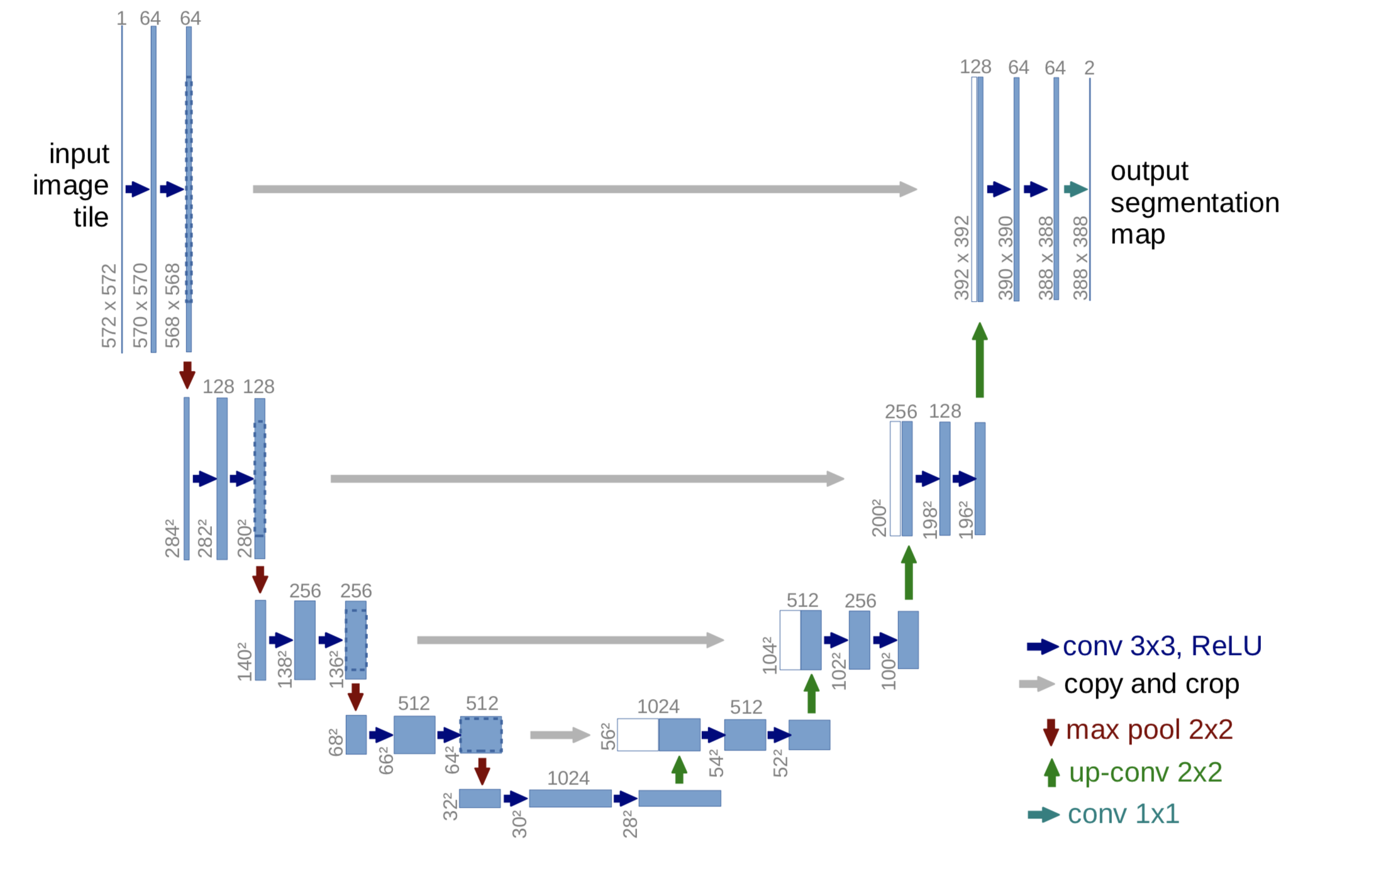
Unet neural network architecture:
State-of-the-art architecture for semantic segmentation of bio-medical data.
Deep feature extraction, up sampling with residual connections
U-Net: Convolutional Networks for Biomedical Image Segmentation
Olaf Ronneberger et al, International Conference on Medical Image Computing and Computer-Assisted Intervention, 2015
Notes:
בחרנו בגישה קצת נאיבית שמניחה חוסר תלות בין הפרמטרים למרות שזה לא נכון ולקחנו את הערכים שהביאו למקסימום בכל סריקת פרמטר כלשהו. באופן מפתיע זה עבד ושיפרנו ב5 אחוזים את הריצה המקורית (עם אלפא 2 , דלתא טי 4 ומקדם חלקות של 1)שלנו עבור 20 דוגמאות
סטיית תקן של 0.2 צריך להוסיף.

Slide 10
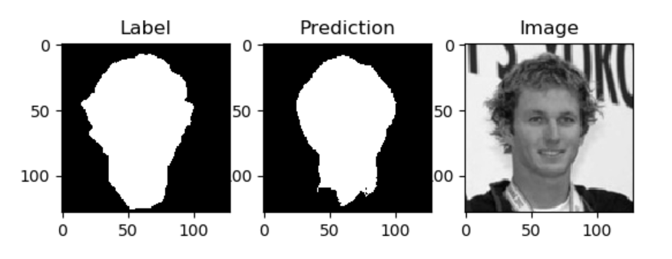
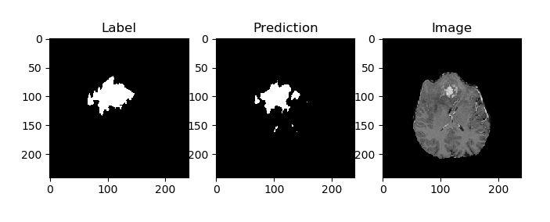
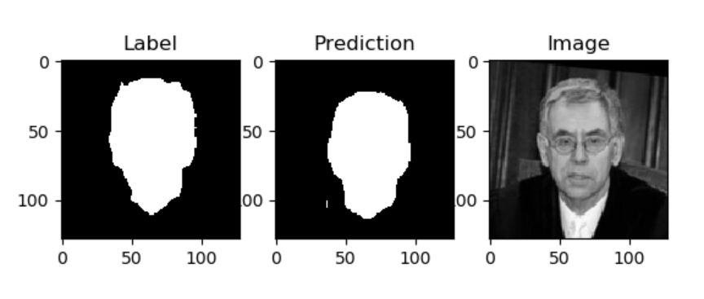
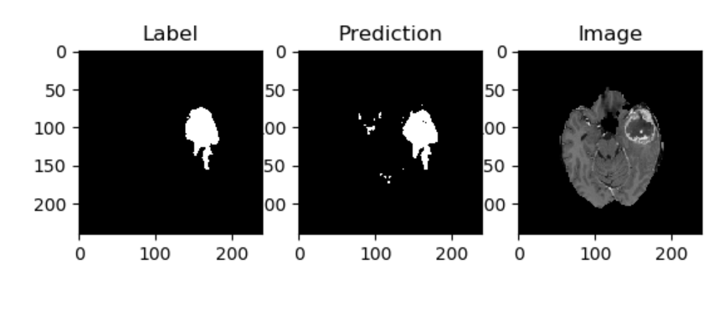
Unet neural network architecture:
Dice = 0.86
Dice = 0.64
Notes:
בחרנו בגישה קצת נאיבית שמניחה חוסר תלות בין הפרמטרים למרות שזה לא נכון ולקחנו את הערכים שהביאו למקסימום בכל סריקת פרמטר כלשהו. באופן מפתיע זה עבד ושיפרנו ב5 אחוזים את הריצה המקורית (עם אלפא 2 , דלתא טי 4 ומקדם חלקות של 1)שלנו עבור 20 דוגמאות
סטיית תקן של 0.2 צריך להוסיף.

Slide 11
Future work:
Deeper literature review for different network architectures.
Implementation of more complex, accurate and innovative architecture:
  3D Unet
  FCN+LSTM
  More…
Notes:
בחרנו בגישה קצת נאיבית שמניחה חוסר תלות בין הפרמטרים למרות שזה לא נכון ולקחנו את הערכים שהביאו למקסימום בכל סריקת פרמטר כלשהו. באופן מפתיע זה עבד ושיפרנו ב5 אחוזים את הריצה המקורית (עם אלפא 2 , דלתא טי 4 ומקדם חלקות של 1)שלנו עבור 20 דוגמאות
סטיית תקן של 0.2 צריך להוסיף.

