Slide 1
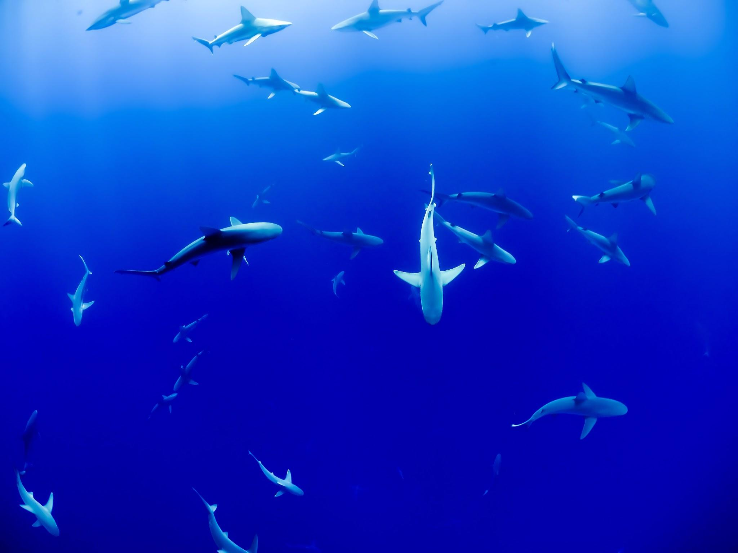
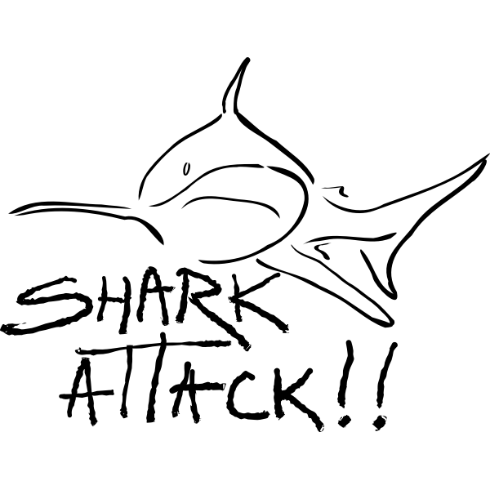
GROUP 2
Project: Shark Attacks
Members: Dimitra, Negar, Elio, Roy

Slide 2
HYPOTHESIS
1. Hypothesis Statement: The frequency of shark attacks is influenced by geographical factors such as country and state (or month).
2. Hypothesis Statement: Certain activities, such as surfing or spearfishing, are more prone to shark attacks compared to other water sports or recreational activities.

Slide 3
Data Cleaning
Relevant cleaning methods:
.drop
.dropna
.replace
.fillna
.to_numeric
.str.extract (r'([A-Za-z]{3})')
Justification of our imputation strategy (Why we did what)
Filling missing values at “Year” with data from the Date column, by using pattern search - 4 consecutive digids.
Creating “Month” column, using the “Date” column, by using pattern search - 3 consecutive letters. Cleaning the data prior to that to exclude words that are not months.
Data relevance: keeping in the analysis data from the year 1947 and forward. These data consist the 75% of the total data.
Dropping columns that we know will offer no insight to our analysis, either due to content or excessively missing data.
Deleting rows with all empty values.
Filling empty values in State, Species and activity with unknown or undefined, so as not to reduce our data too much. In age we use the average to fill in the non values, and in name we create anonymous1, 2, 3.
Formatting data, capitalize everything, pass age as integer, remove extra spaces and sort by descending year.

Slide 4
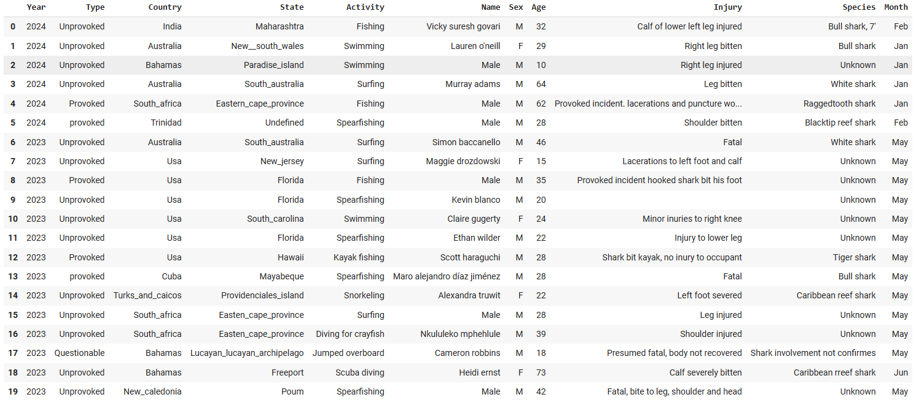
Data analysis after cleaning
File link:
https://colab.research.google.com/drive/1n1WOvVmrp22mCaJHadxqg86I-gnMMA5n#scrollTo=b013e73a

Slide 5
Major Obstacle during the project AND LEARNINGS
Data Cleaning was a challenge – a lot of deleted data which we fear may impact the results of our analysis.
Time constraints
Challenge for division of tasks. Sometimes recycling tasks slowed us down because we had to get up to speed with what our teammates worked on earlier
LEARNINGS
WORKING ITERATIVELY AND WITH AN AGILE APPROACH!!

Slide 6
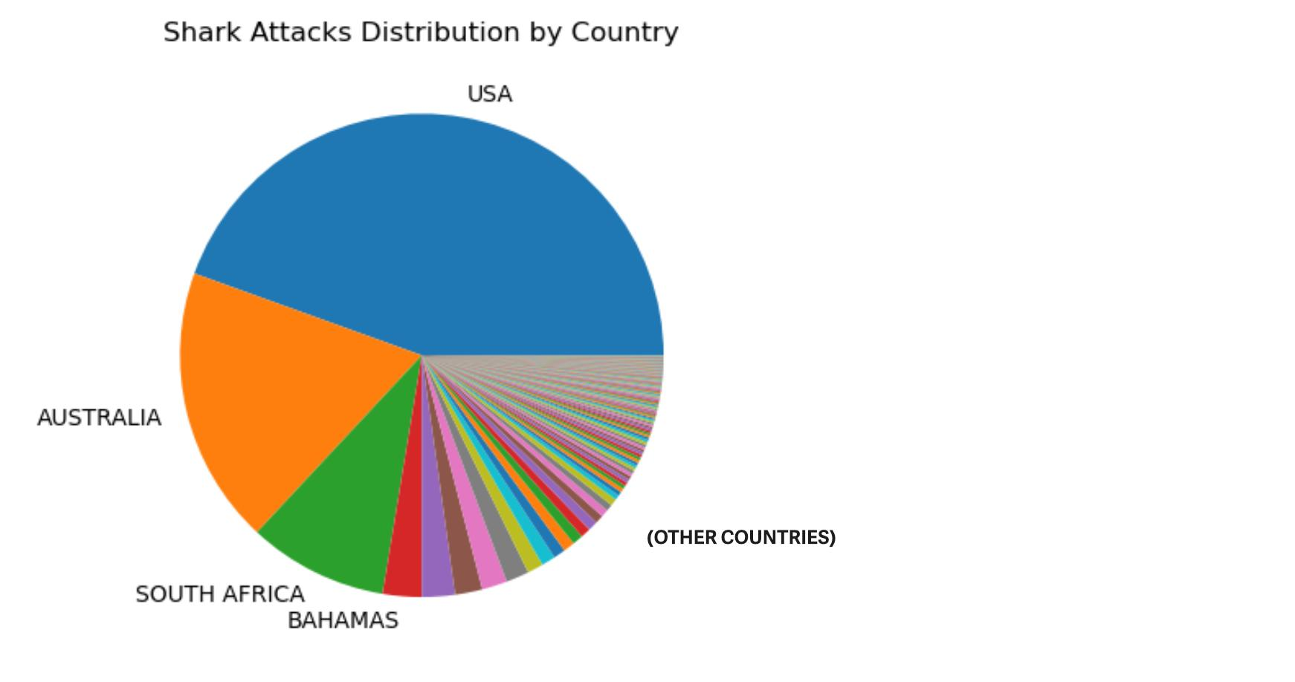
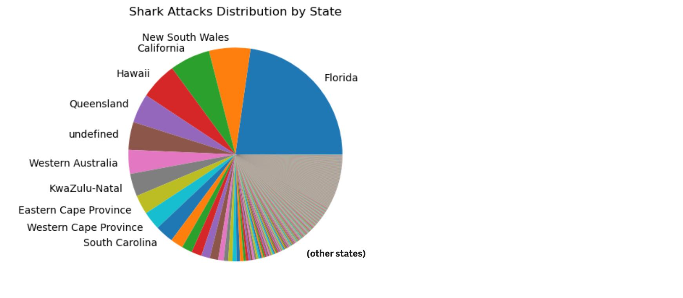
HYPOTHESIS 1- Frequency of Shark attacks correlates with geography(country/STATE)

Slide 7
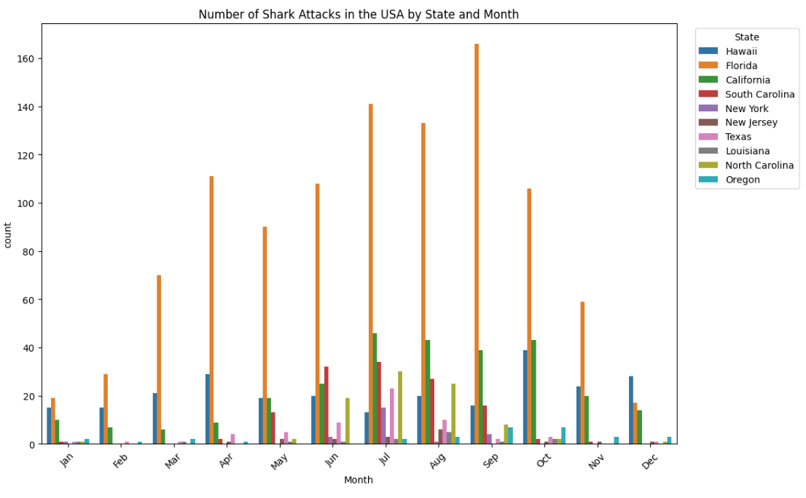
HYPOTHESIS 1- Frequency of Shark attacks is relative to geography(USA)

Slide 8
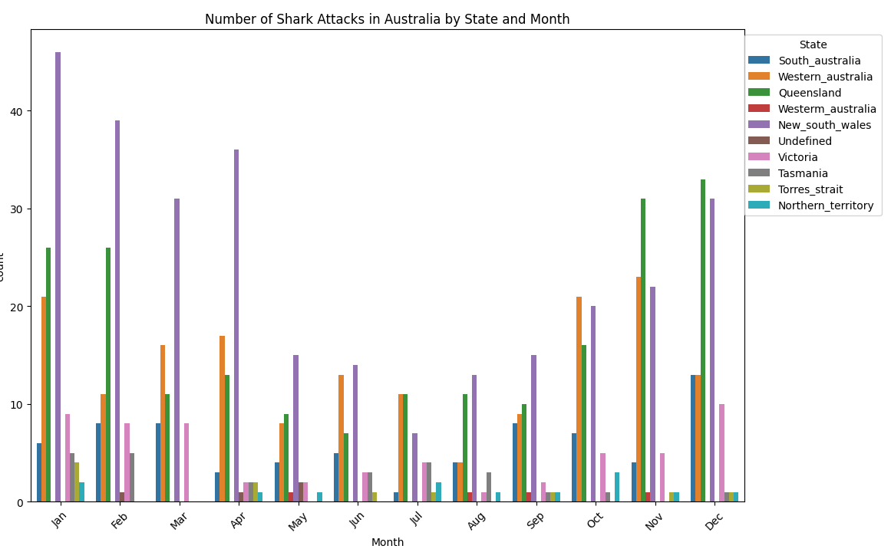
HYPOTHESIS 1- Frequency of Shark attacks is relative to geography(Australia)

Slide 9
Hypotheses 1 validation & data-driven conclusions
The Hypothesis Statement 1: The frequency of shark attacks is influenced by geographical factors such as country and state is justified.
Business Opportunity: The travel agency, DREN co. specializing in beach vacations could use this information to offer safer destinations for their customers or offer tours for shark cage dives.
INSIGHTS
Additionally, our plots indicate the seasonality of these attacks with respect to months of the year. This helps in more informed decision making for investments, and harm prevention.
Beach resorts and local authorities can implement targeted safety protocols and lifeguard schedules during high-risk months to mitigate shark attack risks.

Slide 10
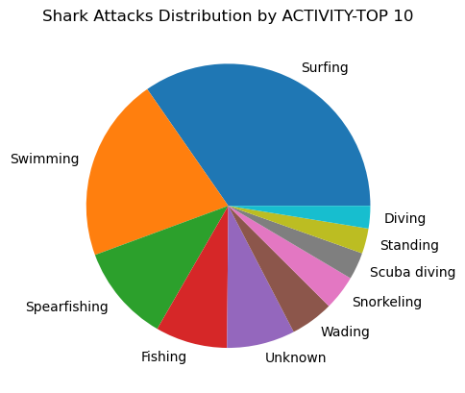
HYPOTHESIS 2- higher Shark atTacks occur during certain activities

Slide 11
Hypotheses 2 validation & data-driven conclusions
The Hypothesis Statement 2: The Hypothesis Statement: Certain activities, such as surfing or spearfishing, are more prone to shark attacks compared to other water sports or recreational activities, is justified
Business Opportunity: Companies selling water sports equipment (eg: safety gear) or offering adventure tourism packages can tailor their offerings and safety measures based on this analysis.
INSIGHTS
The data suggests that surfing and spearfishing are more susceptible to shark attacks. This highlights the significance for companies in these sectors to educate participants about shark attack prevention measures, presenting an opportunity to promote safer experiences and enhance the feeling of security while enjoying these activities.

Slide 12

THANK YOU !!

